Slide 1

Bringing retail customer service experience to the virtual engagement
Library and Student Centre model at the University of Westminster

Slide 2

Stop – Reflect
2022
Library and Student Centre
Library enquiries
Library spaces
Library resources
Notes:
Chat-based customer service is a popular choice for many businesses. It offers a quick and convenient way for customers to resolve issues and get support. In this section, we will provide an overview of chat-based customer service and discuss the benefits and current trends in chat interactions.

Slide 3

Virtual training
Training project
OneNote project
Recruitment and induction project

Slide 4

Customer Experience Managers
Shift from academic background to retail
Key attributes and how these respond to our customers
Customer Service Expertise
Problem-Solving and Conflict Resolution
Customer and User Engagement
Strong Work Ethic and Adaptability

Slide 5
A lesson from Hospitality
Provide a world-class hospitality offer that prides itself on customer service and then..
Ensure feedback is received and acted upon and look for repeat custom to secure..
Income generation that supports the charity and initiatives to...
I worked in a hospitality venue which was owned by the religious group 'The Quakers'.
We knew customer service was vital to not only secure income but also because we represented the charity and the faith group.
Managing reception, a café and a bookshop, me and my team were the initial 'face of the Quakers' for customers and enquirers, so we had to ensure each customer had an experience which made them want to revisit us and learn more about the what we offer

Slide 6

Start – Academic Year 2022/23
Bringing 36 Academic Support teams to LibAnswer dashboards – Cultural change
Establishing Teams chat channels with service partners
Setting up Service Level Agreements
Adjusting our service opening hours to incorporate weekly training sessions

Slide 7
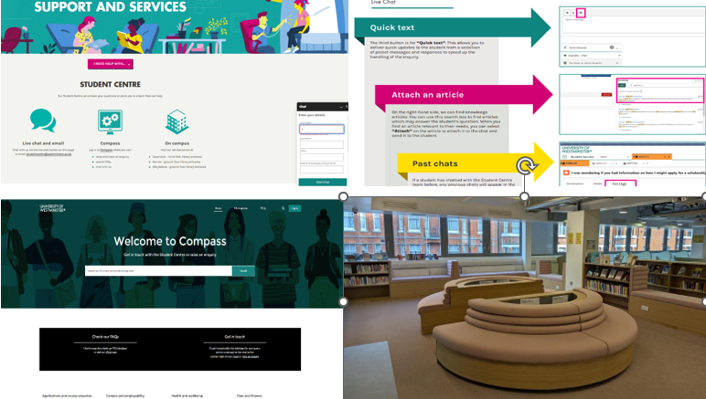
Continue – Academic year 2023/24
Salesforce – COMPASS
Upgraded library spaces
Lessons learnt – Enrolment
LiveChat upgrade – November 2024
Notes:
.

Slide 8

Effective Chat Communication Techniques
Clarity and Consistency in Responses
Customer Engagement – Virtual queues
Managing Difficult Conversations
Utilizing Technology for Enhanced Service

