Slide 1
Leveraging FAQs to Enhance Service
Sunny Frith, Library Assistant
Notes:
>New to libraries/HE
>Learning effective customer service
>Today, look at it through
FAQs

Slide 2
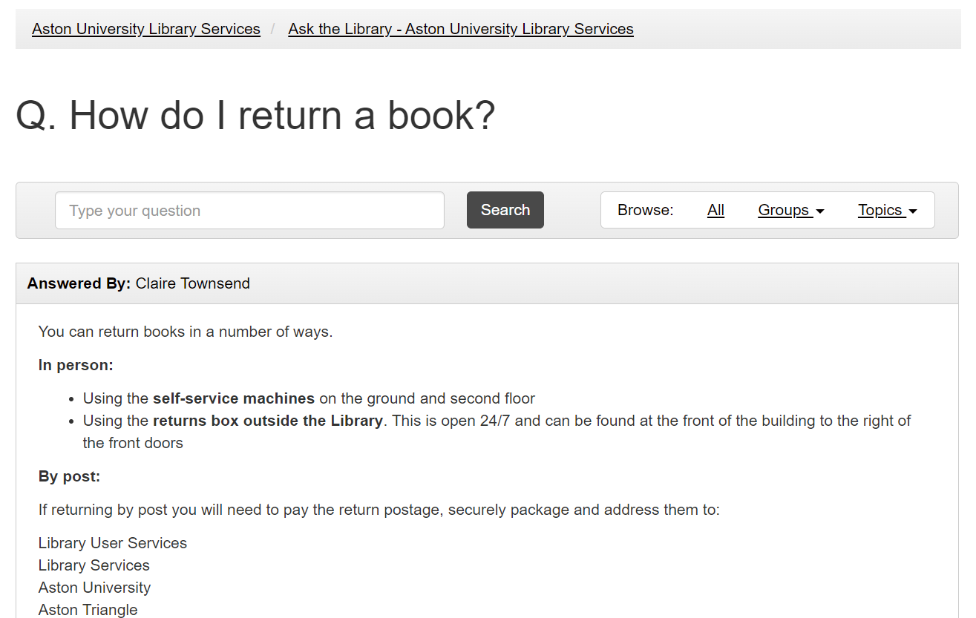
Why FAQs?
Notes:
>Seen FAQ pages before
>Qs with As underneath
>Quick example: how to return a book
>Library page or google, find info
>No direct interaction with staff
>Does this count as service?
>Let’s explore

Slide 3
Assisting Customers
Giving information about book loans
Demonstrating how to use printers
Helping to locate a book
Reactive Service
Notes:
>First, common scenarios (asked the most)
> All have something in common
>Customer initiated
(clicks)
>Reactive service

Slide 4
Proactive Service
Anticipates customer’s needs in advance
Delivers on those needs before the customer has to ask
Reviews what’s available to ensure it’s fit for purpose
In terms of Library Services:
Developing tools & infrastructure to allow customers to assist themselves!
Notes:
>But we also engage in Proactive service
> (points)
>In terms of library assistant role (point)
>FAQs meet this criteria (clicks)
>Yes, they’re proactive customer service
>AKA self-service

Slide 5
Why Self-Service Matters
Customer satisfaction
Many users find it rewarding to solve problems themselves
University goals
Allows users to develop their independence, an important skill in their HE journey
Differing needs
Users may prefer written guidance over in-person communication
Staff onboarding
Helpful for new staff who’re also learning about the service
Notes:
>Why this is important…
>Listed benefits
> (points)
>I can speak from
experience re: last one

Slide 6
For Example…
Notes:
>User asks: how to export references from DB into citation tool we provide.
>I searched “How do I export references” on FAQ page.
>Concise list of 4 bullet points + screenshot.
>Walked through the steps and told them where to find the info.
>This interaction inspired me to look into topic.

Slide 7
FAQ Building
What are the aims?
Provide solutions for common queries
Communicate information efficiently
Ensure information is easy to find
Empower customers to assist themselves
Notes:
>When building FAQs what are the aims?
>[lines]

Slide 8
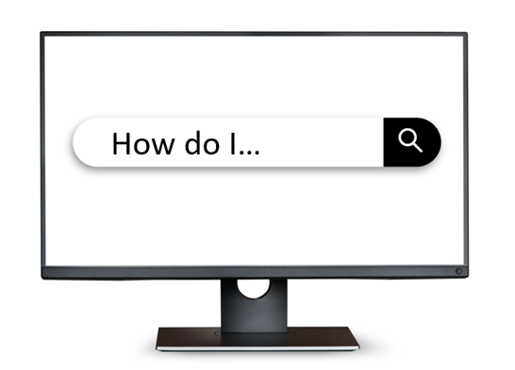
Finding Questions
What service points do users interact with?
Where can we gather analytics about queries?
Circulation
E-Resources
Laptops & PCs
Printers
Accessibility
Academic Support
Reception
Help point
Online chat
Phone
Email
Roving Staff
Notes:
>With those aims in mind we start by finding Qs.
>Two areas to draw from:
>Service points and analytics
>Mapping out service gives us an idea of possible queries
>Analytics qualifies what’s actually being asked frequently

Slide 9
Customer Journey
“People don’t search for your solution, they search for their problem”
- Susan Farrell, Nielsen Norman Group
Notes:
>How do users interact w/ service points?
>No guarantee they will intuit the intended use
>[quote]
>Broad in approach, if answers don’t match exactly they’re still useful
>We use the language of Qs & As, it’s how users speak.
>Might not be experts in crafting searches.
>Ultimately we have to listen to them to know what they want

Slide 10
How Frequent is Frequent?
Comprehensiveness vs Curation
Fewer posts make navigation easier and are easier to maintain
Initially it may be best to err on the side of fewer questions
We can refine this overtime with analytics
Notes:
>AKA How long is a piece of string
>No magic number for how expansive FAQs should be
>It’s about finding a balance: cover what’s needed without becoming unwieldy
>Start with fewer questions
>Analytics will indicate gaps overtime

Slide 11
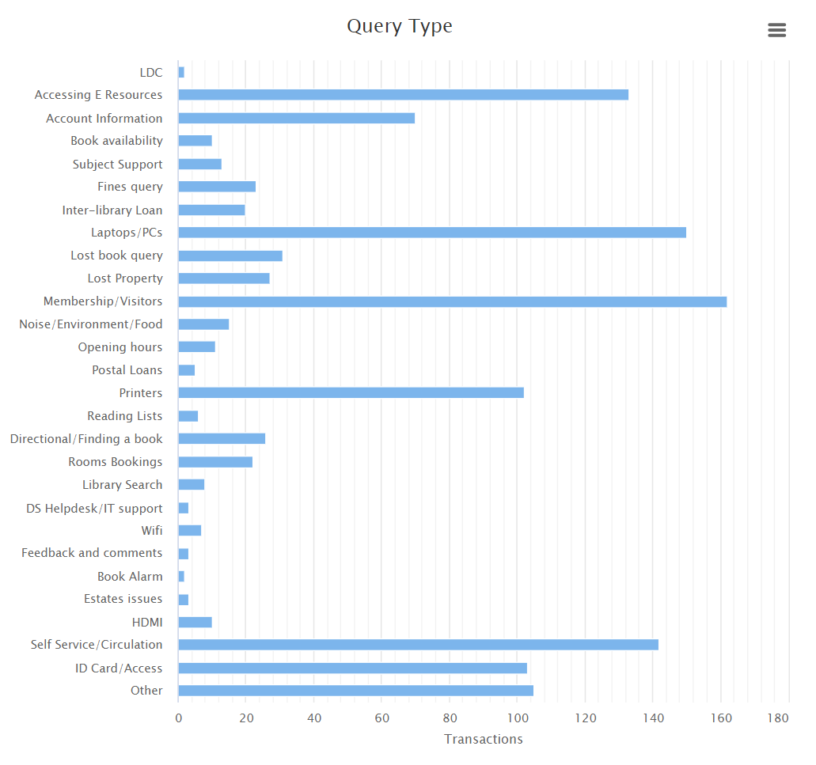
Utilising Analytics
DATETIME | QUERY | SOURCE | TAGS | USER
03-19 12:14 | Is there a way. | Email | Printers | Visitor
03-19 15:25 | Would I be ab. | Chat | E-Resource | Ugrd
03-20 08:56 | What’s the w. | Reception | Wifi | Staff
03-20 10:39 | How do I prin. | Roaming | Printers | UGrd
Notes:
>Tracking data to draw conclusions
>What to track: query, when it happened, how it was asked, what topic it relates to
>Look at patterns & trends in queries
>Do they change depending on the point in the year or time of day? >Any spikes in Qs around particular service points?
>Match up changes to Qs with recent changes to service?
>Different Qs from different users?

Slide 12
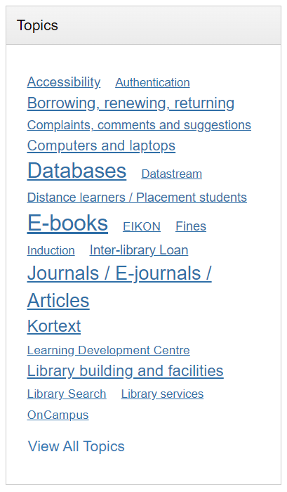
Writing Answers
Format the question from customer’s point of view
Direct, concise communication
Don’t use jargon or assume knowledge
Let people know where they can find out more
Make use of tags!
Notes:
>Now we have Qs, we need
to write As
>Use “I”
>Short paragraph
> (point 3)
>Still answer the Q, don’t
just link (summarise)
>Organising, filtering, searching

Slide 13
Challenges & Limitations
Maintenance
Keeping information up to date.
Reviewing answers for relevance.
Collecting feedback on posts.
Format
Text-based.
Requires a device & network connection.
Users may not be aware it exists.
Scope
Not a one-size-fits-all solution.
Information should also be signposted to users in other ways.
Notes:
>Up-to-date & relevant >regularly reviewed (aided by feedback)
>Limitations to format, text based + requiring online access can pose difficulties for some
>Only a tool in our belt
>Can’t/shouldn’t cover all possible queries

Slide 14
A Useful Scale
- ‘Manuals’ from the webcomic ‘xkcd’ by Randall Munroe
https://xkcd.com/1343/
Notes:
>Panel from popular webcomic xkcd
>Highlights frustration of ineffective info
>Spectrum between ‘solving problems and creating problems’
>Want to aim to move everything as far left as we can

Slide 15
A Useful Scale
Can we make solutions more obvious so an FAQ isn’t required?
Is there anything that should have an FAQ post but doesn’t?
Are any FAQs ineffective or adding to confusion?
Notes:
>From left to right:
[1 click] Ideal is having tools that are intuitively designed + well-signposted, only need minimal reference info
[2 click] Otherwise, we want to be sure anything that needs additional info has it
[3 click] Finally, make sure info that is out there is doing its job & not adding confusion

Slide 16
Continuous Improvement
Review Queries
1. Looking at service points & feedback to find gaps
Collect Analytics
Develop Information
3. Monitor how users interact with service and receive updates
2. Update FAQs to address gaps and maintain relevance
Notes:
>The review process-
>Review queries: Look at service points + feedback to find gaps
>Develop info: update FAQs to address gaps & maintain relevancy
>Collect analytics: monitor how users interact with the service & see how updates are received

Slide 17
The Bottom Line
“Good self-service is good customer service!”
Notes:
I hope I’ve got across why I think FAQs are an important part of good service, but to summarise: [line]

Slide 18
Thank you. Any questions?
(frequently asked or otherwise)
Notes:
Thanks for listening. I’ve never actually given a presentation before but I think that went well. Any questions?

