Slide 1
Library Life Pulse
Welcome!
Michelle Sharples and Michael Douglas
The University of Manchester Library

Slide 2
Library Life Pulse
Why do we do it?
Leading, challenging and connecting strategy 2013-2017
Aligned to University core goal:
Outstanding learning and student experience
Assess student satisfaction with Library services, resources and customer experience
Provide targets and insight for further service development

Slide 3
Library Life Pulse
Why Alterline?
Resource not available internally
External research more influential with stakeholders
Tender process with 3 suppliers
Alterline were new to the market and we were impressed by their investment in our success

Slide 4
Library Life Pulse
What is it?
Annual survey since 2013
Average of 1,200 participants
Online survey plus a range of other research methods
Additional insight for service development

Slide 5
Library Life Pulse
Key success factors
Library Leadership Team on-board and involved
Clear timelines for survey design, sign-off, go live and reporting
Targeted communications for students and staff
Use incentives
Consult with the wider University

Slide 6
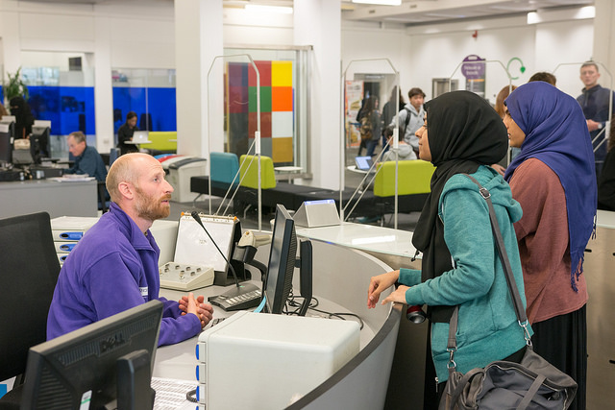
Library Life Pulse
Areas of interest
Research activity has changed depending on what we wanted to find out
Finding and using books and resources
Provision and availability of study spaces
Accessing help & support
Library training & skills development
Communications

Slide 7
Net Promoter Score
NPS score of +32%
down from 2016 +36%
Increase in detractors from last year

Slide 8
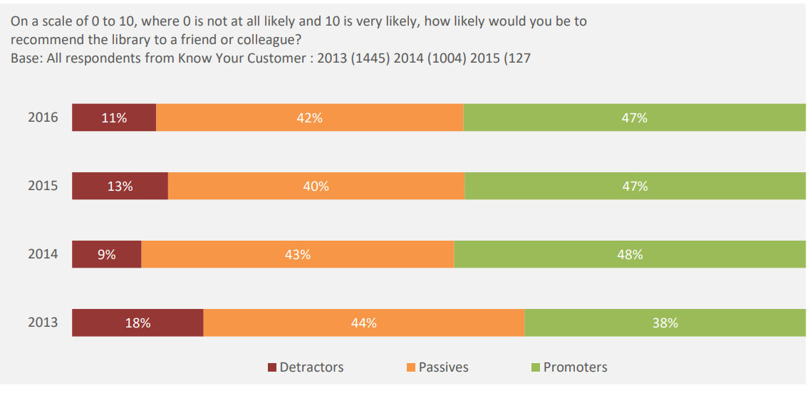
Net Promoter Score

Slide 9
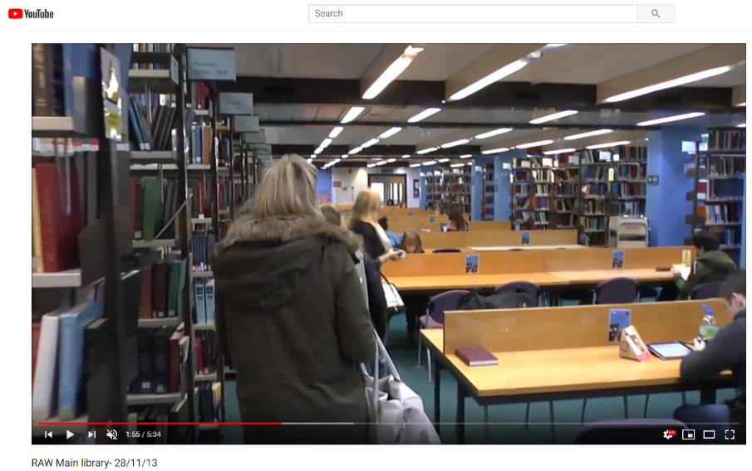
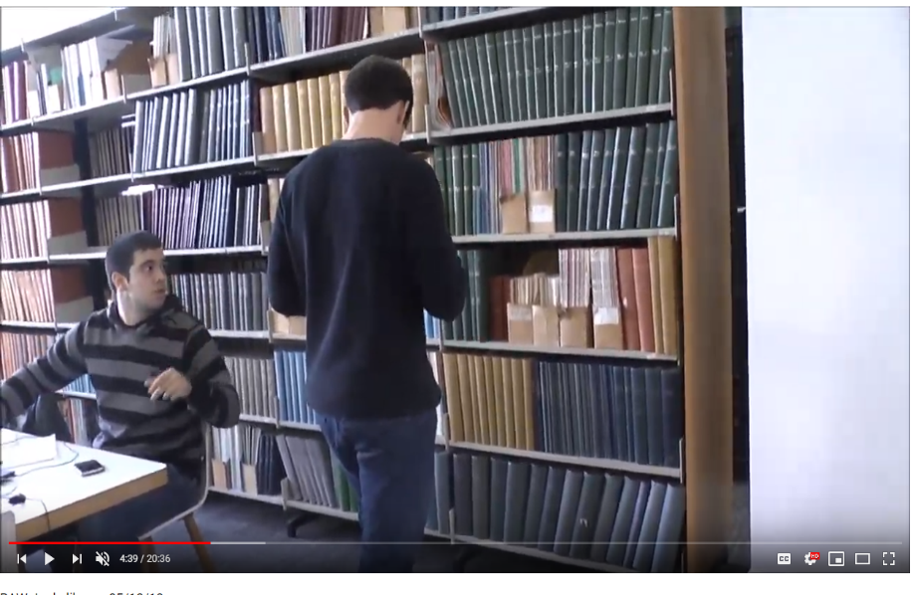
Wayfinding – Ethnographic Study
In 2013 Alterline conducted ethnographic research - following and videoing students on their journey through Library sites to find a book

Slide 10
Wayfinding – Ethnographic Study
Followed this up in 2017 with more ethnographic reporting for the Find a Book project

Slide 11
Storytelling Images
Student’s eye view
Forces us to avoid complacency – are standards slipping?

Slide 12
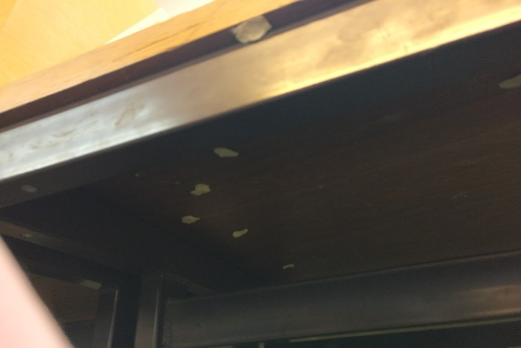
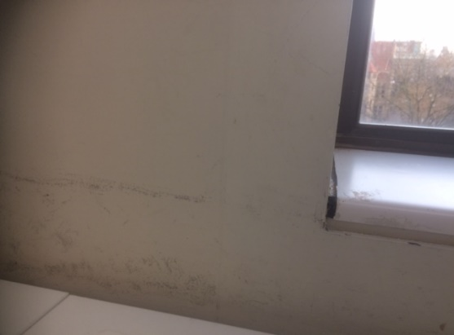
Study Spaces – Storytelling Images
“The horrible amount of chewing gum stuck underneath every desk and never cleaned.” – Storytelling task
“Scuff marks on the walls from what I can only assume are the tables. Been at the university four years now and pretty sure it has remained like this.” – Storytelling task

Slide 13
Library Life Pulse
Big Wins
Find a Book
New shelving standard
New shelving team
Big Book Move
Space and estates improvement
Re-decoration of areas in Main Library – Green, Blue 2&3, Purple Ground, 2&3
Carpets deep cleaned
Under desk cleaning
Going to upgrade water fountains and convert space freed up by Big Book Move to study space

Slide 14
Library Life Pulse
Big Wins
Digital access off campus
Needed to improve customer satisfaction in accessing ebooks and online journals
Invested resource to create a more customer-focused experience and improved satisfaction year on year
LibAnswers
Improved efficiency in online enquiry management
Single point of contact – no more paper forms!
Provides stats which help us focus resources on the areas students most need help with

Slide 15
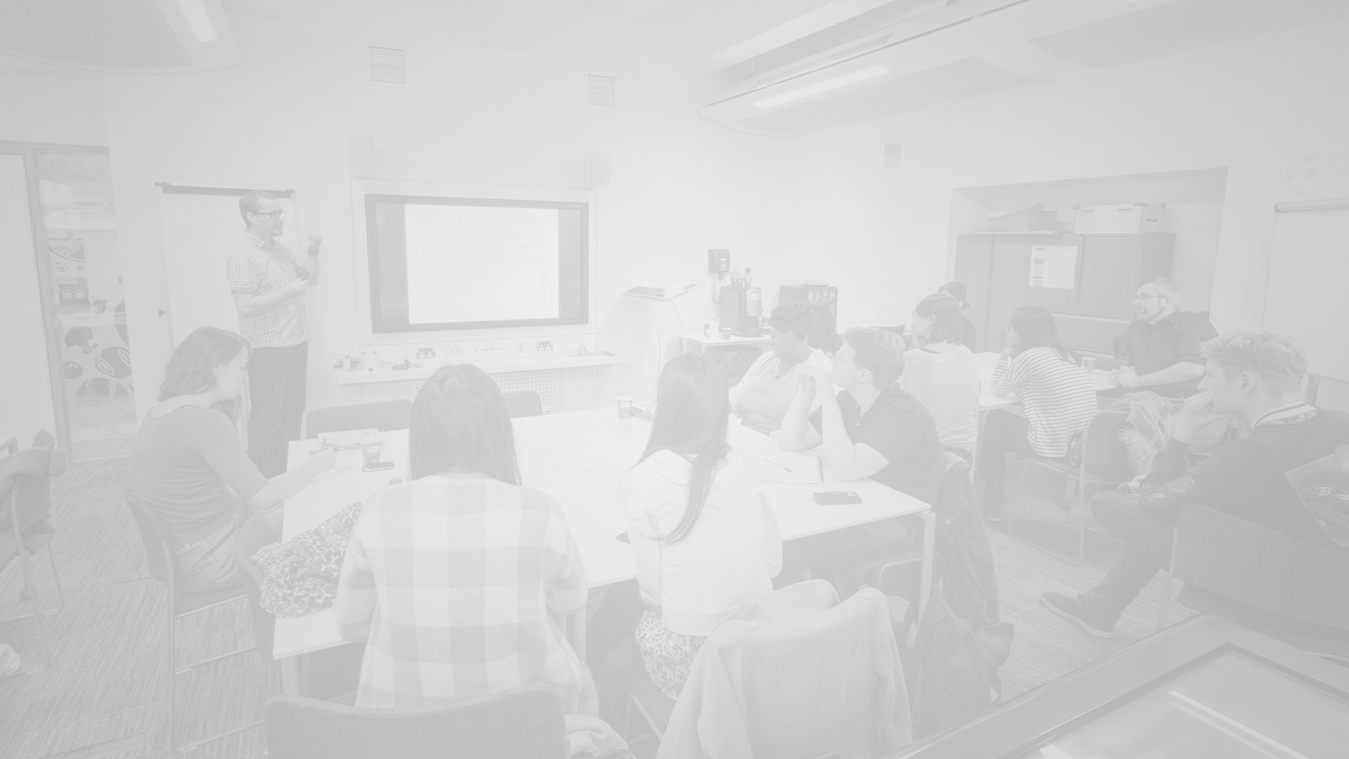
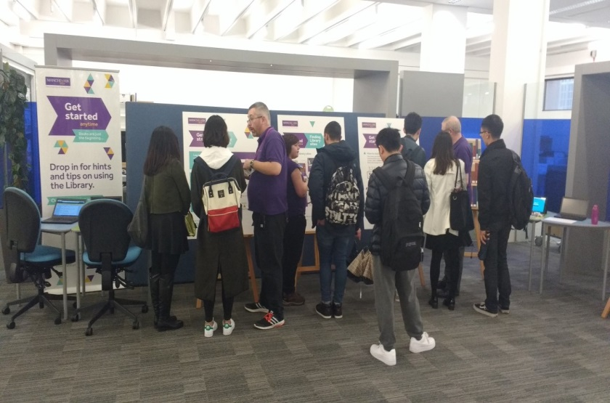
Campaign Evaluation
Get Started - annual welcome campaign for the Library. Evaluation methods:
Qualtrics surveys for students and staff
Google analytics to monitor website use
Social media metrics to evidence impact
In 2017 we trialled new Get Started Anytime drop-in sessions. Gathered feedback to help inform future campaigns i.e. 83% of attendees found it ‘very useful’
“Very accessible and user-friendly introduction to the library services. It was nice to be able to walk in on my first visit to the library and be immediately taken to this introduction.”

Slide 16
Any Questions?
michael.douglas@manchester.ac.uk
michelle.sharples@manchester.ac.uk
Please follow us on Social Media!
@UoMLibrary
UoMLibrary

