Slide 1
Supporting students using electronic resources
Gower College Swansea
By Gwen Couch & Taran Johal

Slide 2
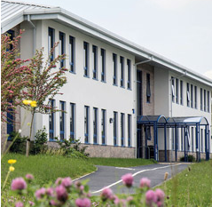
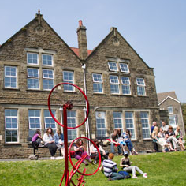
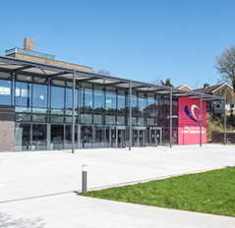
Gower College Swansea
Gower College Swansea is based over 7 campuses in the Swansea area. There are over 9000 students in a variety of courses and qualifications, ranging from pre-entry level to level 7. These include a range of modes of attendance, including FT, PT, distance learning and WBL.
Click here for more information

Slide 3
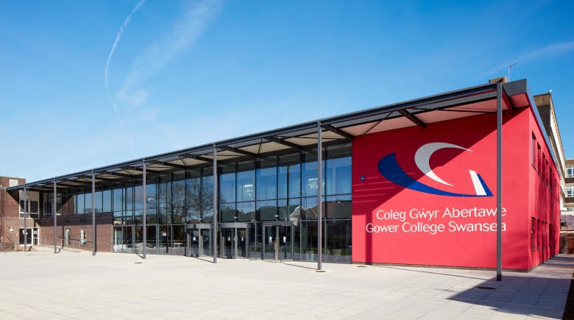
Office 365
Chatbot
Online academic support
Video platform
Developing our VLE
Social Media
Access to eBooks
Library copyright guidance
Teams sessions

Slide 4
ebooks
We are focusing on obtaining more core books for students.
Liaising with lecturers to see what’s required.
Using websites that help show eBook usage for stats. (e.g Bitly, Proquest)
Creating and sending out reading list of eBooks we have for each subject area.

Slide 5
Office 365
How-to videos and online sessions demonstrating features and benefits
Easy for students to share work with lecturers
Promotes learning by giving access to a variety of apps
Providing support on Office 365

Slide 6
Microsoft Teams
Teams has been a great resources for the college, as it has allowed students to access lessons remotely.
It has also allowed the library to upload a lot of its content to Office 365, and so become available to learners easily.
Provision of:
Laptops (≈1500)
Wifi Dongles
Sim Cards

Slide 7
chatbot
Created to provide easy access to all Library services in one place.
Intelligent online first responder to library enquiries.
It’s a new innovative idea for FE Libraries. Helps with our shift to online presence.
Developing this with our virtual library tour.

Slide 8
Online academic support
Library staff have a presence and are available in specific subject/area Teams.
Online teaching sessions/asynchronous
teaching materials available.
Assistance with specific skills e.g. referencing, research, academic writing.
Drop in Q+A sessions available for any library based queries.

Slide 9
Video platform
Using websites like Planet eStream to help with
1. Promoting documentaries to watch for learners in a wide variety of subjects.
2 . Promoting students, especially vocational, to upload using Planet eStream, assignments that require visual evidence.
Staff have been recording lessons, which we then edit for them. When complete staff have then uploaded them onto their Office 365/ Moodle page and made it available to students.

Slide 10
Developing VLE
We are using many VLEs
Moodle
Canvas
Teams
Smart
Assessor
Blended
Learning
Consortium

Slide 11
Library copyright guidance
To help learners we are scanning more books either up to 10% (20%) during the lockdown) or a chapter of a book whichever is greater.
Exploring other OA resources
Advising students of other reputable resources and research techniques
Keeping them informed of the proper referencing guidance

Slide 12
Social Media
Promoting Office 365
Latest eBooks available
Getting hold of library staff for support
Emphasising student wellbeing
Support for home learning
Promote wellbeing activities

Slide 13
Thank you ☺
If you have any queries, please
contact us:
Gwennan.couch@gcs.ac.uk
Tarandeep.johal@gcs.ac.uk

