Slide 1
Aspiring for a Higher Education Academy Accreditation

Slide 2
HEA accreditation:
is a national recognition awarded to academic staff who are dedicated to supporting learning in higher education;
offers academic support staff credits for their participation in professional development;
is an internationally-recognised badge of academic success, which is important for personal and professional development.

Slide 3
Any academic support staff are eligible for a HEA accreditation, which is a recognition for the ‘teaching’ aspect of our role.
At UEL Library & Learning Services we are all ‘teaching’, without even thinking about it. ☺

Slide 4
Shelvers (S) ‘teaching’ the students how to search for items on the library kiosks, giving directions, explaining the Dewey classification system, and more…

Slide 5
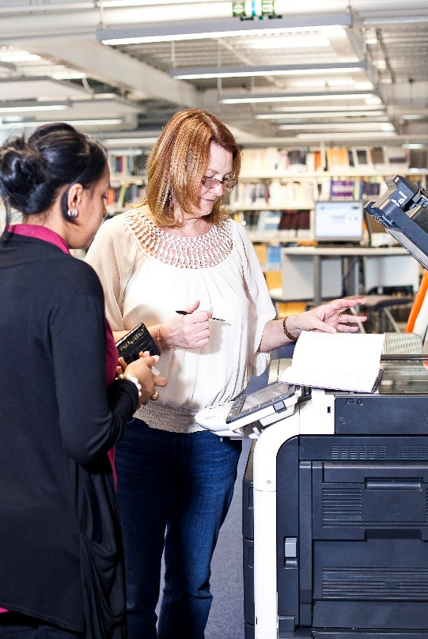
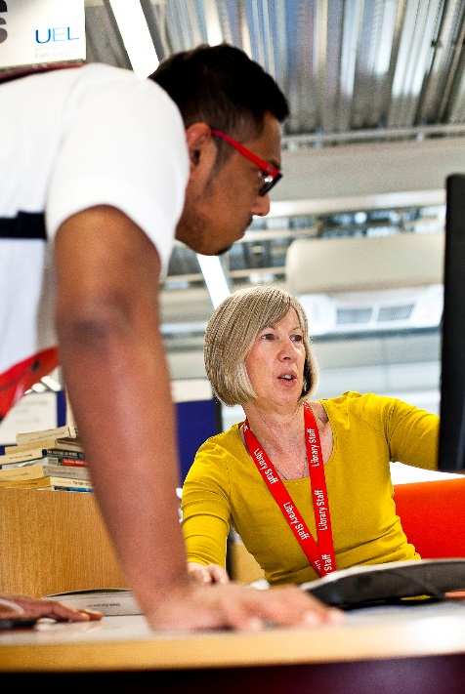
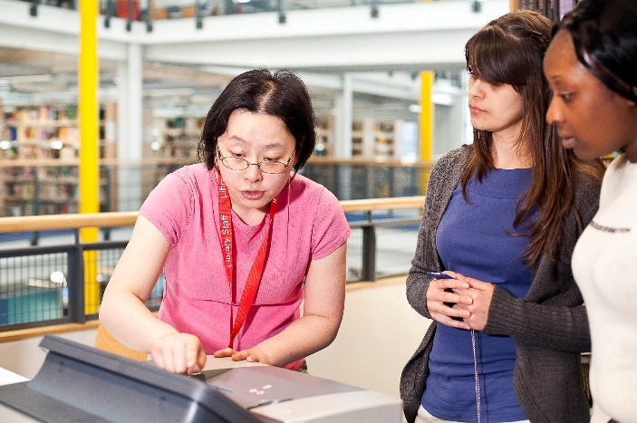
Library Assistants (LA) ‘teaching’ at the counter, printers, on the phone, SCONUL, Inter Library Loan, Question Point, etc.

Slide 6
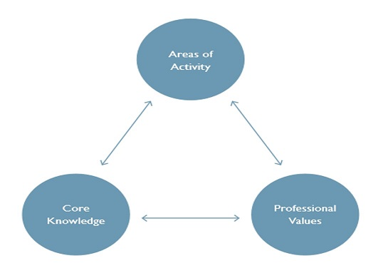
UKPSF (UK Professional Standards Framework) Descriptors
A
K
V

Slide 7
FHEA (Fellow of Higher Education Academy):
Subject Librarians (SL)
Learning Academic Achievement Assistants (LAA)
Skill zone Advisors (SA)
All areas of activity (5 A’s)
All Core Knowledge (6 K’s)
All Professional Values (4 V’s)
One-to-one teaching
Planning
Feedback

Slide 8
AFHEA (Associate Fellow
of Higher Education Academy):
Assistant Librarians (AL)
Library Assistants (LA)
Support staff with library assisting duties (S)
3 areas of activity (3 A’s)
4 Core Knowledge (4 K’s)
2 Professional Values (2 V’s)

Slide 9
AFHEA (Associated Fellow of Higher Education Academy):
Areas of Activity (A)
A1: Design and plan learning activities and/or programmes of
study (N/A)
A2: Teach and/or support learning (LA; S)
A3: Assess and give feedback to learners (N/A)
A4: Develop effective learning environments and approaches to
student support and guidance (LA; S)
A5: Engage in continuing professional development,
incorporating the evaluation of professional practices
(LA; S)

Slide 10
Core Knowledge (K)
K1: The subject material (LA; S)
K2: Appropriate methods for teaching, learning and assessing in
the subject area (LA; S)
K3: How students learn, both generally and within their subject
area (LA; S)
K4: The use and value of appropriate learning technologies
(LA; S)
K5: Methods for evaluating the effectiveness of teaching (N/A)
K6: The implications of quality assurance and quality
enhancement with a particular focus on teaching
(N/A)

Slide 11
Professional Values (V)
V1: Respect individual learners and diverse learning
communities (LA; S)
V2: Promote participation in higher education and equality of
opportunity for learners (LA; S)
V3: Use evidence-informed approaches and the outcomes
from research, scholarship and continuing professional
development (N/A)
V4: Acknowledge the wider context in which higher
education operates recognising the implications for
professional practice (N/A)

Slide 12
UKPSF relevant areas of activity (A) for UEL Library Assistants and Support Staff
A2: Support students and staff directly or via
visual/audio means: IT Blog, IT Manual,
questions and answers, printed instructions
A4: Develop effective approaches to
support student/staff learning: leaflets
(stapling, double-sided printing); guided
tours
A5: Engage in continual professional
development (Skillzone shadowing;
attending training and courses, etc.

Slide 13
UKPSF relevant core knowledge (K) for UEL Library Assistants and Support Staff
K1: The subject matter, i.e. printing, Wi-Fi,
Samsung Tablet; Turnitin, etc. (IT Blog; IT
Manual).
K2: Appropriate methods for supporting
students and staff learning, i.e. teaching
materials (pack of cards; printed
instructions); library search (Open Day).
K3: Awareness of how students learn, i.e.
oral/written instructions, explanations;
demonstration; kinaesthetic learning; one-
to-one
K4: Emailing instructions on how to access
web pages and databases; library tours.

Slide 14
UKPSF professional values (V) for
UEL Library Assistants and Support Staff
V1: Respect individual learners and
diverse learning needs:
special needs, dyslexia, etc.
V2: Promote participation in higher
education and equality of
opportunity for learners

Slide 15
Examples of supporting new members of
staff (A2; K1,2,3; V2):
Mentoring
Contributing to in-house learning and teaching
PowerPoint presentations for evening and weekend staff
Examples of trainee teaching (A2; K1,2,3; V1,2):
One-to-one support
Designing teaching materials, i.e. leaflets, etc.

Slide 16
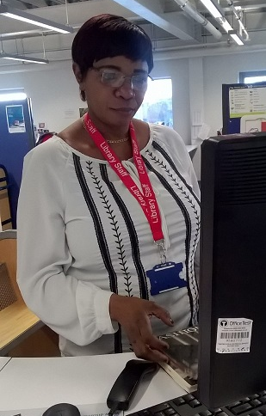
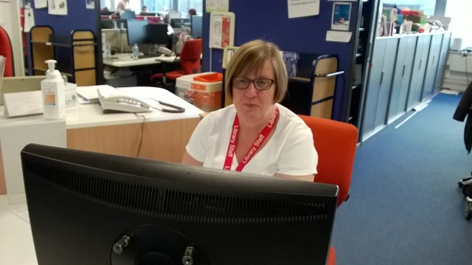
Support Staff: Shelvers with Library Assistant duties
A2, A4, A5: Support students and staff at the library counter; leaflets; printing and scanning; attending training for CPD.
K1, K2: The subject matter, (Blog; IT Manual); leaflets, instructions.
V1, V2: Dealing with special needs / dyslexia students; equal opportunities

Slide 17
Marina, AFHEA,
former Shelver,
currently Library & IT Support Assistant
Notes:
Welcome!

Slide 18
Motivation
“Making the decision to apply for an Associate Fellowship of the Higher Education Academy was not a very difficult one. Once you begin to think about the work that you undertake as a university Library Assistant it quickly becomes obvious that you are certainly qualified enough to apply.
Upon finding out how straightforward the process of applying was, it became a no-brainer for me!” (To be continued...)

Slide 19
Motivation
(continued)
Being able to add the Fellowship to my CV is a big plus –when thinking about applying for university library jobs, it is certainly something which demonstrates your commitment to providing excellent support to students.
Most importantly, being successful in my application brought me a certain sense of satisfaction, making me feel appreciated for the work that I do, and this was well worth the few hours I spent on my application.”
Annamarie Burchett, AFHEA
Library and IT Support Assistant

Slide 20
Motivation
(continued)
“Personally I had two reasons to apply for
AFHEA:
Firstly I was driven by my personal ambition to be
a lecturer one day, and I felt that this would be
the right step towards building my confidence
for reaching that goal;
Secondly I thought that the job we do in the
library involves a large teaching and learning
component and this deserves proper
recognition.”
Anca - Elena Zahan, AFHEA
Library & IT Support Assistant

Slide 21
Motivation
(continued)
“The reason I applied for a FHEA accreditation
was because I wanted to validate my
professional experience and my extensive
research into peer mentoring.
I also thought it would be useful to reflect on my professional practice so as to further develop myself personally and professionally.”
Sarah Bailey, FHEA
UEL Peer Mentoring Coordinator and PASS Supervisor

