Slide 1
Virtually There?
Providing a digital help service to library customers and measuring our impact
Lynn Sykes, Alison Morton
and Elka Hubenova
University of Sheffield

Slide 2
Aims: showcase our digital help service, how it fits in with the strategic direction of the library and to what extent the impact on the student experience can be measured

Slide 3
Reaching out to students digitally
The Library Strategic Plan
Notes:
Reaching out to students digitally features strongly in the universities strategic plan - show link - and we are trying to provide resources and help and information in the digital spaces that students in habit as well as the physcial environments. I am leading a project to Develop service models to reach all students in all their spaces, physical and digital and here is our mind map which detail the areas we are concentrating on

Slide 4
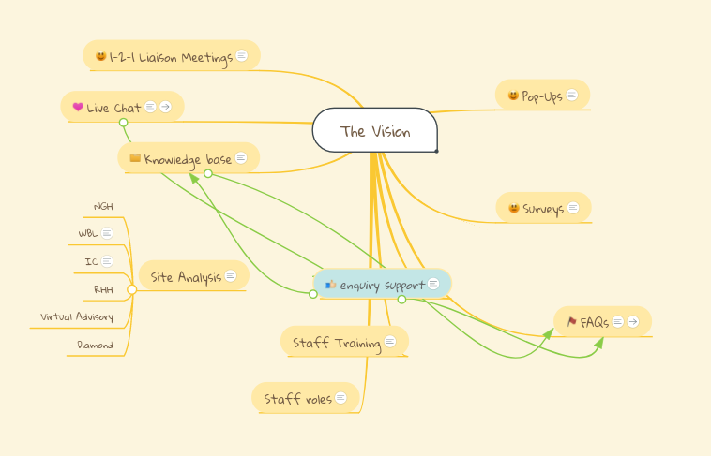
Service Delivery Project - The vision:

Slide 5
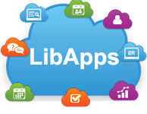
Development of the Library Enquiry Service

Slide 7
Feedback Mechanisms as tools to measure impact
Comments Cards
Surveys
Within Chat
Library Help Week
Also, using the development
of relationship with students
via the queries that they ask

Slide 8
Measuring Impact considerations
Notes:
By having a robust enquiry management system which capture relevant data, both quantitative and qualitative, underpinned by a strong and supportive quality assurance framework which enables consistent review of enquiry content are we creating ways in which we can begin to measure our impact?

Slide 9
Practical ways in which we are measuring our impact:
Student enquiries -
capturing quantitative and qualitative data:
Case study and showing impact
Enquiry Cafes - enabling staff across the library teams to discuss actual student enquiries to enable service development & enhance student engagement
Notes:
let’s look at an example via an anonymised case study...please ignore the dates and imagine that the enquiries were sent over the student’s time at university - student X is an UG
show and discuss the growth/ sophistication of the enquires and that the student was aware of our services and returned because he trusted our brand.
We recently delivered enquiry cafes where staff from oir faculty engagement team, Library Learning Service and systems teams looked at a selection of real enquiries from a diverse cross section of students. Our aim was to not only improve on our delivery of enquiries but to see how we could work across teams to embed a cohesive service offer...delivering services at the point of need and in the correct format.

Slide 10
Measuring impact relies on customer’s awareness of our services
Live chat embedded in StarPlus (Library Discovery Platform) captures complex enquiries
Live chat in the student VLE aligns library support within L&T spaces
Library Subject Guides that link to our Information and Digital Literacies
Notes:
To measure impact students need to be aware of our services, Elka our lead Student Associate Learning and Teaching will talk more about this in a few minutes. these are the measures we have taken to improve our visibility and promote our iDL offer to students

Slide 11
Student Associates in Learning & Teaching (SALTs) project co-deciding and student perspective:
Aims
Scoping and IDLs
Delivery outcomes: FAQs / Workshops/ tutorials / screencasts
Notes:
Alison to introduce Elka who will give brief overview of SALT project - Collaboratively prioritising and developing online information and digital literacy solutions for student success, employment and citizenship. etc….
Building on the success of the 2016/17 Library SALT project we again propose to undertake a participatory action research project, to collaboratively prioritise and develop our information and digital literacy offer. This year the project will explore and develop the library’s engagement with students via our student enquiry channels, including at our helpdesks, via email, live chat, phone, tweets and SMS (text messaging). During busy periods these channels can generate several hundred enquiries each day.
The SALT team, working alongside the University Library’s Virtual Advisory and Help Service, and in collaboration with Library Learning Services Unit, will develop support for information and digital literacy queries, via the use of screen sharing software, screencasting, web conferencing, online tutorials, and video, to create high quality, targeted resolutions to information and digital literacy queries. The project will be evaluated through staff and student reflective writing.
A co-produced information and digital literacy online offer
An interactive webinar to showcase the offer
A portfolio of reflective writing, to evaluate the project
Successful elements of the project will be embedded in our full IDL offer, thereby ensuring the project is sustainable for future years
Elka to talk about scoping IDLs and how this will impact on how we deliver student support ...use of surveys and focus groups.methodology and approach
delivering content via screensharing / screen casting/tutorials

Slide 12
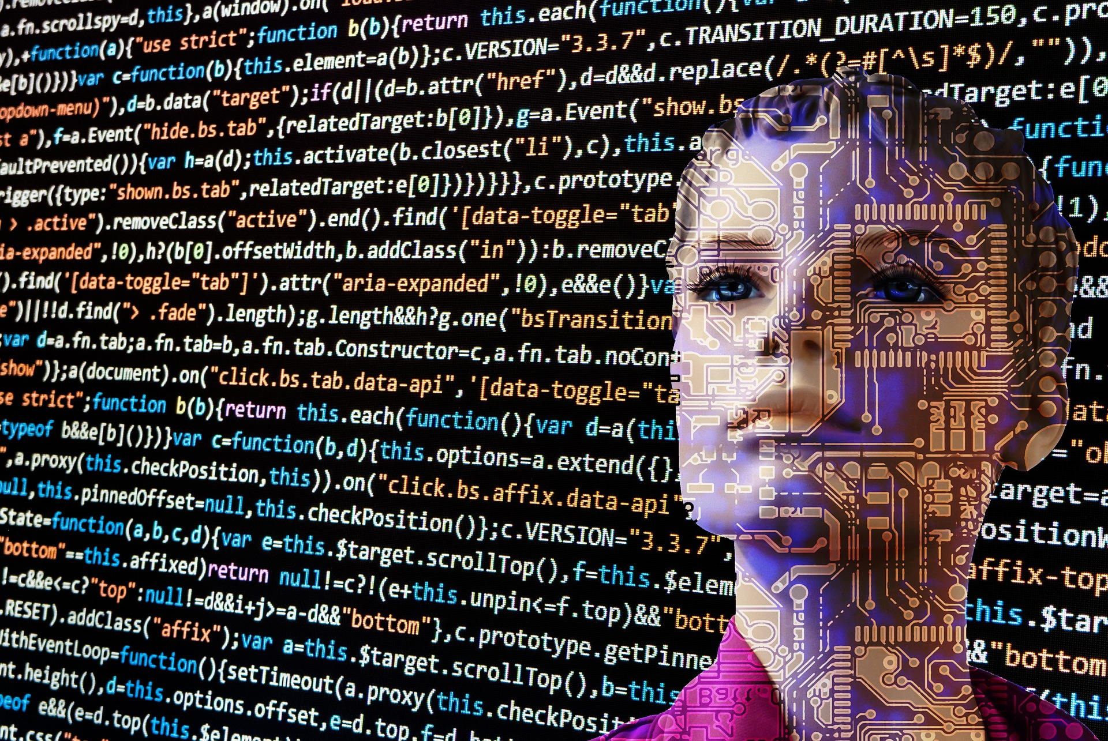
Future plans - but first of all…
Issues to consider:
How to improve awareness of services
What can and can’t be measured
The virtual boundaries will always be expanding
The literacy has to drive the digital

Slide 13
What we we plan to do:
Embed Library guides into Chat and email replies to improve awareness
Work with other teams to develop partnerships with students
Use real enquiries and customer feedback to direct staff training and development
Enquiry cafe - example of best practice and impact
Quality Assurance proofing of our responses - staff and student monitoring
Notes:
WWUsing real enquiries and customer feedback to direct staff training and development via:
Enquiry cafe - example of best practice and impact
Cross-team participation
Quality Assurance
All this is from a Library perspective...

Slide 14
Q&As

