Slide 1
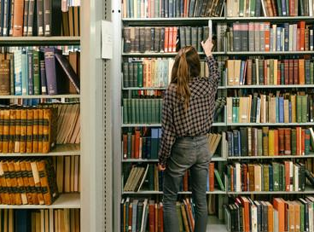
Café Culture: Strengthening enquiry support whilst supporting staff development through Enquiry Cafés
The University of Sheffield Library
Georgie Broad & Dafydd Spink

Slide 2
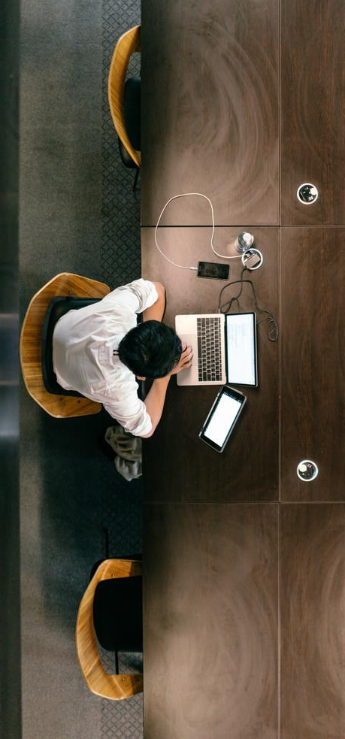
What is an Enquiry Café?
Collaborative sessions open to staff in all library departments
Deconstructing real enquiries in groups to share approaches, ideas, and knowledge
Examining the journey of an enquiry from user to staff response

Slide 3
The Enquiry Cycle
Enquiry from user
Respond and add value
Refer on?
Follow up emails for F2F enquiries
Link helpful resources
Screen share?
How can we help?
What does the user want/mean?
Do we have resources available for this enquiry?
How can we add value?
Discussion & Collaboration
Reach out to Core Referral and team for ideas and support
Have we had similar queries in the past?

Slide 4
Staff development and student satisfaction
Staff development increases student satisfaction - the more confident we are in answering questions and the more value we can add, the better the enquiry experience for our students.
Enquiry Cafés are open and inclusive, with attendance encouraged by line managers throughout library departments.

Slide 5
Outcomes of Enquiry Café Sessions
Affect a user-driven change to our systems and policies to make them work for our staff
Demystify the enquiry and assigning process through LibAnswers
Build the confidence of our staff, and the confidence of our users in the service

Slide 6
Outcomes of Enquiry Café Sessions: from our staff
“People feel like they leave the sessions having learned something, and that’s a good thing”
“I felt like reviewing the different scenarios was really useful as it can be so easy to become complacent when answering enquiries.”
“It's really interesting and informative to hear other people's views and to share best practice.”
“Great to be able to discuss with a variety of colleagues. I liked hearing how another section worked too”

Slide 7
Conclusion and questions
“But we're a university! We have to have a library!" said Ridcully.
"It adds tone. What sort of people would we be if we didn't go into the library?"
Terry Pratchett, The Last Continent

