Slide 1
Moving to a full-service model in the evenings and weekends
Iraj Mansouri
Rees Arnott-Davies

Slide 2
An introduction to Birkbeck Library

Slide 3
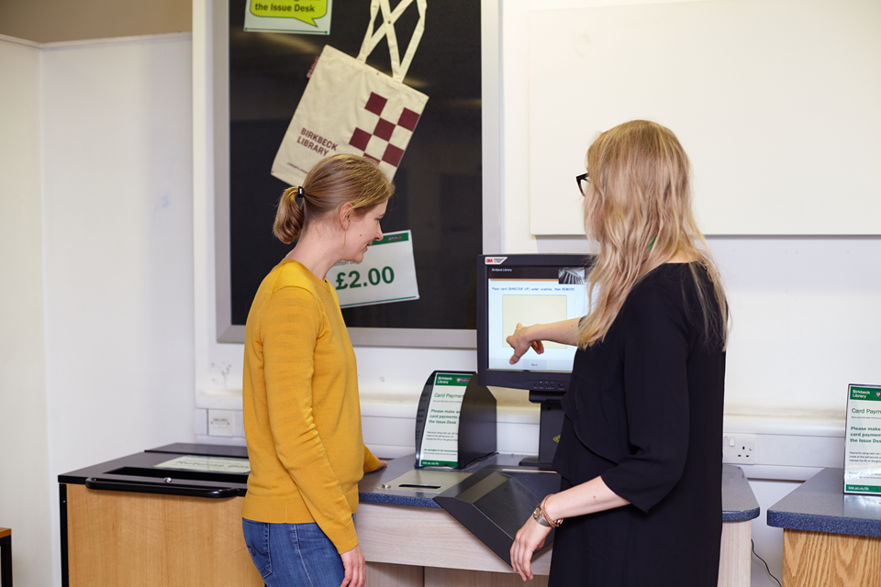
What was it like before?

Slide 4
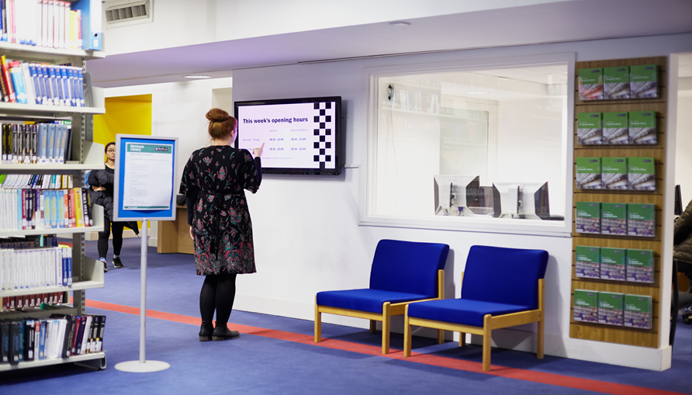
What did the students want?

Slide 5
How did things change?
The Library operates on full-service between 8.30 in the morning and 11.45 at night
Shelvers are now Library Assistants or Senior Library Assistants
Every member of the evening and weekend team is trained to work on the Issue and Help Desks
Staff are free to circulate between Issue Desk, Help Desk, and shelving roles

Slide 6
Positives
Consistency of service
Skills and knowledge shared across the whole team
Greater flexibility in work
Abolished grade 2

Slide 7
Negatives
More work in the short-term
More work, less time
Shorter breaks
More shelving

Slide 8
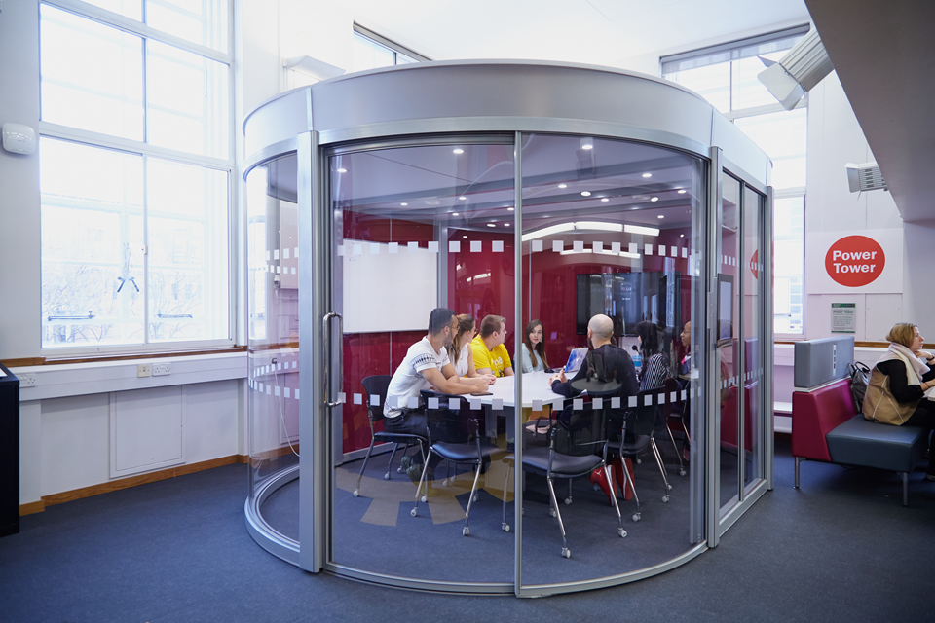
Any Questions?

