Slide 1
Noticeboards in Hallward Library: a Lean Management approach to improvement
Timothy Johnstone
Sally Rowlatt
Notes:
(Introduce ourselves – My name is Tim and this is Sally and we work at Nottingham University in Hallward Library, which is the library for Arts, Humanities, law and social sciences) Within libraries at the university of Nottingham we are very passionate about the Lean process. Lean is an approach that supports the concept of continuous improvement, a long-term approach that seeks to achieve small incremental changes in order to improve efficiency and quality

Slide 2
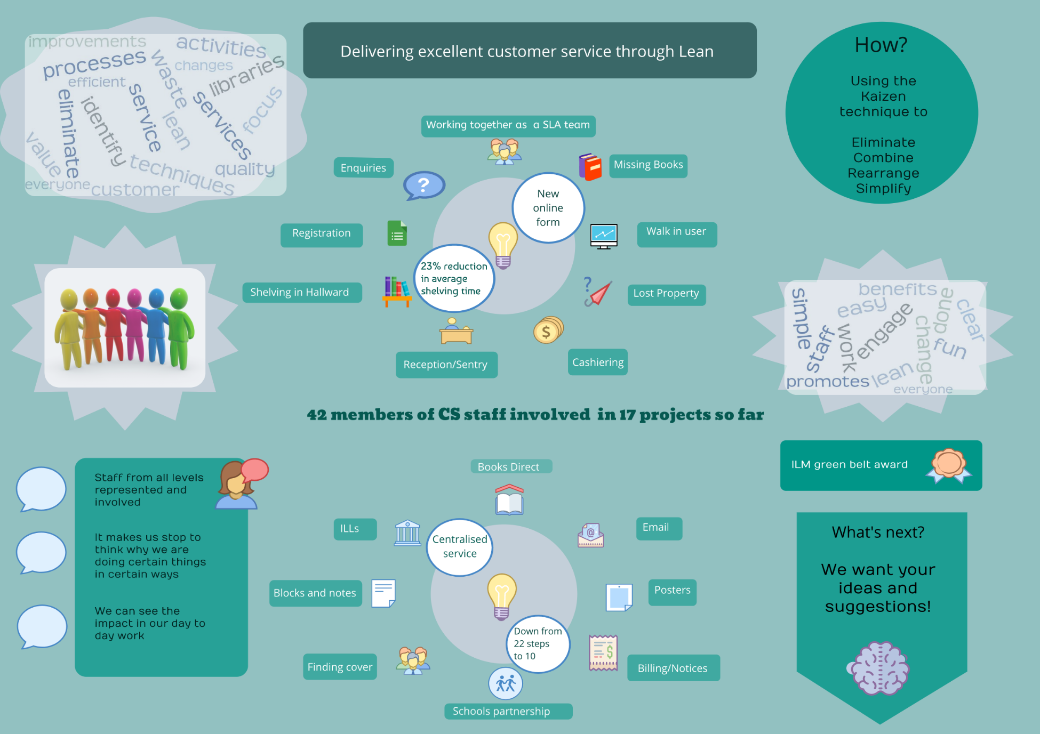
Notes:
Over the years we have run many Lean projects within Nottingham University libraries. A team is usually made up of around three people which includes staff from all levels, typically one senior member of staff, one person that has done the process before and one that is new to it
There have been 17 lean projects on processes such as Registration, Enquiries, Missing books and cashiering.
If lean methodology is used correctly it should make us stop to think why we are doing certain things in certain ways. We should be able to see the impact of a lean project in our day to day work. Lean techniques have helped us as a service,to get somewhere new, have changed our ways of thinking and embedded behaviours such as collaboration, being open to new ideas from colleagues and helped us see our workflow from our customers’ perspective

Slide 3

Removing obstacles - Kaizen
A Definition
Kai
Take apart and make new
Zen
Think about, so as to help others
Notes:
A key part of a Lean project is often about using a process called Kaizen. This is a Japanese term KAI – take apart and make new, Zen think about to help others. Looking at a process and creating the most value for the customer while minimising resources, time, energy and effort.

Slide 4
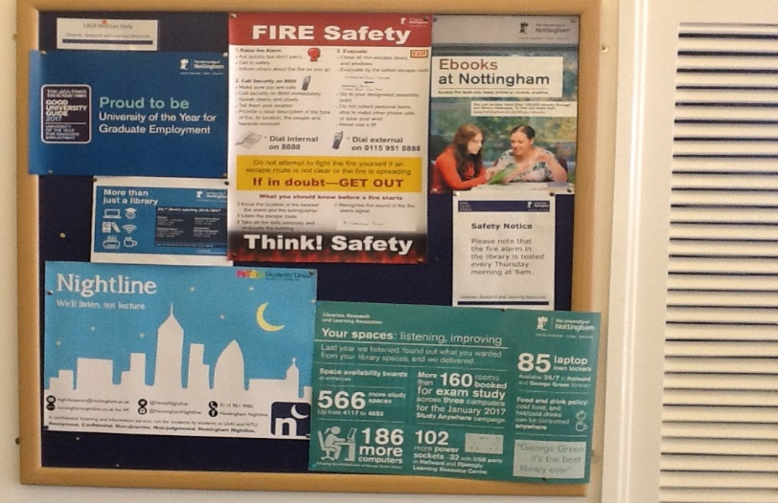
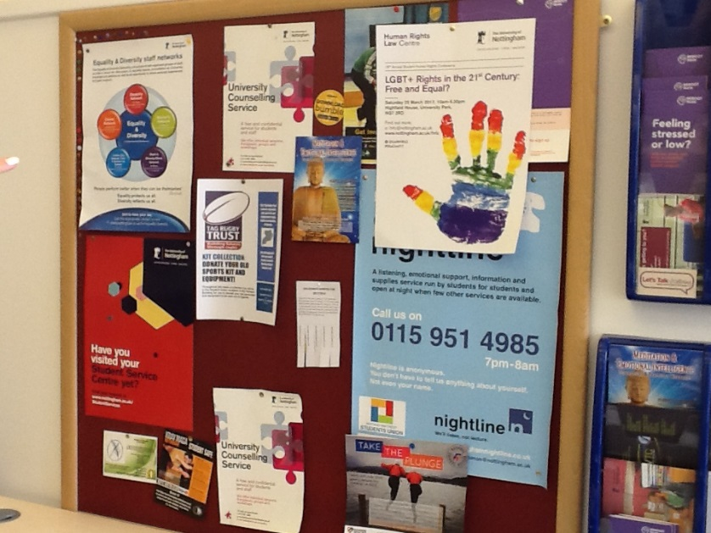
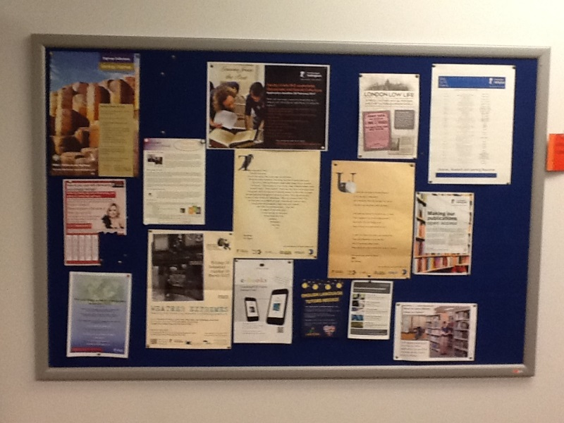
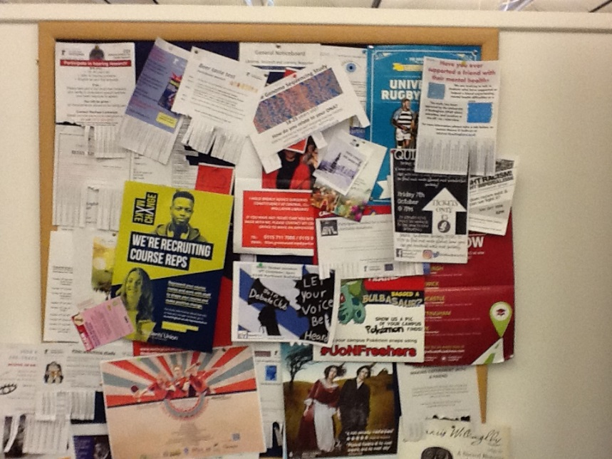
What our project was
Notes:
We recently did a small Lean project on the many notice boards that we have in our library. We have 10 noticeboards that are used for library information and 6 general boards that we have for our students to display posters and information of their own. So as you can imagine there is a lot of information and the boards had become very cluttered and disorganised and difficult to maintain, which made it hard for our students to see anything clearly . We wanted to ensure that the information on the boards was up to date, relevant and that there was a procedure for regularly monitoring the boards. Here you can see the boards

Slide 5




How we used Lean techniques
A systematic, scientific pattern of working
1
2
3
4
Understand
the Direction
or Challenge
Grasp the
Current
Condition
Establish Next Target
Condition
Experiment
Toward the Target Condition
TC
CC
Planning
Phase
Executing
Phase
Notes:
When starting Lean this is the process:
Understand the Direction or challenge – (this is what we would like to achieve)
Clarify the current condition – (Create what we call a process map) It is important to understand where you are now
The next stage is establishing your target condition (This is where we want to be not how to get there as we might not know exactly at this point how we are going to achieve it) and then you experiment towards that
This is something we can keep returning to so that we don’t lose sight of our aim
We then need to start experimenting with changes to see what gets us towards that ultimate destination

Slide 6
To make all information on noticeboards and notices clear, concise and accessible, so that all users are able to find the relevant information required easily and quickly. To create interesting, creative and inspiring displays. To make all communications/information positive and welcoming
Challenge statement (understanding the direction or challenge)
Notes:
We then wrote a challenge statement which was our ultimate destination
So this is our challenge statement

Slide 7
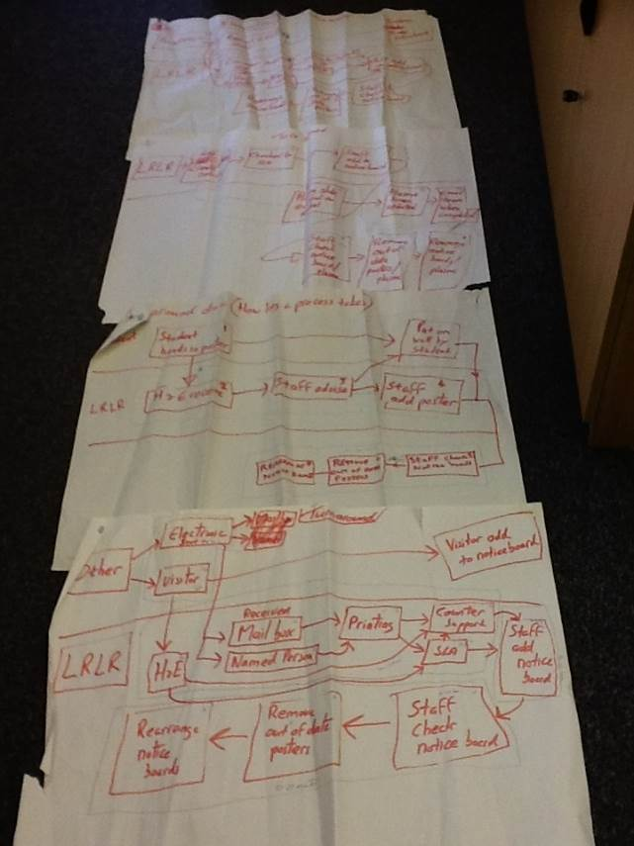
Process Mapping and Turn Around Time Analysis (reviewing the current condition)
Notes:
We start with process mapping. This is where we looked at each stage of the process. Process mapping is basically a map of all the sequence of steps in a process. This looks similar to a flow chart (or can do swim lanes), you need to obtain actual data, and don’t rely on assumption (this is exactly how we do something, and this is often the point where you see that you are repeating yourself or going round in circles) What does this involve? Review the Current Condition for waste. It is important to understand where you currently are, before you set any goal.
The Lean process can help organisations see that we tend to do things in a certain way because we have always done it that way.
You then look to see if you can remove any unnecessary steps or simplify the procedure. We had posters and notices coming from different sources, so we looked at how they were handled and by whom, so that we could try and avoid overhanding.

Slide 8
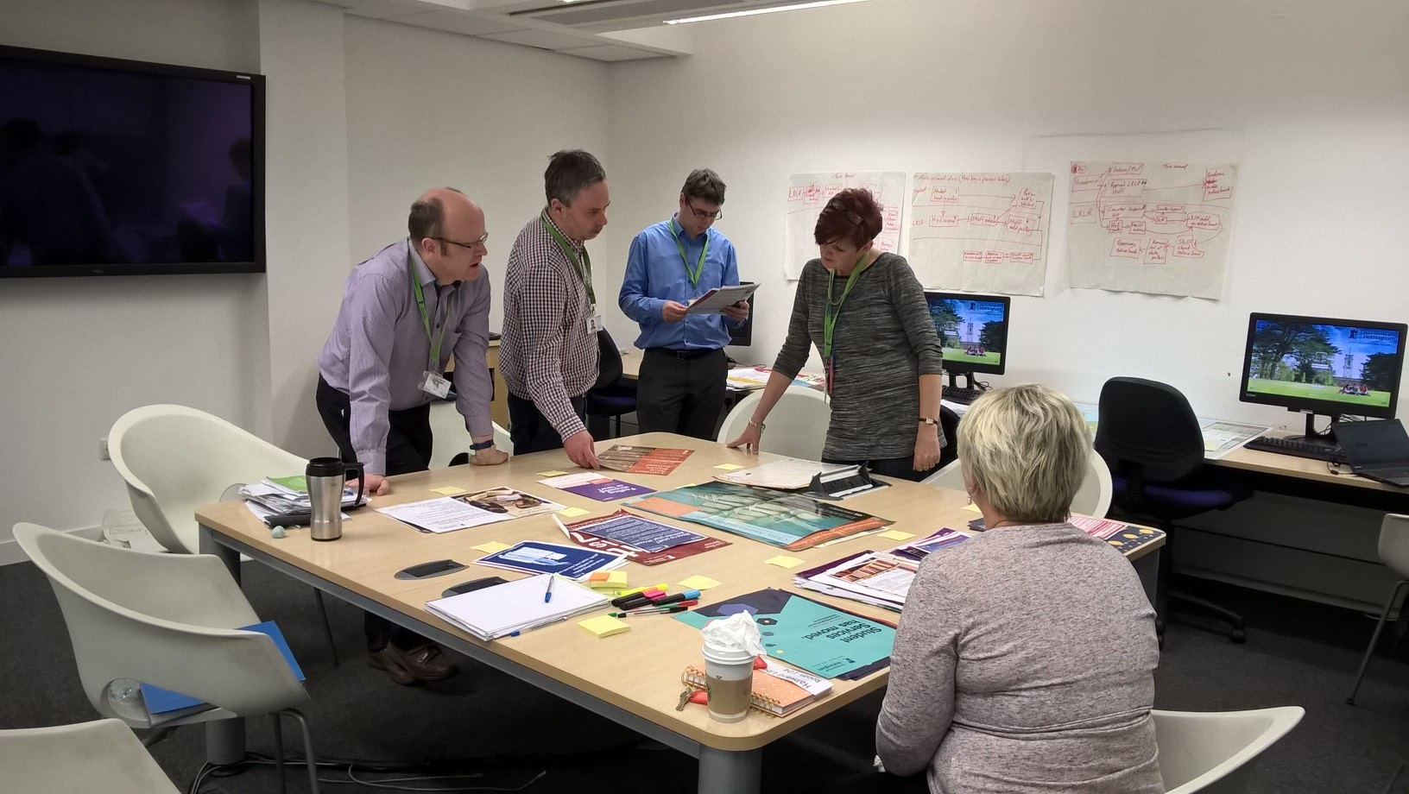
Kaizen day
Notes:
As a group we had a Kaizen day 9-4.30pm. We were off the library rota and focused exclusively on notices and noticeboards. As most of our time is spent doing Customer focused duties Kaizen days are a useful opportunity to take some time away from that and take stock of what we do. Beforehand we wondered if we’d set aside too much time for this, but in the end the time went quickly as we had a lot that we wanted to do.
The starting point of the day was to take down all the notices from all 10 noticeboards in Hallward Library. We looked at each poster in turn to decide what category they fitted, library info, health and safety, upcoming events. We found posters that were out of date and some where the information was no longer relevant and they were immediately discarded. With having so many boards dotted around the library and seeing them every day we had become a little blind to the information that was displayed on them.
During the day one of the first changes that we made, was to make a Standard Board. Hallward Library covers 4 floors, and so we wanted a board on each level displaying important and consistent information, such as Safety, Well-Being and library help information. We all thought that this was a very easy and immediate improvement to making things clearer for our customers. This also would make the maintenance of the boards easier, already cutting time and effort.
This slide shows us sorting the posters into categories

Slide 9
Setting Next Target Conditions
Target Condition statement
seeeeessddddddddddddddddddddddd
That notice boards are up to date, relevant and regularly checked
Establish the next Target Condition to head towards the Challenge statement
Notes:
It is important to keep looking at what you have achieved and set the next Target Condition, as it's not always possible to make all the changes immediately. You need to start thinking and try implementing your ideas and changes one at a time. You try things and see if it works and if it's practical. Sometimes they aren't, but you don't give up. You re-evaluate and try something different and keep your Challenge Statement in mind.
Sometimes, there is no better way to do a process, in which case you leave it. It isn't about making changes just for the sake of it, but often just by tweaking a small thing, it makes a difference.
As Tim has said, we often do a certain thing in a certain way "because we've always done it like that", LEAN challenges that statement.
After our Kaizen day this was our target condition - We wanted to make sure that the boards were displaying up to date and relevant information and we needed to keep thinking how we could do that in an efficient way.

Slide 10
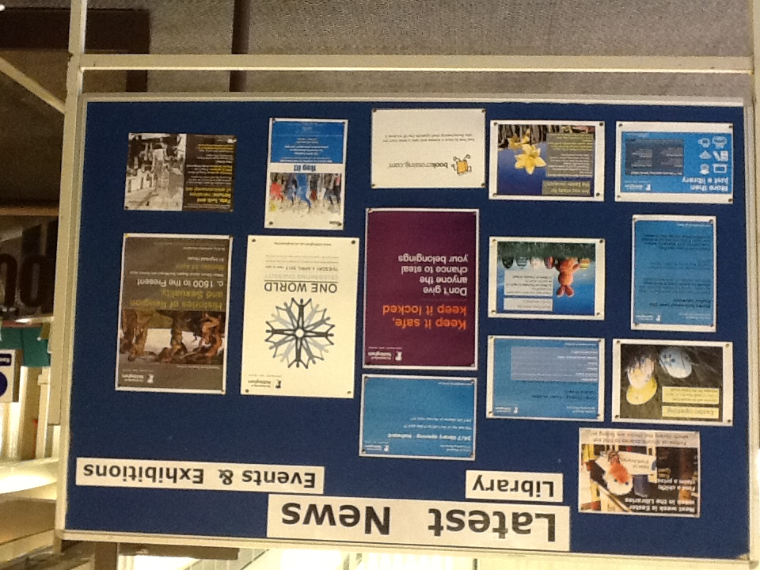
Results achieved
New Latest News notice board
Survey
Numbered the boards
Notes:
We wanted to give the boards a clearer identity, so that our customers can easily find the information that they are looking for, so they now all have New Headers, which shows more clearly what information it is displaying. We also have our Standard Board, of which I'll talk a little bit about in a minute.
One of our ideas was to create a Latest News Board. We wanted a place where we can display current library information, and highlight things that are different for that month, for example vacation opening dates and times.
We also have a lot of interesting events and exhibitions happening around the campus, and often posters for these can get a little lost on our general boards, which we think may be a missed opportunity for many. So, we think our Latest News board highlights the library specific things you need to know and the things you may find interesting.
We ran a small survey asking for feedback about the changes we had made. Overall it was very positive, but we did re-position the Latest News board as it was decided it perhaps wasn't in the best place to attract the most attention.
The general boards, which are the ones that are mainly for student use, have also been numbered and signage has been added, asking that a date is put on the poster, and after 1 month (or the information has become out of date), we remove it to allow space for others. We periodically check the boards to ensure that the information displayed is appropriate and not out of date. At this point, we can add a date to the notice if it hasn't already been done by the student.
We have also created a Poster Diary, and we note down the dates that certain posters will need to be removed along with their board location. This means that we don't have out of date information displayed, as it is removed immediately. This also saves us time as we aren't having to continually check the boards.
Our library is very open with lots of very large windows, so the positioning of the boards isn't perfect, but we have to work as best we can with what we've got.
You can't always do everything that you might want to do, so with LEAN there are often going to be compromises that need to be made.

Slide 11
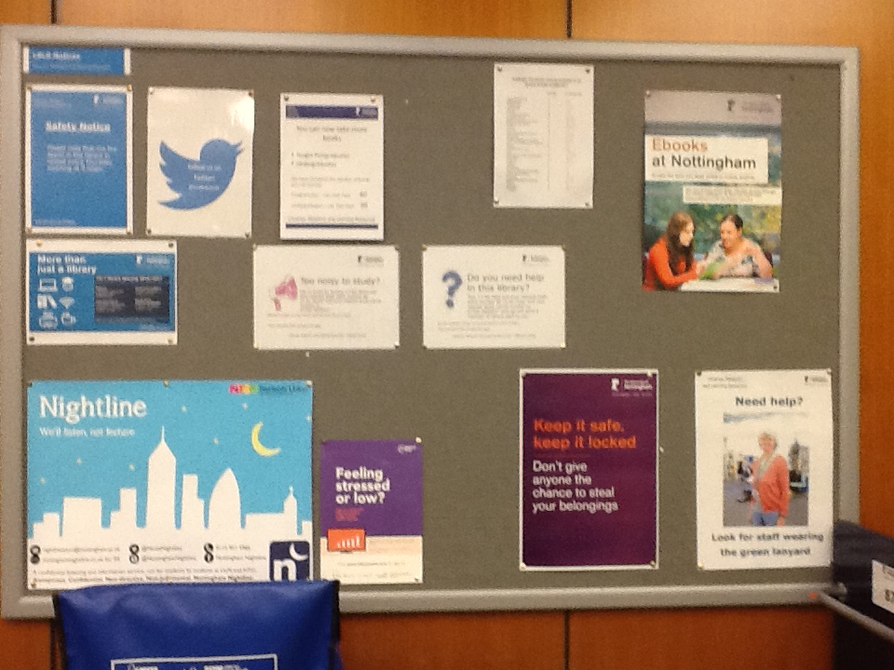
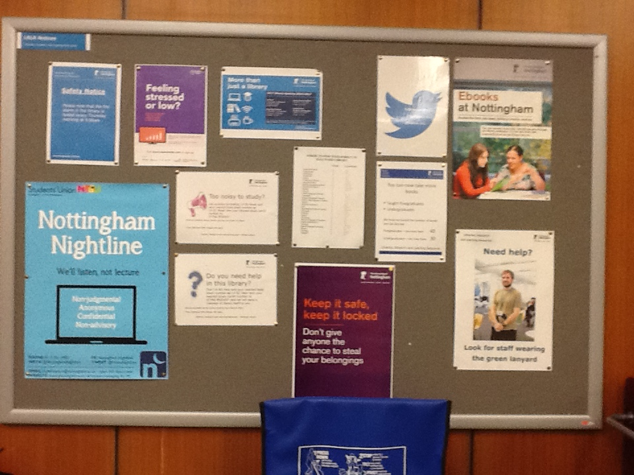
Standard boards
Notes:
These are two of the standard boards, and we have one on each of our 4 levels.
The type of things that we put on them were:
Health & Safety – Things to do with fire alarm testing
Wellbeing – Nightline, which is a telephone helpline that we have for students to ring if they are feeling stressed and need support
Help & Enquiry – How to locate the books you need, and posters showing who to ask for help
This is information that is of use to all, and as the boards are the same they are easier to keep maintained.

Slide 12
Review your Target Condition and Challenge Statements
Conduct any repeat verification of processes, steps, activities or things you measured.
How does it compare to your original analysis?
Lean never finishes
Notes:
During the process we need to keep looking at where we are and reviewing what we have done.
After each experiment, you ask yourself the following questions:
What is your target condition?
Where are you now?
What did you plan to try in your last step?
What was the result?
What did you learn?
What is your next experiment?
So again, as Tim has already said, Lean never finishes
As this was a simple project we only used a few of the tools available, but there are many more that can be used to gather data to help you.

Slide 13
Sharing success through
Report Out
Notes:
During the process we talked to and listened to colleagues and took on board any ideas, and once we had completed our project, we shared the information with them.
We felt quite happy that we had made significant improvements, and we felt that we had met our Challenge Statement that had been written at the beginning of the process.
It is not always possible to improve things and as I said earlier, you don’t make changes for the sake of it. Once you start thinking in a lean way you can apply the techniques to many things and those small changes can make quite a difference.
You may even find that you start to introduce it into your own homes.
LEAN is all about continual improvement

Slide 14


http://www.leanhehub.ac.uk/lean-he
Any questions..
Notes:
More information about Lean can be found at the Lean HE hub http://www.leanhehub.ac.uk/lean-he

