Slide 1

Accessible Recruitment
Helen Rimmer and Deepa Rathod

Slide 2
Inspiration
Employ Autism training for AELD colleagues
Recruitment -graduate student – fixed term contract
Same graduate student - successful application for a permanent contract – excellent set of skills and confidence in the workplace

Slide 3
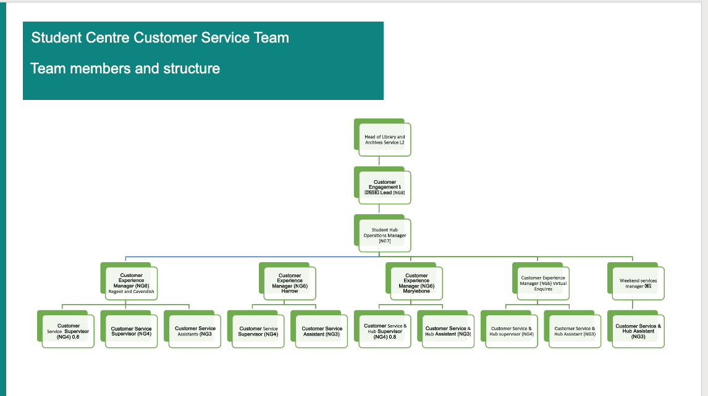
Specific approaches
Overview of the team and the post
Notes:
We created a Recruitment Welcome Pack for interviewees which included:
Names and pictures of the interview panel
Information about the team and the post
Interview tips and guidance
Interview Questions
We gave the interview questions in advance (in the
Recruitment Welcome Pack)
A statement on the adverts stated that we welcome candidates from neurodiverse backgrounds and that we are committed to inclusive hiring practices
4. The Recruitment Welcome Pack was reviewed by the student whom we employed, for any inconsistencies, language and areas of common knowledge that may not be understood by neurodiverse people.

Slide 4
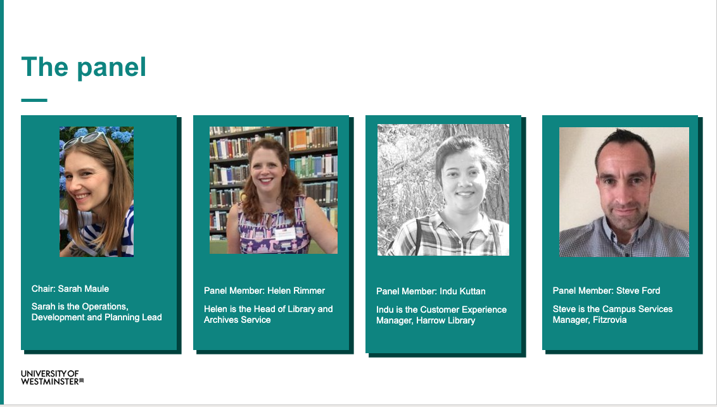
Specific approaches
Pictures and information about the panel
Notes:
Make up of panel -
We always have an external, a mix of grades and a representative panel in terms of diversity. HR have a policy where people of lower grades can take part in the panel if the job will work closely with them as a development opportunity

Slide 5
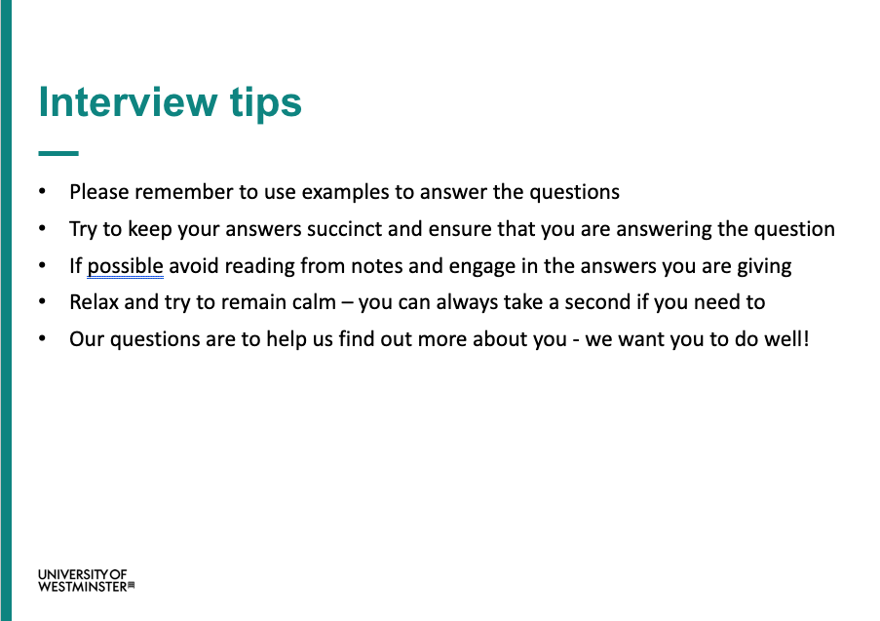
Specific approaches
What to expect from the interview
Interview questions
A task if appropriate
Tips for the interview

Slide 6
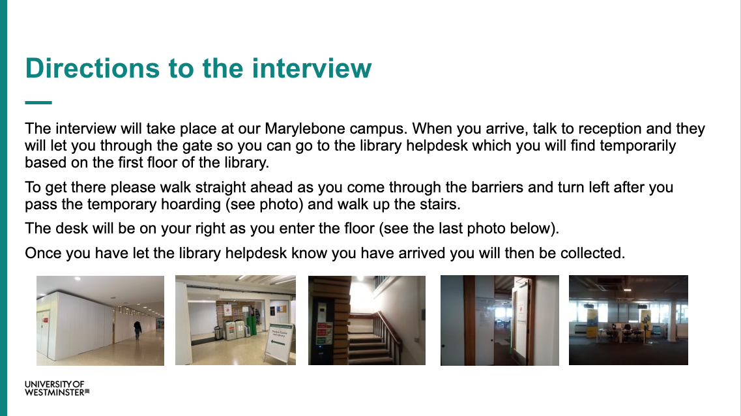
Specific approaches
Directions with photos
Notes:
Make up of panel -
We always have an external, a mix of grades and a representative panel in terms of diversity. HR have a policy where people of lower grades can take part in the panel if the job will work closely with them as a development opportunity

Slide 7
We aimed to :
Make
Make the process as transparent as possible
Support
Support our neurodiverse applicants by giving them information and enabling them to plan and prepare
Make
Make it clear that we wanted applicants to succeed in this process
Put
Put applicants at ease so that they can do their best at interview
Enable
Enable applicants to plan and research their answers (enabling candidates to do their best).

Slide 8
Main ethos in our approach
the interview is not about finding someone who is best at thinking on their feet or answering interview questions
but rather, to find the candidate who aligns with the needs of the role and the service
Notes:
This approach allowed us to appoint the candidate that best matched the role and skills required.

Slide 9
Initial concerns and assumptions
everyone will do well, including applicants who were not in fact suitable for the role.
there was also concern that in giving the questions in advance candidates could get help or look up answers to find what they think we might want to hear.

Slide 10
Concerns mitigated by
Using follow up questions as appropriate which are not given in advance (though candidates are aware this may happen) to probe deeper into answers
01
Having clear scoring criteria and expectations from each question
02
Notes:
even with the questions in advance there were still clear differences in candidates’ strengths and answers
candidates did not necessarily answer questions in the way that we required
even with the interview questions sent in advance and best practice tips written on the interview pack, some candidates lacked general interview skills or digital skills
The use of follow up questions worked well to identify depth of knowledge and understanding from candidates and was a significant help in identifying successful candidates.
on two occasions we completed follow up interviews to ensure we were completely happy with our chosen candidate which strengthened the overall process where that was necessary.
the scoring criteria ensured there was consistency when marking the answers
the panel was able to distinguish clearly between the candidates suitable and not suitable for the role, and
the questions given in advance in the interview pack did not mean every candidate answered them fully and appropriately.

Slide 11
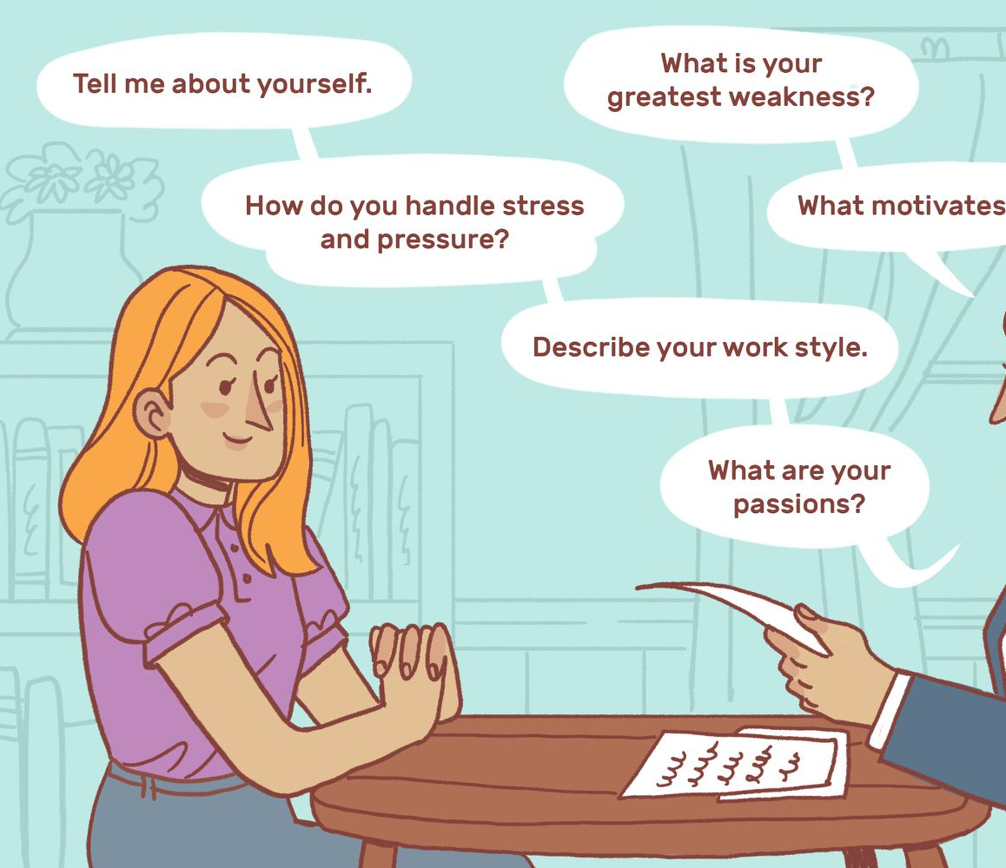
Interviewing Experience

Slide 12

Feedback from other people
Notes:
“I can easily say it was the best interview experience I've ever had.”
“It reduces factors like stress and emotions, which can affect recall. Furthermore, it puts candidates coming from different backgrounds, and having different cognitive and physical needs, at a more level playing field.”
“I felt positive and excited about interviewing for a post at an institution that takes accessibility and EDI seriously, putting the principles into action.”
“It also showed you were more interested in the answers to my questions rather than surprising me with tough scenarios and that’s the kind of place most people want to work for - a supportive place.”
“I also felt much better about the interview knowing that you “want me to do well” and that the institution is looking after candidates’ mental health and wellbeing.
It certainly made Westminster University stand out and made it come across as a friendly, fair and supportive institution which is serious about equality and diversity in a workplace.”

Slide 13
Colleague's Experience
Having a brief on four specific questions and three further fields of questioning was useful.
Useful to be prepared with information regarding the new structure of the Student Centre, and the role which I would (prospectively) be playing in this.
The pictures of the panel was helpful because it meant I knew who I was looking for when I arrived.

Slide 14
Outcomes and next steps
Candidates delivered in depth answers which supported us in making more confident choices in who to hire.
Overwhelmingly candidates commented on how the University of Westminster is clearly committed to EDI and compassionate employment, and that candidates would want to continue to explore ways to work with University of Westminster in the future.
Leading the way across the University
Mix of Questions and Themes
Accessible recruitment

