Slide 1
Supporting staff at UEL
Taking a human approach to an exceptional situation
Florence Achen-Owor Amy Stubbing
Notes:
Florence followed by Amy ( we will be introduced by the moderator)
We are presenting using pecha kucha style on how we supported staff through lockdown. As with all library services, the University of East London (UEL) library team has had to rapidly develop and change our approaches in the wake of the COVID-19 pandemic.
We implemented a series of working practices to support our staff effectively.

Slide 2
Whatsapp
Before
Notes:
Amy
One of the first things we implemented in the run up to lockdown was staff whatsapp groups. This was to ensure that staff knew they were kept up to date and to stop staff feeling like they had to be on e-mails 24/7 because things were so turbulent. It was agreed that this would only be used for work, and we sent an update message every morning. We did not use this group for anything other than the daily updates. Staff noted that this really helped their peace of mind at the beginning of the pandemic.

Slide 3
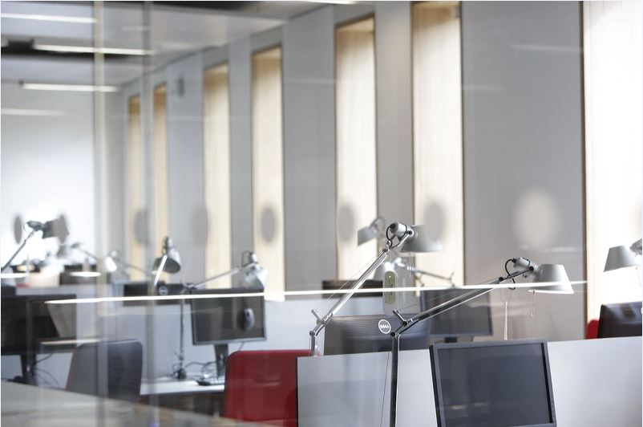
Before
Training
Notes:
Florence
Training staff was crucial so we quickly put together a programme to keep the team up to speed on key tasks that we wanted them to complete remotely. We had refresher sessions on databases searching, answering online chats and on the back end tasks such as tidying databases, a task that the teams could complete remotely.

Slide 4
Teams sites
Before
Notes:
Amy
- in the move online we realised the importance of informal enquiries and relationships with students and that we'd lost that outlet and chance for staff to engage with students (which is why most of them are in the job). We created a teams site for library staff and students to chat and engage in a more informal space. We posted things such as recipes, free things to do in lockdown, coffee and chat sessions and more. Students had to opt in to sign up, which meant building numnbers was tough but those that joined did actively engage.

Slide 5
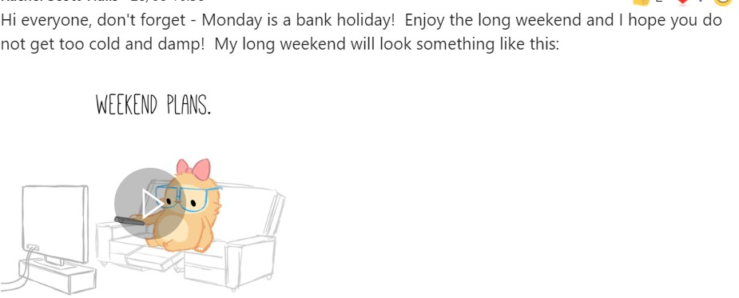
Support message
Teams chats
During
Notes:
Florence
-Microsoft Teams chat served as the main forum for communication and a focal point for bringing the team together. It helped to embed our remote working practices in place.
-Staff used the forum for clarifying procedures, getting updates and for supporting each other.
-We set up several channels focused on different themes e.g .

Slide 6
Increased Team Meetings
Weekly
Team updates and regular individual 1T1s.
Notes:
Florence
-Senior managers had daily meetings to plan our works flow and also to give key update information to the team.
-All staff had weekly meetings and regularly one to one support to help bring everyone up to speed with the new ways of working.
-We used the forum to update team on key updates from the university, follow up on key instructions, tips on working from home and sharing good tips from training we attended.

Slide 7
CS Away Day
Centered on our core values and purpose
Notes:
Florence
-We planned this in June to help us bring together the team in a fun way but also to work on our vision and strategy that underpins our activities.
-Key theme of the session focused on where we wanted to be, our purpose and value as a service.
The key benefits from this day was staff engagement and their contribution which was well received.
-Emerging themes were understanding our users, signposting the service, listening to one another understanding their feedback.

Slide 8
Project Work
During
Notes:
Amy
A big part of ensuring we could keep staff connected and motivated was project work. For our team, so much of their job has previously been able to physical space and books, so a lot of planning went in to identifying online tasks, and focusing on projects which would ensure that despite the delays caused by the pandemic we were still moving forward. All projects were made visable to everyone, with progress clear which made monitoring how staff were doing much easier. We didn't have targets which was really important to maintaining the wellbeing focus, but being able to see who was struggling to login or complete tasks gave us an idea of who needed support.

Slide 9
Additional Training
During
Notes:
Amy
in the move to online we found that the soft touch training that would happen in the offuice dropped so we incorporated additional training opportunities into the working day and meetings. This was particularly important for digital literacies which we realised was inconsistent across the team. So alongside encouraging staff to take part in specific training courses online, we offered additional training in meetings or as specific sessions on key things such as microsoft skills, using systems, leadership and more.

Slide 10
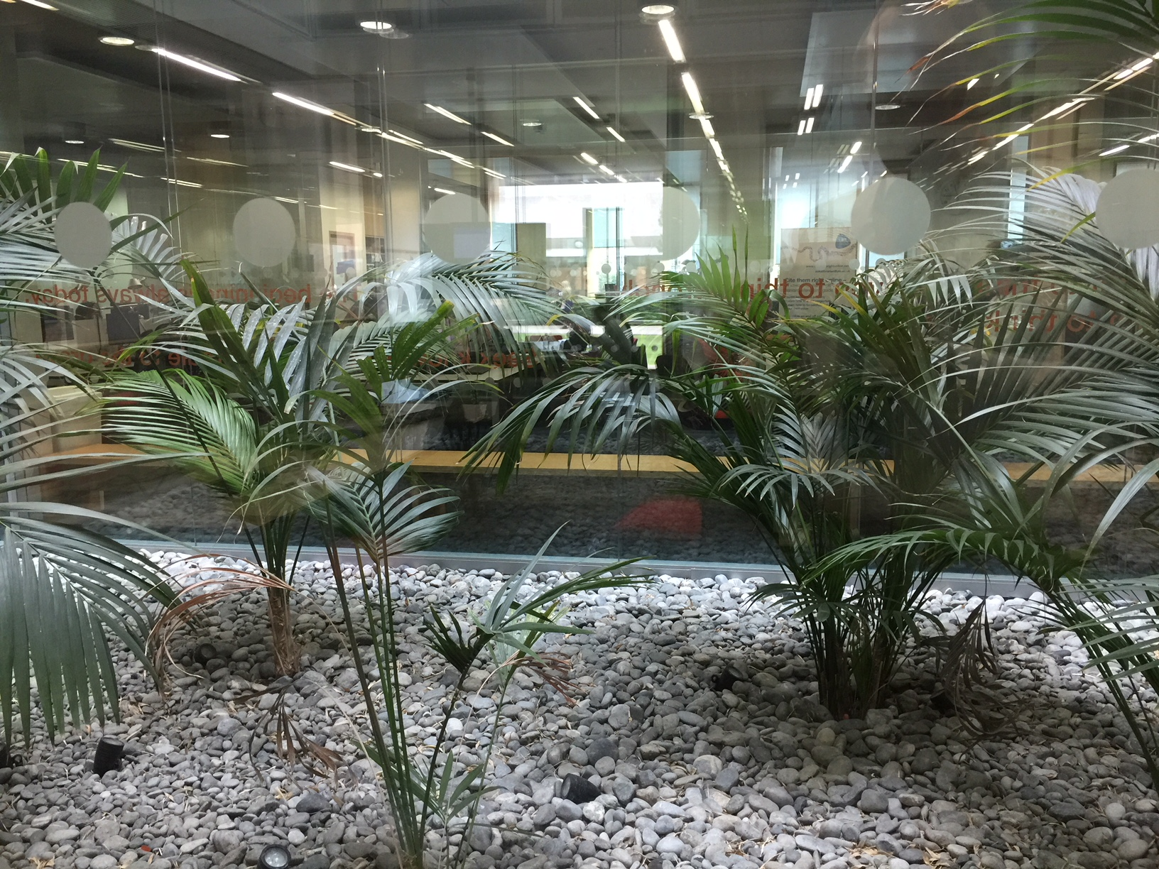
Wellbeing
During
Notes:
Amy
We took staff wellbeing very seriously during this time. We had a few key pieces of work that supported this area including the creation of a staff working from home and wellbeing document and best practice which was agreed by managers. This document included best practices for all teams including a focus on flexible working patterns and hours, regular breaks finding time for the informal and encouraging coffee breaks and time to not work during the working day, helping staff to be mindful of capacity for work and mental health. Essentially, our focus was much more on the not working than the working during this time.

Slide 11
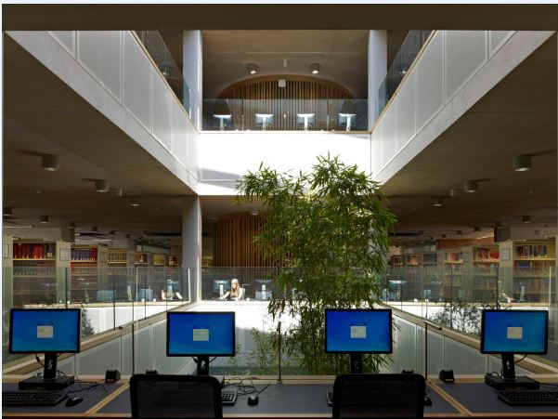
Quiz
During
Notes:
Amy
Leading nicely on, we wanted to ensure there was time to socialize and switch off when it had been such a difficult time. As such we created things such as our staff quiz. With this we created staff teams made up from a mix of people across the services and grades and we gave everyone the afternoon off to attend. This was a nice a light afternoon activity when staff stress levels really had been quiet high. We had other activities later on such as a games afternoon and staff feedback was positive.

Slide 12
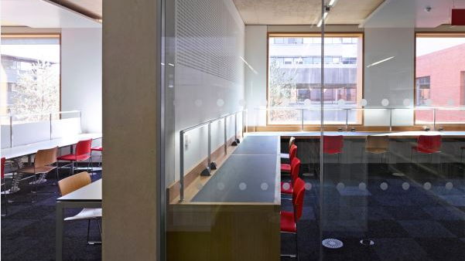
Coffee Mornings
During
Notes:
Florence
-This was informal and quite short so it provided a forum for senior managers to update the team on key emerging issues but also a forum for teams to discus issues of concerns and share how they are coping with the pandemic and above all see each other.
-Staff had the opportunity to discuss issues of concerns openly and we encouraged everyone to engage using the chat functions during this session, their questions were read out a lot of staff were more engaged this way.

Slide 13
Buddy System
During
Notes:
Florence
-We all have our key areas of strengths and the ones that needs working on.
-Some of our team struggled with technology so we paired team up with colleagues who were confident in IT and this ensured that everyone were supported.
-It was opportunity to work on joint tasks and projects together remotely.

Slide 14
Professional Development
During
Notes:
Amy
One of the last things we wanted to highlight was professional development. The pandemic and lockdown has been really tough, but our ability to focus on professional development was a real benefit. Tying in with our approach to wellbeing for staff and the gaps in knowledge, working from home has been a great opportunity to focus on professional development time. Using webinars, linkedin learning, secondments, and cross team projects, there has been more time for professional development than ever before.

Slide 15
Conclusion
Notes:
Florence
-Move from ftf to online was challenging for the team. We have used a difficult time to redefine our focus as a library team by building a robust communication strategy and creating best practice with balancing the needs of the team and supporting users using the strategies we shared. In the end it has helped us to support our learning.
We That is the end of our presentation. Thank you

