Slide 1
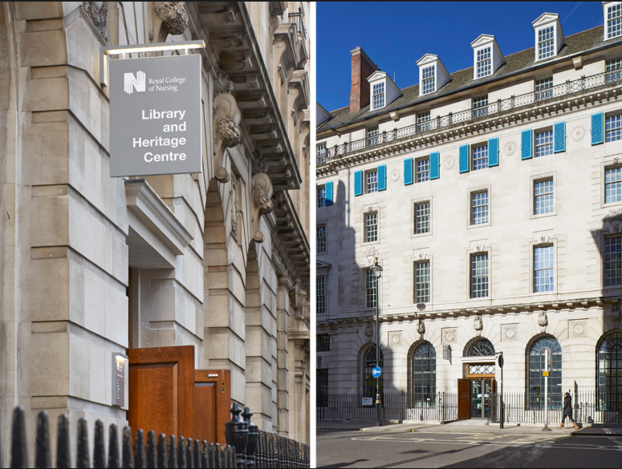
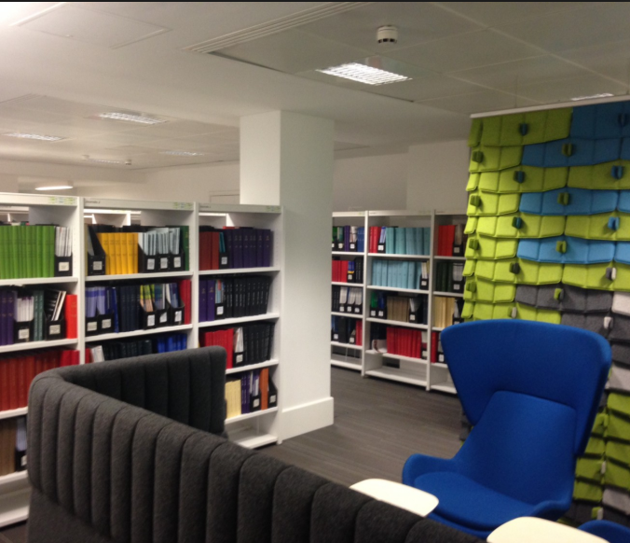
What is the Royal College of Nursing?

Slide 2
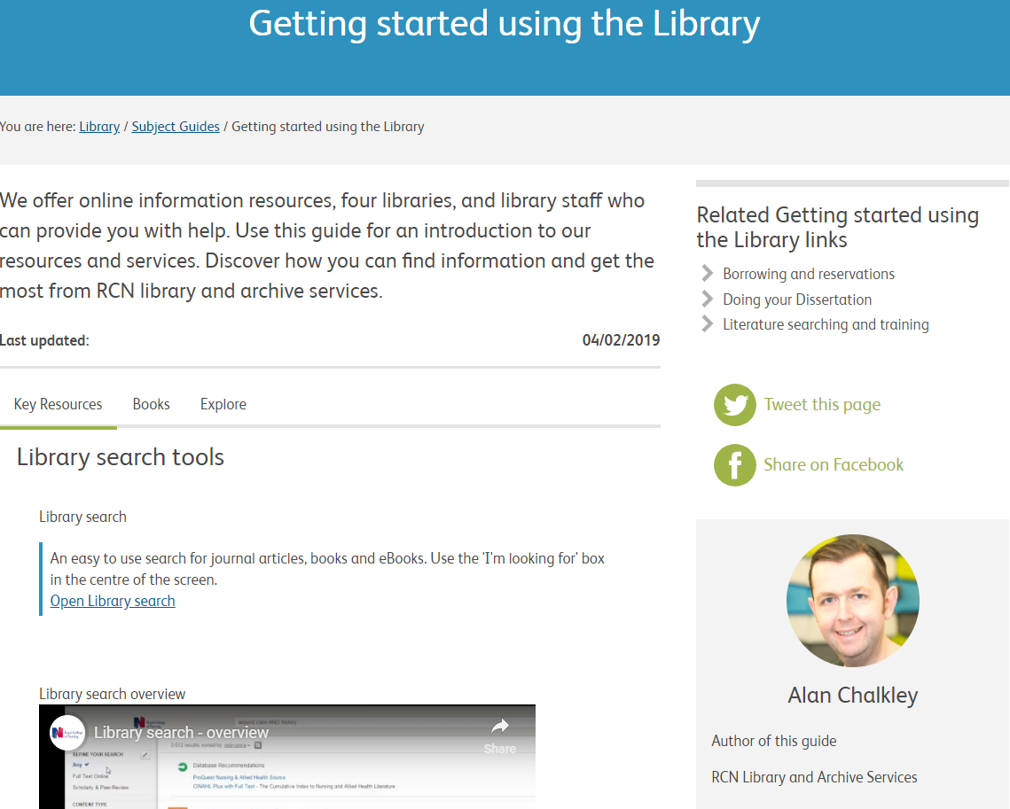
Subject guides
Key topics
Clinical leads & forums
Videos
Library resources
Other resources worth exploring

Slide 3
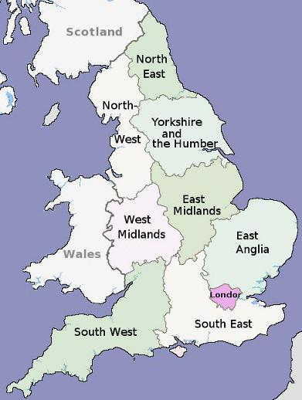
Outreach
Background
Introduced 2016
How it works – each library assistant:
Works with a designated region
Informs regional staff about services
Promotes services to members
Attends events and meetings in each region

Slide 4
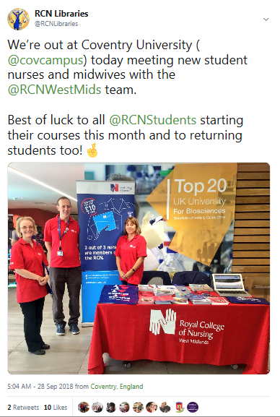
Outreach
Indicators of success
Measured through increased contacts with regions
Number of members interacted with
Resource usage by region
Evaluation
- 103 events in 2018 – saw over 5,500 people
- eLibrary Logins increased 78% - eJournal downloads by 18% vs quarter 4 2017
Notes:
Royal College of Nursing regional contacts outreach project
Reaching out to users unable to physically visit the library is a challenge for most library services. The Royal College of Nursing (RCN) supports over 435,000 United Kingdom-based members. The geographical dispersion of these members and other factors, for instance pressures on healthcare workers’ time, mean the vast majority are unable to regularly visit any of the RCN’s four libraries. Efforts to redress this previously were sporadic and outreach lacked coherency across the service. As a result, the library was often criticised for being focused upon centralised resources.
The RCN’s Library and Archive Service (LAS) started a regional contacts project in 2016, committing to developing staff and member relationships through activities across all regions of the UK. Nine LAS staff were assigned a region in England. Named library contacts also perform a similar role in the other three countries (Northern Ireland, Scotland and Wales).
18,788 miles of travel were accrued by the team throughout the English regions alone in 2016 and the team in Scotland engaged with over 2000 people through their outreach activities. Events range from presentations and information skills sessions to topical quizzes at conferences and a travelling handling collection of nursing artefacts. Visits frequently involve liaison with library staff in universities and hospitals too.
There has been a dramatically expanded online offer during the same period. Regional contacts are able to highlight the services available and to explore collaborative opportunities. Challenges have presented themselves, however in terms of the impact upon staff workloads and removing LAS staff from the core functions of the library. Some regions are also more willing to engage than others.
This way of working is still relatively new to LAS. This paper looks into what impact the regional contacts project has achieved and new methods of collaboration forged between LAS staff and other parties. This is done through a mixture of feedback gained during these outreach activities and through analysis of service use by region.

Slide 5
Online exhibition
Quotes
Videos
Images / artwork from physical exhibition
Object cases with clickable ‘hot-spots’
Engage a much wider audience
Big uptake with over 443 average daily views

Slide 7
Contact us:
Nadia Munir & Kat Black
Email: rcn.library@rcn.org.uk
Phone: 0345 337 3368
Twitter: @RCNLibraries
Instagram: @RCNLibraries

