Slide 1
The Shakespeare Institute Library’s
Current Awareness Service
Notes:
Title screen slide

Slide 2
Current Awareness
What is it?
How does it work?
Are we getting it right? Student response.
Notes:
1. It is a service set up in 2012 from an idea by the Shakespeare Institute Librarian Karin Brown to help our research students get the most out of the library by pointing them in the direction of articles and chapters of books in newly arrived stock that would be of interest to their research.
2. Flyers were made – like the one on the right - and distributed to the research students at the library induction sessions at the start of term. Students who expressed an interest in the service were asked to give their topic of research and some keywords to help the team identify relevant material.
3. Yes is the simple answer. Now in its fifth year it is going from strength to strength and is now run by a team of 3 staff. This current academic year the service has 17 students and 1 academic member of staff. Last year the service was opened to our academic fellows and the team got a huge pat on the back and much thanks when the member of staff’s book was published.
4. It does take a considerable amount of staff time but we are a post grad site and see our students on such a regular basis that we feel it’s actually good to know and discuss their topics of research more so for our distance learners, especially if we can point them to articles they can read on line. Of course new stock does not arrive every day so the checking does not have to be done on every work shift and the team get on with their other day to day library routines but some of our journals do come on a regular basis like the TLS every Friday so Sara knows that it will be there for checking when she comes on duty on every Sunday.

Slide 3
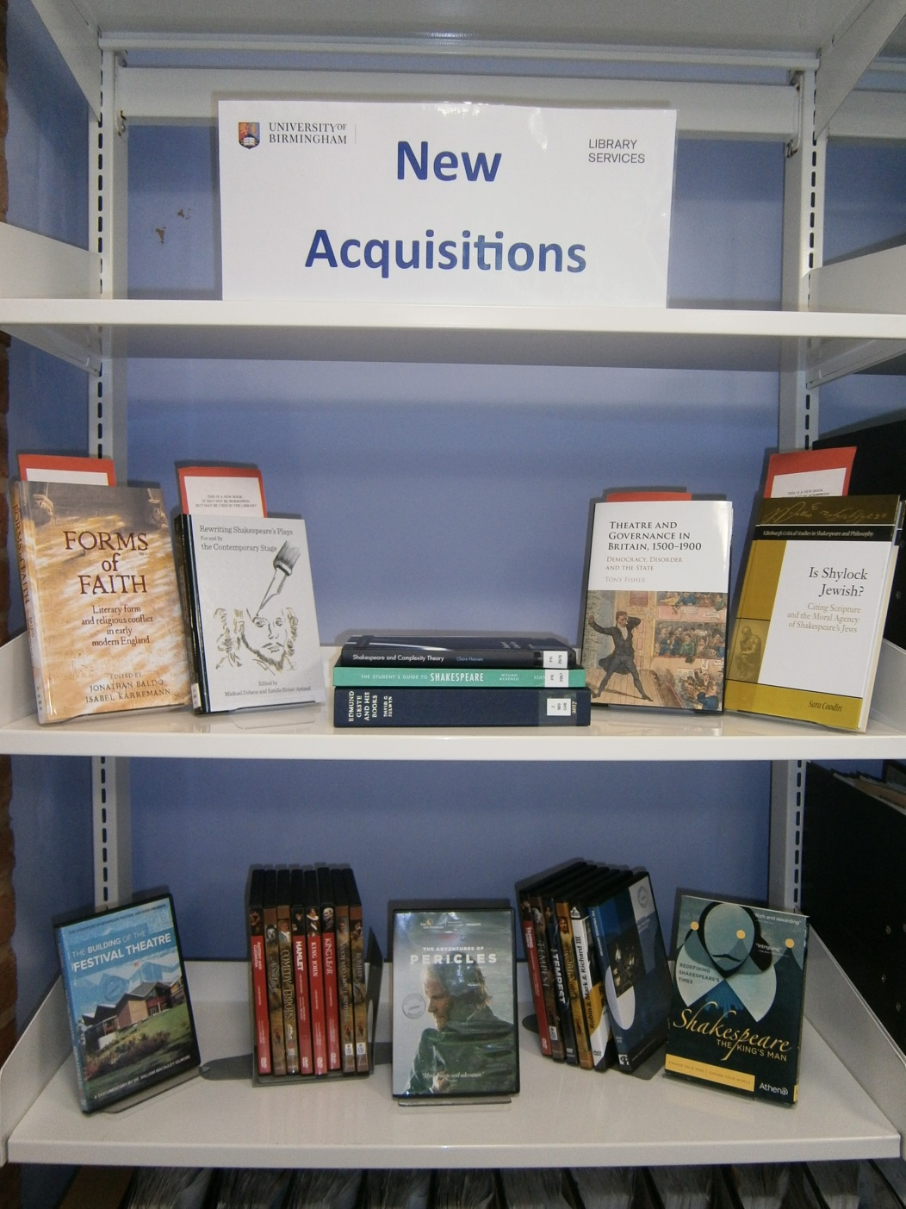
What is it?
A service to point research students in the direction of new material that is received into the library, which may be of particular interest to them in their studies.

Slide 4
How does it work?
Staffing
Time
Promotion
Research titles
New acquisitions
Check all new materials
Inform students

Slide 5
How the service works: Researchers and the titles
Student | Research title | Keywords
6
[Student] Email address | Early modern epilogues and their audiences | Epilogues Audience Applause Paratexts London-centric plays (written and performed in London) (All in early modern period)
7
[Student] Email address | Non-authentic Representations of Elizabethan England in 21st Century Design for Shakespeare and his Contemporaries | Costume Design Period dress Nostalgia Stage design Elizabethanism Reconstructive
8
[Student] Email address | Shakespeare in Spain and the Basque Country | Shakespeare Translation Translation Spanish Basque Euskera [the Basque language] Minority Languages Spain Basque Country
9
Notes:
The first step is to add the student’s details to our list of researchers and their titles.
This is an example of a page from our master list that the team work from and as information does change during the students period of study the list will get updated constantly. Email addresses have been removed for this presentation.

Slide 6
Example of periodical check - in sheet:
Periodical title, Vol., No., Date Remember to check back in! |  | Relevant chapters/ pages | Of interest to | Date student emailed
Modern Philology Vol 116 no 3 February ’19 |  |  | X
TLS 22 Feb 2019, no 6047 | 27-8 33 | Michael Robertson: “The revolution will be ficitonalized” Megan Marz: “Appreciating carcasses” | [Academic] (nascent socialism) [Student] (anatomy) | 24/2/2019 24/2/2019
Shakespeare Jahrbuch no154 2018 | 11-30 31-53 75-91 92-105 106-125 126-139 140-154 155-172 | Janet Clare: “Reform and order on the Elizabethan stage” Cornel Zweirlein: “Tyrannenmord, Majestätsverbechen und Herrscherwechsel bei Shakespeare” Elizabeth Hodgson: “Playing Judge” Richard Hillman: “Mercy unjustified” Anne Enderwitz: “Ökonomie und politisches Kalkül” Isabel Karremann: “Post-Reformation memory culture” Lieke Stelling: “‘Leaving their humours to the word mongers mallice’” Gordon McMullan: “The last days of William Shakepeare” | [Student] (English reformation) [Student] (sovereignty) [Student] (Lear) [Student] (English reformation) [Student] (English reformation) [Student] (English reformation) [Student] (Polemic religious) [Student] (historiography) | 5/2/2019 5/2/2019 5/2/2019 5/2/2019 5/2/2019 5/2/2019 5/2/2019 5/2/2019
Notes:
All new journals that arrive in the library are added to the check sheet – left hand side. A Current Awareness team member will then look at the journal to see if there are any relevant articles/ book reviews and add the details. Emails of relevant details will then be sent to the research students who can look for the articles when next in the library or view on line.

Slide 7
Example of book check - in sheet:
Author, Title Publisher date Remember to check back in! | Classmark | Relevant chapters/pages | Of interest to | Date student emailed
McCartney, Mary. Twelfth Night. Heni, 2016. | qPN2596.5.G6 | Volume of photographs from the 2013 production of Twelfth Night (with Mark Rylance) | [Student] (Costume) and [Student] (Costume) | 30/1/2019 30/1/2019
Brejzek Thea and Lawrence Wallen. The model as performance: staging space in theatre and architecture. Bloomsbury, 2018. | PN 2091.S8 |  | [Student] performance spaces | 30/1/2019
Ney, Charles. Directing Shakespeare in America. Arden Shakespeare, 2018. | PR 3105 |  | X
Anderson, Susan L. Echo and meaning on early modern English stages. Palgrave Macmillan, 2018. | PR 658.E24 | ‘of interest to students of early modern drama, music and dance’ | [Student] (early modern music) | 30/1/2019
Notes:
Similar to the journals, all new books are added to a check sheet where a Current Awareness team member will look at the book to see if there are any relevant chapters and add the details. Emails of relevant details will then be sent to the research students who can look for the book when next in the library.

Slide 8
Statistics | No of Students: 12 | No of articles/ items found | No of articles/ items found | No of articles/ items found | No of articles/ items found | Total for year | Student feedback/ comments
 |  | Jan – April | May - June | July-Aug | Sept-Dec
2015/16 |  | 40 | 56 | 22 | 68 | 192 | a must-read for me!!!
 |  |  |  |  |  |  | very helpful
 |  |  |  |  |  |  | big thank you to all staff involved
 |  |  |  |  |  |  | very helpful especially as I'm heading to a forum on Chinese & Japanese noh theatre next week
 |  |  |  |  |  |  | many thanks for spotting the review and I have now ordered the book for myself
 |  |  |  |  |  |  | Everything you have pointed me in the direction of has been most useful
Stats | No of Students: 17 | No of articles/ items found | No of articles/ items found | No of articles/ items found | No of articles/ items found | Total for year | Student feedback/ comments
 |  | Sept – Dec | Jan - Mar | April - June | July - Sept
2016/17 |  | 83 | 40 | 99 | 52 | 343 | A helpful, friendly and very useful scheme - thank you
 |  |  |  |  |  |  | Great service, very helpful in focussing my reading - saves so much time!
 |  |  |  |  |  |  | It works really well!
Notes:
We keep spreadsheets of stats and in the first year we had just 7 research students signed up for the service which was run by just one member of staff.
During the following year the number of students had increased from 7 – 11 and another member of staff took on some of the workload of checking for articles in new books.

Slide 9
STATS | No of students: 24 | No of articles/ items found | No of articles/ items found | No of articles/ items found | No of articles/ items found | Total for year | Student feedback/ comments
 |  | Sept - Dec | Jan - March | Apr-June | July - Sept
2017/18 |  | 88 | 63 | 81 | 209 | 334 | This is great - many thanks.
 |  |  |  |  |  |  | These are interesting leads
 |  |  |  |  |  |  | These are all fantastic, as are the all previous suggestions you have forwarded to me. Thank you all for your time
 |  |  |  |  |  |  | Wonderful - thanks very much! We know how lucky we are to have this service, and we’re so grateful for it
Notes:
By the end of 2015 there were 15 research students signed up and there were three members of staff working to offer the service to our research students. The service is still monitored by Anne Phillips who started the service and who adds all new stock to the check in sheets and speaks to the students who express an interest in signing up to the service; Sara Westh (LSA), currently working towards her PhD at the Shakespeare Institute checks all the new journals when they arrive and makes a note of the relevant articles and Dr Jill Francis (LSA) who checks all new book material and co-ordinates the check-in sheets and emails the students. All the current working sheets are kept on the library’s Wiki pages which works fine except when someone forgets to check in. It’s easily done so we have made a note in bold letters Check in now when finished but it is not the end of the world when this happens. Having the working sheets on Wiki means the team members can leave messages for each other eg if a new research student is signing up Anne will leave a note for both Sara and Jill to say that the student is about to come on board and that she will add them to the research list along with their topic and keywords when she has spoken to the student. If Jill or Sara with their beady eyes spot a potential new book for the library they will make a note on the wiki pages and Ann will bring to the attention of the senior information assistant Kate Welch.

Slide 10
Student Feedback:
Particularly useful and I can get it online! I’m glad to have that pointed out
Fantastic to hear about new books as otherwise would potentially overlook them
You can bet the Shakespeare librarians are going to feature in my PhD
Is it possible to scan articles as I am based in Hong Kong
For a student who does not live in Stratford the emails have been my only contact with the Institute
Even when on a more general note they help me in a most decisive way to keep in touch with what is going on in the discipline more broadly which is of tremendous help
Thanks very much! Huang is one of the main authors I reference, and I met Minami a month ago. I would be interested to read the review.
Thanks, the second of those looks particularly interesting, and I can get it online. I’m glad to have that pointed out.
I think this is one of the best and most unique services provided by the Shakespeare Institute Library
Brilliant, Thanks!
Notes:
So many comments but its good to make sure we are getting right

Slide 11
Promoting the service - Current Awareness leaflet
Notes:
Last year the team looked at new ways to promote the service . Flyers and word of mouth had worked previous years but the team decided a new Current Awareness leaflet was needed and also a promotional talk at the research seminar of the first term. The above if the front cover for ur new leaflet which we give our to all our new research students on our library induction days for new students

Slide 12
Reverse side of Current Awareness leaflet with the tear off section:
Notes:
A tear off section was added for research students to add their contact details as well as their topic of research and keywords. The talk at the research seminar was given by Sara and judging by the results – I think it was an extra 5 students signed up! Went down spectacularly so a huge pat on the back to Sara and it is so good that Sara is one of our research students and if you look at the check in sheets you often find For me! Of course Jill also did her PhD her at Birmingham and knows just how great it is to have that extra help and be pointed in directions that maybe a student would otherwise not think of looking.

Slide 13
Always keen to promote library services
Notes:
Finally we end with our current plasma screen shot which along with other library services’ notices is always on display in the conservatory area of the Institute. We have tried to cover every avenue in order to capture the attention of our research students and with such a positive response from our current users of the service and Karin’s support as our librarian and subject advisor we hope this service will continue for many years to come.
Questions – open to all and be prepared .

