Slide 1
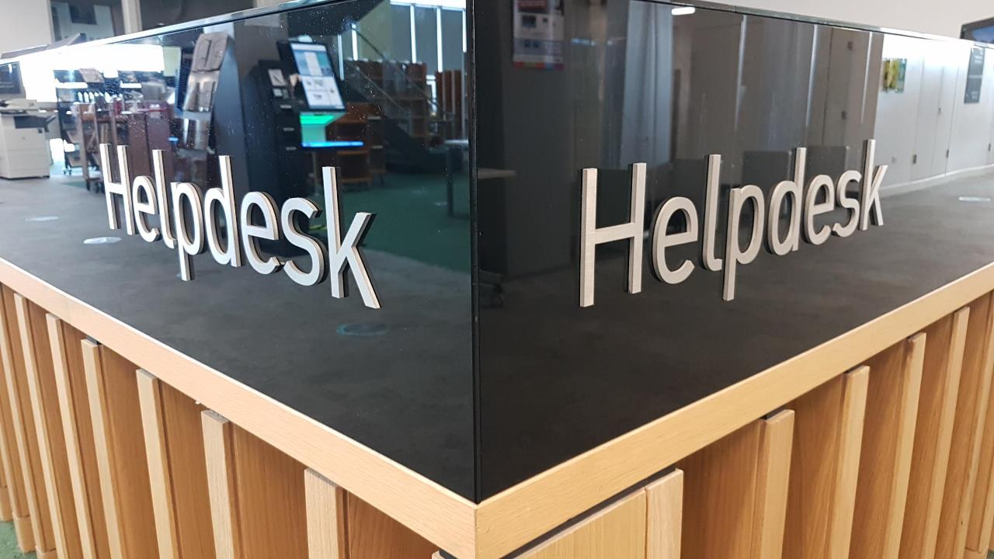
Supporting students on their 20/21 return to study
laura.percival@bcu.ac.uk

Slide 2
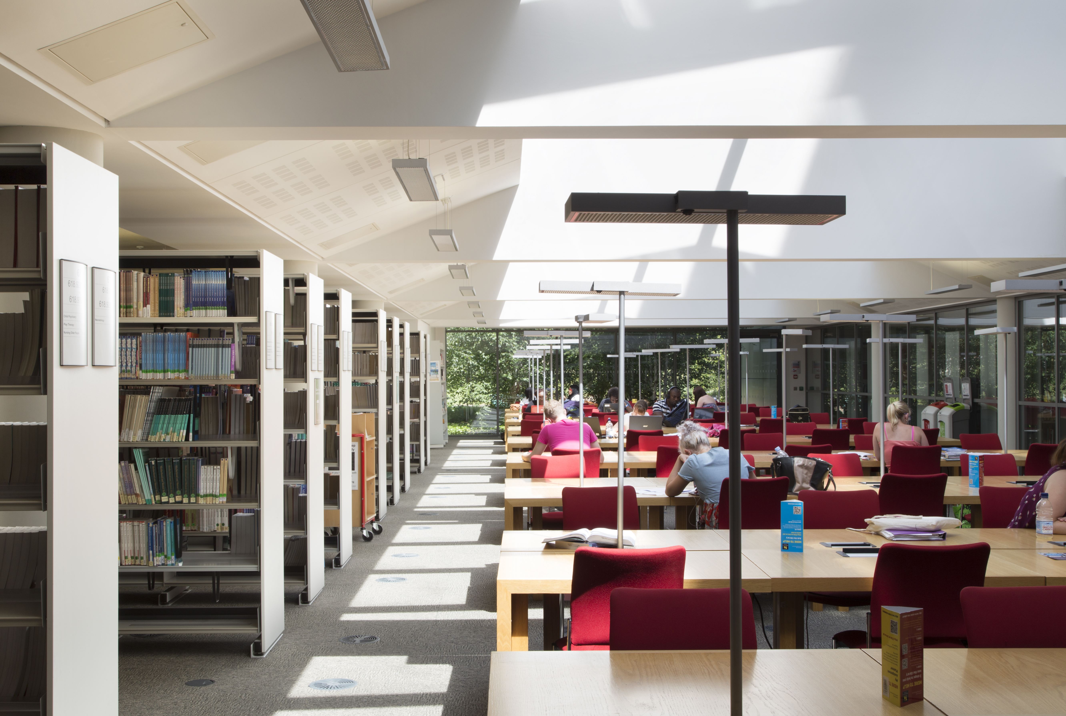
Birmingham City University
28,000 students
Multiple campuses
70% commuter students
50% face to face teaching in Semester 1

Slide 3
Priorities
Safe return to campus
Supporting students online
Circulation and access to reading materials

Slide 4
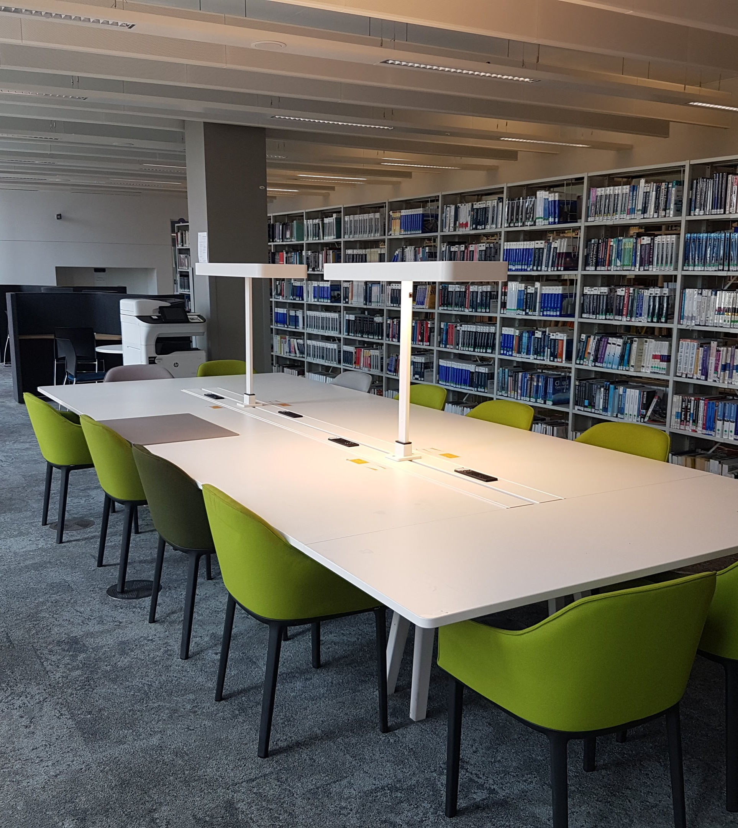
Safe return to campus
Socially distanced study spaces
Springshare Libcal Seats module for space bookings
35% capacity

Slide 5
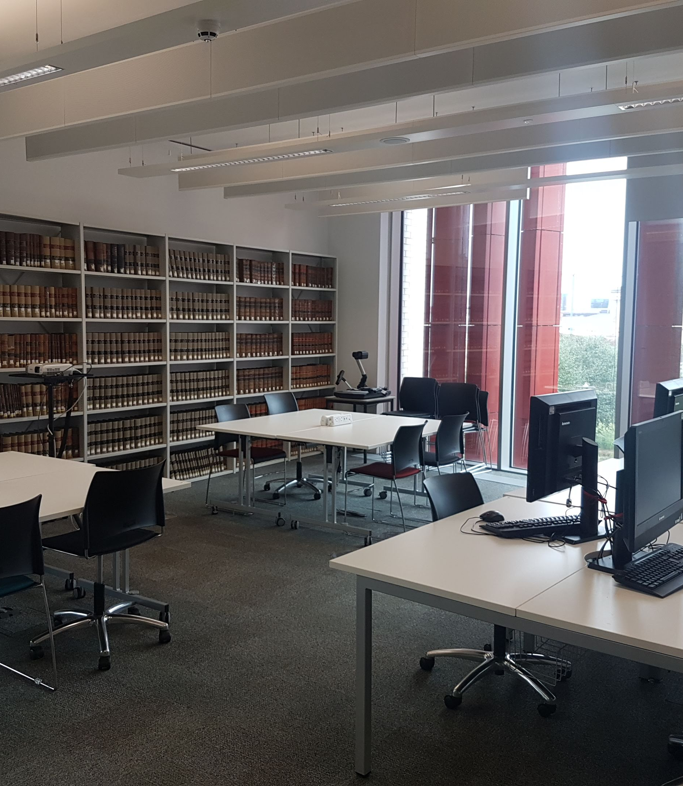
Safe return to campus
Cleaning in-between bookings – 3 hour study slots
Reducing footfall/contact where possible – autorenewals, no fines, external book boxes, and freepost returns for final years

Slide 6
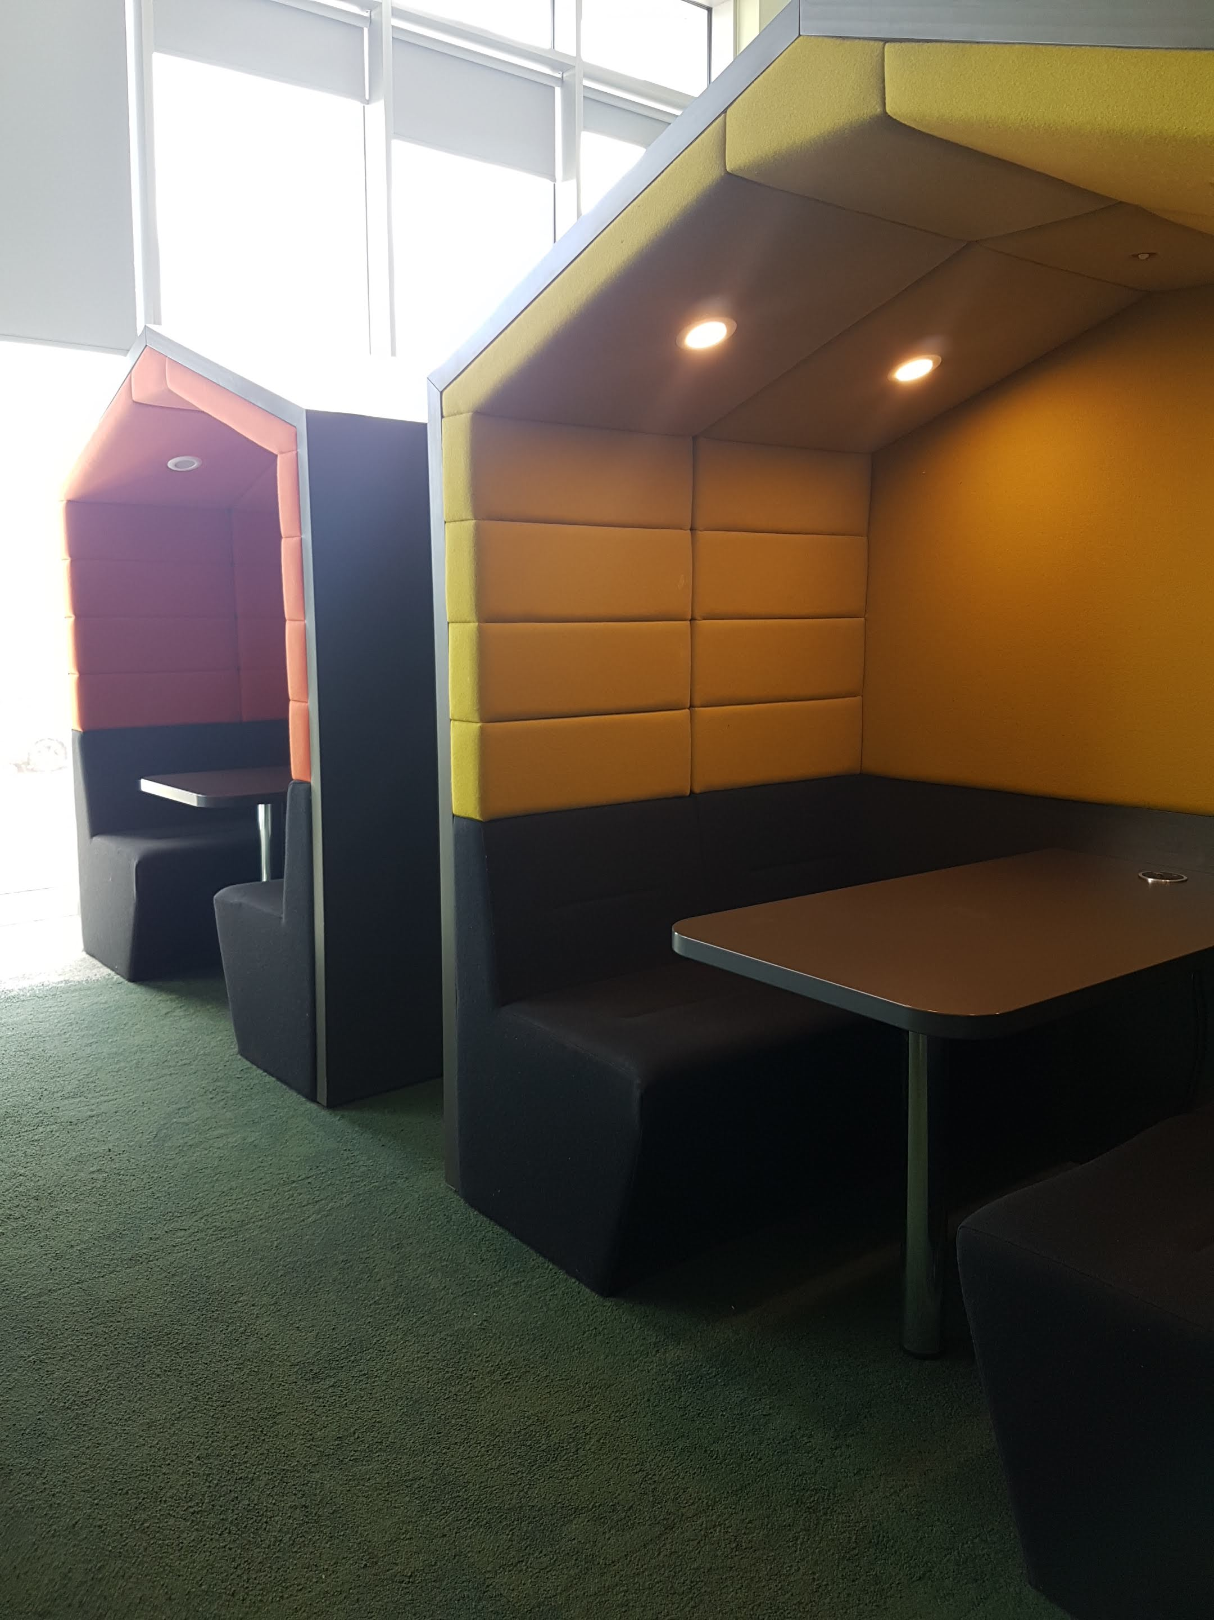
Safe return to campus
"I am grateful for access to the library during these difficult times. A quiet place to study when sometimes I can't get this at home."
"Thought the staff were really helpful and the amount of cleaning done makes it feel like a very safe place to study."
- Space booking follow-up survey

Slide 7
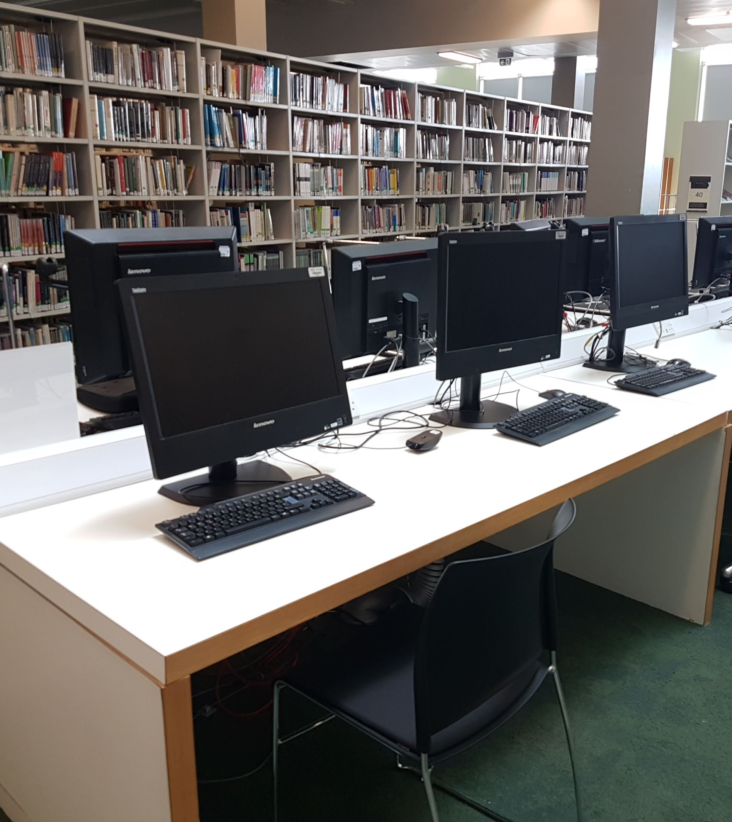
Supporting students online
24/7 chat with an expanded Customer Service Team
200% increase in virtual enquiries (Sept-Oct)
Online tutorials via MS Teams
Online workshops
Increased ebook purchasing and digitisation

Slide 8
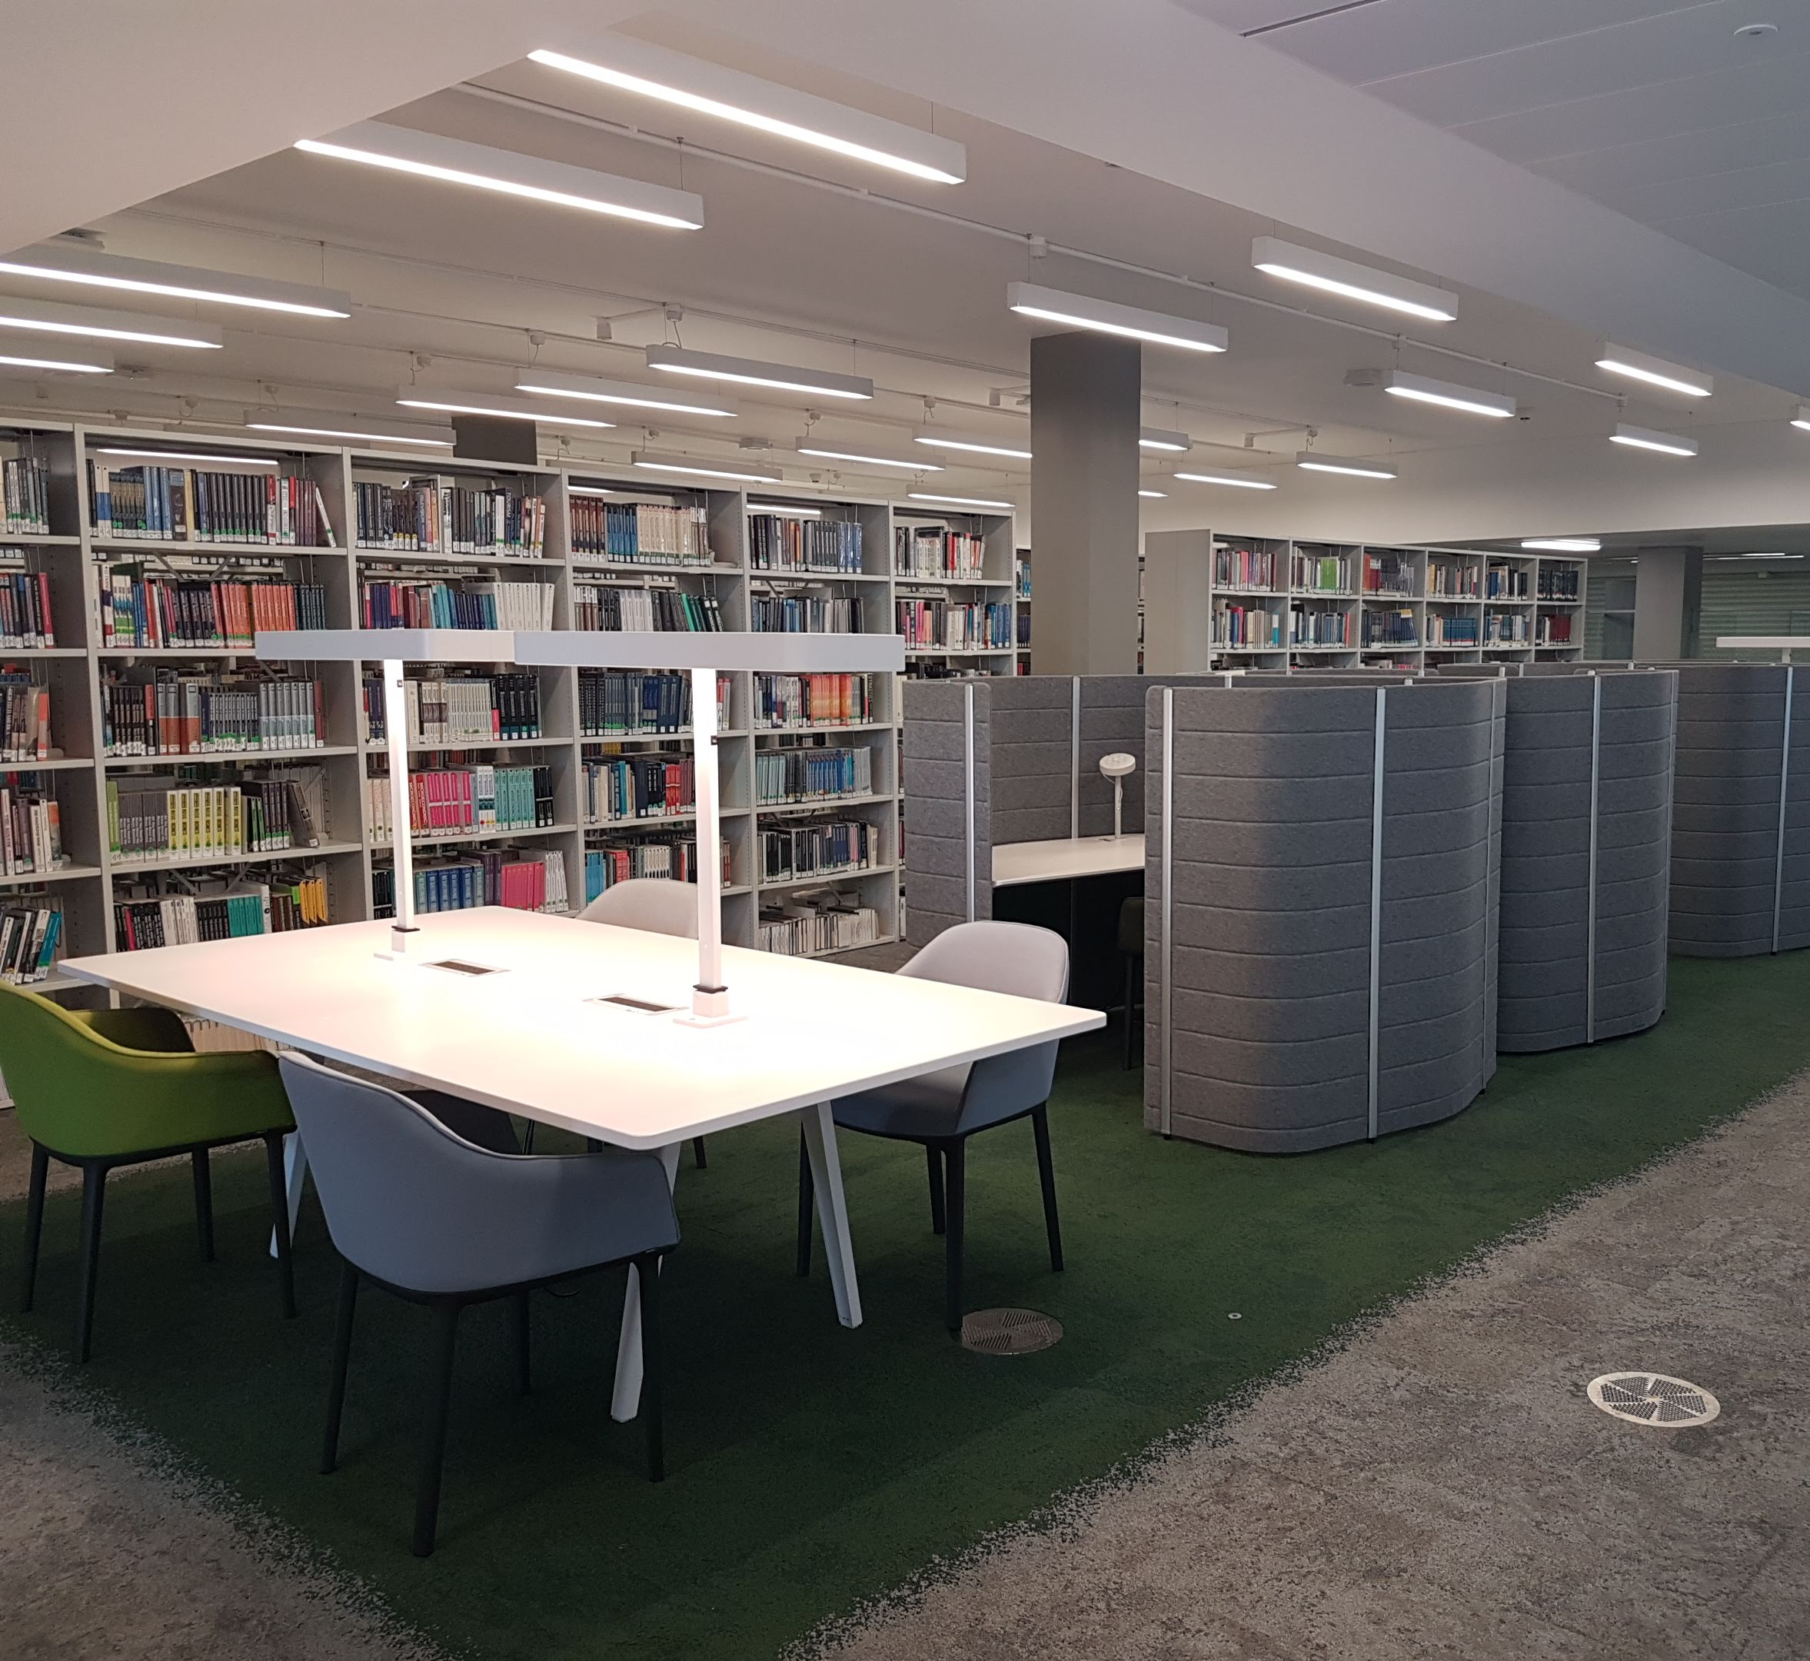
Supporting students online
"This really is an absolutely brilliant service. Especially at the moment where we're not in Uni- I would definitely be lost without it. You're all doing a brilliant job. Thank you for always being here!"
- LibChat comment

Slide 9
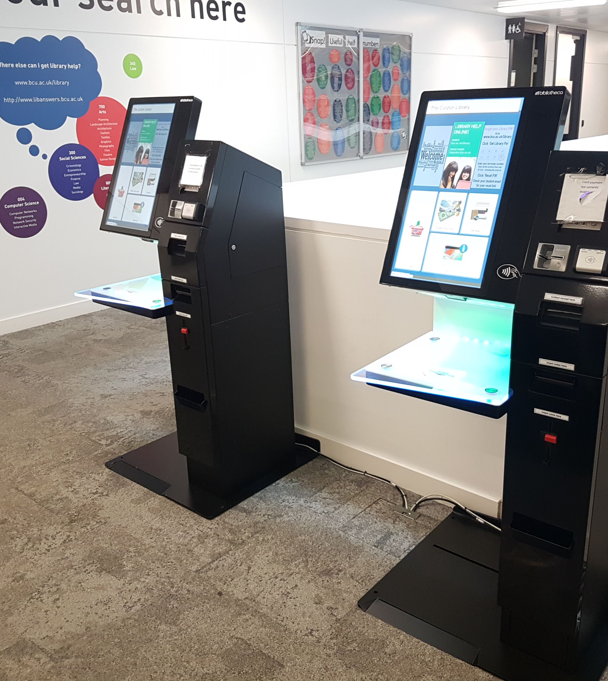
Circulation
Digital poverty = need for print resources
Click and collect
Browsing and self-service available to students who have booked a space
New, standard loan periods & autorenewals

Slide 10
Key takeaway: Be flexible!
We increased space booking allowances
We added some extra study spaces
We implemented click and collect at a smaller campus
We moved a collection point to a better location

Slide 11
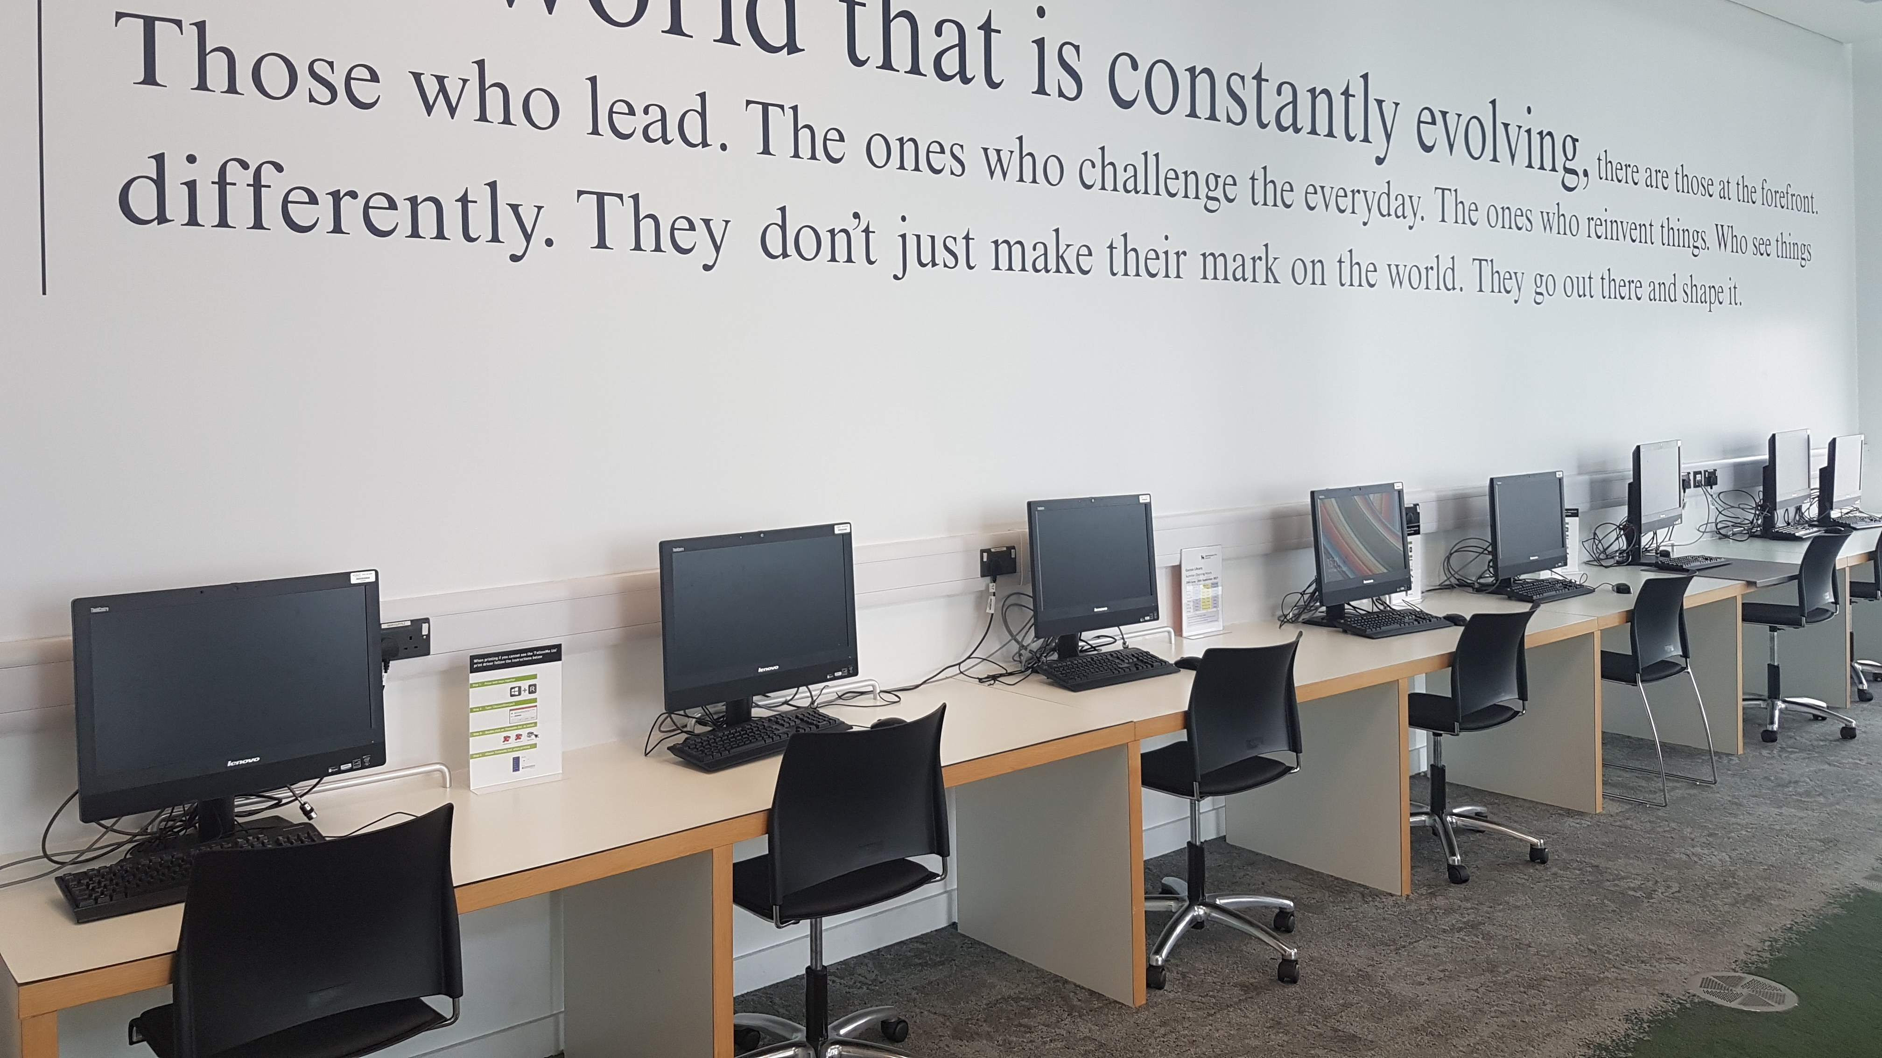
Thank you

