Slide 1
MENTAL HEALTH SUPPORT
Helping to support staff

Slide 2
AGENDA
Identifying the need for support
Planning provision of support
Delivering training

Slide 3
Staff in front line positions
Do our staff feel supported and confident to support service users?
Are we as a team ready for any situation?
How do we identify and close gaps in knowledge?

Slide 4
MORE STORIES TO TELL
Gather information from staff
"Tell us about your experience"

Slide 5
What about students?
Gather information from students

Slide 6
Building good open communication between front line staff and management

Slide 7
We have a plan!
Who has the know how to empower our team?
Can Student Services help us?

Slide 8
SPEAK UP AND ASK FOR HELP
Creating a space for inclusivity
Creating a culture of support and safety
Building a better relationship between the Library and other departments

Slide 9
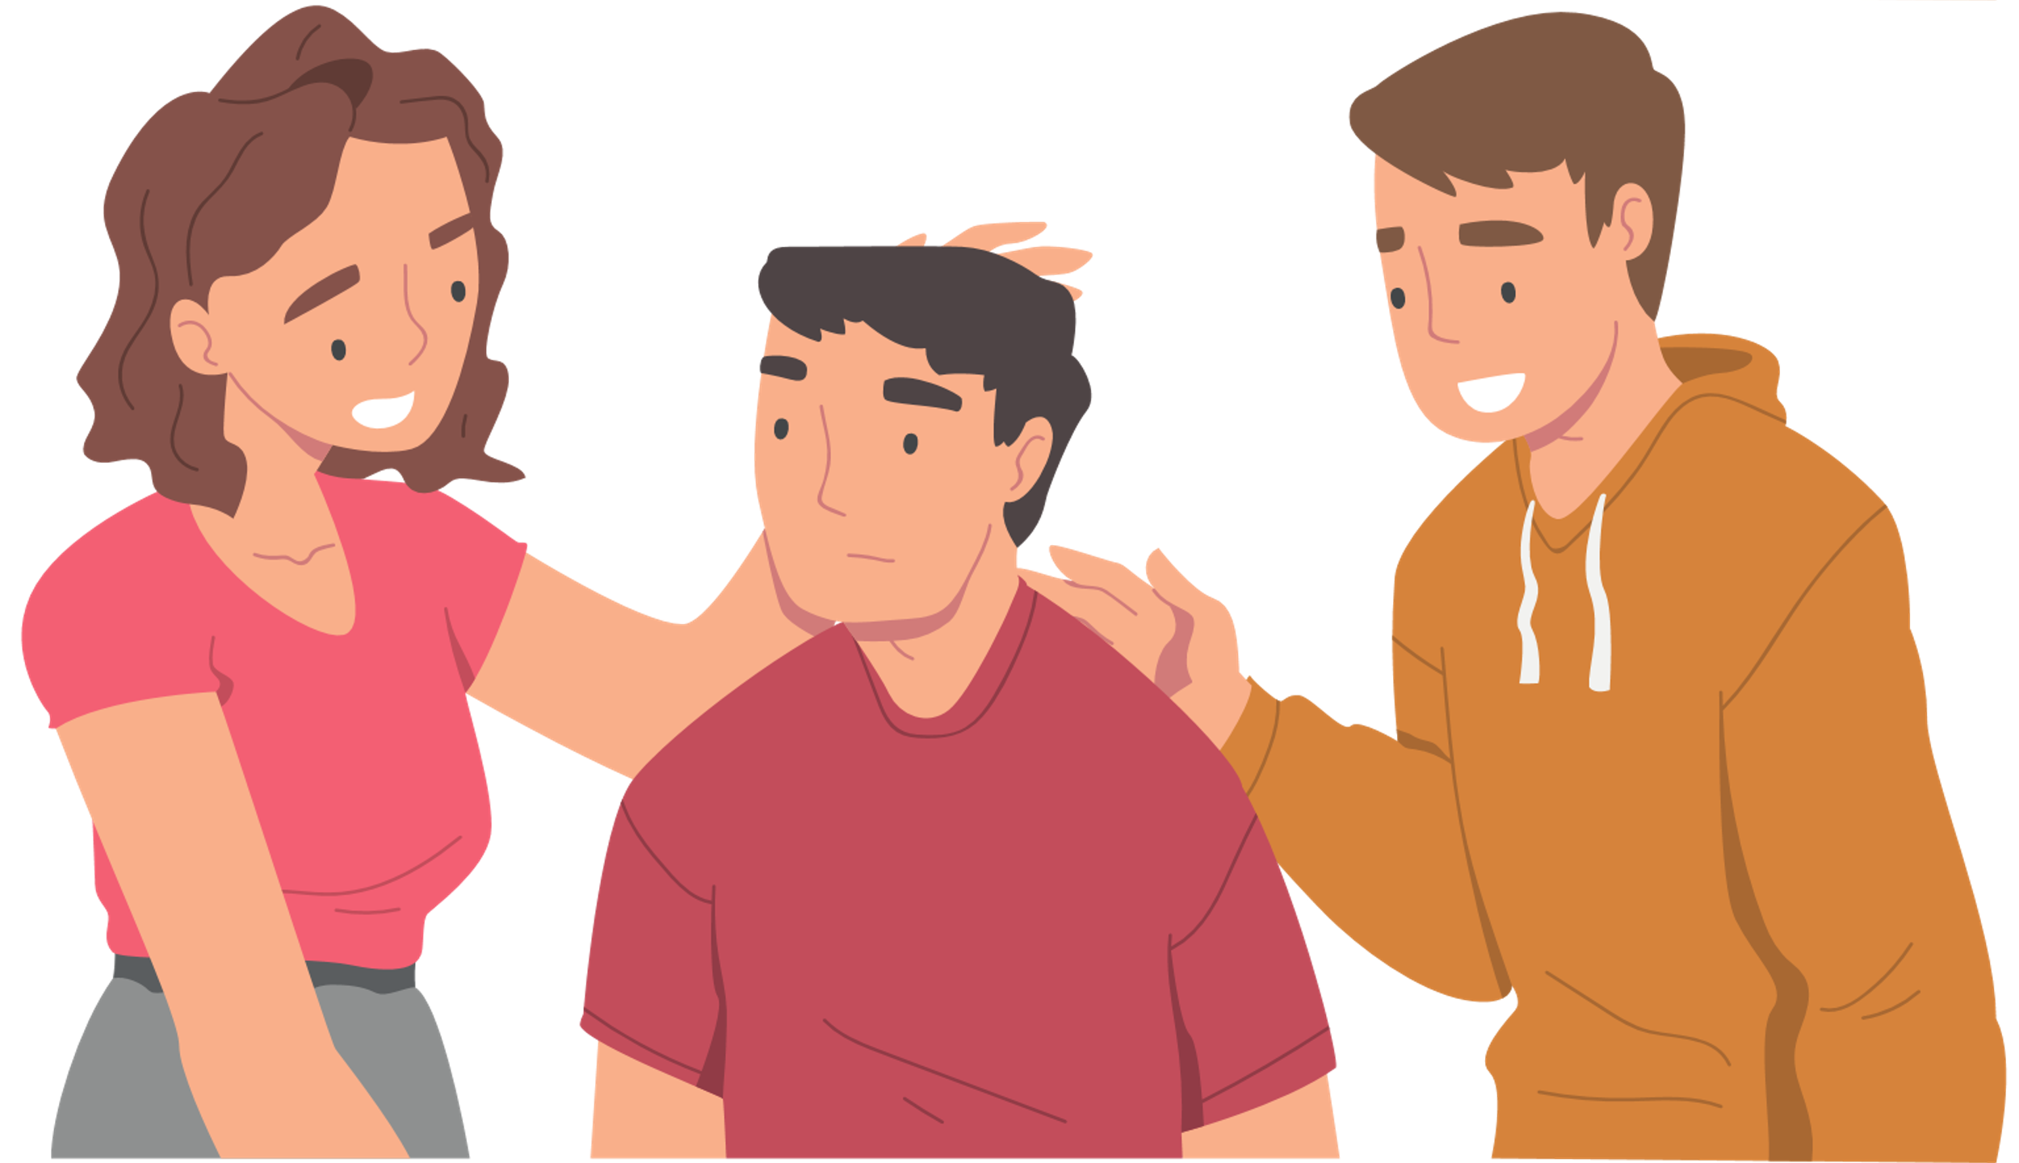
SUPPORTING EACH OTHER
Have a good team around you!
Encourage sharing of experiences
We know we are not alone :)

Slide 10
THANK YOU!
For allowing me to share this with you!

