Slide 1
Using frontline library staff experiences to develop customer service delivery during times of change
Rachel Dolan (Campus Library Manager) & Hattie Blenkinsop (Customer Services Team Leader)
University of Sunderland

Slide 2
Introduction
Huge physical estate developments across two campuses
Changes to Library spaces & service offers
Changes to staff & student groups
Customer support in an evolving physical estate

Slide 3
Changing frontline services
2016 | 2023
35 Library Assistants & 2 shelvers 2 Library sites (11,538m²) Number of students (HESA) 10542.8 15 borrowable student laptops 323,267 print items Top 3 enquiries: Book / Print / Reservation | 16 Customer Services Assistants & 2 students 4 Library sites (5,982m²) Number of students (HESA) 14575.5 324 borrowable student laptops 243,580 print items Top 3 enquiries: PIN / Laptop / Library

Slide 4
Importance of frontline staff experiences
Frontline staff B2B interaction is a key wider service aim
Keen to use our team’s expertise & experience
How to encourage engagement?

Slide 5
Integration of student experiences & feedback
Collaboration & engagement
Recognisable & user-friendly channels
Student Peer Support Assistants work as part of our team

Slide 6
Increased importance of data to show impact
Live chat continues to be our most popular communication channel

Slide 7
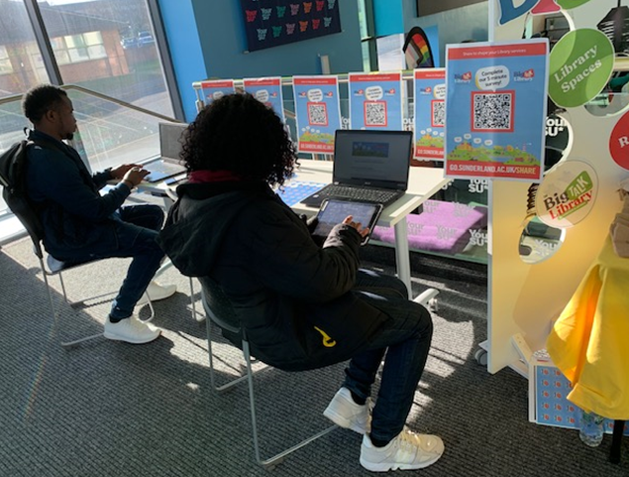
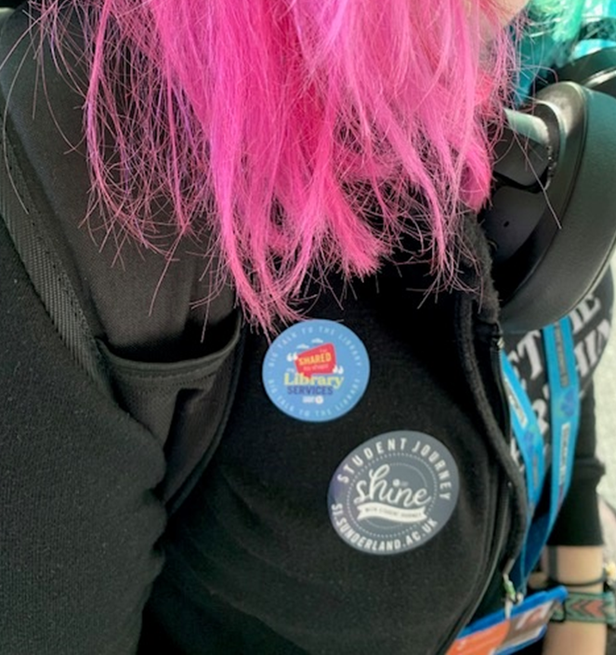
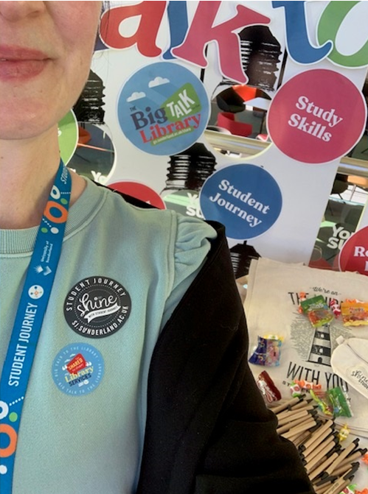
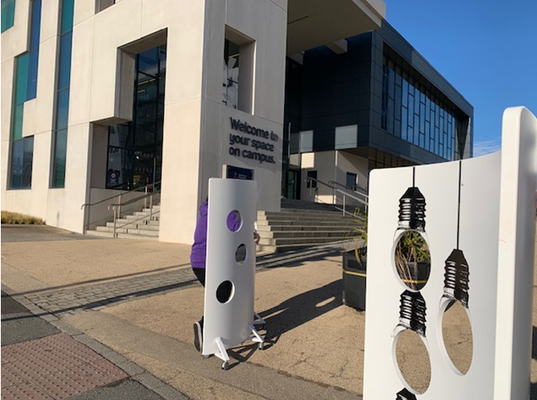
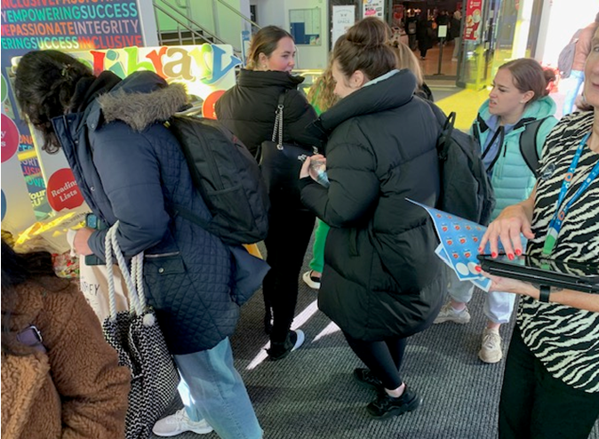
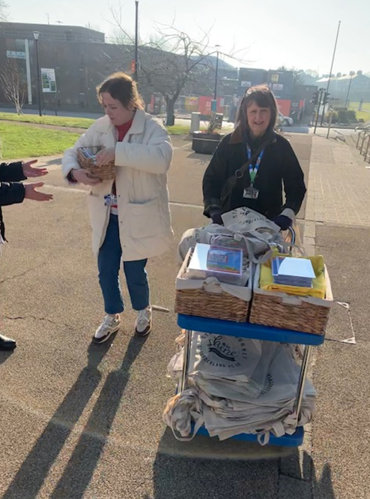
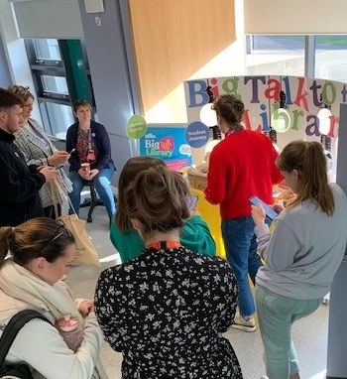
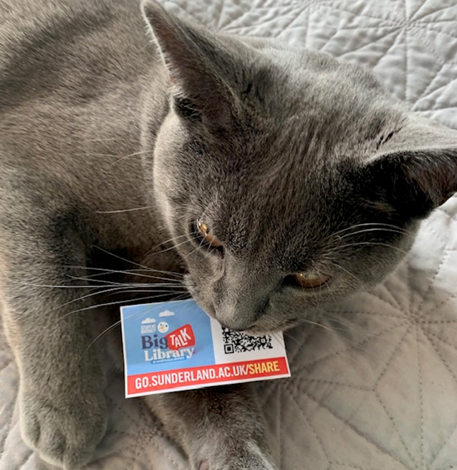
Big Talk 2023
2063 responses from students

Slide 10
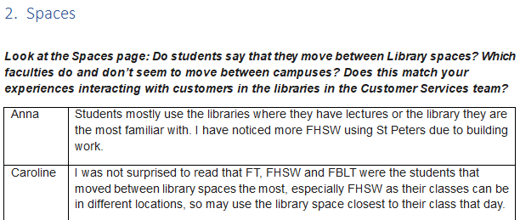
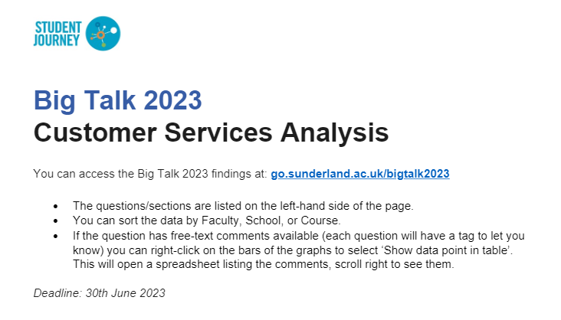
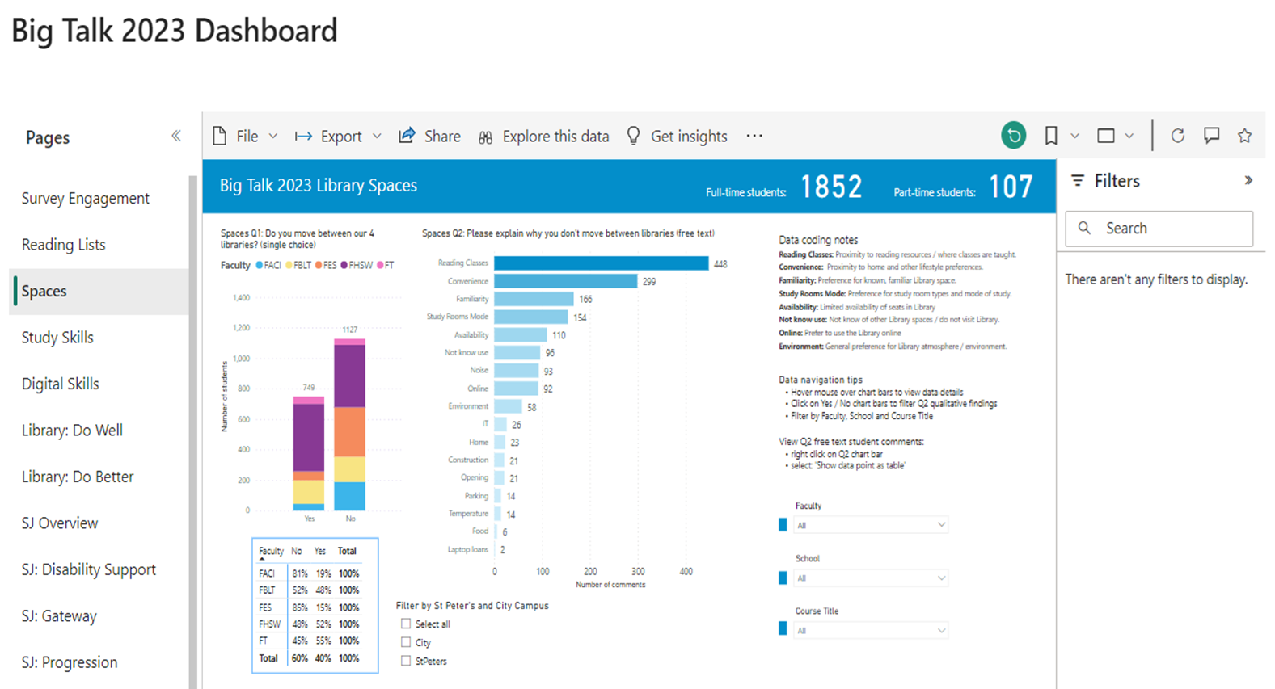
Frontline staff analysed data
Pulled into a PowerBI dashboard
Spaces – promotions – digital skills

Slide 11
Acting on the results of our team’s suggestions
Spaces promotion designed by our team
Support for common digital skills issues
Recruited additional Student Peer Support Assistants

Slide 12
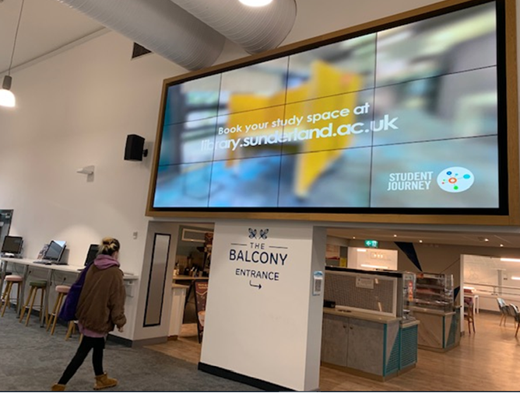
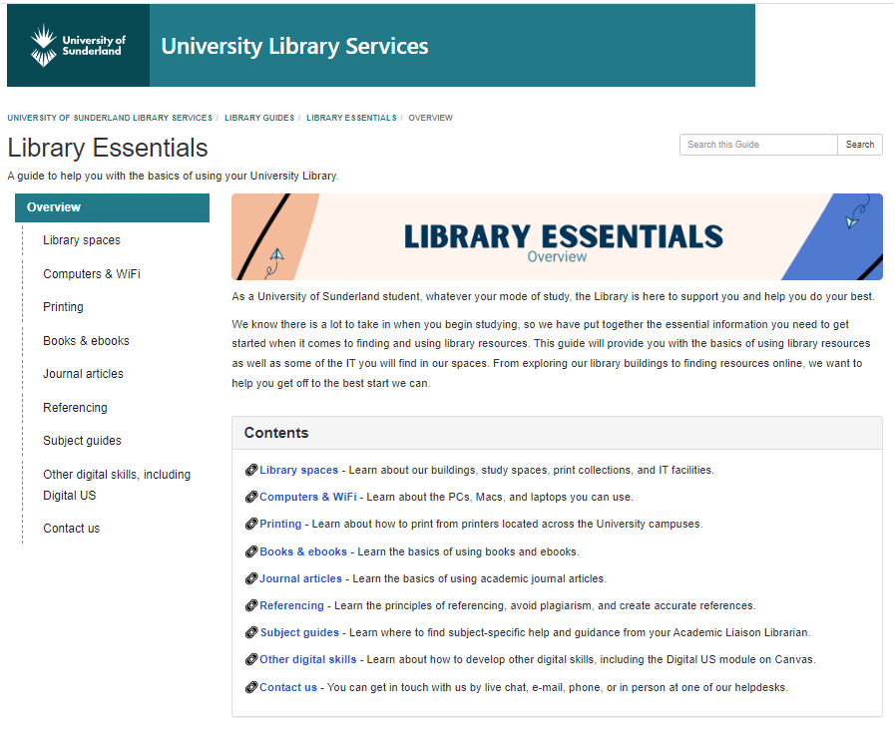
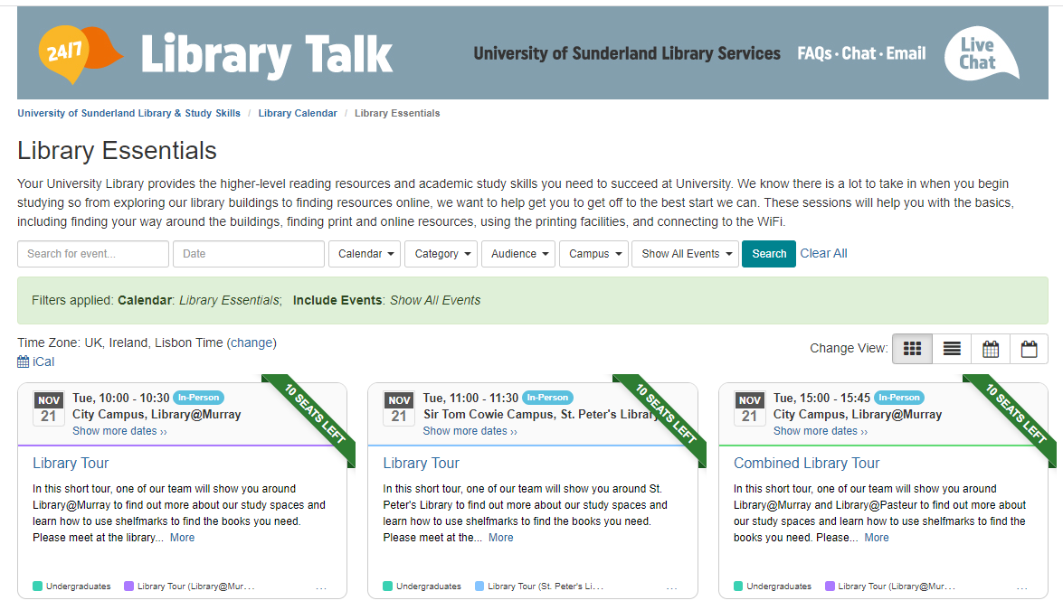
Customer services-led spaces promotion Digital signage Library Essentials guide Library Essentials bookable tours

Slide 13
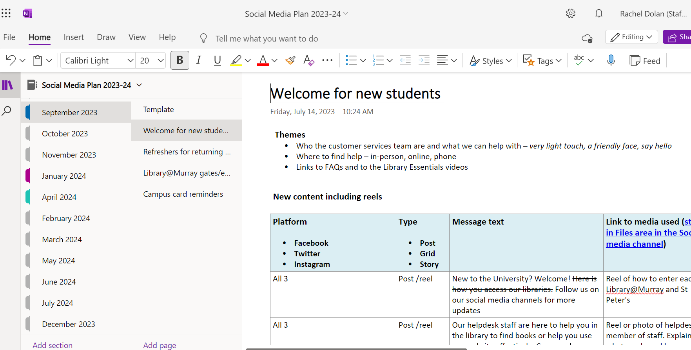
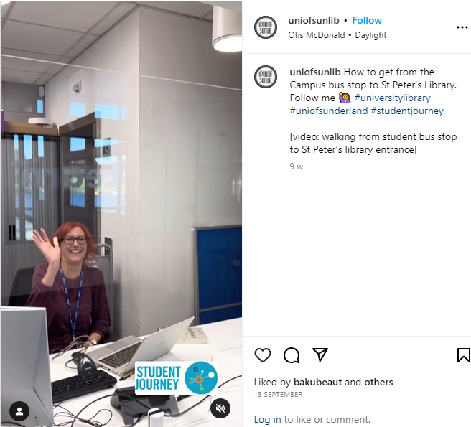
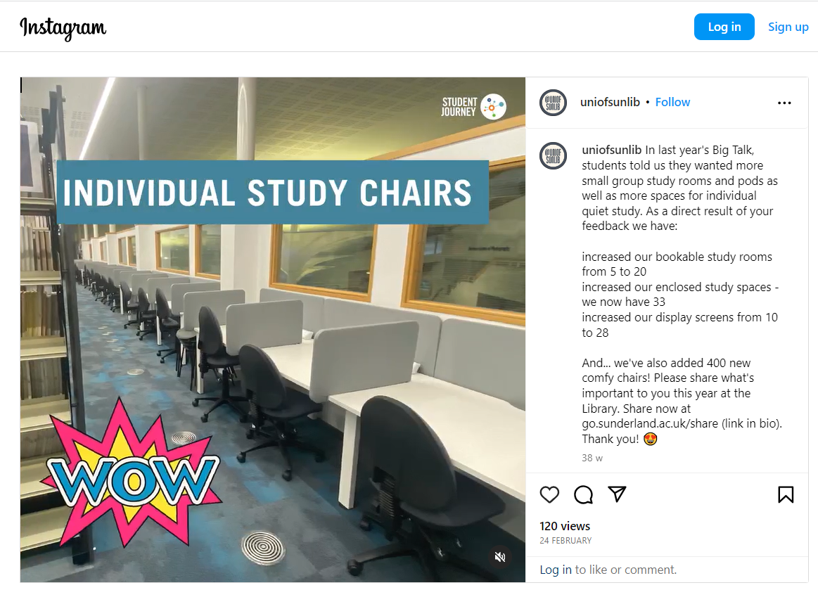
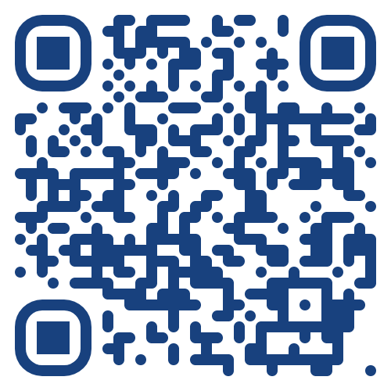
Customer services-led spaces promotion Social media campaign

Slide 14
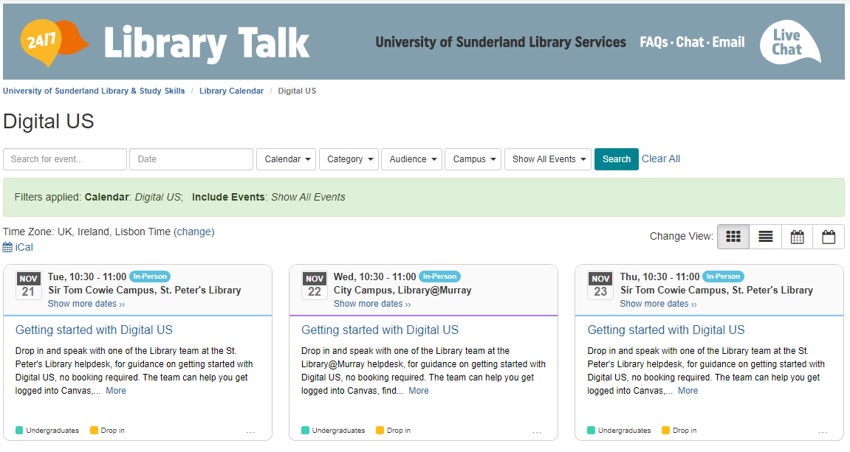
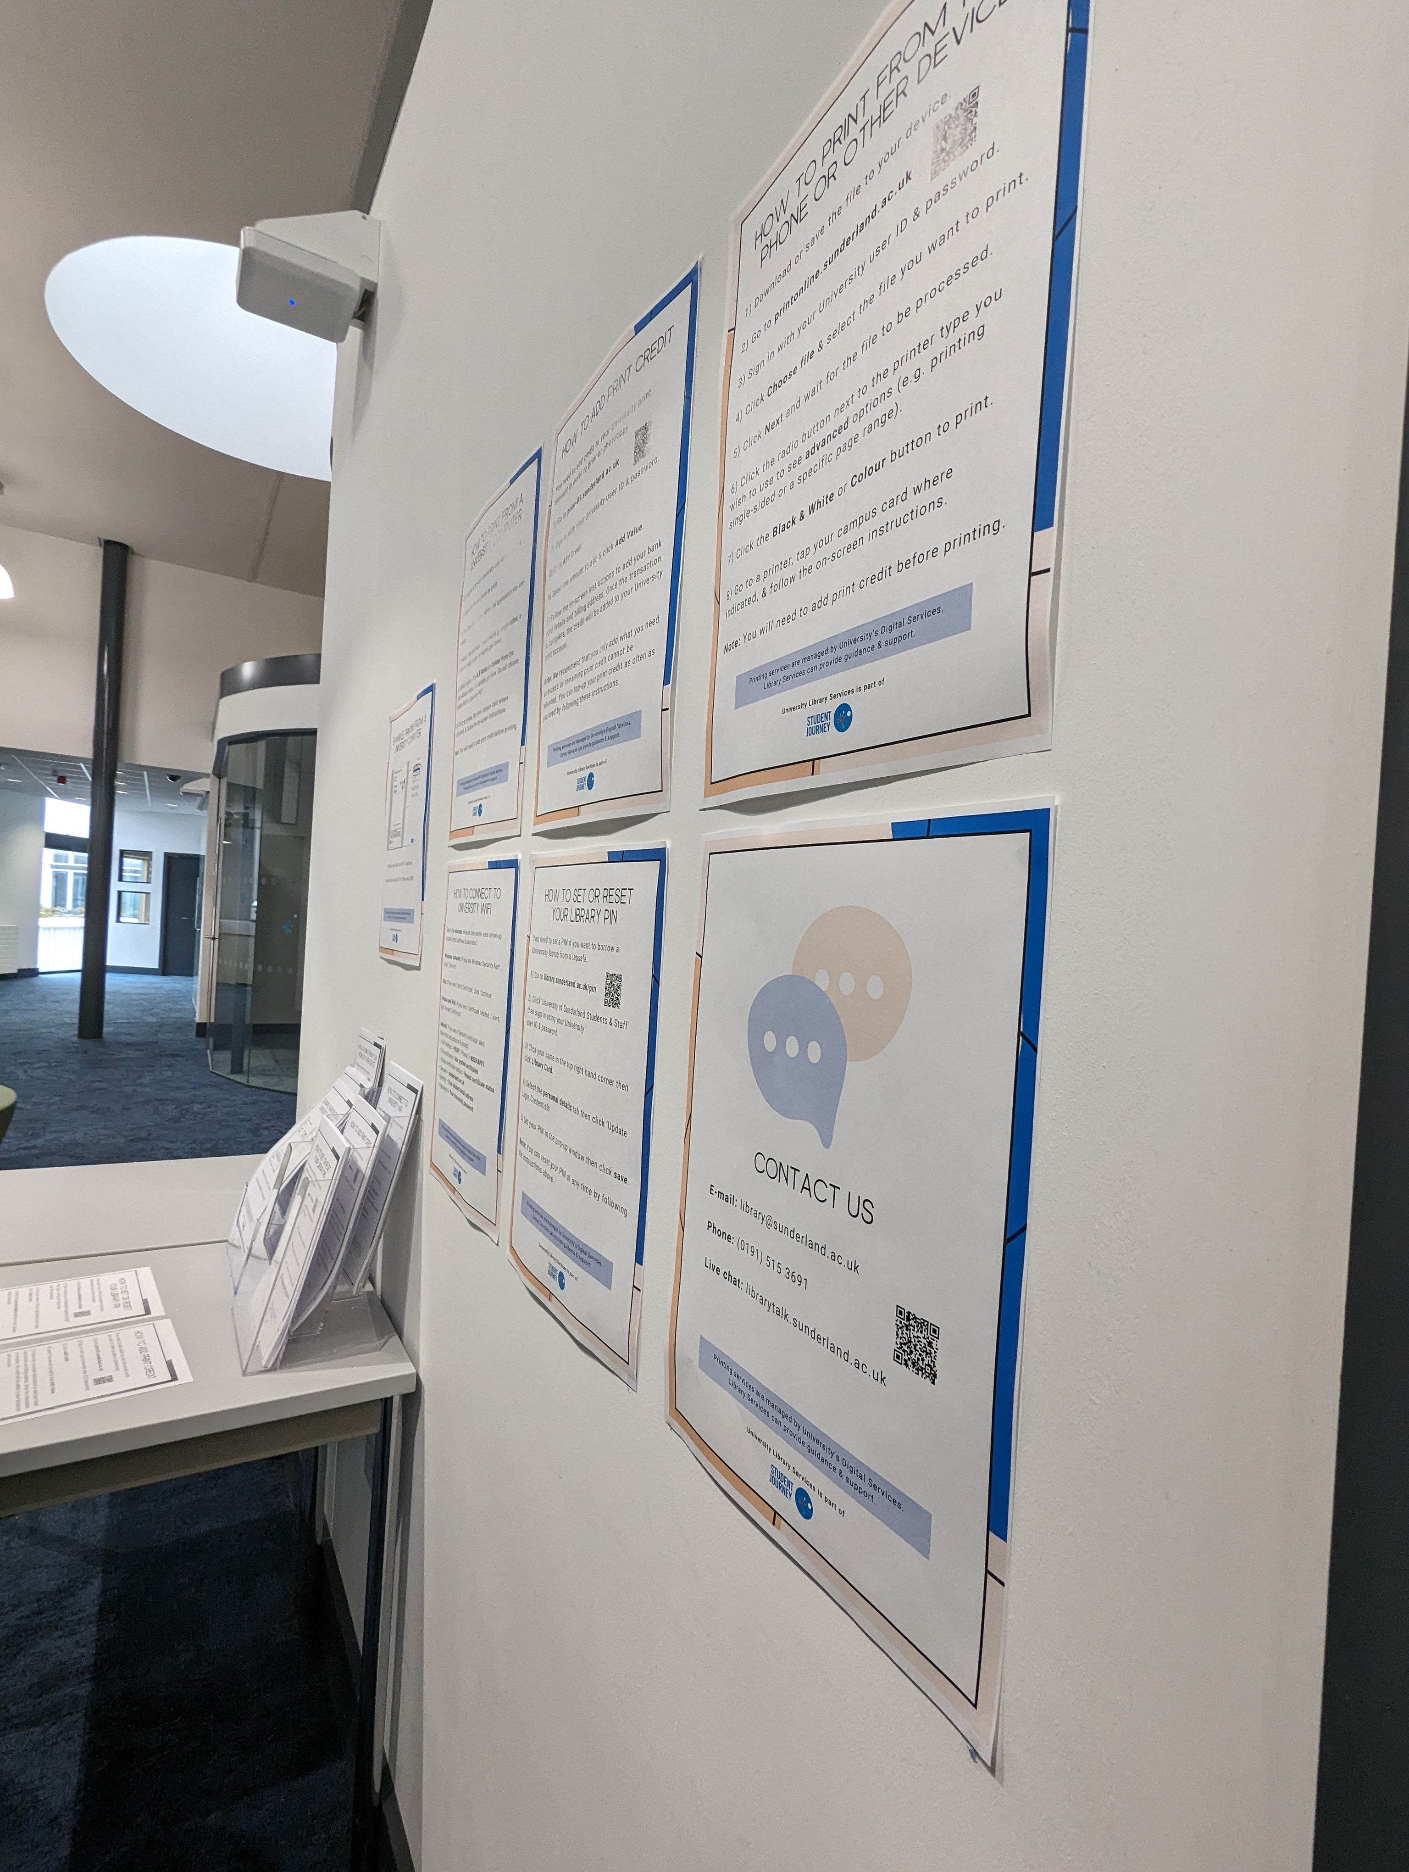
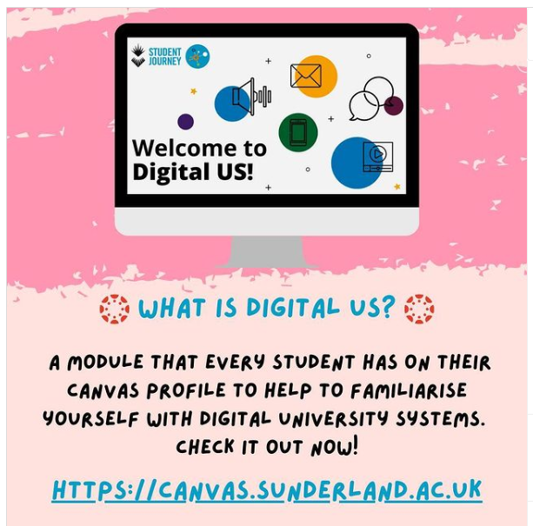
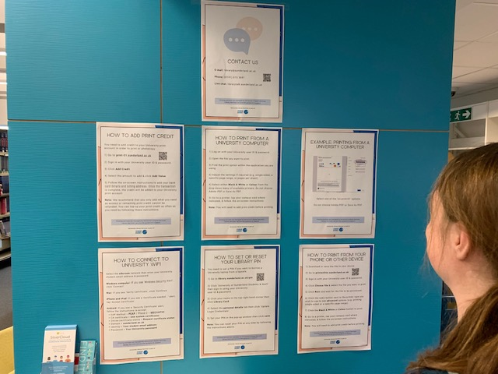
Support for common digital skills issues Digital support drop-ins Visible step-by-step signage & guides

Slide 15
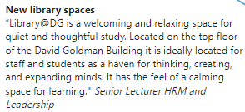
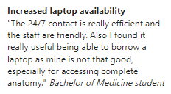
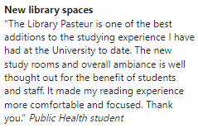
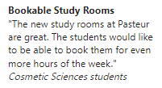
Impact of this approach Comments from staff & students

Slide 16
Adapting to ongoing changes
3-year building project to begin in 2024
Growth of the ‘Health Campus’
Further reduction in print stock
Library becoming central for English language support

Slide 17
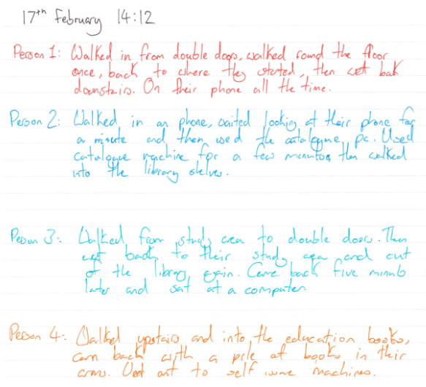
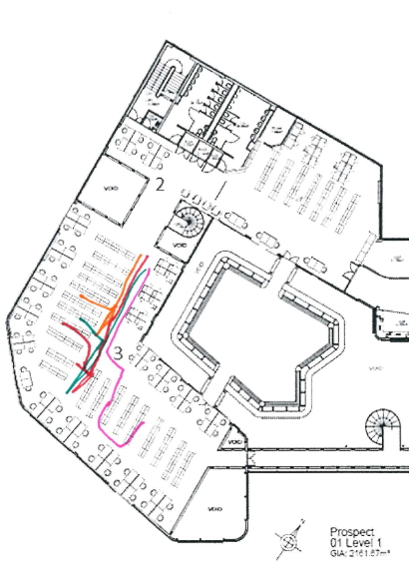
Study of student behaviours in the Libraries

Slide 18
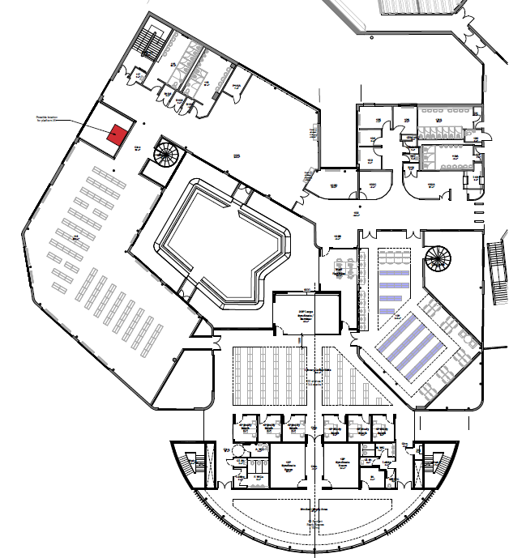
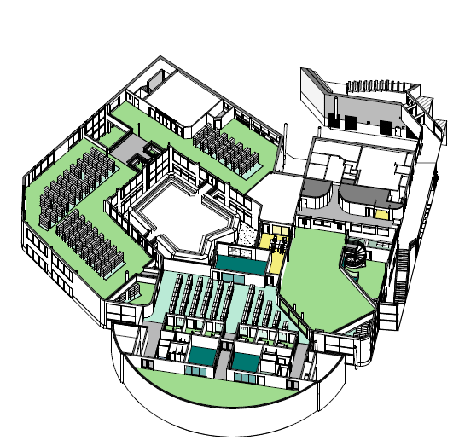
Planning collection
layout & signage

Slide 19
Activity
Turn to the person next to you - how do you use staff and student insights in your libraries?
Do you have any ideas we can steal? 😅

Slide 20
Conclusion
Ongoing collaboration
Push & pull between pragmatism & innovation
Change is now – all the time!

