Slide 1
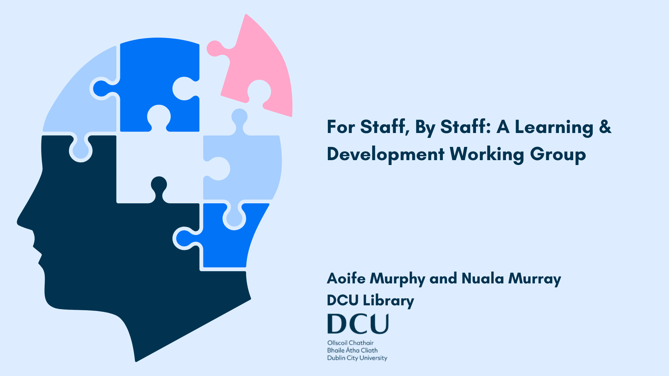

Slide 2
DCU ranked as Ireland’s Top Young University and 59th globally (Times Higher Young University Ranking, 2024)
DCU ranked in the top 400 universities worldwide (Times Higher Education World University Rankings)
DCU ranked 1st in Ireland for Student experience at the Education Awards 2022
DCU ranked 1st in Ireland and 23rd in the World for Graduate Employability (QS Graduate Employability Rankings, 2022)
DCU Business School ranked in the top 1% of business schools globally

Slide 3
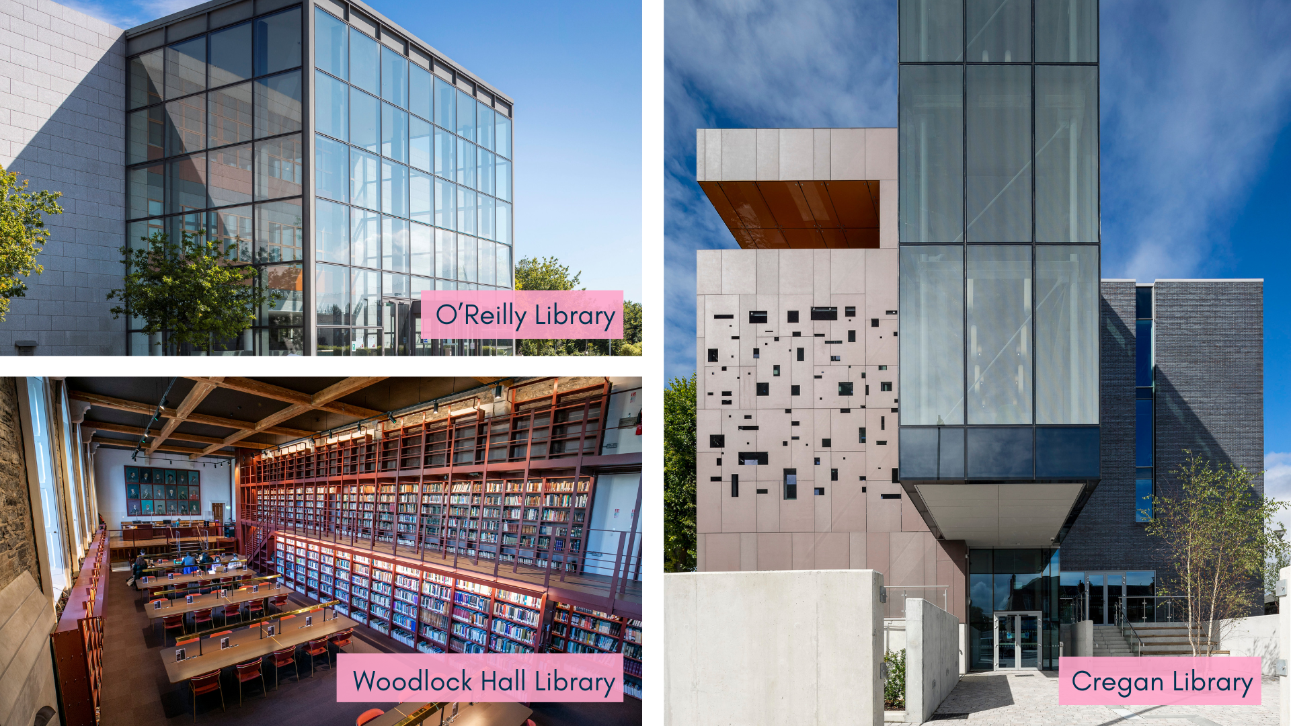

Slide 4
Evolving Tomorrow’s Skills Today
Soft Skills - Flexibility, Self-Confidence, Self-Motivation and Resilience.
ALA list ‘lifelong learning and continuing education’ and ‘technological knowledge and skills’ in its core competencies (ALA 2022)
‘From public perception of library as place to collections, services, and modes of instruction or information delivery, virtually every aspect of library operations has undergone significant transformation—all in order to meet the information and learning needs of increasingly diverse library service communities’ (Trembach 2024 p. 148).

Slide 5
LDWG: Aims and Objectives
The LDWG was created in order to ‘support and promote a culture of continuous learning that facilitates the ongoing development of the skills, knowledge and expertise of all staff’.
Identify common L&D needs that could be effectively addressed at an organisational level
Empower library staff to enhance personal growth and advance their professional skills
Be champions for, and promote the development of a supportive L&D culture within DCU Library
Advise the Library’s Leadership Team on matters relating to staff learning and development

Slide 6
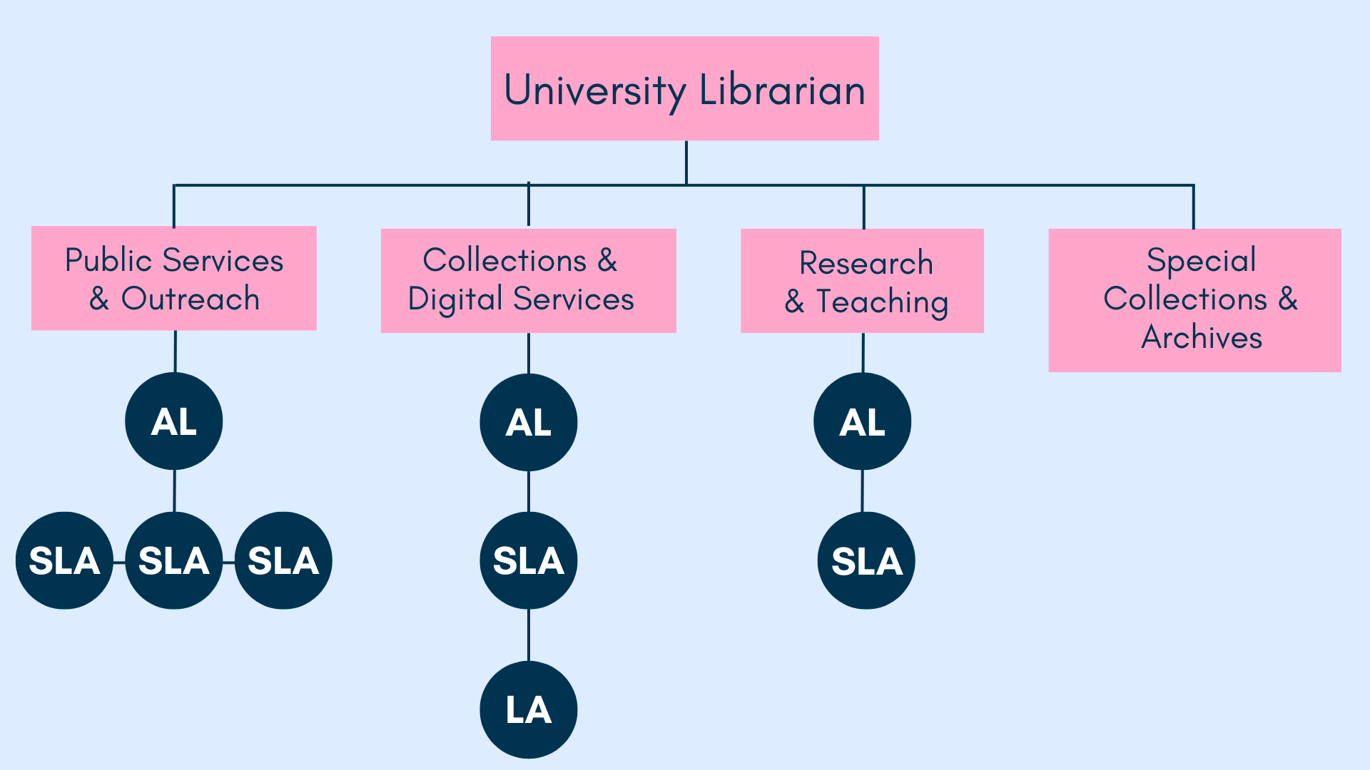

Slide 7
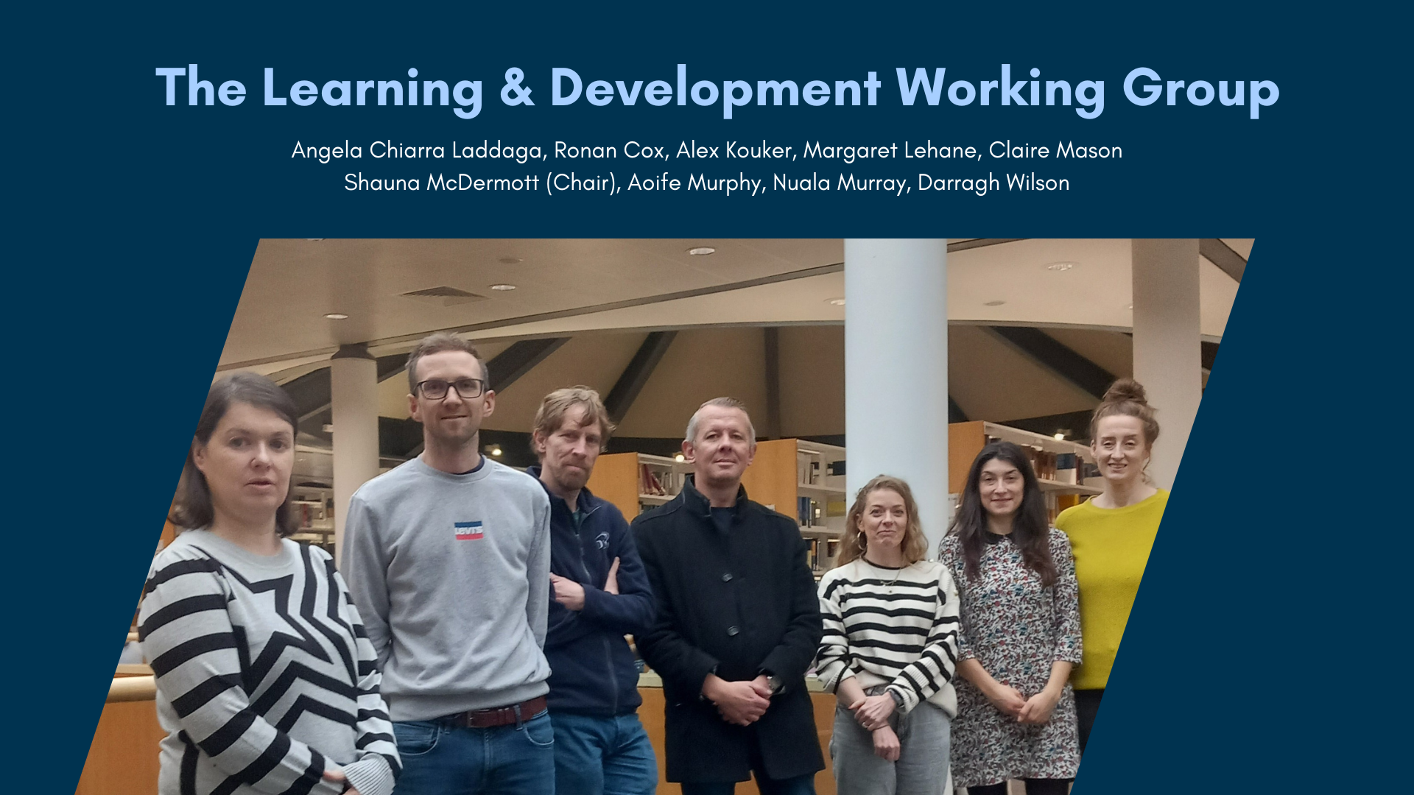

Slide 8
Functions of the LDWG
To organise, coordinate and promote appropriate Library L&D opportunities including but not limited to:
Reviewing and updating the Library’s induction programme for new staff
Organising an annual staff learning at work day
Organising in-house opportunities for staff to learn about the work of other Directorates (staff shadowing)
Organising opportunities for staff to report on and share learnings from course work, conferences or seminars attended e.g. brown bag lunches, online meet-ups etc
Review DCU LinkedIn Learning resources and promote to all staff
Create a central repository for L&D resources accessible to all staff

Slide 9
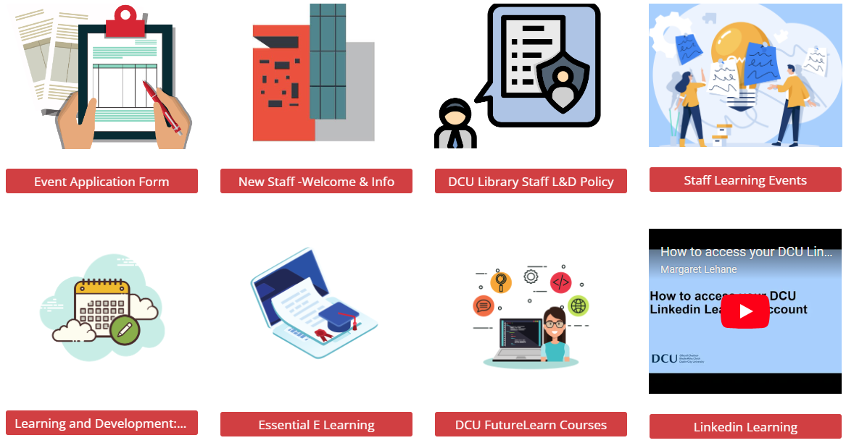
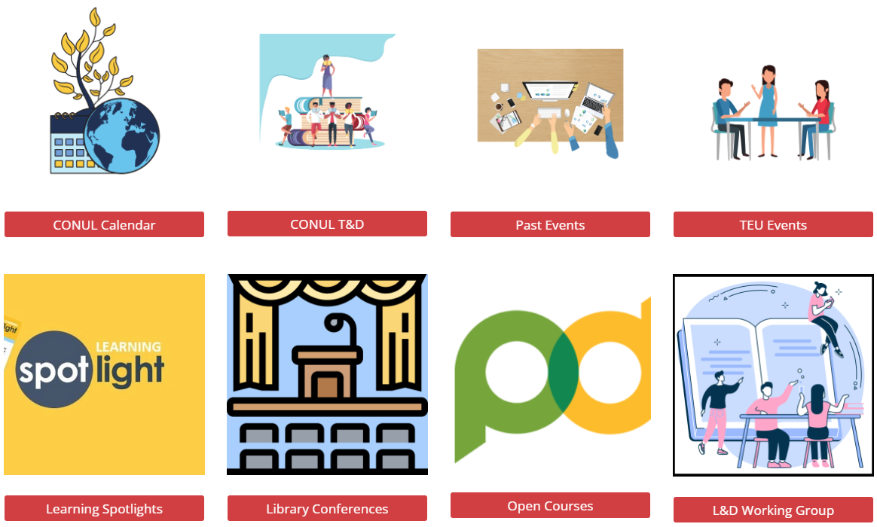
STAFF LEARNING & DEVELOPMENT

Slide 10
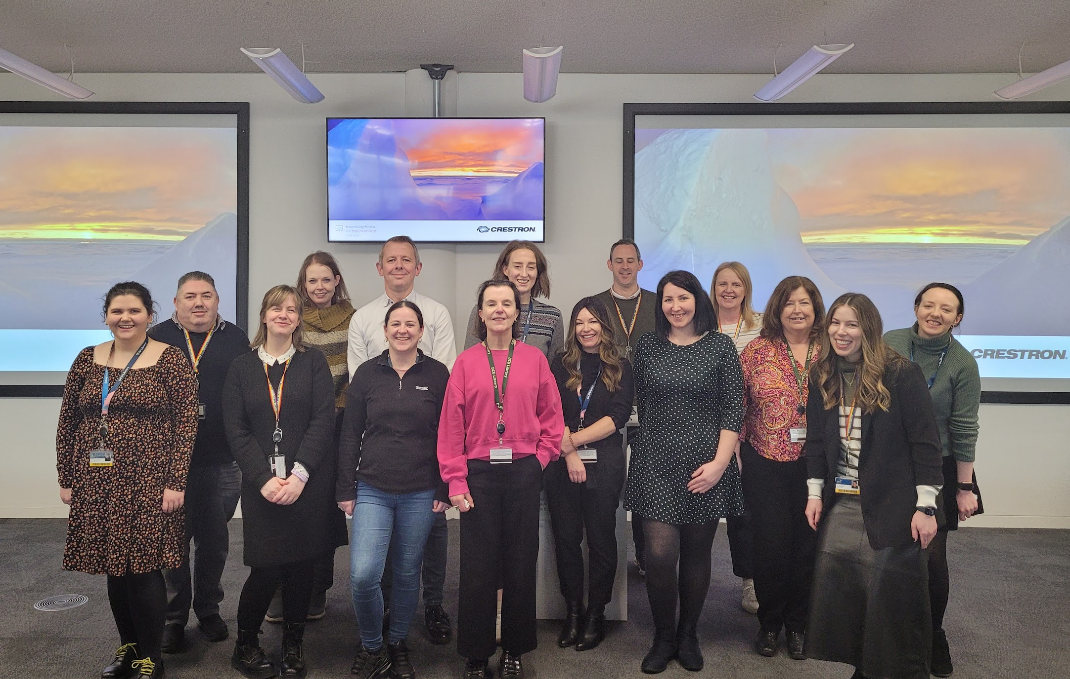
Staff Learning at Work Day
“A great way of learning about other projects and departments”
“The relaxed, social atmosphere definitely helped calm some nerves”
“A fantastic stepping stone into public speaking”
“ It was nice to be able to present in public again, having not done so for some time…A thoroughly worthwhile experience”
Preparation: staff invitation, resource guides & workshops, peer-to-peer support, run through practice.
Eight submissions, featuring a mix of solo and co-presenters.
A diverse range of topics showcasing various projects and initiatives within the library, including resource management, data collection, history and mental health.
“I am confident that I would be able to present again and it was a fantastic opportunity to hone my skills”
“A safe space…this should be an annual event”

Slide 11
Staff Questionnaire
62.5%
A short questionnaire was designed to gather feedback which will guide improvements in the DCU Library induction programme.
Reported a positive induction experience, finding the information provided clear
Target Group: New staff hired in the last 12 months
Design: 8 questions, combining closed and open-ended formats:
Closed Qs: Yes/No, Likert scale, multiple choice
Open Qs: encourages personalised feedback
Pilot Testing: A preliminary survey was tested internally within the LDWG to refine phrasing and format
Participation: Voluntary and anonymous
Outcomes and Recommendations: Directorate specific Induction packs, continue on an annual basis and explore the introduction of a buddy system
70%
Expressed that a buddy system would be beneficial

Slide 12
Future Initiatives
Staff Buddy System
Each new employee will be paired with a current staff member for guidance and support as they settle into their role.
Staff Shadowing
Staff have frequently shown interest in learning about other directorates, and job shadowing provides an opportunity to explore potential new roles by observing colleagues in action.
Sue Miller Bursary
Established in memory of our late colleague, and offers an annual grant for a colleague to attend a UK or European conference or seminar.

Slide 13
Challenges
As a newly formed group, we are effectively learning as we go. The primary challenges we’ve encountered so far include:
Scheduling: Coordinating group meetings, especially in person, has been challenging with staff spread across multiple sites, working remotely, and on different shift patterns. Hybrid meetings have been an effective solution to accommodate everyone’s availability.
Balancing Workload: Managing regular duties alongside new development responsibilities has been challenging. Although we're enthusiastic about new initiatives, we've learned that each one requires significant time and planning. To stay realistic, we’ve agreed to limit new initiatives to two per year.

Slide 14
Reflections and Future Aspirations
Strengthening Relationships Across Directorates
An enjoyable experience that fosters social interaction among colleagues who don't typically work together, strengthening both personal and professional relationships.
Shaping a Culture of Continuous Learning and Support
It's exciting to be part of a group entrusted with such responsibility and to play a role in shaping a culture of continuous learning and support.
Leadership Support
The leadership team has recognised our achievements to date, setting a strong foundation for the creation of more peer-led groups within the library.
Long-term Vision
We are committed to continually championing internal talent, promoting ongoing learning, and fostering a collaborative learning culture for the future.

