Slide 1
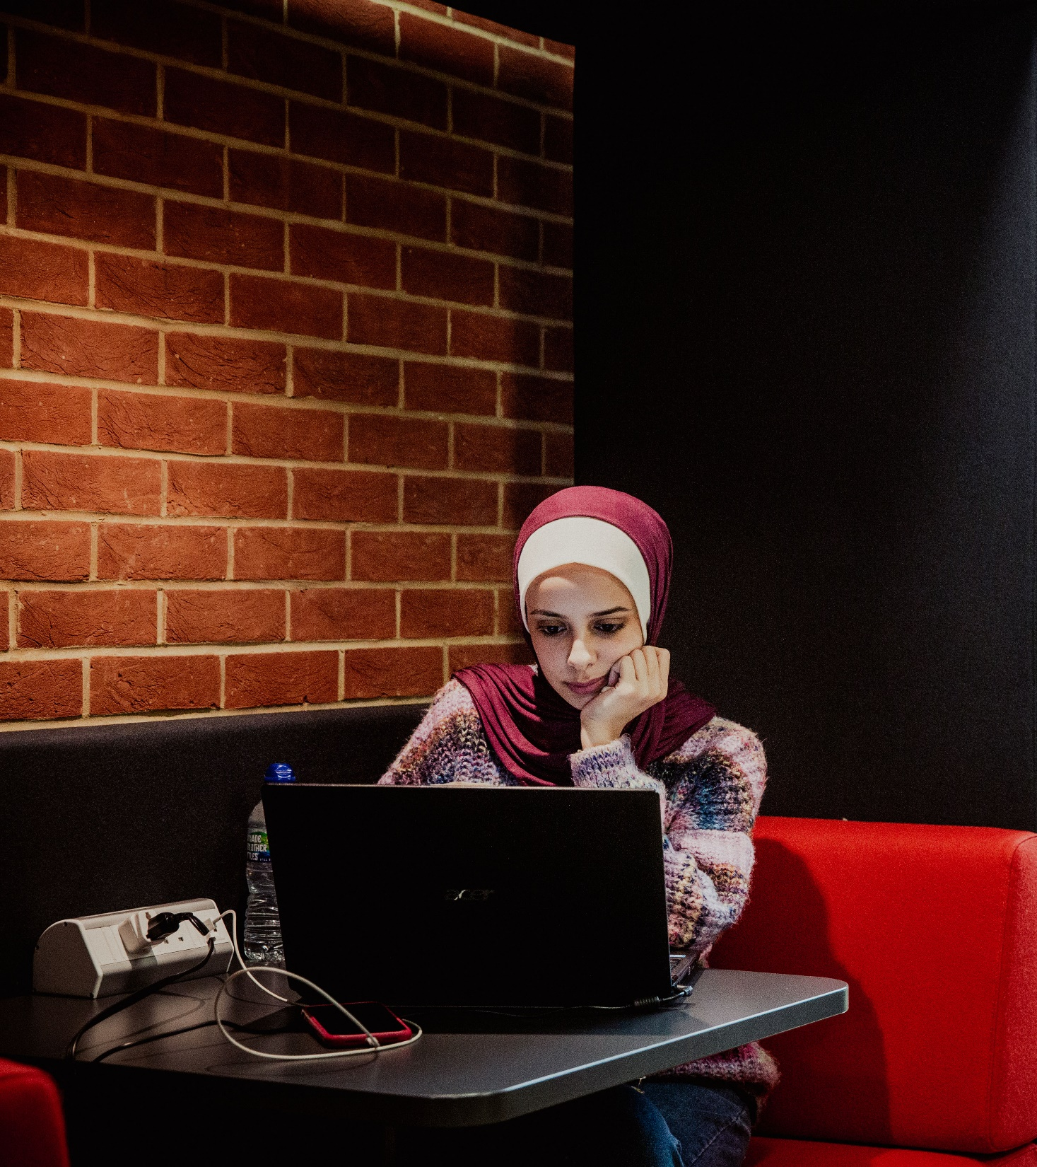
Implementing a whole-library chat service
Ant Groves and Sean Goddard
University of Sussex Library

Slide 2
Background
Library Chat service since 2012, open to all
LibAnswers, Bailey Enquire, Olark
Historically staffed by LATS Team, Mon-Fri

Slide 3
March 2020
Mon 16th – 3 extra licenses purchased
Tue 17th – Chatbox added to 60+ pages
Thu 19th – Training begins for other staff
Fri 20th 5.30pm – Library building closes

Slide 4
Supporting staff
22 training sessions
9 training videos
20 page online Enquiries Manual
Teams Channel with 62 members
Weekly email digest
Role-playing

Slide 5
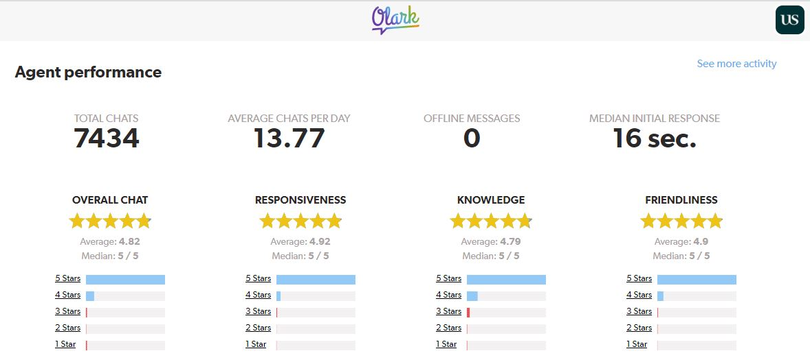
Supporting customers
Rolled out to weekends from September 2020

Slide 6
Challenges
Rota
Conflicting priorities
Quiet shifts

Slide 7
What next
Stick: has become embedded
Evaluate and iterate
Continue training
Weekly LATS/FAB meeting to raise issues

Slide 8
Contact us
Ant Groves
A.groves@sussex.ac.uk
Sean Goddard
S.p.goddard@sussex.ac.uk

