Slide 1
Digital Skills in the Library - A Service Design Project Using the Jisc Co-design Playbook
Nancy Ali & Kerry Gregory
Sheffield Hallam University

Slide 2
Project Overview
The Brief
Evaluate student digital training needs and generate recommendations for a potential digital skills service that is shaped students themselves.
Project Requirements
To create and deliver a sustainable digital skills service that provides students with the digital skills needed at University and in the workplace.

Slide 3
JISC Co-design Playbook
Jisc Co-design Playbook is a method for working closely with end users and stakeholders to explore new ideas and develop solutions that meet their needs.
Some suggested examples of engagement include:
Co-design plays
Feedback
Student voices
Panels/Steering groups
Project reports

Slide 4
Structure - Who is involved in co-design?

Slide 5
Library Digital Skills Team?
Library Digital Skills Project Team Structure Chart

Slide 6
The Jisc Plays
The Playbook describes a number of ‘plays’ that can be used when developing co-design activities

Slide 7
Understand: Engage Users
Stakeholders need to be involved in the core of the process
Notes:
3 in-depth qualitative focus groups with 15 students

Slide 8
UNDERSTAND: IN-DEPTH INTERVIEWS WITH USERS
"It was fun and interesting, I enjoyed talking to everyone and finding out what other students think" (Janet, Nursing student)
Notes:
cognitive mapping

Slide 9
UNDERSTAND: FIND OUT WHAT USERS THINK
Cognitive mapping of users digital identity
'You've got to be careful how you portray yourself online, anything you share could come back and bite you'' (David, Psychology student)
Notes:
cognitive mapping

Slide 10
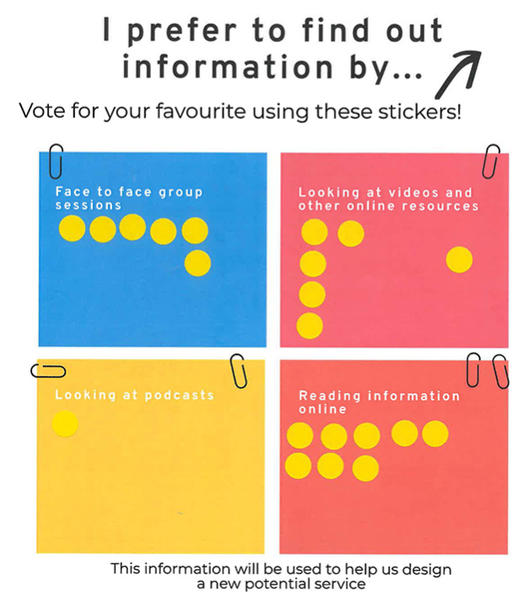
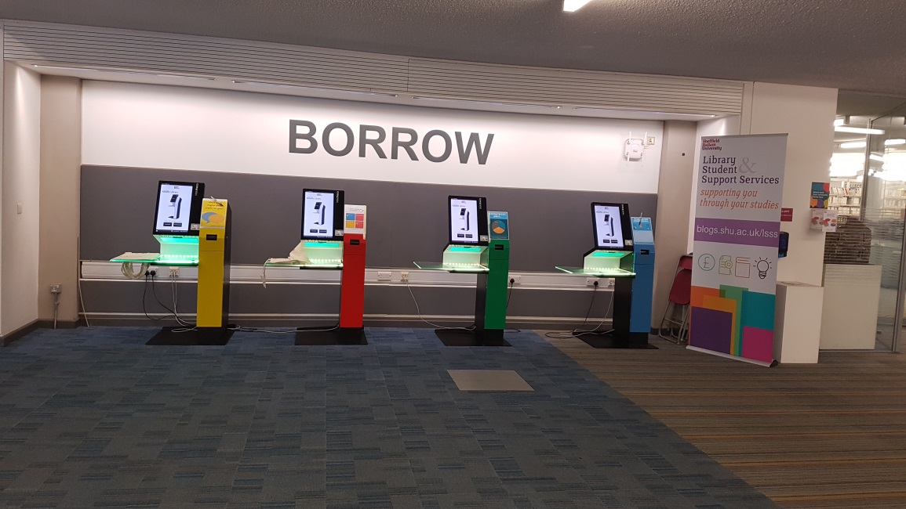
Understand: Find Out What Users Think
Dot polls
Locations for student engagement

Slide 11
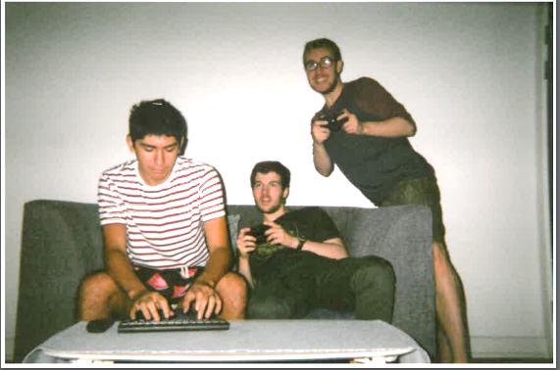
Imagine: Deploy cultural probes
Disposable cameras to document use of users digital skills

Slide 12
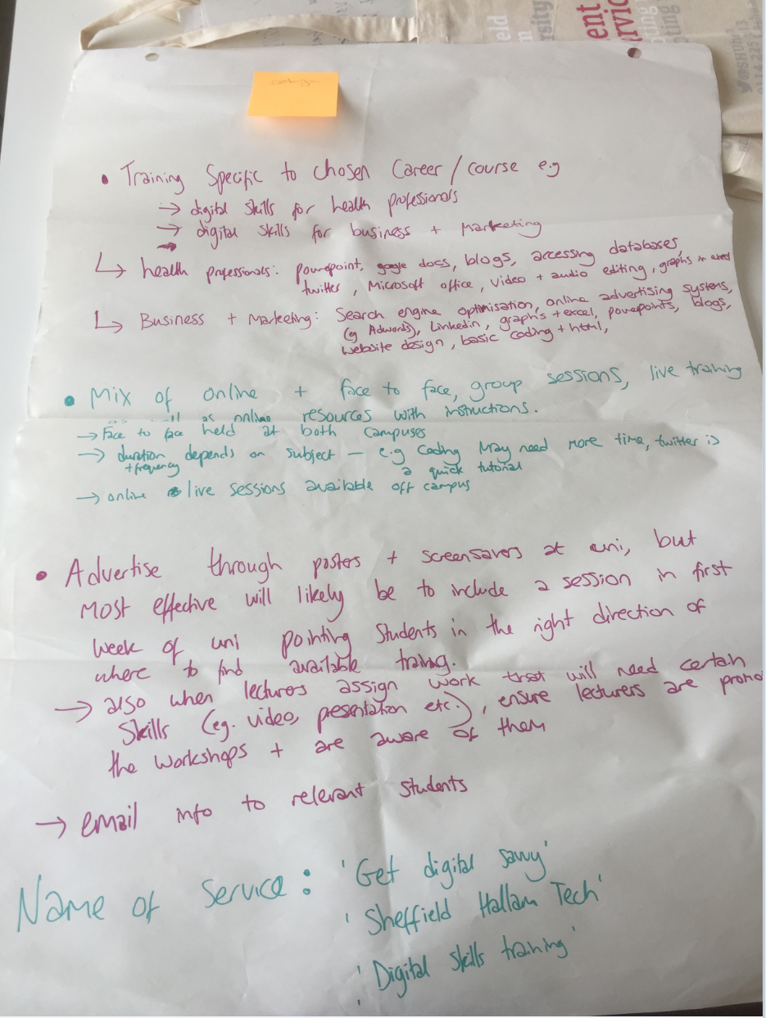
Imagine: Create future user journeys
Develop visions of the future user journey

Slide 13
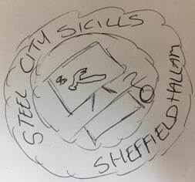
Imagine: Create future user journeys
Students were asked to produce a list of preferred service names along with possible logo designs. The most preferred name was Hallam Digital Skills.
Sketch out these ideas and add them to the future user journey

Slide 14
Build: make & test Lo fi Prototype
"Run campaigns through the year make them bold bright and straight to the point. Identify all the campaigns with a single logo". (Rachel, Nursing Student)
Students and staff have also been given the opportunity to vote on the final logo design.

Slide 15
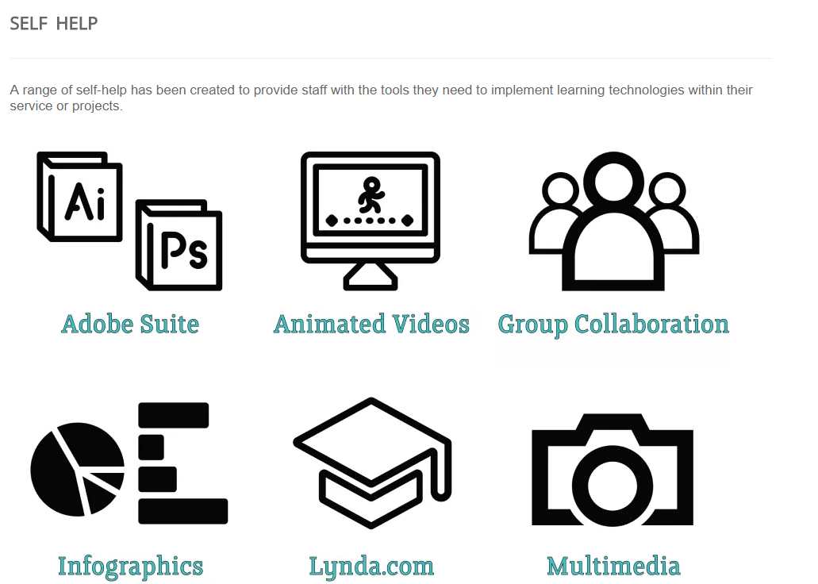
Understand: Survey the field as it stands
Review existing products and services in the area, share these insights across the team

Slide 16
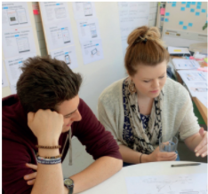
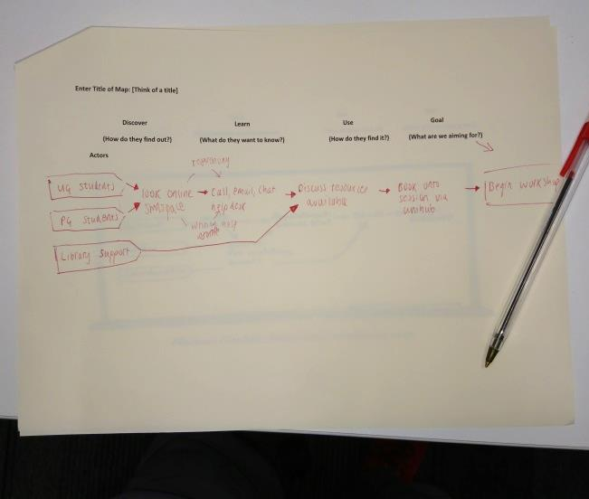
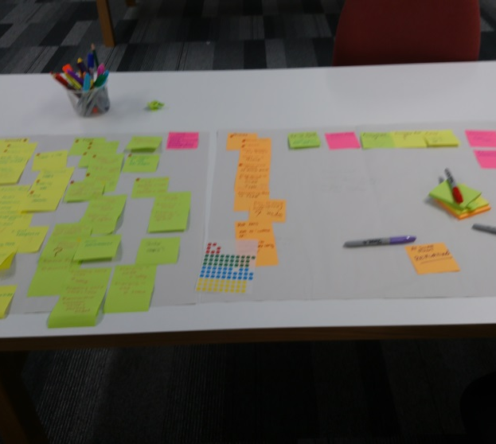
Understand: Talk to experts
3 minute lightning demos
Identify users
How might we notes

Slide 17
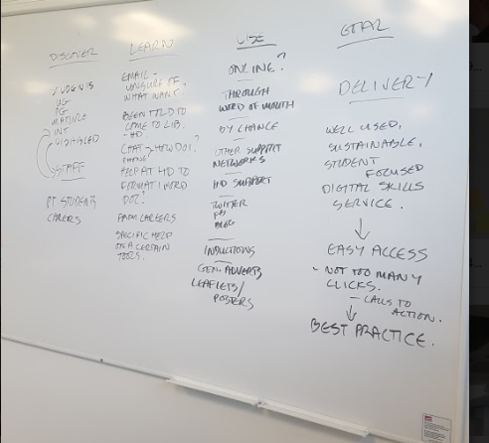
Imagine: Create Future User Journeys
Map key processes for all Users

Slide 18
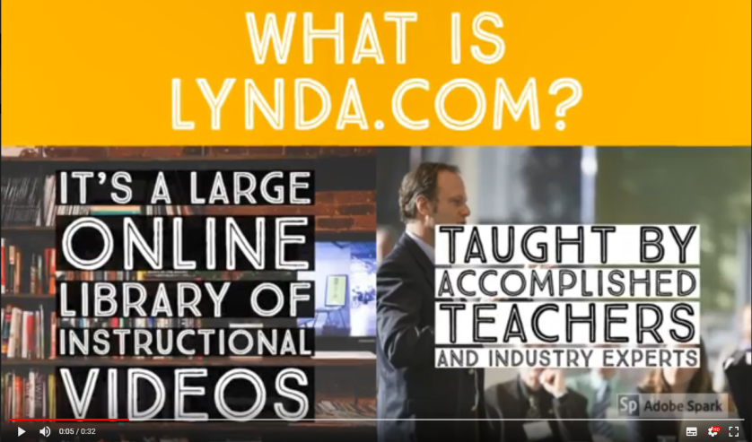
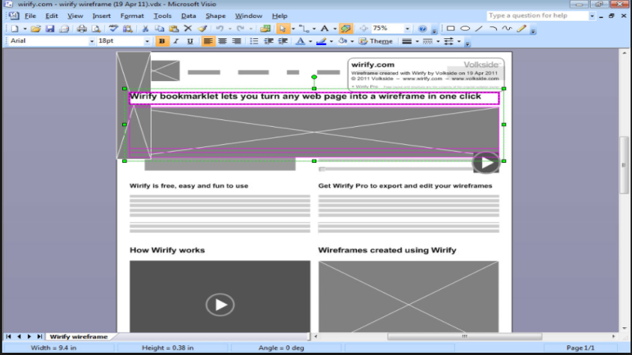
Build: Digital Prototype
Develop functional versions of proposed advertising and content for the service

Slide 19
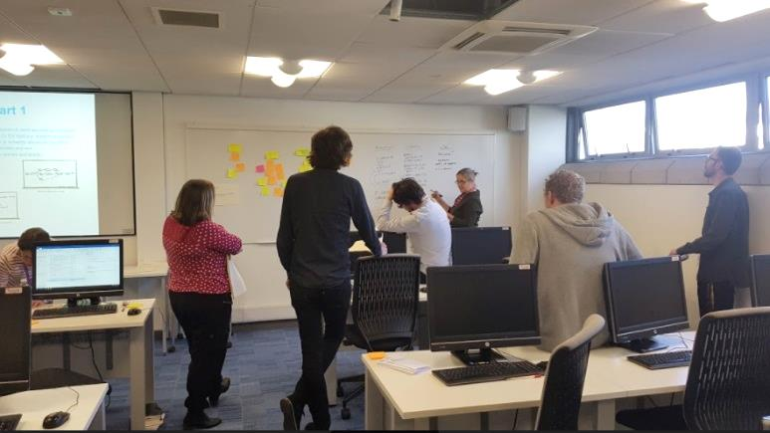
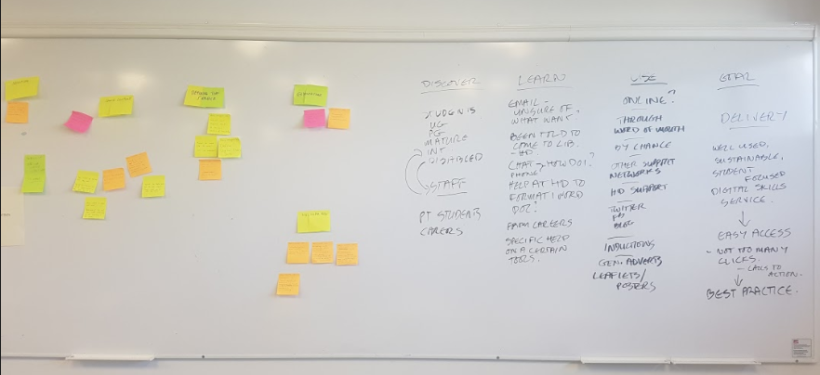
Build: blueprinting a service
The Project team are now using the feedback provided by students to create a service that meets the students needs

Slide 20
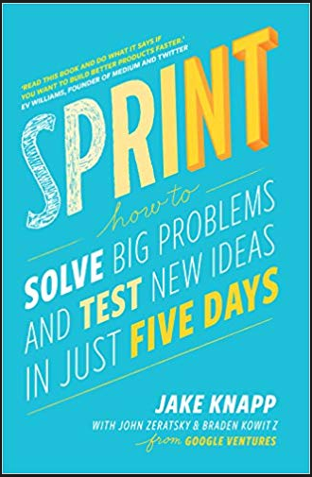
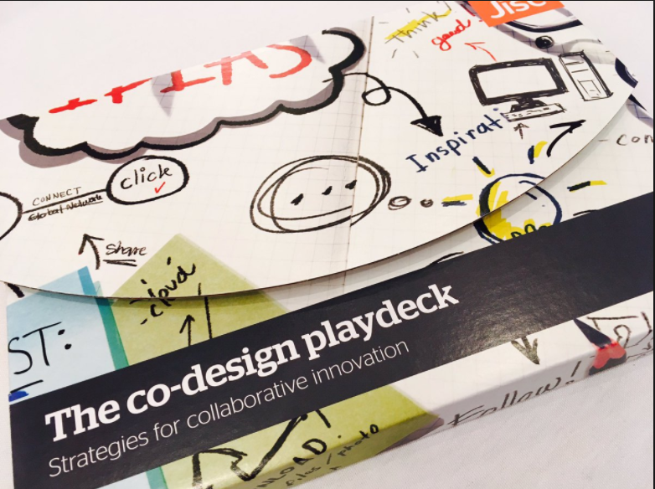
Supporting Resources
Jisc url: https://www.jisc.ac.uk/rd/how-we-innovate/co-design

Slide 21
End
Thanks for listening

