Slide 1
Falling between the cracks – managing student expectations with different service models
Rowan Williamson
Learning Resources Manager UAL
Notes:
We are in our third year of night opening, a service provided by an outsourced team of customer focused security staff. This model was largely determined by financial and management constraints, and the immediate demand for 24 hour opening. Three years in, we wanted to understand how much our different service models aligned with our students expectations. We ran a User experience project to find out more about how our students worked day and night.

Slide 2
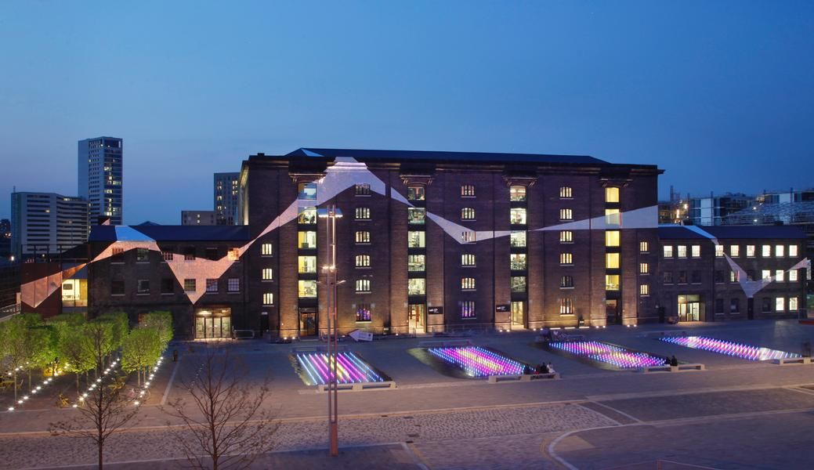
Six colleges, One University
Notes:
I thought it might be useful to start off with some background information about Central Saint Martins and University of the Arts, London. Central Saint Martins is one of the six college across London that make up UAL. The college are - Camberwell College of Arts, Central Saint Martins, Chelsea College of Arts, London College of Communication, London College of Fashion and Wimbledon College of Arts. Although there are some cross over of subjects each college has its own unique identity, student cohort and indeed library!

Slide 3
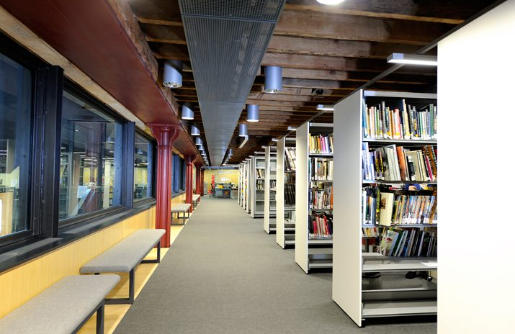
Notes:
An advantage of having 6 unique colleges and libraries is that we have always been able to offer students a really diverse range of study environments. Students from any college have access to the library facilities of all other sites in addition to their own. So we were able to focus our overnight opening on one site yet offer it to all, which allowed us to be efficient, cost effective and responsive.
The executive board rational for choosing CSM to open 24 hours.
Most diverse collection
Busiest Site
Able to easily restrict access
Good transport links

Slide 4
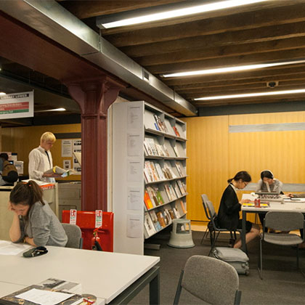
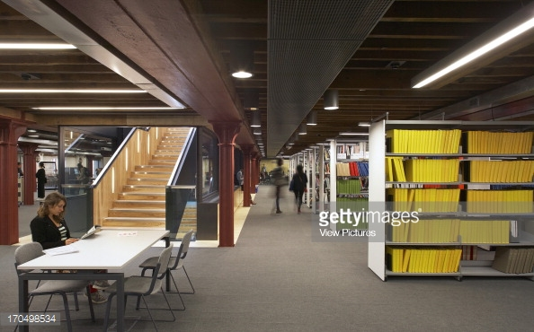
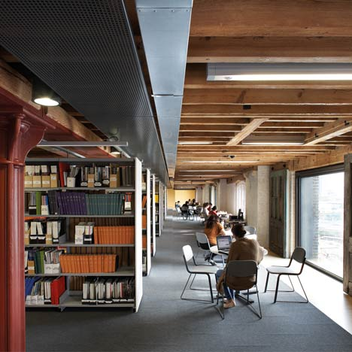
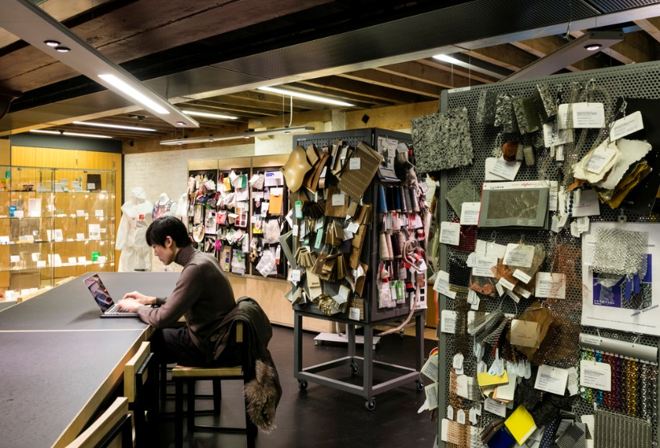
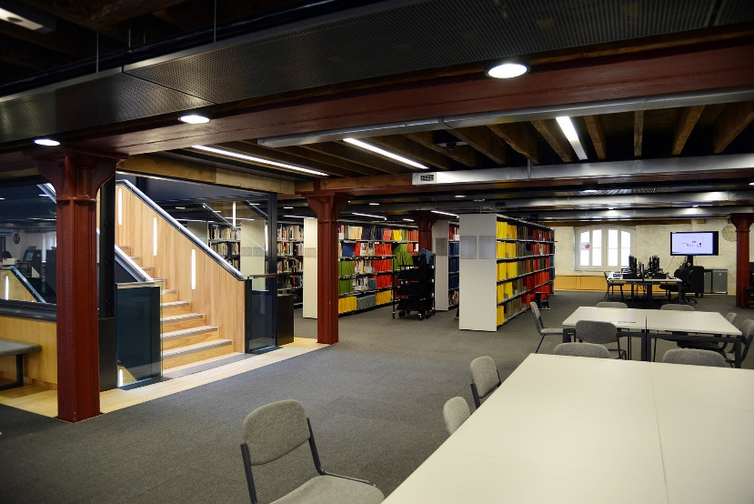
Notes:
CSM is based across 3 floors: LZ, group, quiet.
Our students are all arts students and their work has always been project based. Although some courses do have written assessments most are object based and involve making. CSM provides studios for students to work in. The Learning Zone on the first floor of the library provides space and equipment for that work and we request that student making (and eating) are restricted to the first floor, although we don’t expect to see much of the type of work there that usually happens in studios. We have all the normal problems of having to enforce rules about food/drink/noise etc. In addition we have to manage creative types who regularly decide to move the furniture, re-decorate the walls with post it notes, and occupy large amounts of space making models. We have a ridiculous amount of shelving we can hardly keep up with due to the fact that our students are browsers. Books on tables, not borrowed. Everything scanned for inspiration not targeted reading. And the Library and LZ is so busy it’s hard to even find a seat in the daytime. We are constantly busy at our information desks and the space is managed and occupied by a variety of staff.

Slide 5
Expectations
Needs
Behaviour
Notes:
When setting up night opening for the first time we went to other Uni’s already doing it so we could try and anticipate what might happen.
We ran a pilot with outsourced security to staff the library in addition to the Estates security presence. This is unusual but we wanted a team who were more than just security, and primarily focused on customer service and student welfare. Following a pilot we tendered and ended up using Reassurance to provide that team.
We already had various distinct teams working at evenings and weekends, and scenarios where staff shortages forced us to move to a slightly different service model, (for example limited service/self service,) But night opening was the first time that we had to plan for normal operation with a distinct team using an outsourced model.
The temptation is to focus on the service model and setting expectations about what we are offering – or in most cases what we are not - (less staff support, access to space and facilities only).
We say; ‘You can have the space without full staff support’ so we are limiting their expectations of other services not available BUT
They hear ‘You can have the space’. We do not set any further expectations about what tit may mean.

Slide 6
Getting ready
Notes:
So we anticipated some possible new issues at night.
Usual rules still applied so we just tackled the things we thought were obviously different.
We wrote a policy and designed a campaign about sleeping, and wellbeing.
We installed vending.
We anticipated people taking up residence over night and leaving their things unattended.
We predicted students from other sites may come for night opening, hopefully ensuring the demand justified the investment.

Slide 7
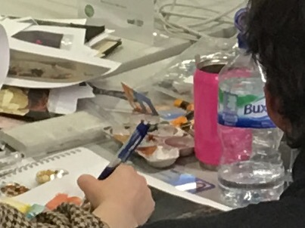
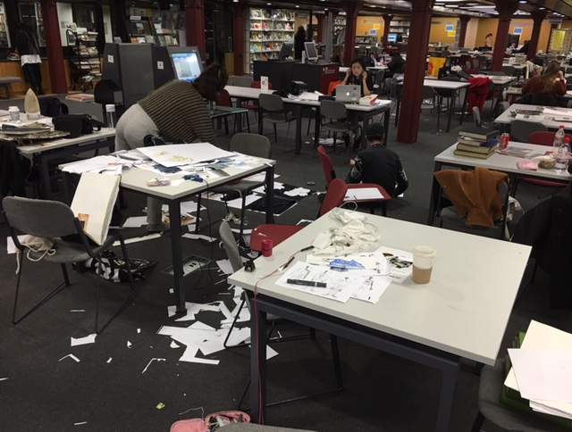
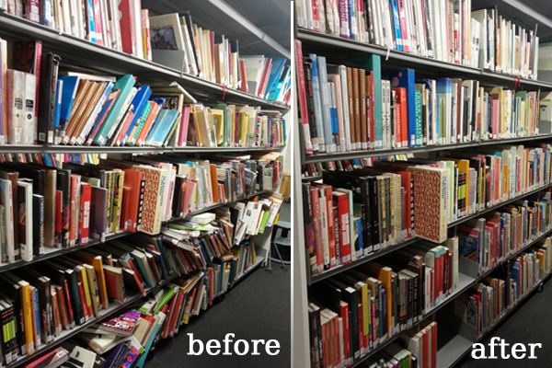
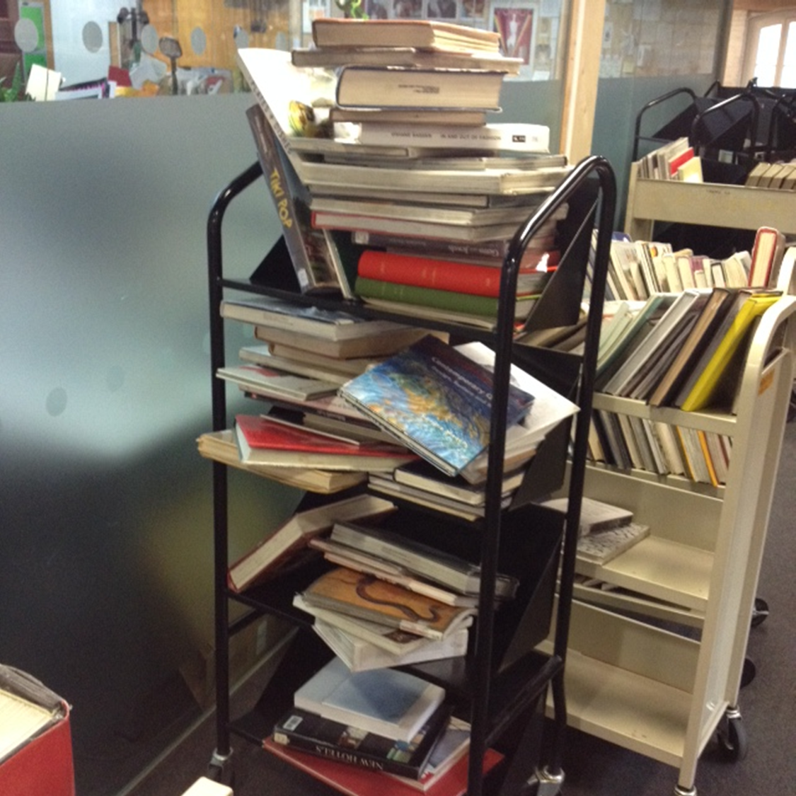
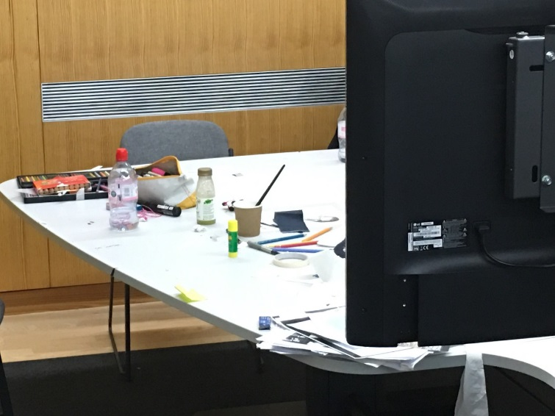
Notes:
But as well as all that it quickly become apparent that, while some students were using the space for more traditional research other were in there as they didn’t have access to their studio. Providing 24 hour access to studios is not possible as they require specialist supervision. So that’s where we came in…
It also changed the nature of our users. Only 60% on average were CSM students, the rest coming from the other Colleges. And although it might be 24 hour opening bringing them, it didn’t mean they arrived at 10pm and left at 9am. We saw daytime usage increase, and our own students perceived this as new competition for their space and it was not popular.
Not only would we come in in the morning and feel like the library has been moonlighting as a art studio, but it was highly territorial. And this usage was bleeding into the use during the day. ‘6 libraries one service’ offer was proving difficult to deliver and our night opening was impacting the day in unforeseen ways.
We needed a whole other way of addressing this.

Slide 8
Notes:
We are used to the library being incredibly full, and although night opening is busy for a night library it is very different from in the daytime. Not unusual in libraries with night opening, but in our case it meant that students felt much more of an ownership of the space and were freer to use it in ways just not possible in the day. While we have an average of 2000 people using the space during the overnight period, from about 3am the headcounts show around 130 people in the space, rather than the 300-400 we see in peak day times.

Slide 9
Notes:
Despite the high demand for a 24 hour library, and the SU campaign to get it, it turned out that what students really wanted was studio access. As they didn’t have that they wanted to use the library to make and create as they studied. To spread out and take advantage of the space, using the time to do whatever activities they needed to do for their course. And that was not always research.
(This is one student using four study spaces)

Slide 10
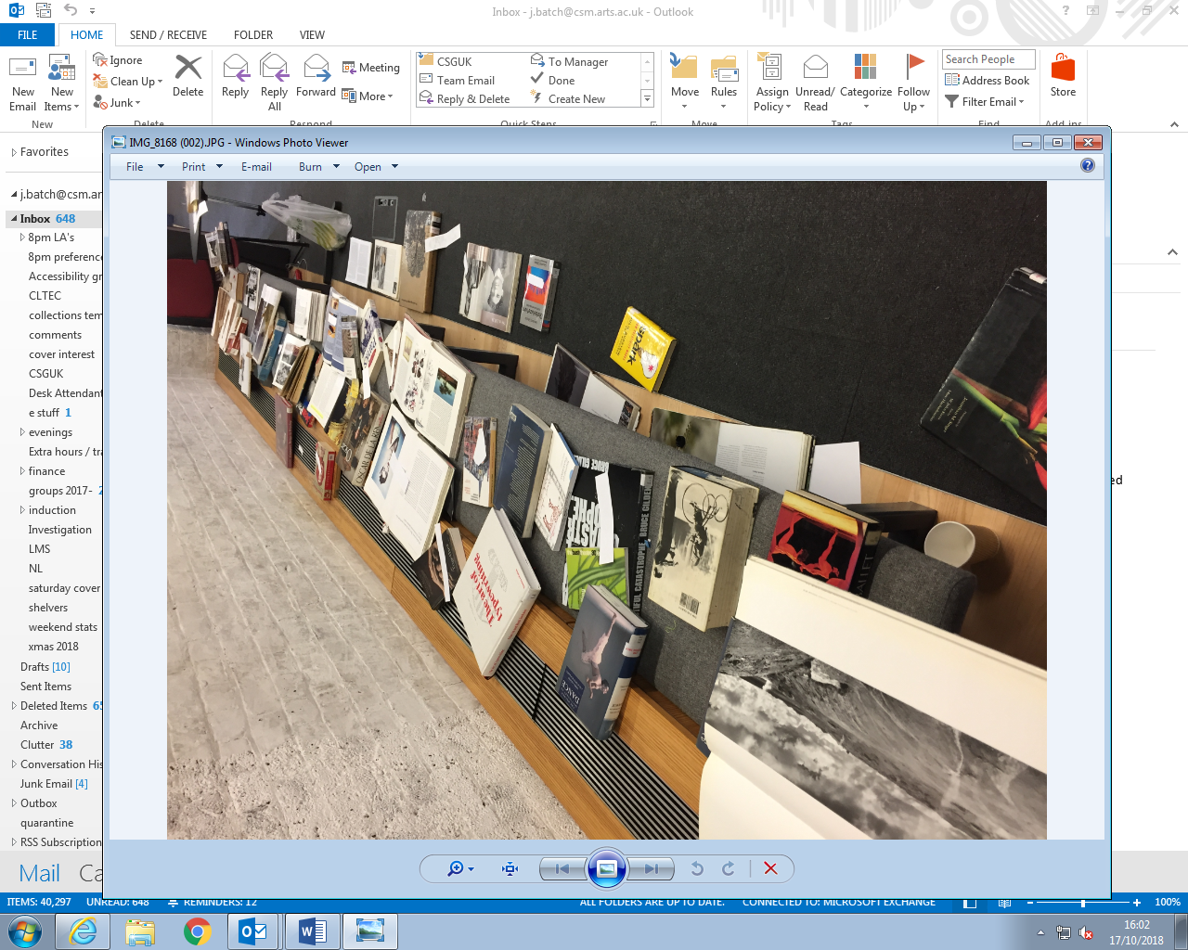
Notes:
Even traditional book based research looks different! This is one students work.
There was a very clear delineation between normal hours library usage and 24/4 usage. Whilst we had set out very clearly what we didn’t offer students overnight, they had filled in the gaps with what they did want to use the space for. We hadn’t been expecting this and initially we struggled to try and restrict their activities to match what happened in the day. However after some futile conversations where we struggled to justify why they could not take up all this space when no one else needed it right then, it became clear to us that we needed to do more work on what our students expectations were and how to adapt to meet them.

Slide 11
To use UX techniques to observe staff and student behaviours within the CSM library and Learning Zone in order to improve user experience by identifying how student needs and service models differ at night to during core hours of staffing
Notes:
Having experience of running user experience projects in the past we were aware of the unique insight they can provide to user behaviour and working patterns. We wanted to understand more about how our students worked during the day and night, and the different expectations they have of the service models that have evolved. We asked to what extent do our services models align with our student expectations?
The project would allowed us to explore to assess students perceptions and customer service needs during overnight opening.
Our goals were -
- To use UX techniques to observe staff and student behaviours within the CSM library and Learning Zone in order to improve user experience by identifying how student needs and service models differ at night to during core hours of staffing.
- To map and record current usage of the CSM library overnight opening, in order to better understand how students use it in order to further develop services and facilities
- To build on and contribute to our responsive CSE approach by developing library services through UX report and action planning
- To inform future library opening hours through observation and discussion with students

Slide 12
Notes:
We assessed through detailed observations of the students and staff in the space, looking at activities, environment, etc as well as staff availability/visibility, nature of the interactions with students and effectiveness in managing the space. We used a ‘mystery shopping’ approach to gauge the quality of enquiries and referrals staff provided, and we ran a focus group and did some journey mapping.
One of the most useful outcomes from the UX project was that we got to spend time with current students who were all really invested in the outcomes of the project.
What quickly became apparent was that none of the activity we had at night was problematic at night. It was only an issue in the day when usage levels changed and staff teams were providing a different sort of service. Where we had anticipated behavioural issues, there were none. No alcohol or rowdy behaviour. Our problems were entirely about the impact that legitimate overnight activity had on the day.

Slide 13
What we found…
Activity was broadly appropriate for each floor
Students use a full range of facilities and equipment
Staff support required is minimal with students preferring to work in the space independently
Students very frustrated by the amount of mess
But students wanted to use the space for activities like making
Notes:
The most striking observations for us were – students used the spaces appropriately by and large, and they were working and using library resources…they were just using a lot more than just that.
1st floor (LZ) has the highest level of activity while the 3rd floor has the least. 2nd floor is mainly used for group study and computers.
Students use a full range of facilities (printers/lightbox/books/laptops)
Staff support is regarded as adequate and the demand for staff assistance appears to be minimal with students preferring to work in the space independently
Students very frustrated by the amount of mess left on tables BUT
Student want the freedom to use the space for a variety of non traditional activities – anything they perceive as their ‘work’ – making/creating – not what we might consider library work – research/writing etc
The question became ‘How do we meet expectations for more relaxed studio style space overnight and provide a suitable working library environment for use during the day?’
How do we walk the line between those conflicting expectations?

Slide 14
What we did…
Transition period
Flexibility
Handovers
Signal the transition to students
Consistency versus fairness
Extra Resources
Cleaning
Shelving
Bin bags/bins
Furniture
Notes:
So we decided to focus on a new approach to transitioning between service models.
To be more flexible our service models signage had to become more prominent and we had to make a more active handover so that students AND staff recognised that the change of shift marked the change in the way the space could be used.
We had to really work with night team staff to understand the ‘grey areas’, and then to find ways to enable them to make a judgement instead of enforcing a blanket policy when there was really no reason to (groups making some noise in the quiet zone when there is no one else in the library)
We also had to separate out the behaviours we could not have at all and those we just needed to manage differently.
We introduced a no wet work rule but bought lots of cutting mats and bought new furniture (wear and tear) – damage from glue/cutting on sofas
We reinforced our zones signage so that we could direct students to appropriate places to eat and do more creative ‘making’ activities on the right furniture, whilst we increased the cleaning and number of bins
We had introduced a 3 strikes and you are out rule as overnight as students were far more likely to stay longer and leave belongings unattended, but we only enforced it after 6am. And we gave out bin bags to get them to help clear up
More shelving shifts

Slide 15
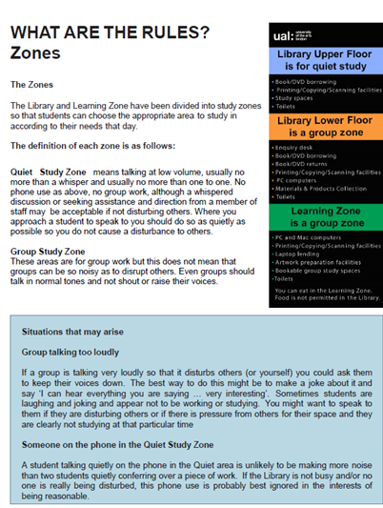
Transitions
Staff accepting change
Train staff with scenarios not lists/guidelines not rules
Empowered to make a judgment call
Trust between teams
Close working with partners from other departments
Notes:
A lot of this was around acceptance of change. We do have space for people to spread out and be a bit messy. But this involves staff accepting that the space isn’t going to be tidy when they arrive at 9am AND that this is not actually problematic until we start to get busier at around 11am. This isn’t an easy transition for staff who are used to a tidy space first thing in the morning and an opportunity to ‘reset’ the library each day. There was a lot of work to manage the day teams expectations of the night team, trying to get the teams to be less judgemental about each other. We use a lot of scenarios and training to emphasise the importance of judgement calls and ensuring a handover that was clear and helped both sides make the transition by explaining what they had done/not done in terms of making those judgements and transitioning back to daytime use. We have not entirely overcome this, and it remains a challenge with an outsourced team to manage the transition and communication effectively so both sides believe they are doing what they should. Its especially difficult given that we are not there at night to see what’s going on, so both sides make a lot of assumptions. This is where ongoing and embedded use of UX will be helpful I think as it surfaces those truths and tensions.

Slide 16
Transitions
Students accepting change
Negotiable/non negotiable
Policy and practice
Health and safety, wellbeing and consideration
Emphasise the parameters
Notes:
Also for students they are not always happy to adjust their work to accommodate the fact that additional study places are needed as we get busier.
We tried to be flexible and communicate a common sense approach. Focusing on transitions from different states of service meant we allowed grey areas for students who could do something at night but not in the day so we focused on impact on fellow students using health and safety and wellbeing to dictate what was acceptable, rather than having rules that are enforced rigidly. Staff were able to point to guidelines and policy that stated the reason we might be asking them to move/change their behaviour, rather than a list of dos and do nots. We used a Twitter campaign on ‘keep night opening sustainable…’ to focus on the transitions and draw attention to the fact that we were encouraging different use.
UX engagement again proved useful. All the students who attended focus groups had a chance to talk through what was happening and to understand both sides. They are hopefully our ambassadors out in the student population, and proved the value of continual embedded student engagement , not just to gain their feedback, but to spread our own messages about the different service models and impact of overnight opening.

Slide 17
Practical tips
Plan for the user experience not the service model
Know your students needs, anticipate changes
Communicate the expectations on BOTH sides
Resist more rules, offer alternatives
Empower your colleagues to use their judgement
Don’t be scared of the grey areas, but give them a clear border!
Notes:
UX is very powerful to inform but also to build ongoing relationships that benefit both sides.
Looking at other places is good practice but we often anticipated only half the story, or we were very well prepared for things that never happened.
Generally we are good at saying what we offer, and what we expect students to do. We are less good at flipping that and communicating students own expectations are and how we will meet them - crucial for explaining how we manage conflicting users needs.
Staff development and guidelines that focus on values and principles – fairness and consideration for others –
Instead of rigid rules that can’t always be logically justified – and therefore cant always be consistently applied.
Some things aren’t negotiable. As long as you are clear what is and isn’t.

Slide 18
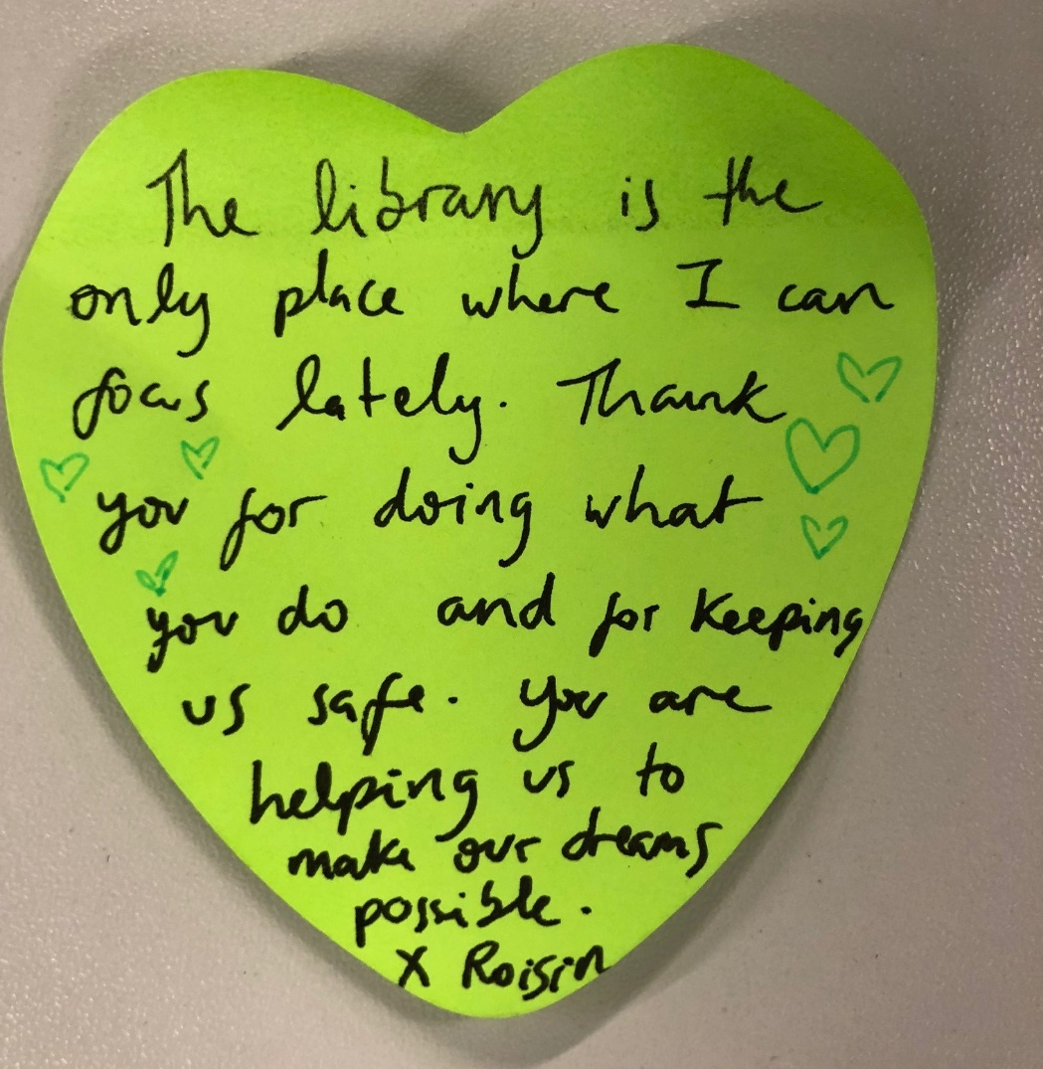
Notes:
When it works….

