Slide 1
Innovative ways of promoting the Library to new University staff – making library services memorable.
Presented by Monika Koziel and Martina Xenia Baldi

Slide 2
Introduction
City, University of London
Library Services
Social Media & Marketing group - News - Social Media - Print and Digital Marketing - Events and Campaigns

Slide 3
Welcome to City
Event to welcome new members of staff.
World Café
8 different departments
10 minutes presentation
6 times
Great opportunity to interact with new colleagues.
How to make the best out of it?

Slide 4
Content
Game for every member of staff, not only academics
Academics | Everyone | Students
Subject & Research Librarians | Online Staff Registration | More Books
Copyright Guide | Fiction and CD/DVD Collection | Disability and Dyslexia Support
City Research Online (CRO) | BoB (Box of Broadcast)

Slide 5
Design – all the rules
Our visual identity is a design scheme which comprises a number of core elements, including logos, colour palette, typefaces, photography and writing style, that come together to create a distinctive look and feel. This makes the City, University of London identity recognisable and differentiated. The core elements will assist in designing and producing compelling communications with a high degree of creative flexibility.
The City brand is more than a logo, it is the sum of everything we stand for and the perception that our stakeholders have of us. The way we portray ourselves is key to this; our brand identity has to reflect the characteristics that make City, University of London unique.
These characteristics are referred to as our ‘brand trilogy’, the three unique selling points that differentiate us from our competitors.
Please note that any design work should be managed by, or in collaboration with, the Marketing Team.
On an individual level, City staff should respect the following rules:
Use of Arial font in Microsoft applications (PowerPoint, Word etc.)
Make sure you use the latest logo on headed paper, email signatures etc.
Respect the rules laid out in the Writing Style Guide, particularly with respect to the format of dates, numbers, contact details and titles
Use the corporate templates for Word and PowerPoint
If you are producing materials on behalf of City, these should be approved by a member of the Marketing Team prior to printing.

Slide 6
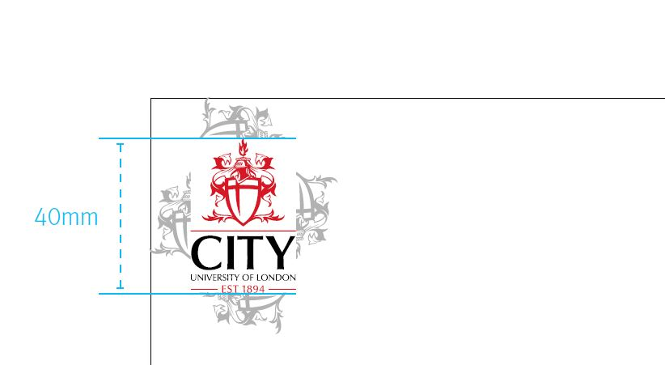
Design – Branding & City logo

Slide 7
Design – Library Colours Palette

Slide 8
Design – Fonts & Wording

Slide 9
Design – Copyright issues

Slide 10
Interactive game
“Ask me a question”

Slide 11
Interactive game
“Tell one fact about the Library or go back!”

Slide 12
Interactive game
Box of Broadcast, example of a grey tile
Questions with multiple answers
What is a Bob?
- American rapper that library staff is crazy about
- Boxes of books
- Bob the builder who works in the library
- Box of broadcast
Prizes for correct answer

Slide 13
What is it?
30 pages long
Short description of a service offered by the Library
One page correspond to a board’s tile
Minimal info, with link at the bottom of the page
Booklet was created specifically for the game, it is not used in the library.

Slide 14
Why is it useful?
It gives information & saves time
The game is only 10 minutes long. Too much information is given in such a short period of time!
Could be helpful in the future to direct students

Slide 15
How did we create it?
“Short text”
Specific design rules
A6 size, small pocket size: - We wanted one topic per page, an A5 would have been too big - Readable size font, Subject Librarian for Assistive Technology and Disability Services
Matching colours with the board

Slide 16
Front cover

Slide 17
Library Feedback Group
Dry run was organized to get feedback from our colleagues.
First introduction to the game for Subject Librarians who are responsible for Welcome to City event.
Suggestions were made how this game could be adapted for teaching sessions.

Slide 18
How it went on the day

Slide 19
How it went on the day
New staff had a great fun, asked lots of questions.
They got very competitive!
Other presenters were amazed by the game too.
People came back during lunch break to play the game again, we were the only table to do 7th presentations.

Slide 20
Thank you!
Any questions?

Slide 21
City, University of London
Northampton Square
London
EC1V 0HB
United Kingdom
T: +44 (0)20 7040 5060
E: library@city.ac.uk
www.city.ac.uk/library

