Slide 1
Everybody Needs a Buddy The new Starter Programme for Student and Library IT Advisers​
Kirstin Thompson–Sims & Sarah Page

Slide 2
Remembering What it's Like to be New ​
Hello
My name is...
The new person

Slide 3
​ How it Used to be
The Old Team
Issues
The New Team
Confusing for students
Challenging for training needs
Staff knowledge gaps
Basic induction

Slide 4
​ How we got Started
“Umm… Can you repeat the part where you said all
the stuff about the things again?” – Homer J Simpson
My Experience
Lucky Dip?
Development for
everyone
New structure, new starters, new team and new
opportunities for us to support each other.

Slide 5
Timelines
When is New no Longer New?
1st Day – Best buds!
1st Week – Add in meetings to calendar and staff photo
3rd Week – 1st Meeting
6th Week – 2nd Meeting
12th Week – 3rd Meeting
6 months – Catch up
12 months – Congratulations, you’ve made it!

Slide 6
Coffee and Cake Q&As
Staff you have met but still not sure what they do? Know their face but not their name?
Are you happy with the office atmosphere, do you need any extra equipment?
Fridge politics!
Work based discussions/questions/bits and bobs

Slide 7
Induction Pack
The Acronym Talk: Decoding the Impossible!
“The SISL’s, ISL’s and WISL’s were discussing the training needed for the LASS teams at HY and CC.
The CTSM’s are happy for the staff to go on the TES and learn on the job but perhaps the team in the
BSU could do a LlITup session to go over BBE and WF procedures……..”

Slide 8
Induction Pack
Everything you Need in one Place!

Slide 9
Resource Hunt
Creating a Sense of Purpose in the Down Time

Slide 10
​ Excel Skills Matrix
Combining the buddy project with a managerial induction/training program to create a smoother induction process for new starters and existing staff.

Slide 11
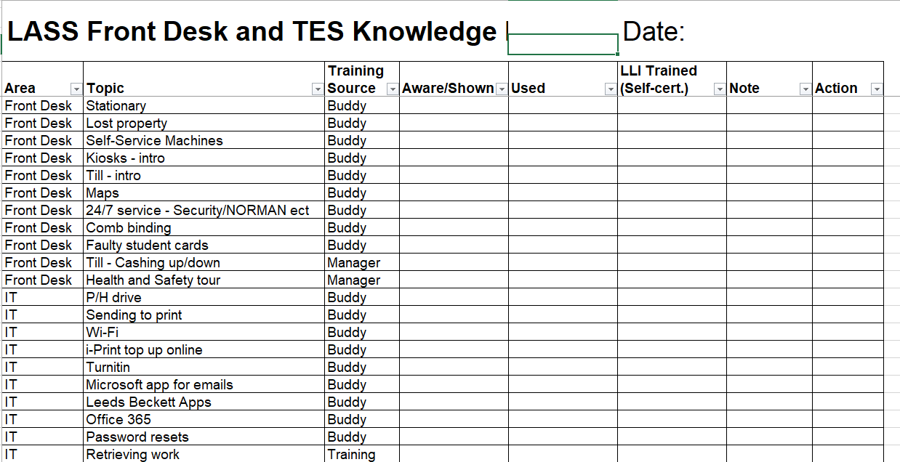
Skills Matrix

Slide 12
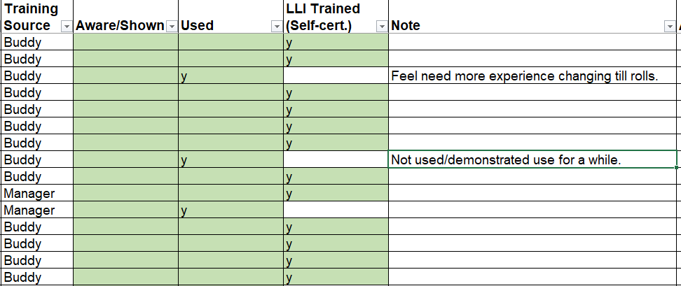
Skills Matrix

Slide 13
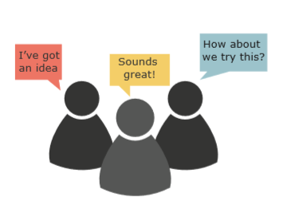
Future Enhancements
Role out to other teams within LLI
Collaboration with other departments in the university (POD & Student Services)
Continuous improvement
Happy staff!

Slide 14
Any Questions​ or Suggestions?
If you would like any more information regarding the buddy project please
contact us on the following details
Sarah Page s.k.page@leedsbeckett.ac.uk
Jamie Phillips j.Phillips@leedsbeckett.ac.uk
Kirstin Thompson-Sims k.thompson-sims@leedsbeckett.ac.uk

