Slide 1
Fostering a Culture of Service Innovation
Ian Keepins, Teresa Jordan, Andrea Kellett, Nick Cull
Library Services, University of Birmingham

Slide 2
Strategic Vision
We needed to make sure that what we do impacts upon the wider aims of the University.
The aim being to be a top 50 global University:
Students at the heart of what we do​
Empowerment at all levels ​
Confidence to get things wrong ​
The space and time to think
All work is underpinned by a clear set of values – all voices are equal voices, everyone has something to contribute, no idea is a bad idea. Share with and learn from others

Slide 3
Why service improvement groups?
Staff feedback:
Staff couldn’t see link between strategic/operational
Staff didn't get the opportunity to use their knowledge and expertise
Staff didn’t feel it was part of their role to make suggestions
Created multiple groups to:
Help staff know and understand LS wide and Uni wide priorities
Help staff know what their part is in achieving that
Use frontline staff knowledge and expertise of our processes, standards and customers.

Slide 4
The Development of the Working Group System
Not a quick fix…3 year period of development (began 2019)
Relationships and trust are key … our expectations were explicit …it’s ok, you can make mistakes, we actively listen to each other, comments should be positively framed, be fair.
Start with the Fundamentals … Foster appreciation of difference : Insights
SI Group focus areas were defined by strategic priorities, user feedback, data analysis and ideas from the team.

Slide 5
2021-22 Service Improvement Working Groups:
Self Evaluation
Microsoft Teams
Scanning and Digitisation
Welcoming staff back to campus
Reaching out to students
Wellbeing

Slide 6
How do the Groups work?
Each year the process has evolved as we have become more adept and experienced….
Remits : Year 1 written by HoS and Development Manager…Year 3 written by the groups themselves
Group Leadership and Management …. Year 1 focus on training of Chairs… Year 3 group members forming sub groups
Real Staff Engagement … Year 1 provided evidence that they would make a difference … Year 3 change is expected
Communication … Year 1 email and word folders… Year 3 MT, live chats, collaborative document creation, padlets
Engagement … Year 1 some staff didn’t choose a group …. Year 3 All staff state their top 5 preferences
Building the Spiral … Year 1 focussed on the process, hearts and minds … Year 3 Gap analysis, SMART targets and
milestones

Slide 7
Self Evaluation Group

Slide 8
Self Evaluation Group

Slide 9
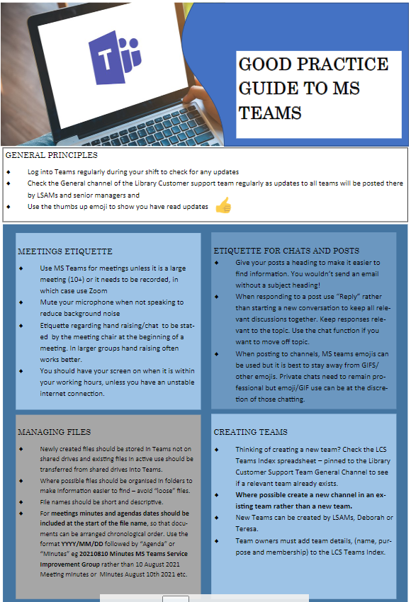
Good Practice
We developed some simple good practice guidelines in 5 key areas:
General Principles
Chat
Meetings
Files Management
Teams creation
Microsoft Teams Group

Slide 10
Final Report: Key Recommendations
Accessibility:
Minimum standards (OCR, single paged etc.) to improve accessibility and benefit all
Alma digitisation workflow
Integrate all scanning workflows.
Replace using email inboxes to monitor and manage requests
‘Open-shelf’ scanning service
Best practice with Russell Group and other academic research libraries
Storage
Replace shared mailboxes and networked drives
Improve record-keeping of scans and requests, especially for copyright compliance
Scanning Group

Slide 11
Benefits:
For our team :
Everyone feels they have a part to play and thus own the outcomes, e.g. Building on the Wins Workshops
Self evaluation is embedded
Helps staff understand limits or how senior staff have to make decisions based on budgets, capabilities etc.
Staff routinely consider wider picture
For our service:
Capacity for implementing strategic change is dramatically increased
Enabled to be agile in pandemic and help staff feel supported
Helped with developing cross-team working
Improvement in staff survey scores
Building on the Wins Workshops
Working on campus and remotely
Remote Service Ideas
New Services
Use of the Main Library and OLRC Building
- Entry Management

Slide 12
Learning Points:
Be very clear about learning objectives for training staff (especially if a third party is involved)
Group leads need as much if not more support in the beginning if they are not used to working in this way
Balance of freedom vs SMART (closing the SI circle)
Annual self evaluation cycle needs to be in sync with timing of service wide priority setting
121’s are key to keeping everything going
Sometimes you get unexpected outcomes …..

Slide 13
Unexpected outcomes...
Ready to respond to senior staff ideas, e.g. Community Hub
Use of MT transformed communication and transparency
Increased visibility in wider university professional services division e.g. Student Services interested in our Customer Promise
Increased profile in library sector, e.g. training in Mercian Collaboration
Sometimes you get lucky!
Notes:
C

Slide 14
What next?
The first 3 year period is at an end (summer 2022)
Some groups will continue, e.g. development of MS teams, self-evaluation
This is now embedded practice and will continue to develop – model for other divisions of Library Services
Finally: we are proud that the teams are positive and enthusiastic about change, that they are taking ownership of their services, and are helping to shape the way we run libraries.
Notes:
T

Slide 15
Thank you – Any questions?
Ian Keepins, Assistant Director of Library Customer Support
i.d.keepins@bham.ac.uk
Teresa Jordan, Head of Service Delivery
t.jordan@bham.ac.uk
Andrea Kellett, Customer Services Manager
a.l.kellett@bham.ac.uk
Nick Cull, Senior Library Assistant
n.cull@bham.ac.uk

