Slide 1
Heena Karavadra and Hannah Congrave
University of Leicester
@heenakaravadra
@hannahcongrave
https://readatleicester.le.ac.uk/

Slide 2
Background
Launched in 2016/17
Campaign to encourage sustained reading amongst students

Slide 3
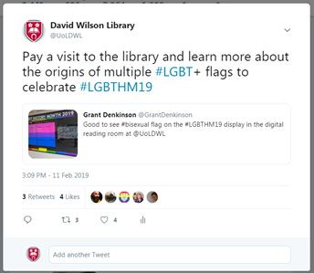
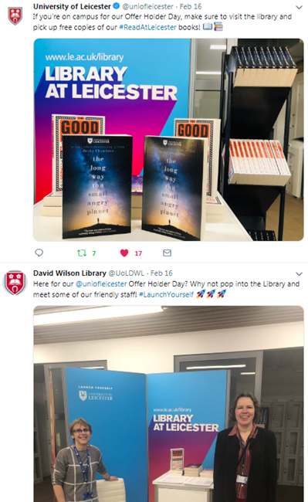
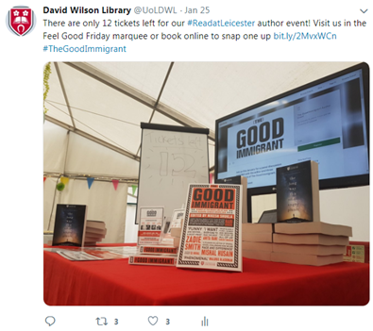
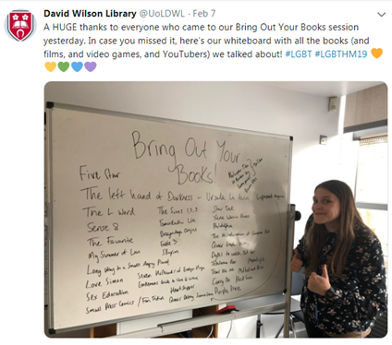
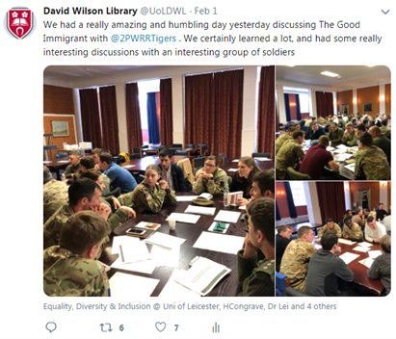

Slide 4
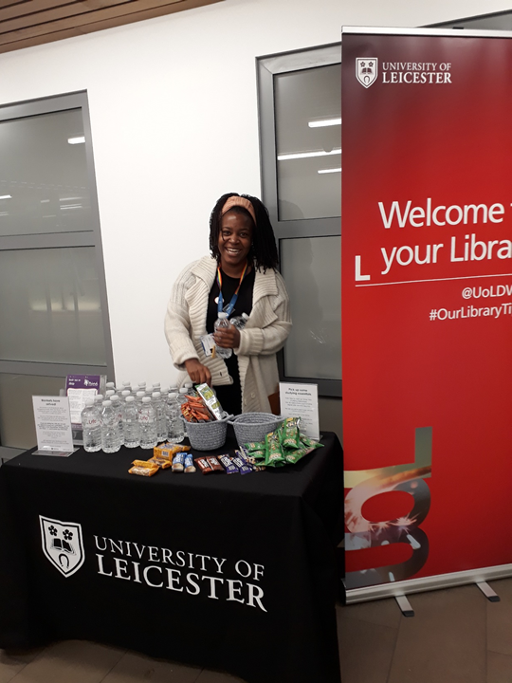
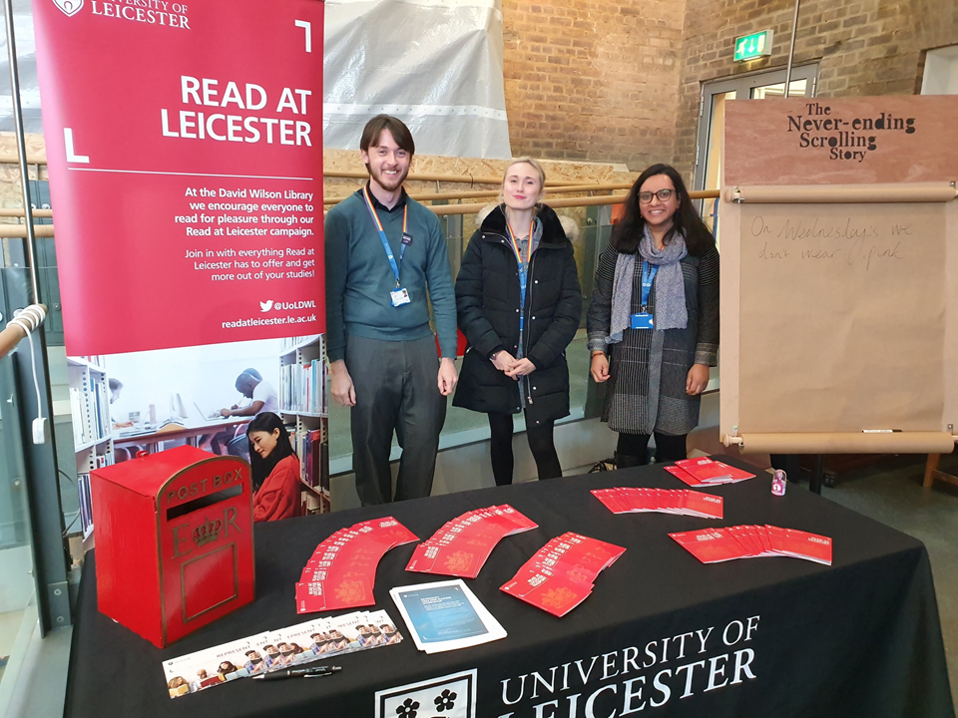
Frontline staff engagement discussing the campaign and wellbeing study tips more generally

Slide 5
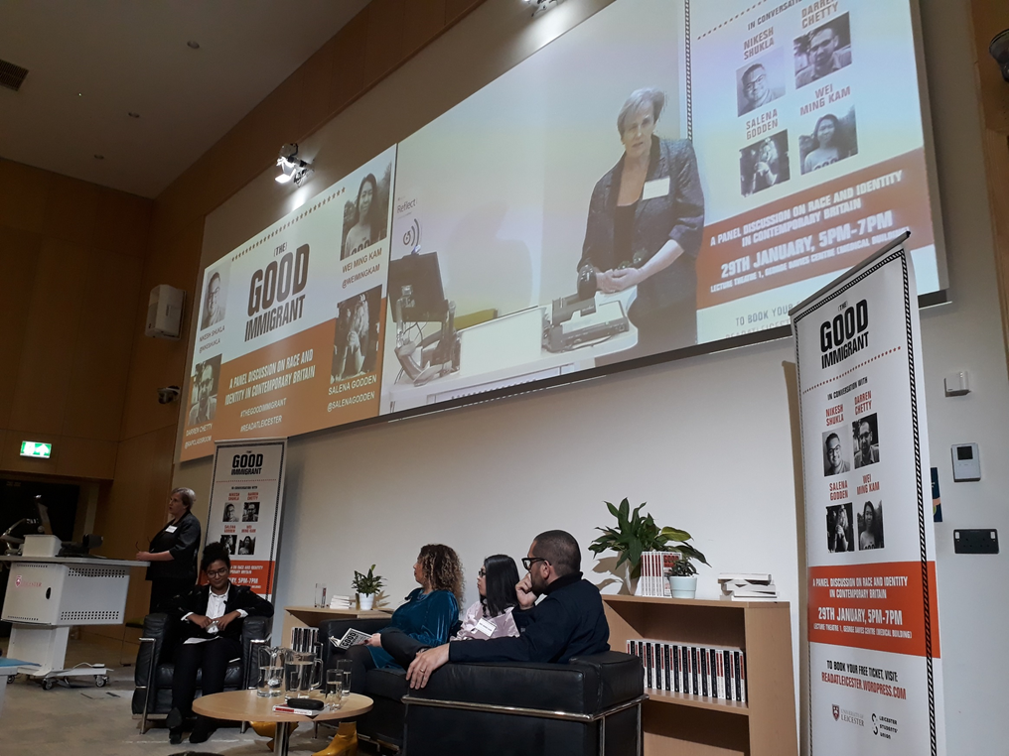
Book clubs
Round table discussions
Walking tours
Author event

Slide 6
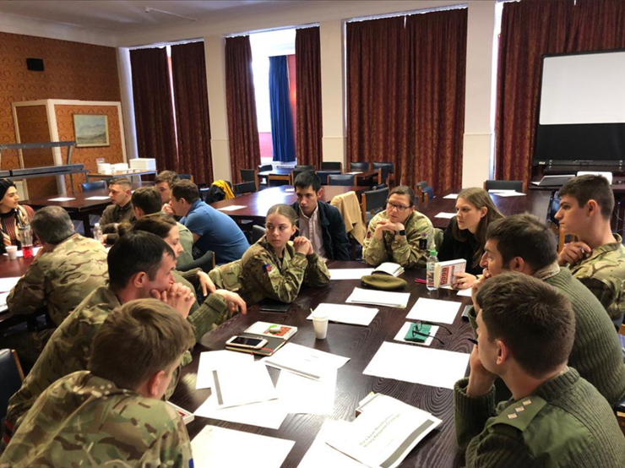
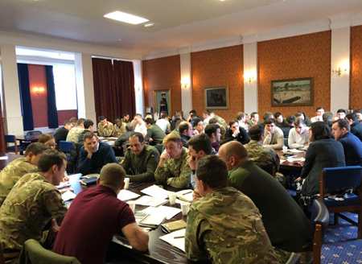
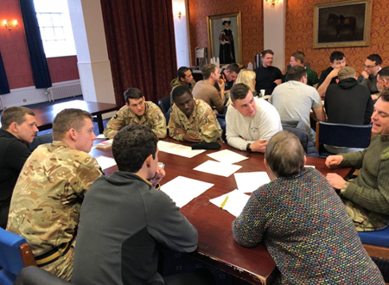
Outreach work with Kendrew Barracks

Slide 7
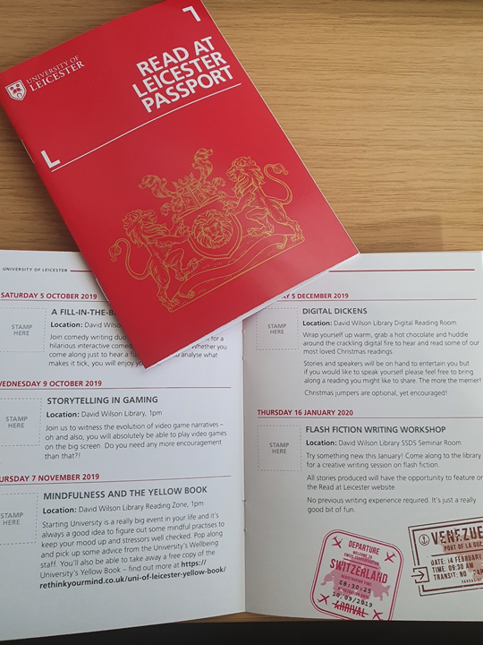
Current campaign
There is no free book - budget restrictions
Campaign to encourage reading for pleasure as an aid to positive mental wellbeing and therefore their studies
Programme of events throughout the academic year - Read at Leicester Passport
Bringing students together across the naturally formed boarders of student experience

Slide 8
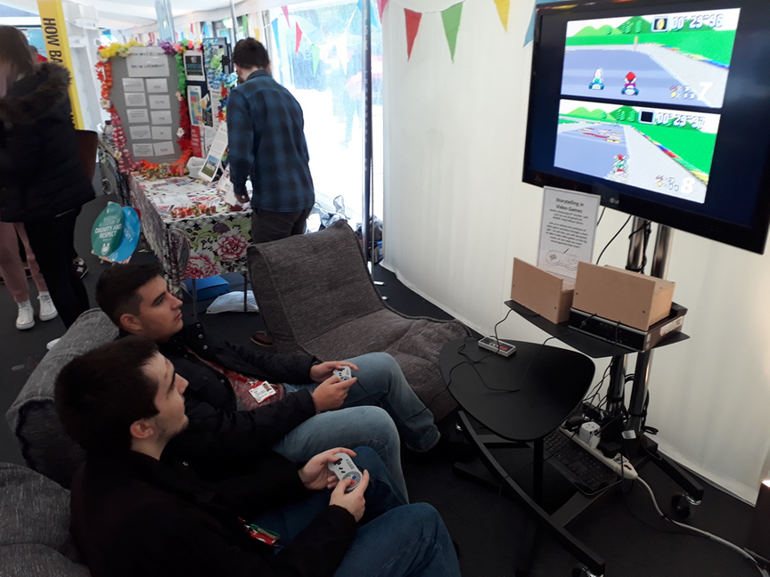
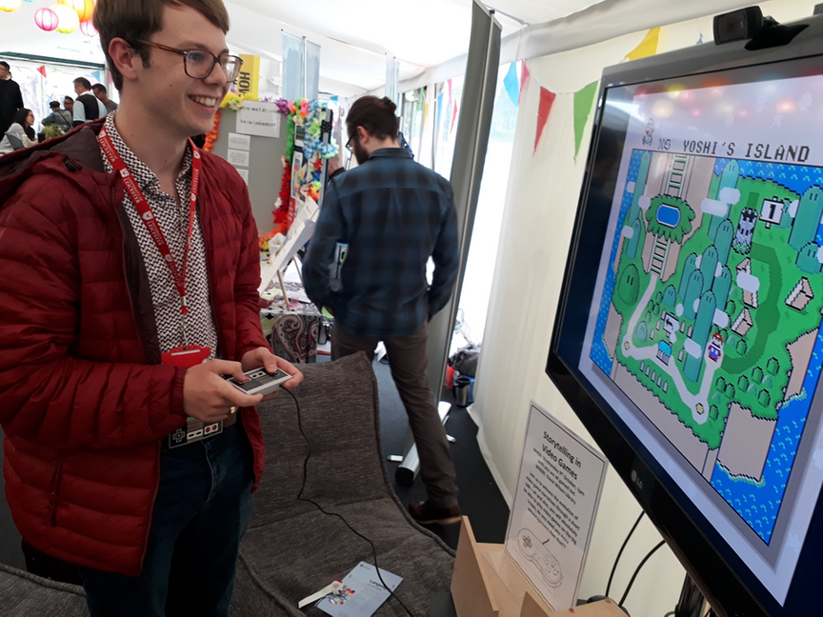
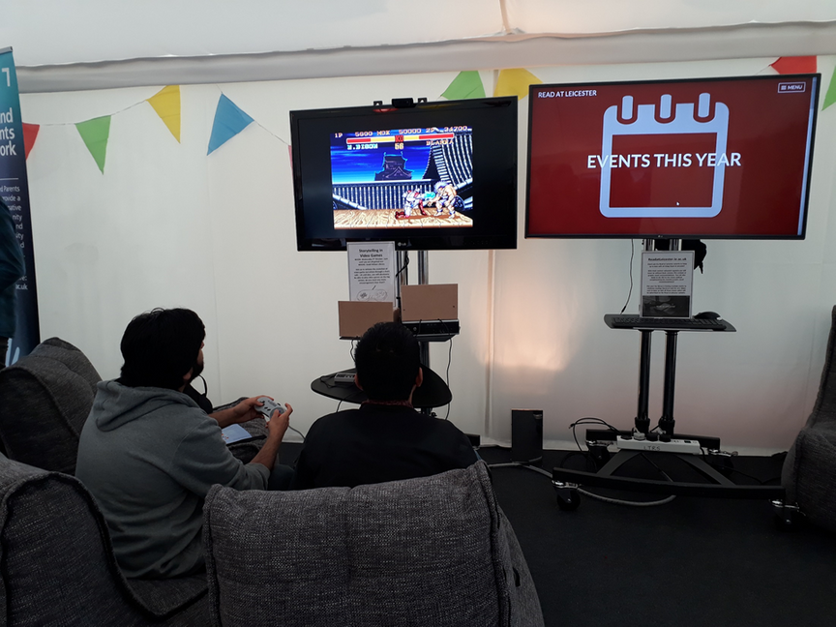
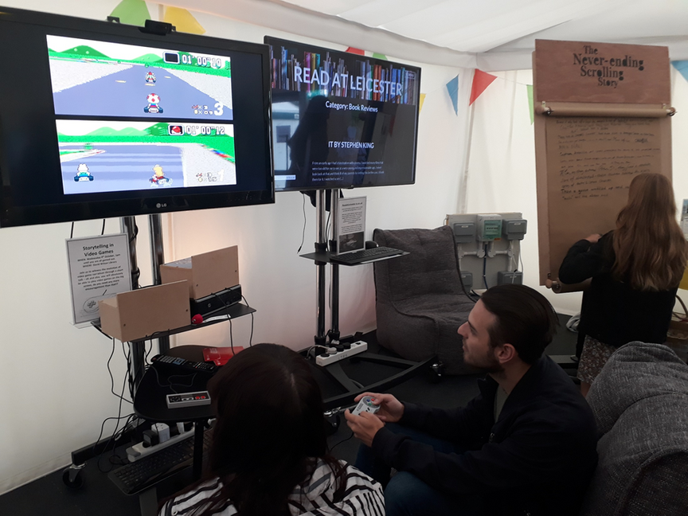
Welcome tent
Scrolling Story
Advertisement of events
Games console set up to draw people in (it was relevant though!)
Opportunity to cascade further library information
Good opportunity to have frontline staff engaging positively with students

Slide 9
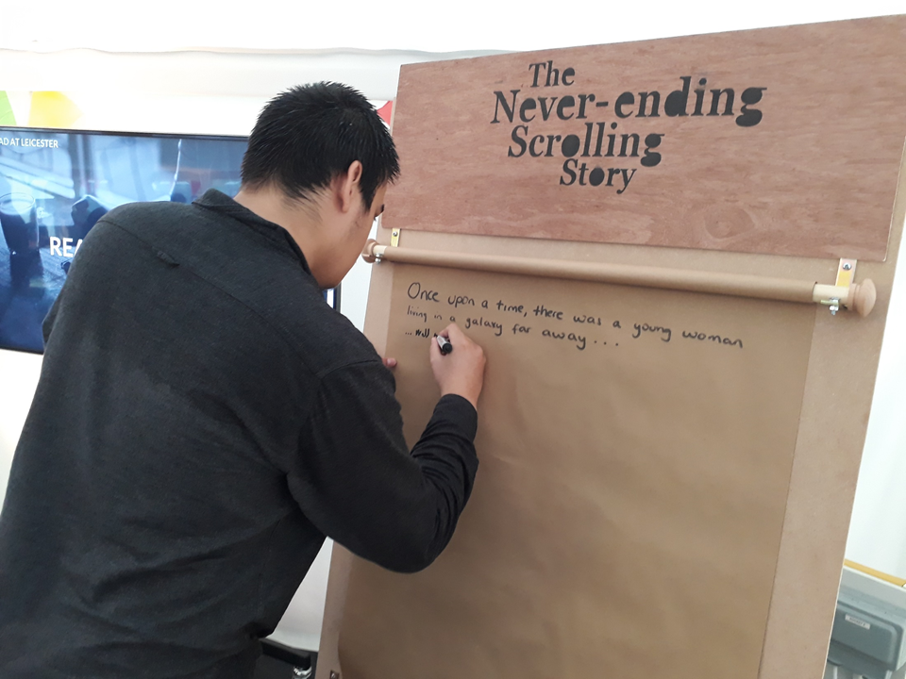
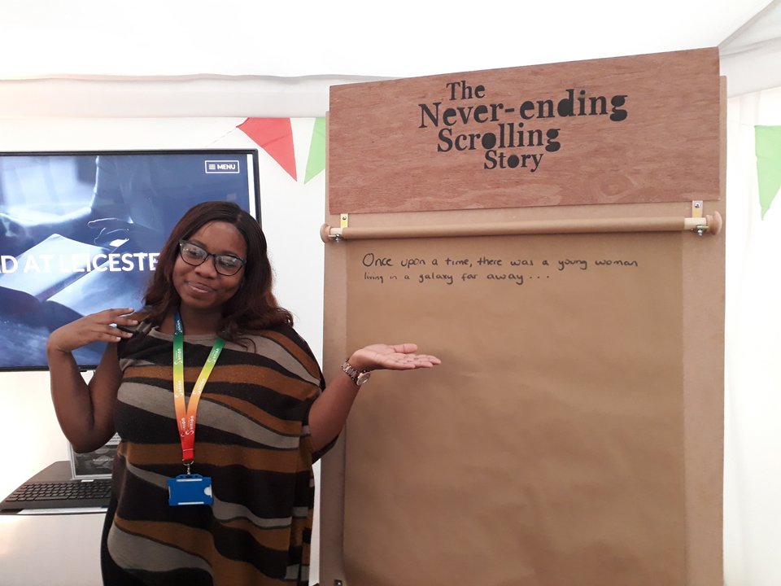
The Never-ending Scrolling Story
Contributed to by numerous people across the University
Everyone's voice has the opportunity to be heard
Will be published on the Read at Leicester website in April
readatleicester.le.ac.uk

Slide 10
He goes up to her and it dawns on him: we are all one and the same person – he is Greta Thunberg! They decide to both go travelling together and explore some new places!
They begin with the USA and the first person they meet is Donald Trump...
Trump said something stupid but Greta stuck up for her new friend and pushed Trump off Niagara Falls.

Slide 11
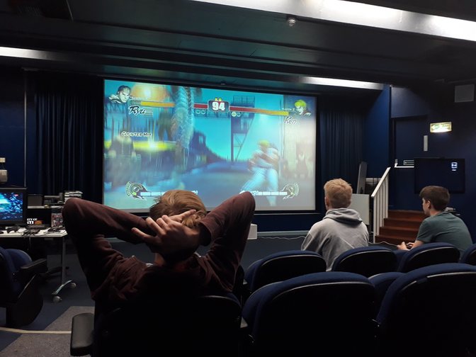
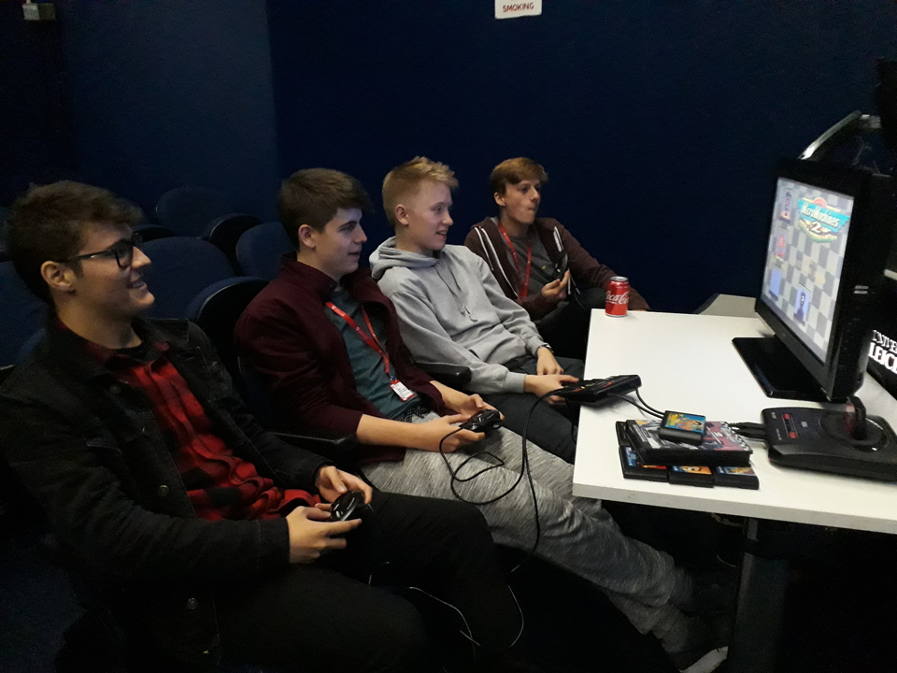
Narratives in Video Gaming
Brought students together
Showcased Library staff as fun and friendly
Staff development opportunity
Prizes were won!

Slide 12
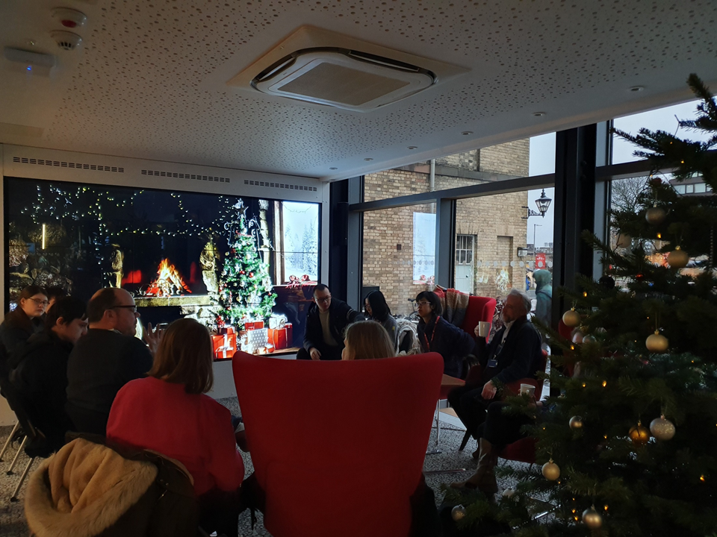
Digital Dickens

Slide 13
readatleicester.le.ac.uk
Events listings
Represent campaign
Book reviews
Film reviews
Reading lists
Graphic Novel Recommendations
We've got issues Podcast

Slide 14
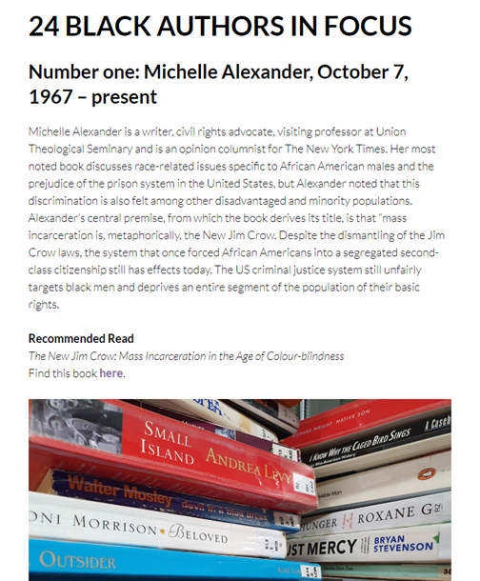
All Library staff are encouraged to contribute and students too!

Slide 15
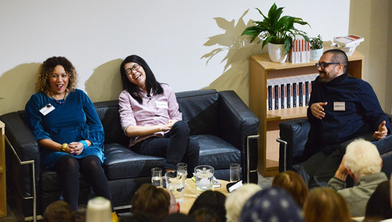
The Good Immigrant
Panel discussion at the University of Leicester with writers from The Good Immigrant

Slide 16
Read at Leicester leisure reading collection

Slide 17
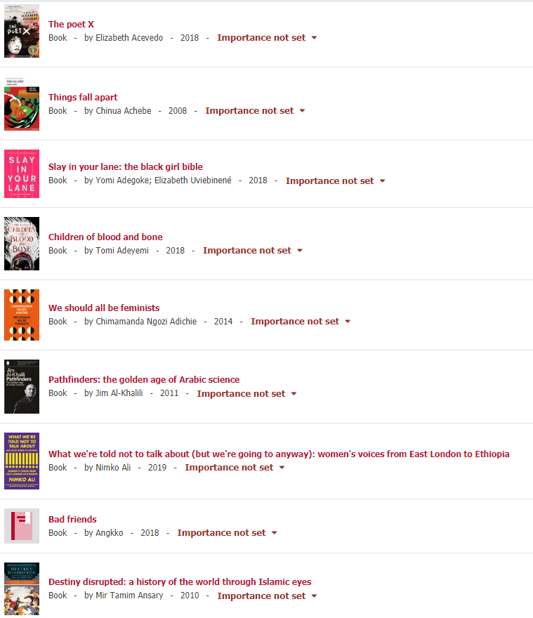
Underrepresented voices

Slide 19
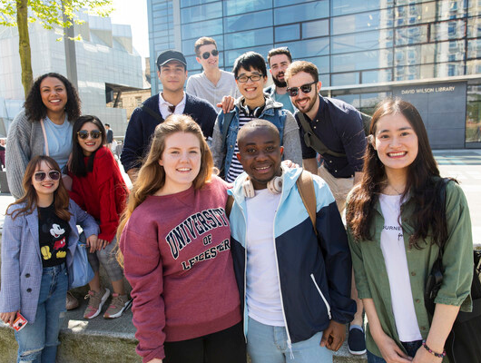
Library Champions
Promote collection within subject departments
Collect feedback about impact of collection

Slide 20
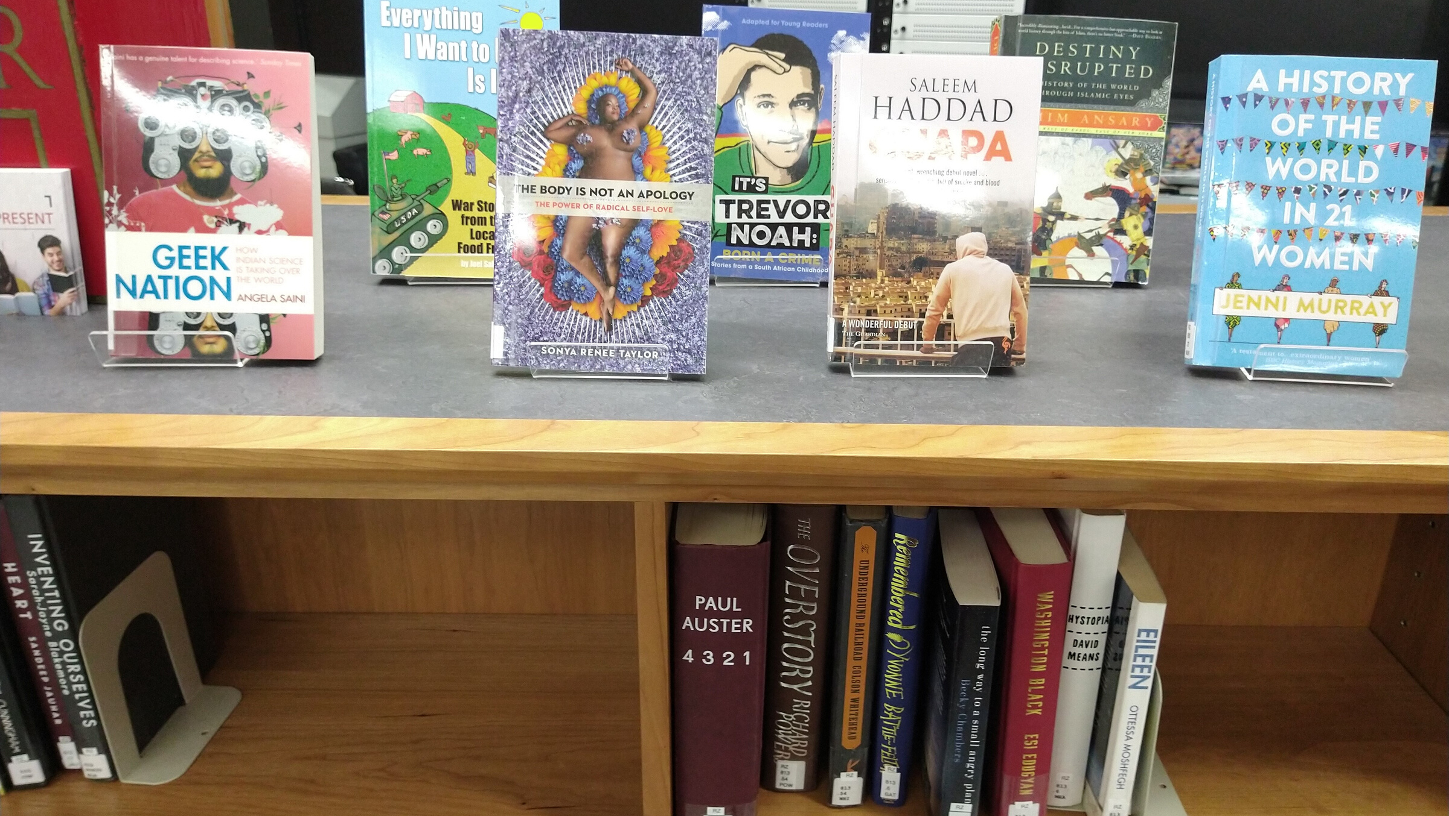
Future Plans
Represent zine making workshop
Funding for next year
Research: Impact of the collection and the Represent campaign
More engagement opportunities

Slide 21
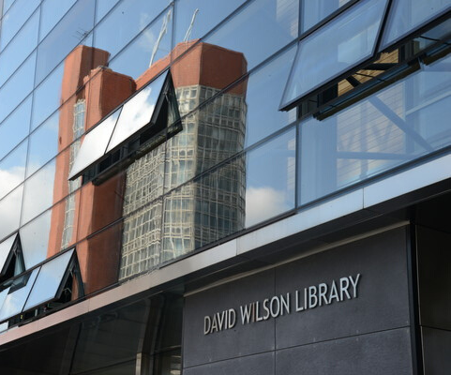
Website
readatleicester.le.ac.uk
Email Address
heena.karavadra@le.ac.uk
hlc48@le.ac.uk
Twitter
@UoLDWL
@heenakaravadra
@hannahcongrave

