Slide 1
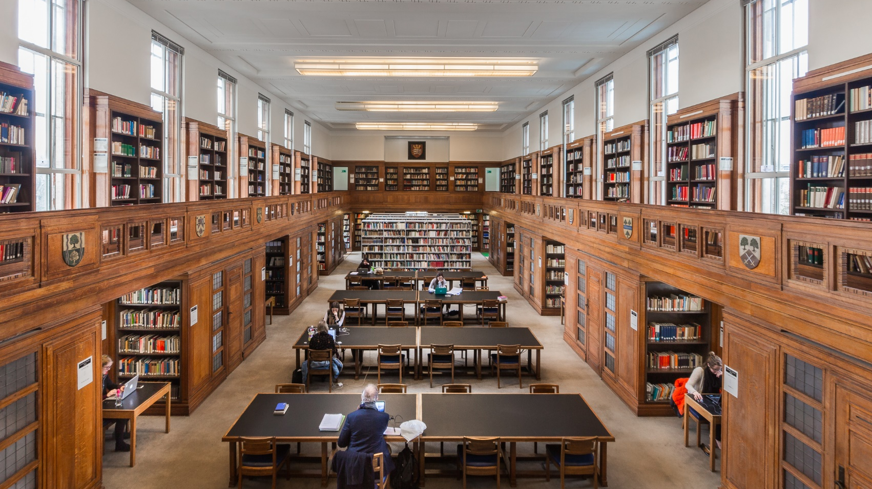
Help Stop Book Damage
@ Senate House Library
University of London

Slide 2
Damaged Books Campaign It’s worth it!
“Please accept my sincere apologies -- and thank you very much for bringing this to my attention.”
“I will most certainly avoid this practice in future”

Slide 3
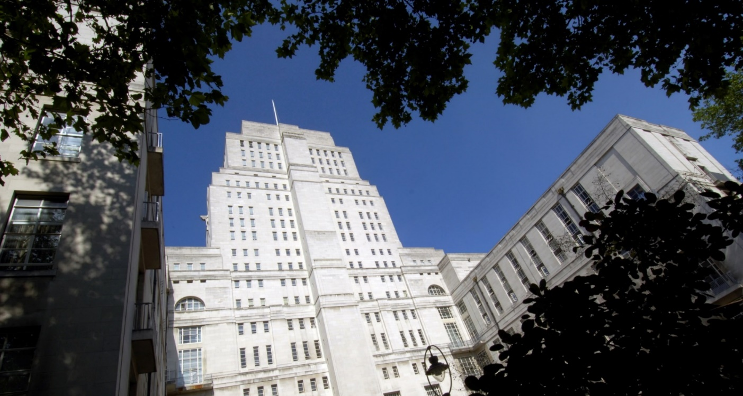
Aleksandra Piotrowska
Library Assistant at Senate House Library

Slide 4
Things we’ll cover:
Help Stop Book Damage – why we started the campaign?
What we did to make it happen
Issues that come with the project
Results of the campaign

Slide 5
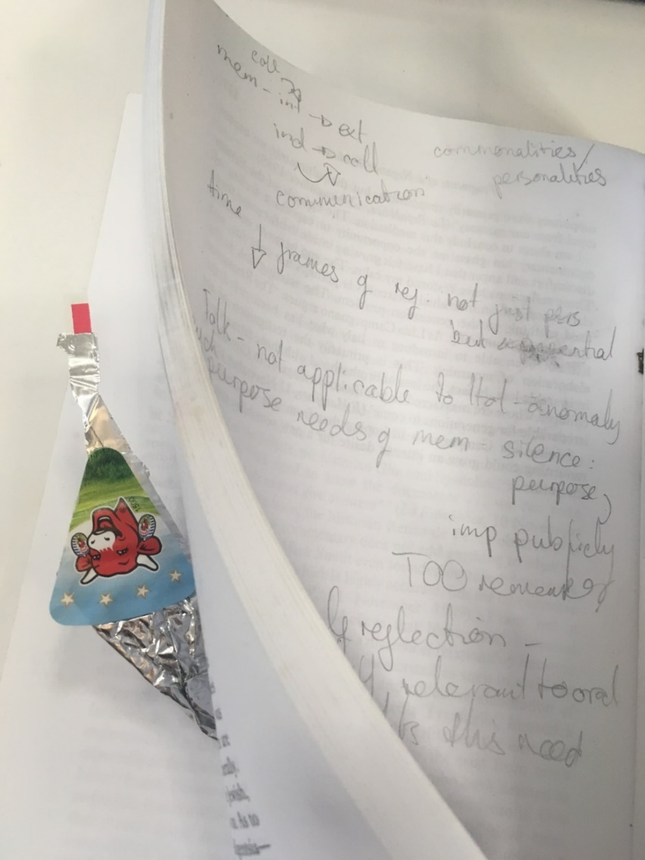
Why we started the campaign?

Slide 6
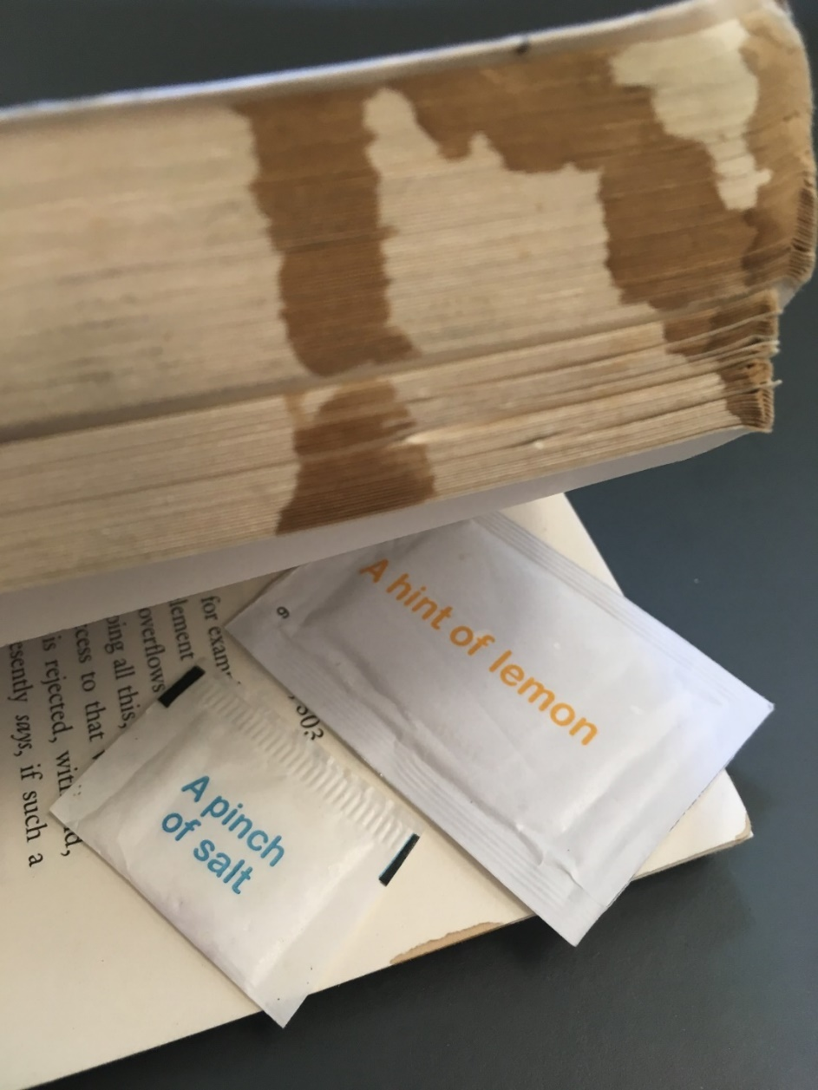
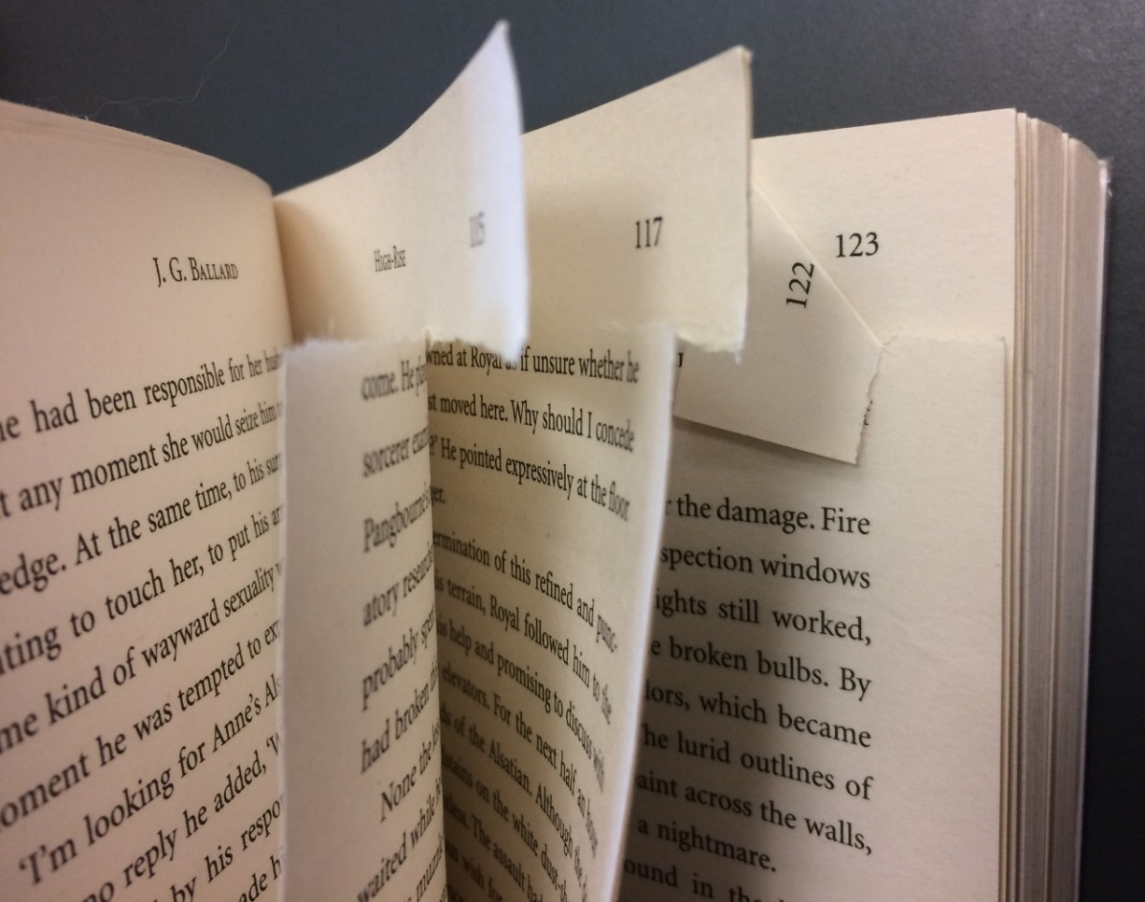

Slide 7
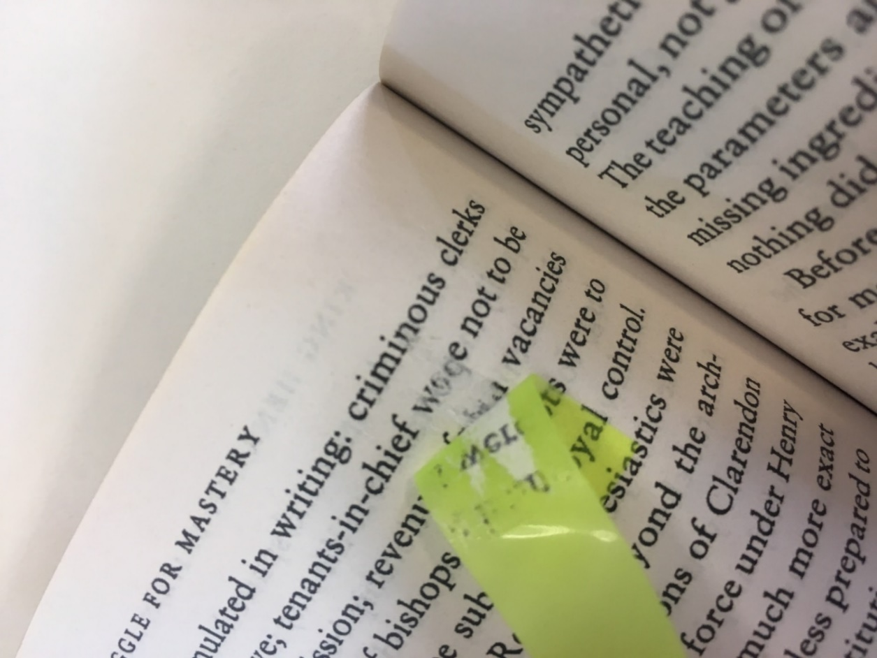
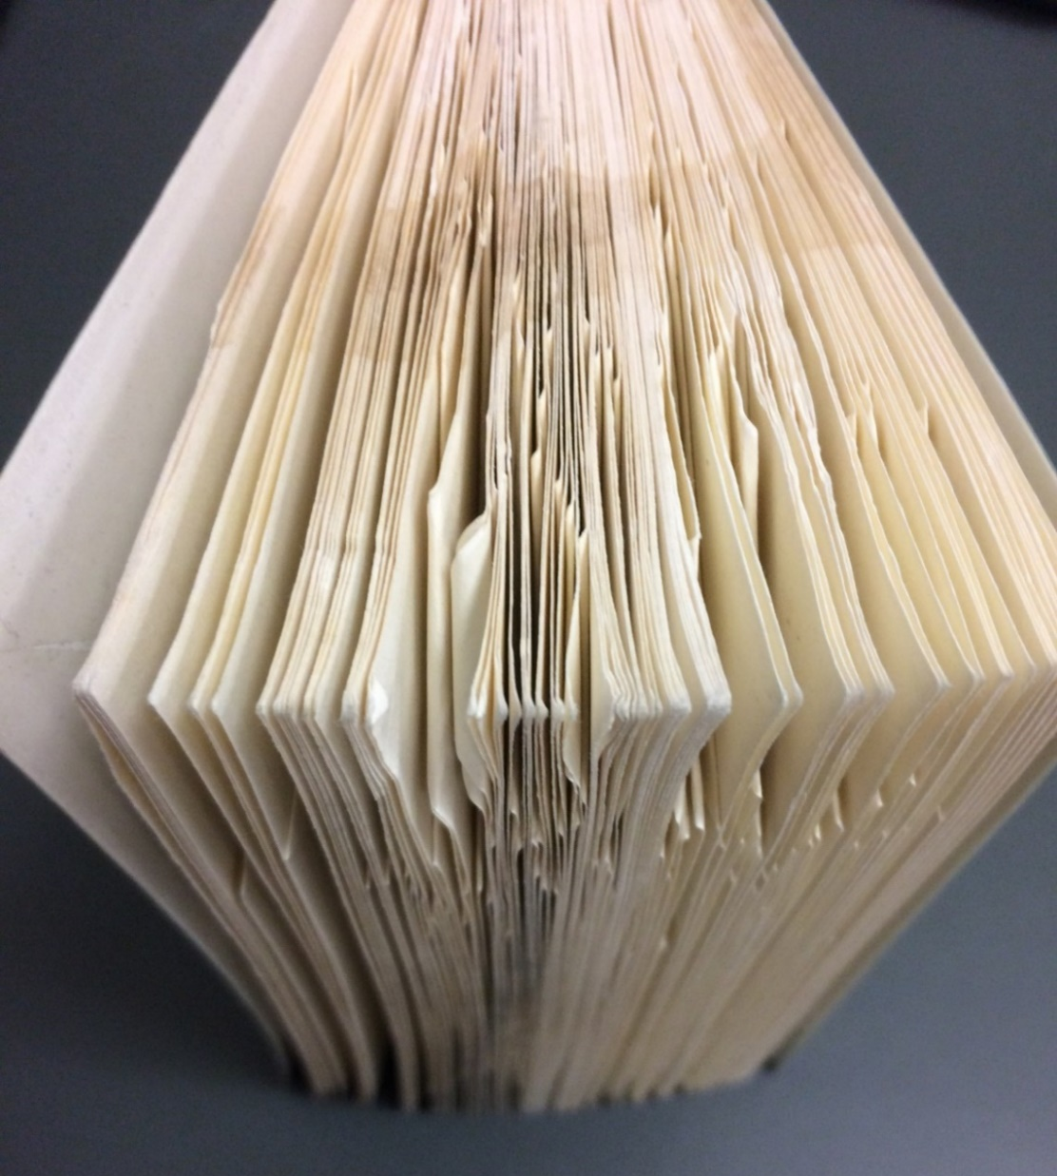

Slide 8
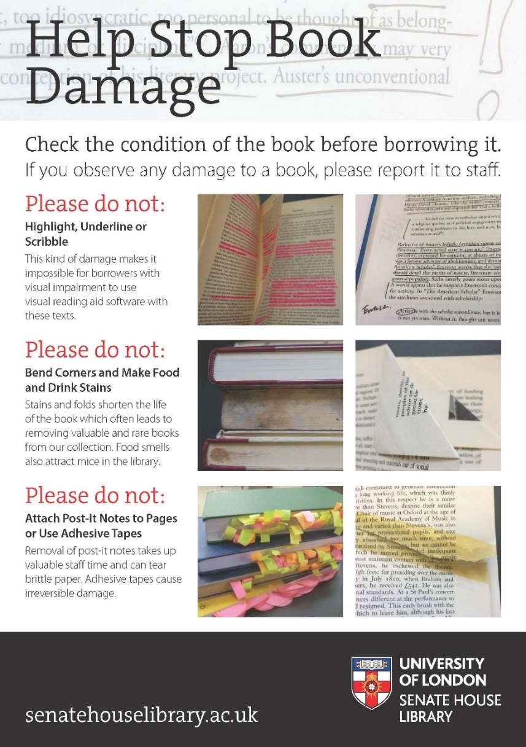
What we did?
Bookmarks
Poster

Slide 9
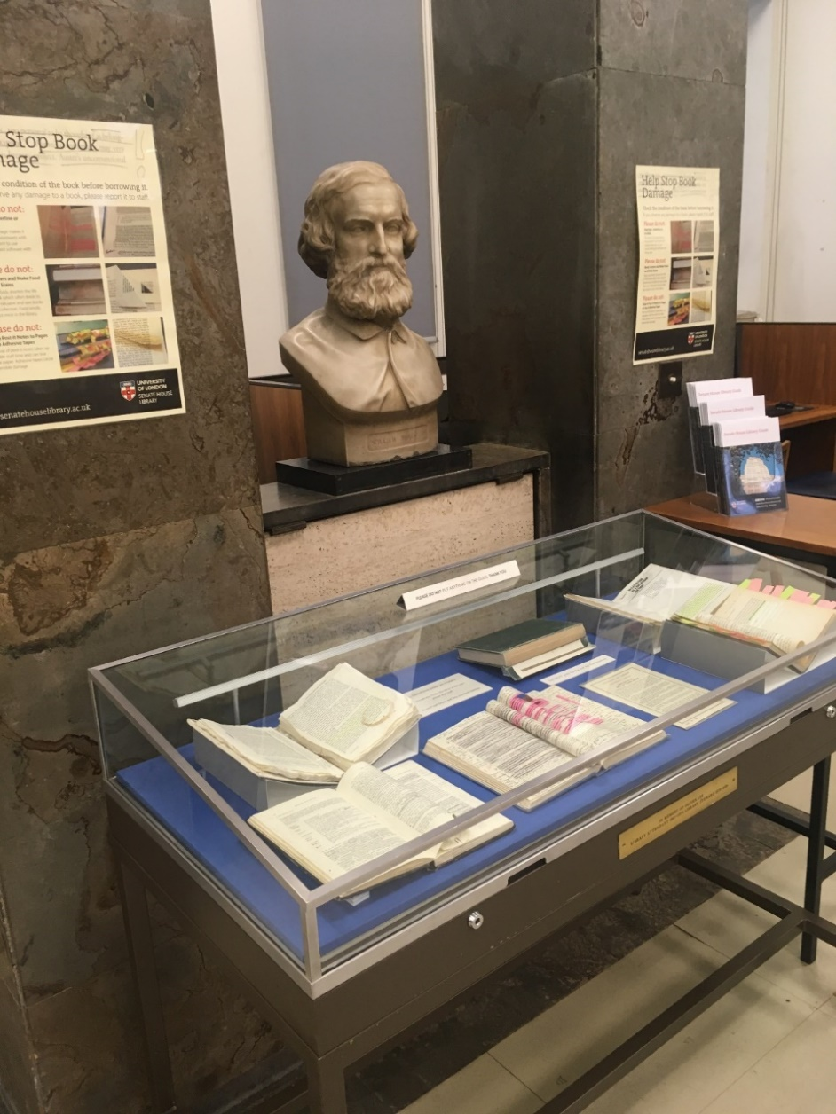
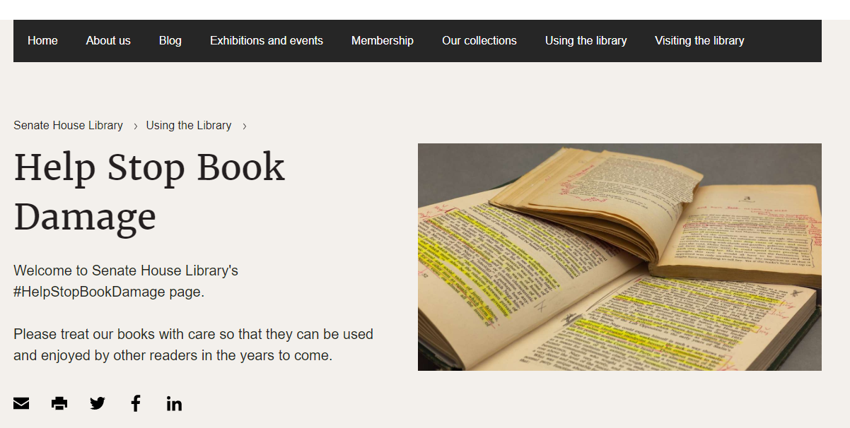
What we did?
Display Cabinet
Web page

Slide 10
We also:
Created a library account for damaged books
Composed procedures for staff
Designed an email template to send to users
Included the campaign in library inductions
Keep information updated

Slide 11
Issues we face
How we gather data: malicious damage vs repairs

Slide 12
How to identify responsibility for the book damage
“These books were already like this when I took them out on loan ”

Slide 13
Results of the campaign
Savings in money and staff time
Increased awareness of the consequences of book damage
Working on the campaign brought staff from different departments together
Readers appreciate that we are working to prevent book damage

Slide 14
Summary
We started the project because too many books were returned in a bad condition
We started publicity campaign to increase awareness
Difficulties we face are mainly around how to collect data and how to identify responsibility
Results of the campaign are evident in lower number of books returned in a bad condition

Slide 15
Damaged Books Campaign It’s worth it!
“I think this is really good, and it is long overdue!”
- library supervisor
“This is great. I think you’re right to keep it succinct and catchy and I think you’ve covered most things.”
- senior conservator
“I particularly like the display case with the defaced pages! I hope our researchers will take that on board.”
- subject librarian

Slide 16
Thank you
Aleksandra.Piotrowska@London.ac.uk

