Slide 1
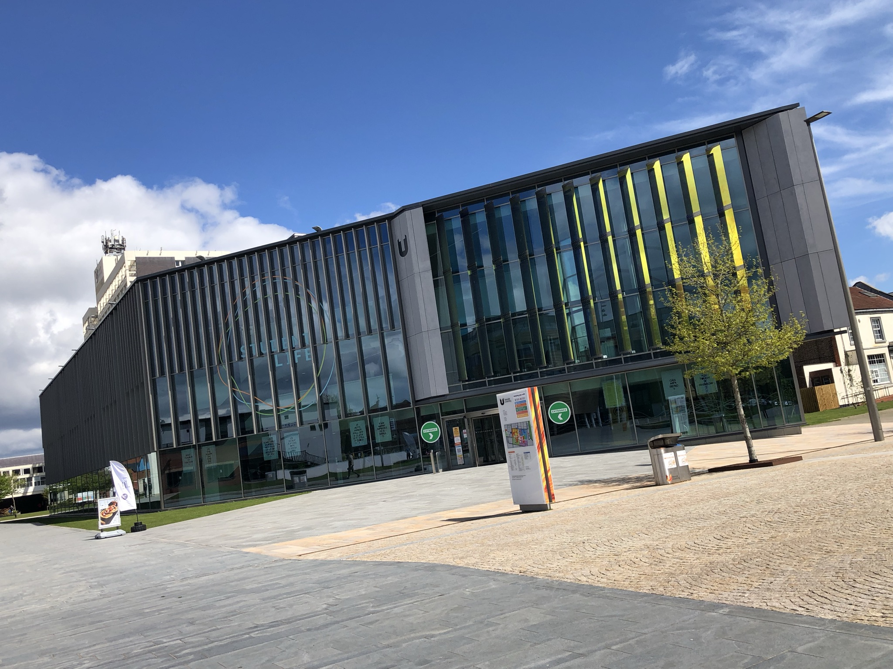
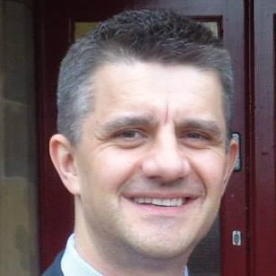


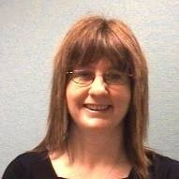

“Twisting at Teesside”
Neal Harper
@nealharper
www.linkedin.com/in/nealharper
Jackie Oliver
@jackoliver40
c
www.linkedin.com/in/jackie-oliver
CSGUK Annual Conference 2021

Slide 2
Contents
Background & context
Converged service
Student Life
Covid-19
Service model
The Future
c

Slide 3
Background & context
Teesside University
Location
Our students
#TeamTeesside
Student Voice
c

Slide 4
History
Joining of Student and Library Services in 2017
Combined Enquiry Management Team for frontline customer services
Launch of Student Life concept
A new building, a new service
Library-based “Pilot”
Hub and spoke model
“One-stop shop for help, support and well-being outside of the classroom”
~20 student-facing services accessible from one place
Significant online offer
  Enquiries Management System + tiered approach
  Knowledgebase
  Web portal
  App
  Self service
  A
c

Slide 5

Launch of Student Life
January 2020

Slide 6

Covid-19
Buildings closed
Switched to entirely home-based working
Virtual customer services provided
Extensive use of MS Teams
Online support & virtual appointments
Moving through lifting of restrictions…
Restricted opening hours
Individual & bookable study spaces
Reserve & collect for printed material
Returned to normal operations – Sep ‘21
c

Slide 7
Service model
Self
service
One-stop shop
First-line / triage
Appointment management
Referrals
Face to face
Phone
Online
Assisted
service
Attended
service
c

Slide 8

What does the future look like?
Much more emphasis on digital
  90% enquiries now virtual
  50/50 pre-pandemic
  Staffing resource / service priorities
Digital first in service delivery
Using data
Constantly improving online offer
  Web & Knowledgebase
Answering as many questions as possible at the first time of asking
Being responsive
Customer Service Excellence
c

Slide 9
Q & A
Thank you!

