Slide 1
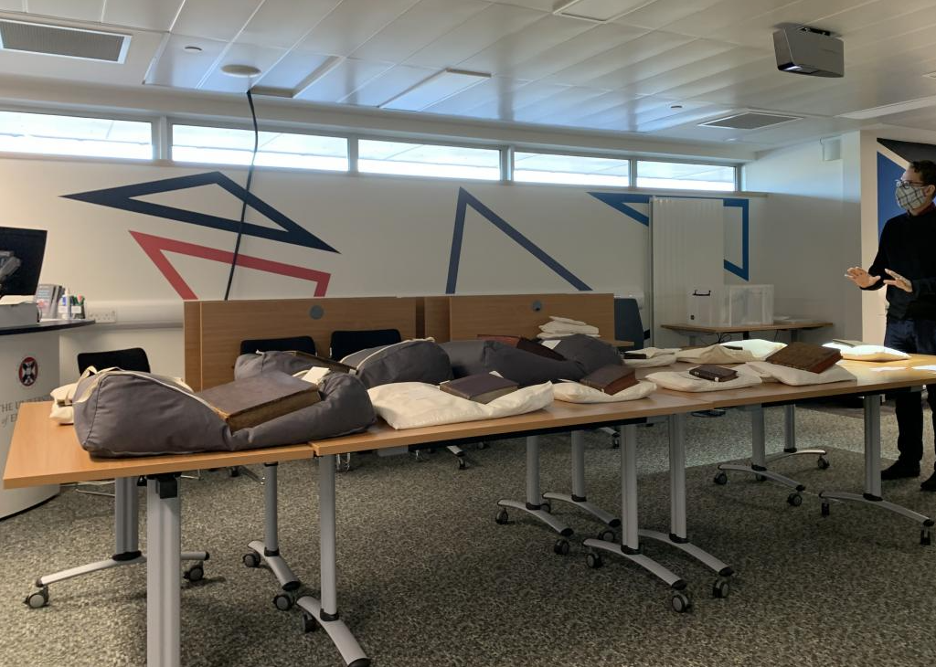
“Going Virtual: Launching a Virtual Reading Room and Teaching Service at the Centre for Research Collections.”
Daisy Stafford, Research Services Supervisor
Paul Fleming, Archives & Library Assistant
#CSGUKinspired

Slide 2
Needs we were responding to…
Keeping users and staff safe.
Alternative access whilst in-person visits weren’t possible.
Increased demand for digital collections.
Access for international researchers.
Maintaining visibility of collections during closure.
Academic need for hybrid teaching spaces.
Creating open and sustainable service offerings.
Maintaining excellent customer service – helpfulness, friendliness, ingenuity.

Slide 3
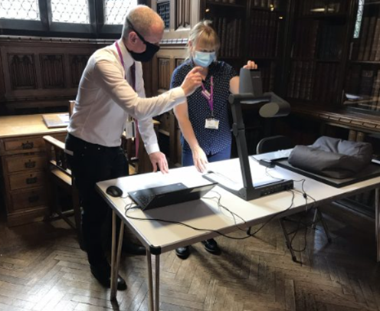
Research
John Rylands Library, University of Manchester
University of Leeds
National Archives (London)
The Virtual Reading Room at the John Rylands Library.

Slide 4
Planning
Staffing
Capacity
Space
Booking process
Staff training
Trouble-shooting Tech
Data protection legislation
Promotion

Slide 5
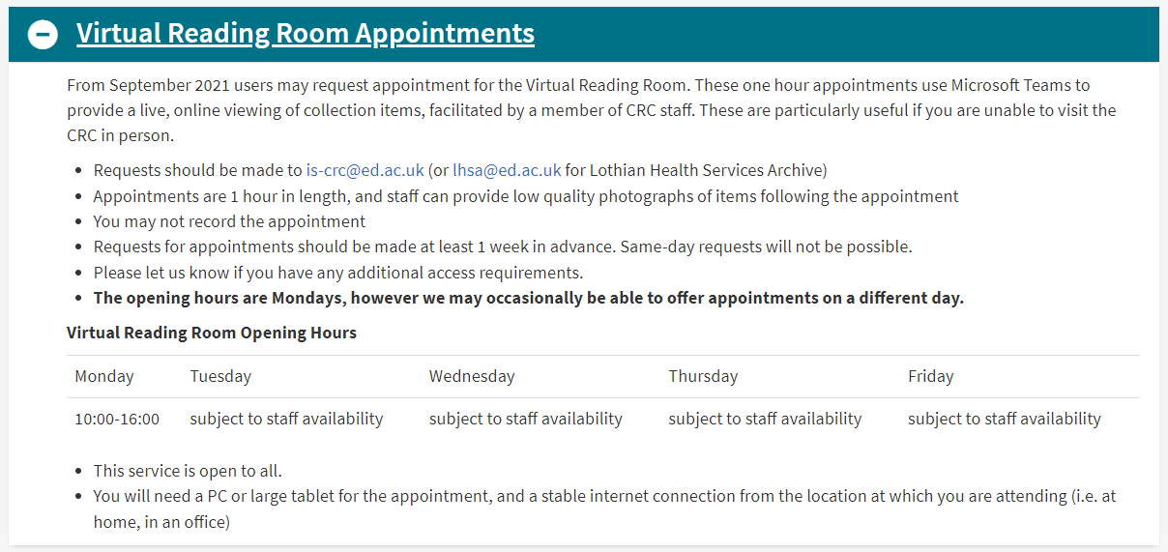

Slide 6
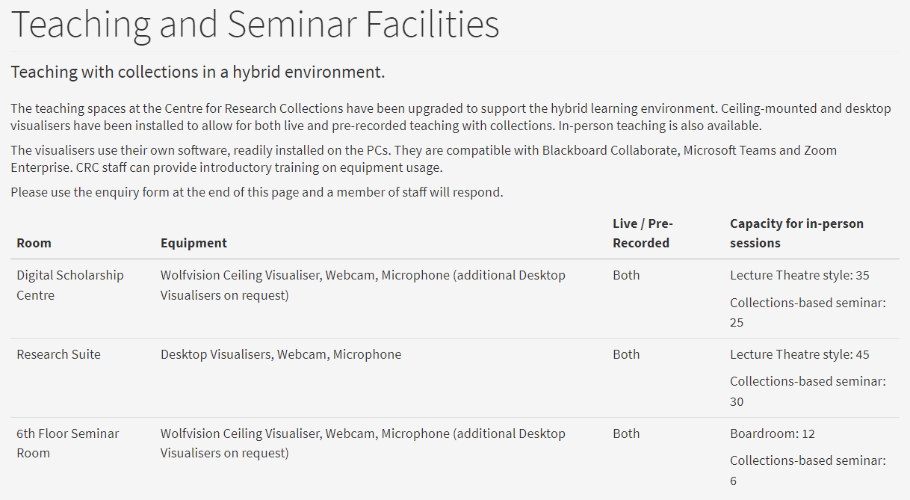

Slide 7
Learnings
Successes/Benefits:
Worldwide access during a time of travel restrictions and beyond - 50% of users in 2018/19 were external to UoE, many international.
Allows users to scope material for digitisation - before ordering copies.
Reduction of barriers such as travel - relevant for those with limited economic means or disabilities.
Sustainable service offering - reduced carbon-cost of travel for in-person appointments.
Complement to (not replacement of) in-person service - enhanced overall service catalogue.
Enabled collections-based teaching curricula - excellent use of staff expertise and knowledge.
Upskilling of staff.

Slide 8
Learnings
Challenges/Limitations:
Training staff to use equipment – need to allow time for academic staff to practice and become confident.
Digital divide – relies on users having home internet, digital skills, and own IT equipment.
Time zones – scheduling challenges with researchers from some countries.
Materiality – limitations with displaying the 3-dimensionality of objects and some other material elements.
Promotion – steady (but not high) uptake.
Time – service is currently offered whilst in-person Reading Room is closed, but may have to start running concurrently.
Trouble-shooting – technical issues and general maintenance of equipment.
Data protection – material with DP restrictions can’t be consulted in VRR (due to potential for screen-shots).
Ongoing costs – for maintenance/upgrading of equipment and staff expertise (Virtual Access Assistant).

Slide 9
Learnings
Lessons:
Be aware of the strengths/weaknesses of the format.
Deliver consultations in a discrete space to reduce potential interruptions.
Set a limit for item requests – for both consultations and teaching.
Build in adequate time before and after appointment – for booking, item retrieval, consultation set-up, and follow-up research/photography.
Treat it as a service addition, not a replacement.
Trial and error!

Slide 10
Other remote services…
General collections: Scan & Deliver.
Free digitisation offerings: quick snaps by Research Services staff (10-20 pages, medium quality).
Paid digitisation offerings: Book scans (£0.60 per page, plus VAT) or HQ (£8.00 per page, plus VAT).
Enquiries service: 1-hour of research per enquiry.
Streamer service: remote-listening for School of Scottish Studies Archive oral history and sound collections.

Slide 11
Thank you!
@CRCEd_Uni
@EU_SSSA
Daisy.stafford@ed.ac.uk
Paul.Fleming@ed.ac.uk

