Slide 1
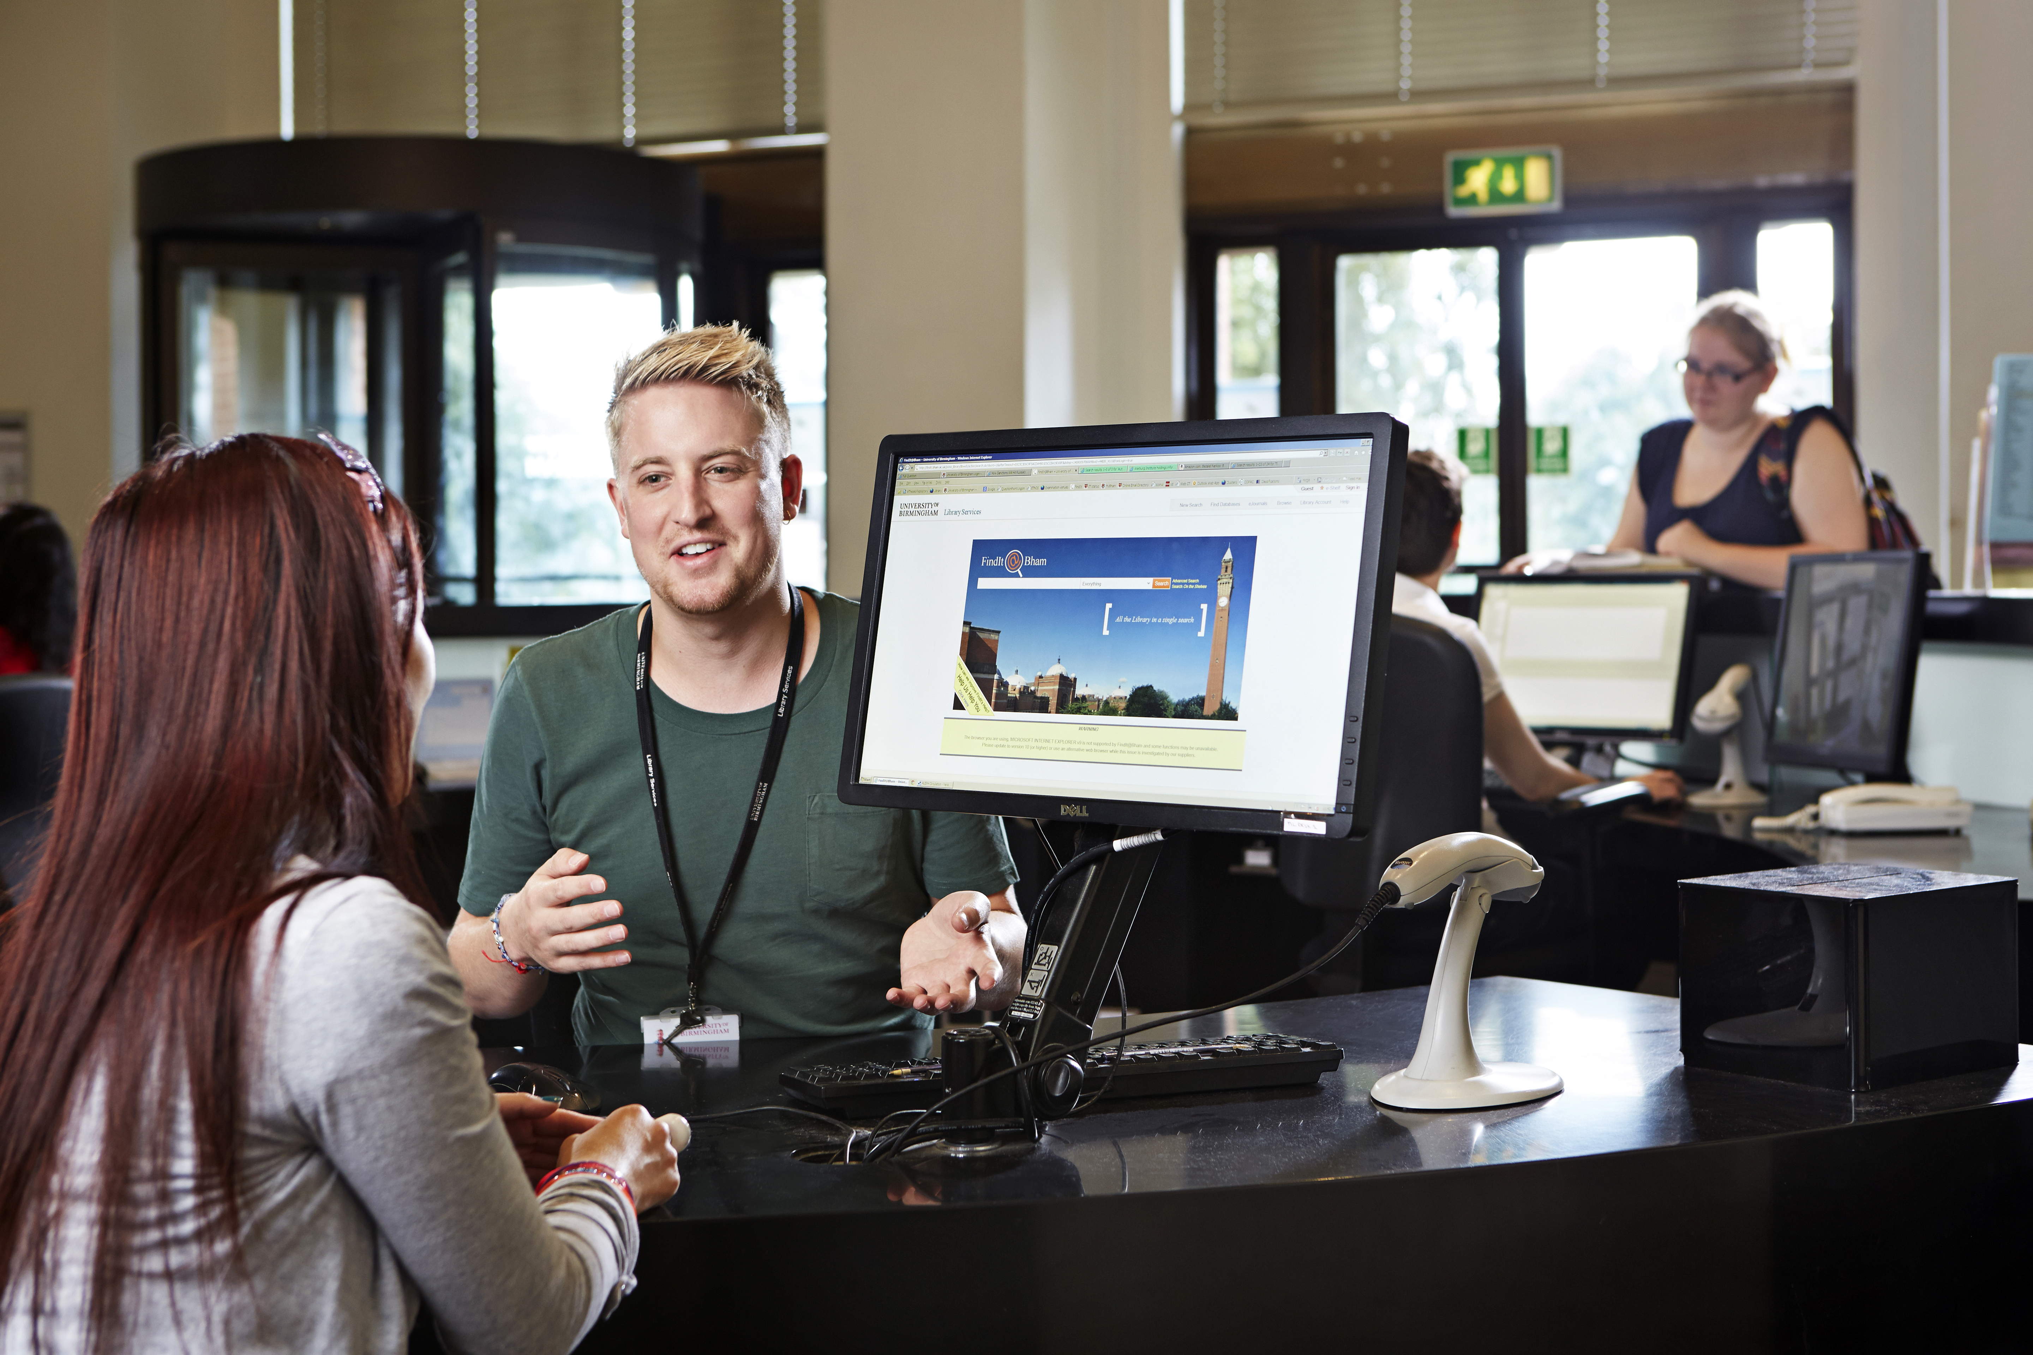

Reinventing Customer Services during Covid 19 (and beyond)

Slide 2
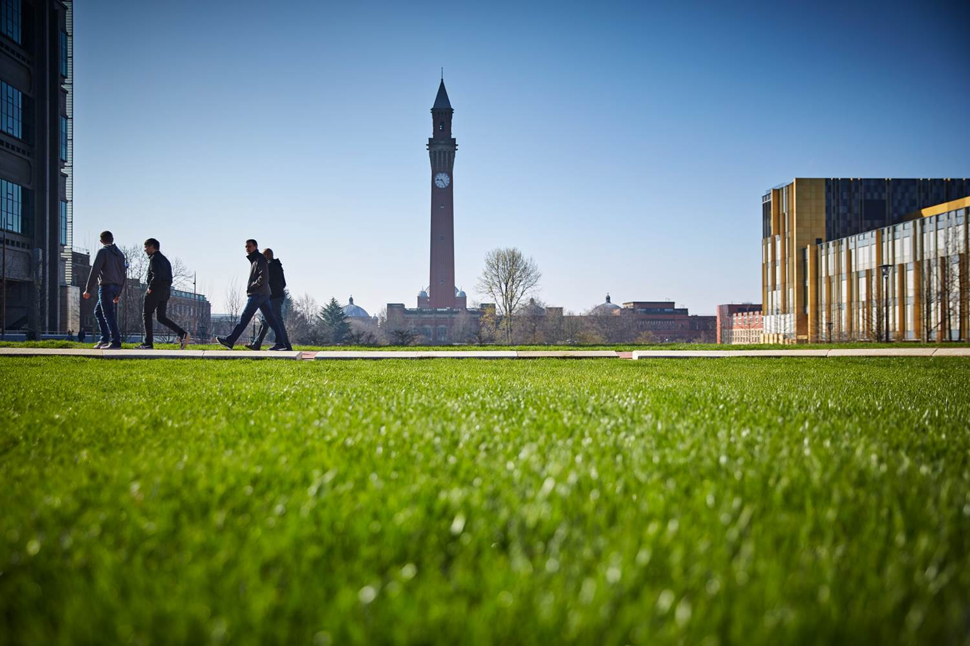

3 areas:
People and service development (Library Customer Support)
Collaboration and relationship building
Two become one; academic engagement & customer support

Slide 3
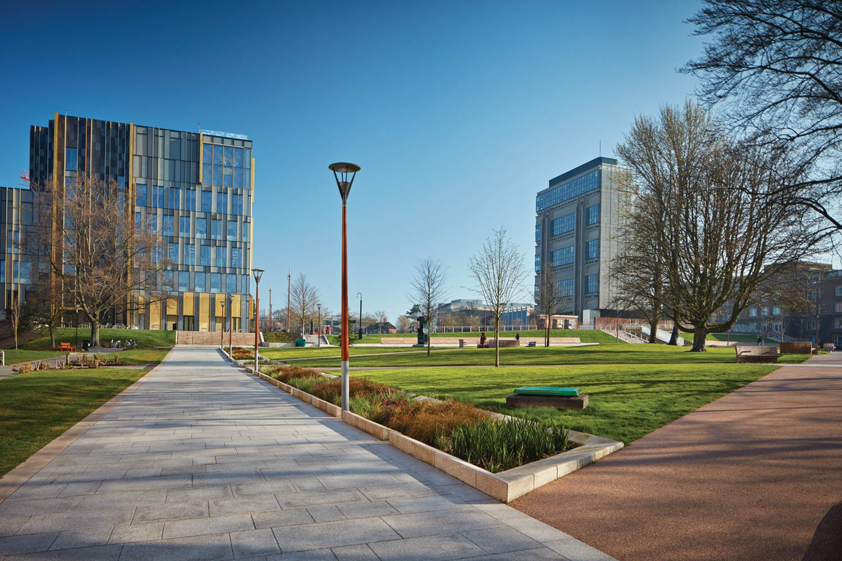
LCS development: remote enquiries
Just Ask team based in Main Library; how to involve sites?
Move from OCLC to LibAnswers
Steps:
Volunteers
Training (online)
Supported shifts

Slide 4
LCS development: remote enquiries
Unexpected benefits:
Site staff loved it – “why didn’t we do all our enquiries like this?”
Single point of contact for users
Staff could connect and share expertise

Slide 5
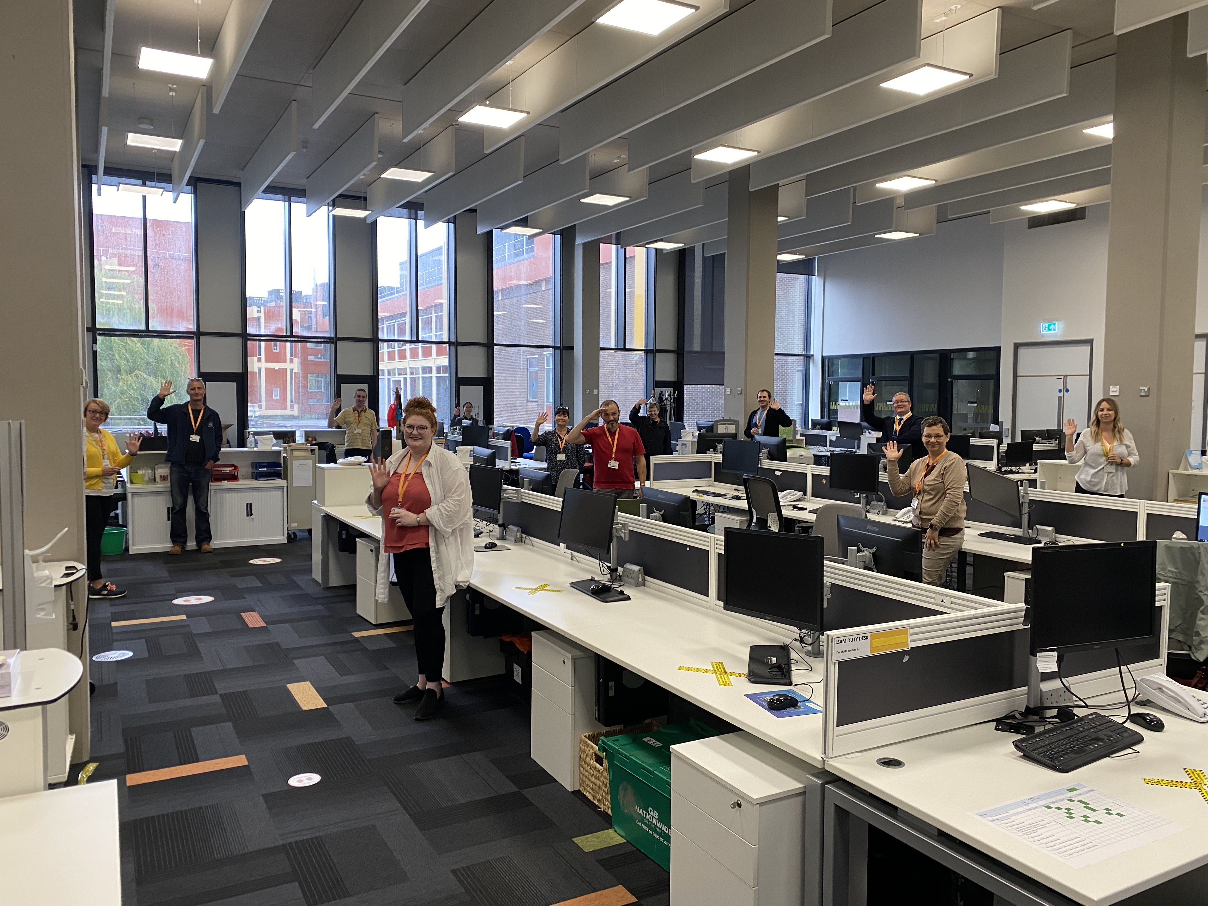
LCS development: remote enquiries

Slide 6
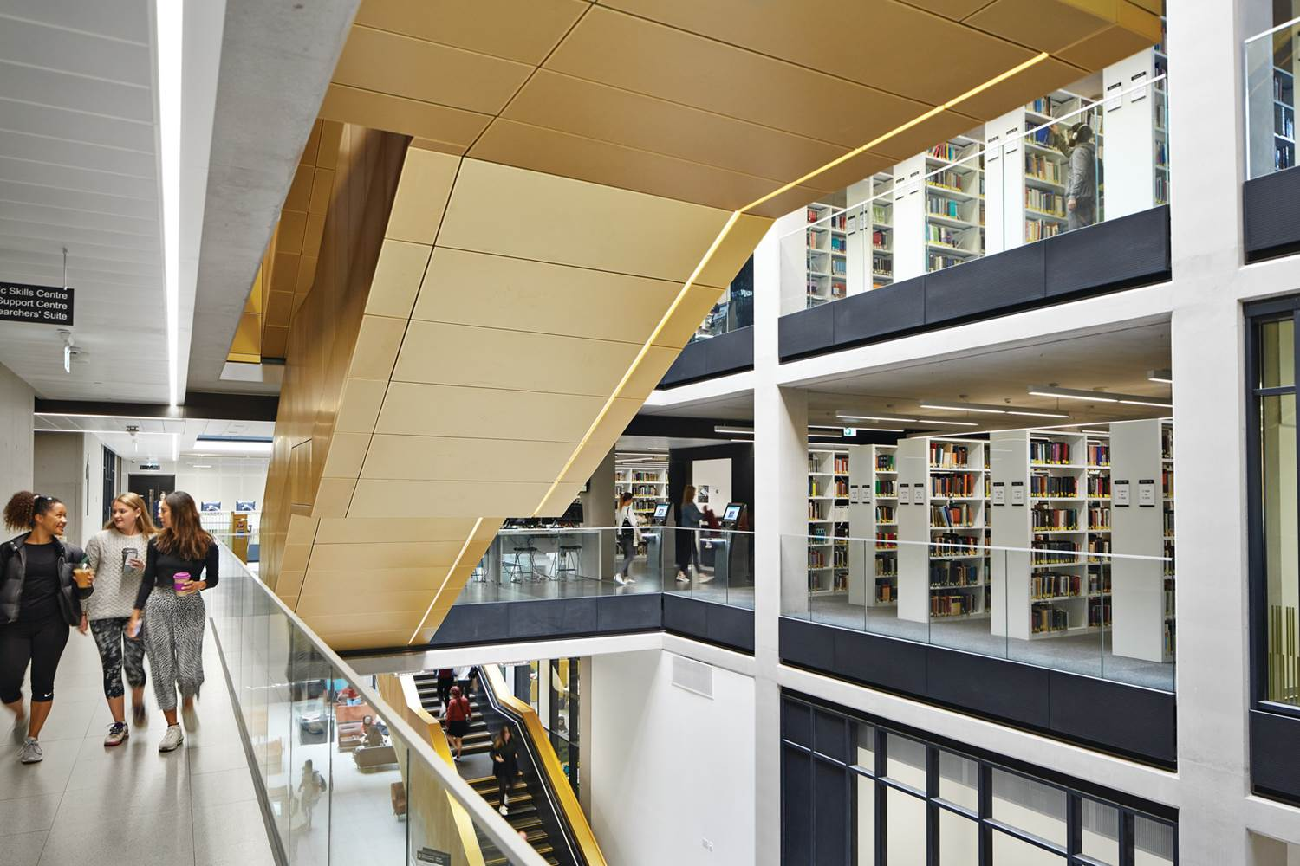
LCS development: service improvement and UX
Improvement groups
MVP & observation
Some progress
In practice:
Disrupted patterns
Experimenting as we re-open

Slide 7
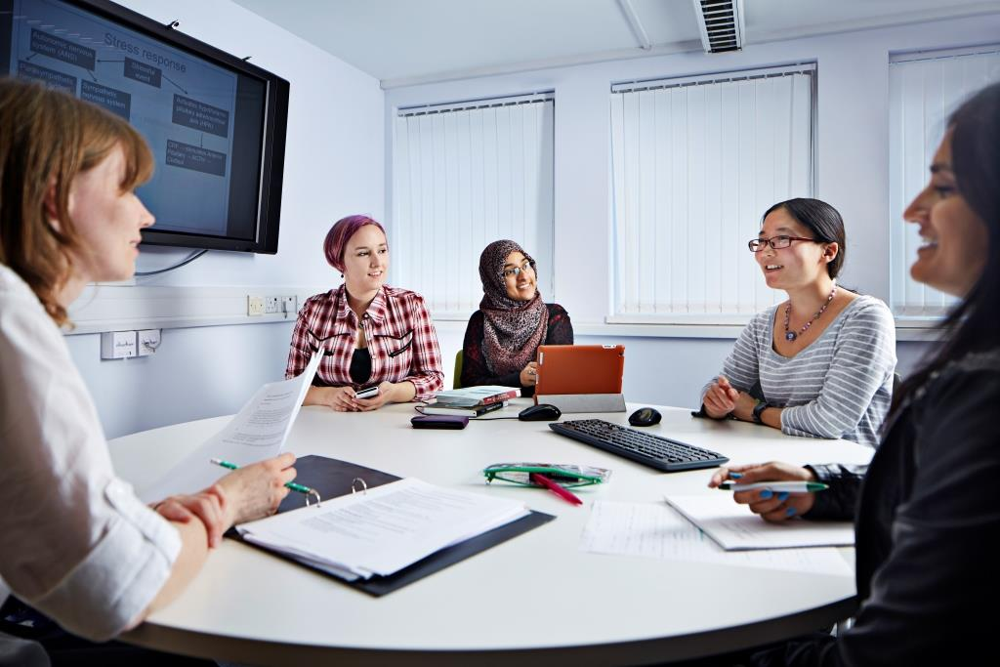
LCS development/internal collaboration
Silo working
Large staff base
Focused on day to day (LCS)
Priorities/ LCS staff involved with:
Digitisation
Resource List reviews
Digital Skills basics e.g. use of zoom/teams

Slide 8
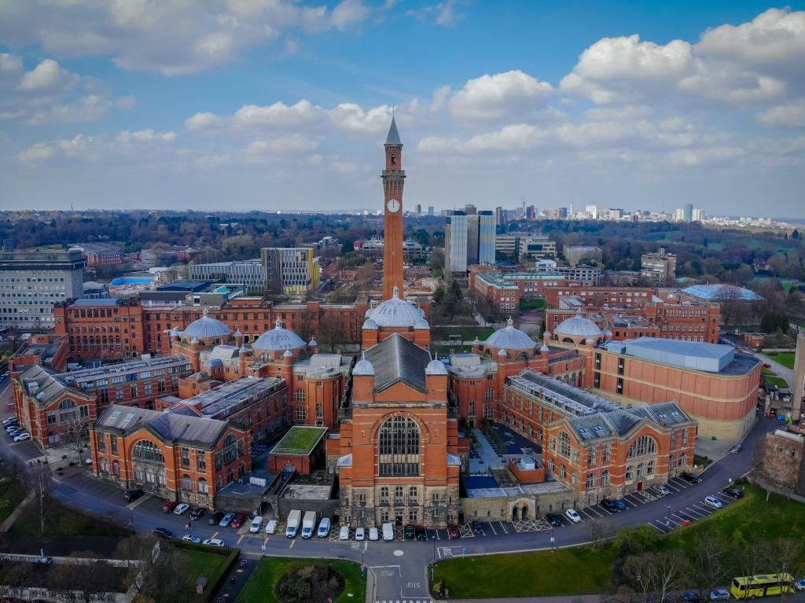
Collaboration: University-wide initiatives (1)
Before closing:
BIA virtual UK and Birmingham – Resource Lists
ITS - VPN/hand out laptops
After closing:
Halls of residence - to drop of books (not allowed on campus)
Across the academy: Wellbeing list & BLM resources

Slide 9
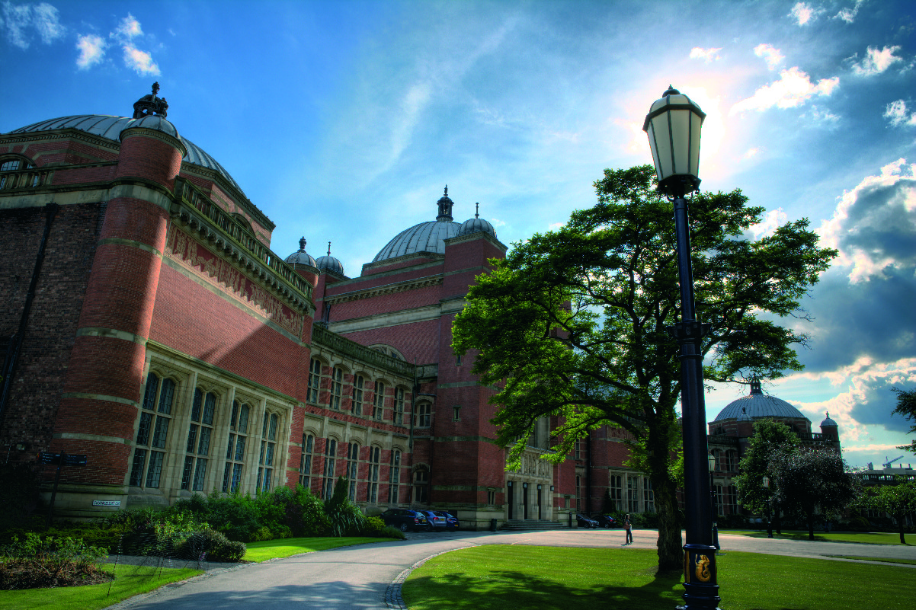
Collaboration: University-wide initiatives (2)
Extending our reach – communications
Weekly student and staff newsletter
Working with wider UoB comms team/student Guild – welcome back video viewed 16,000 times in 4 days

Slide 10
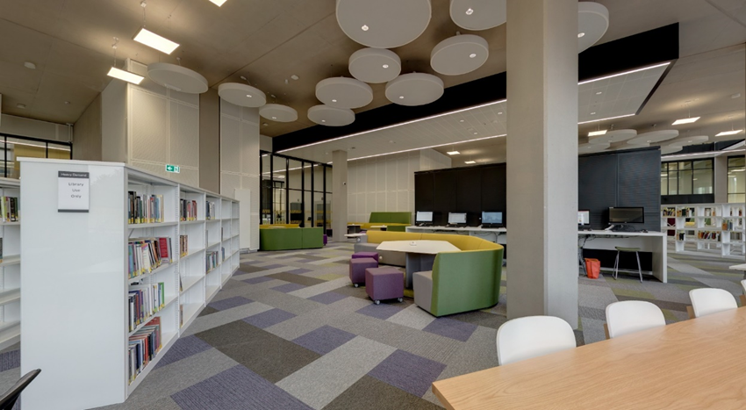
Collaboration: University-wide Initiatives (3) Space
Space for Student Services in Quick Access zone
Pop-up teaching space within the library
Using professional expertise – study spaces on campus

Slide 11
Integration of the Engagement Team into LCS
Integrated communications strategy:
  Improved processes for service-wide student and staff communications
  Surfacing fuller range of services
  Utilising Business Intelligence (BI)

Slide 12

Summary: Re-invention / opportunities
More agile workface
Strengthened Library position within the University through collaboration and strategic alliances
More focussed on our whole service offer (physical and digital) and our whole customer base (academics and students)

Slide 13
Thank you for listening. Any questions?
Claire Browne
Customer Relationship Manager
c.k.browne@bham.ac.uk
Ann-Marie James
Head of Library Engagement a.m.james@bham.ac.uk

