Slide 1


Where the library leads, others will follow:
leading organisation-wide customer service change
Leo Appleton and Nuala McLaren

Slide 2



A tale of two awards!

Slide 3
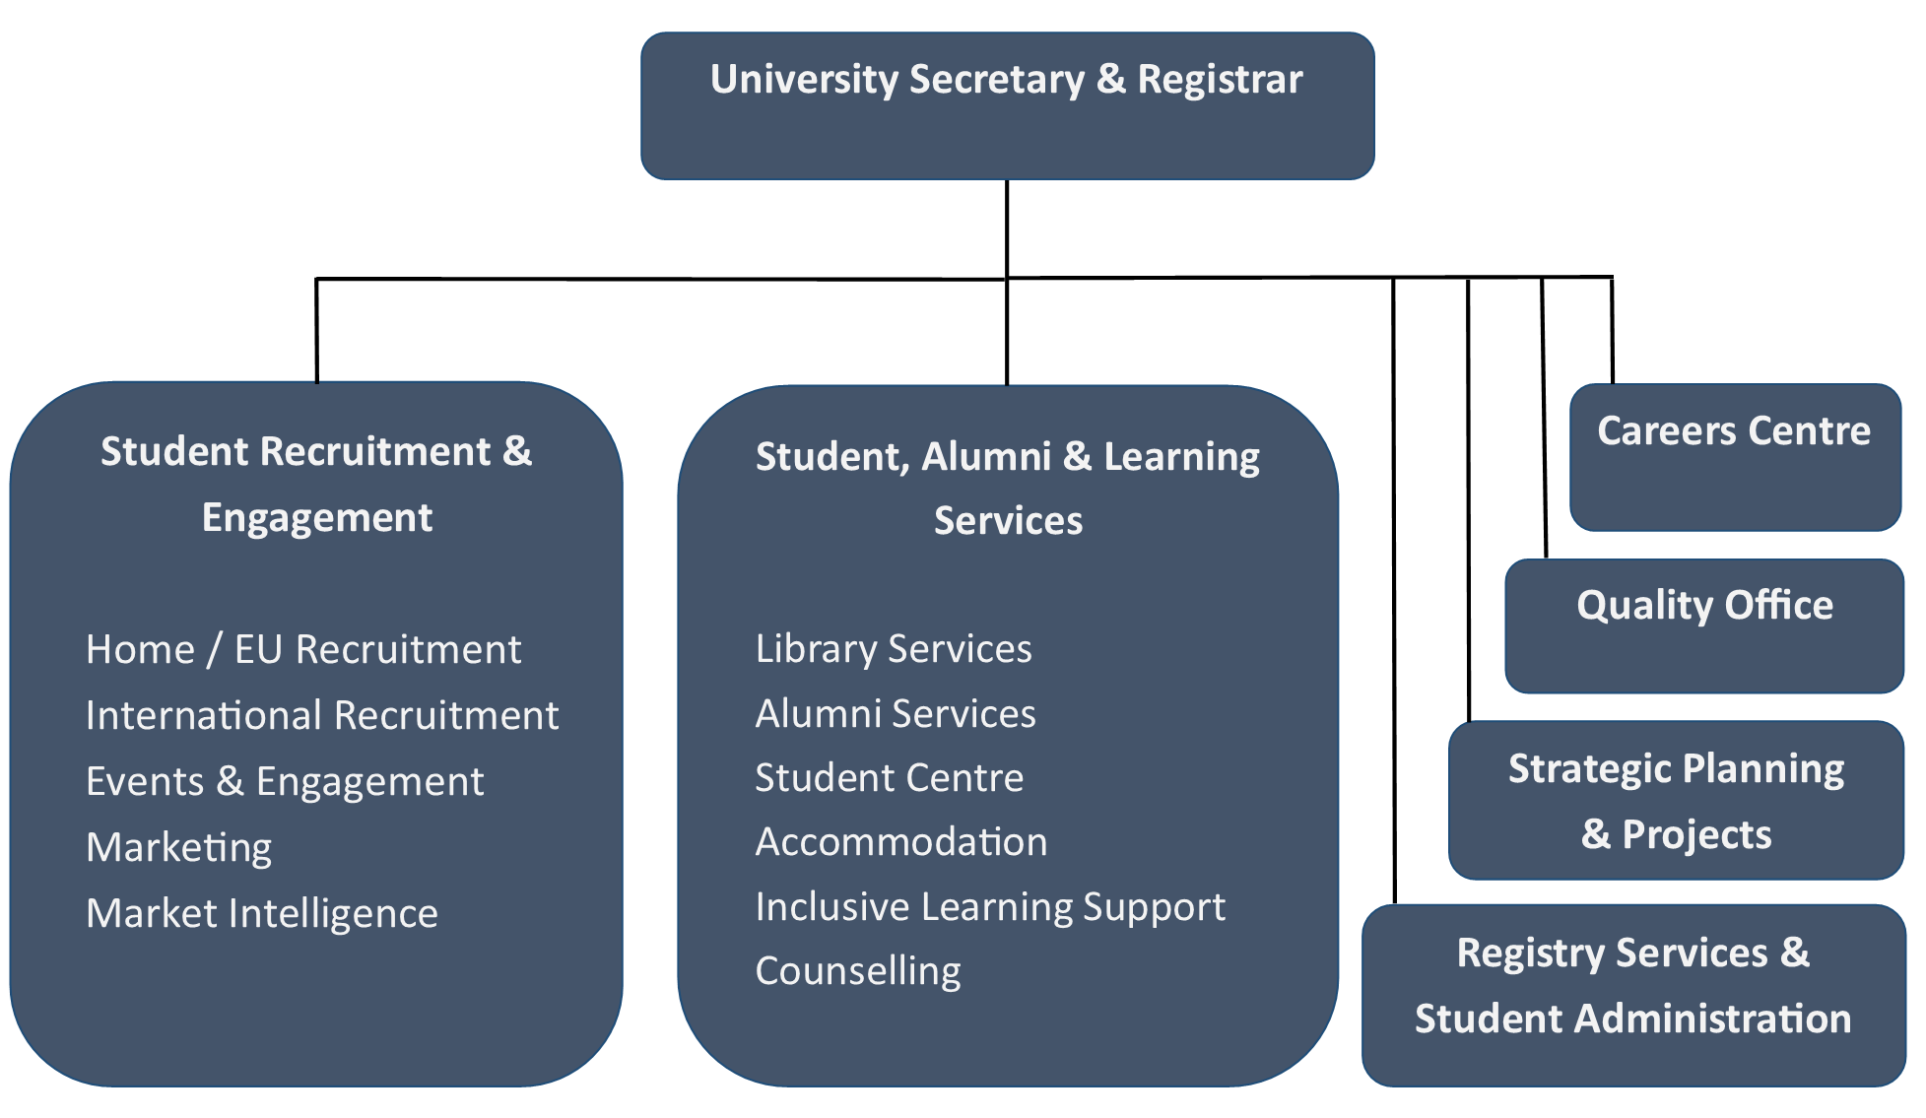
In the beginning..... (2016)

Slide 4
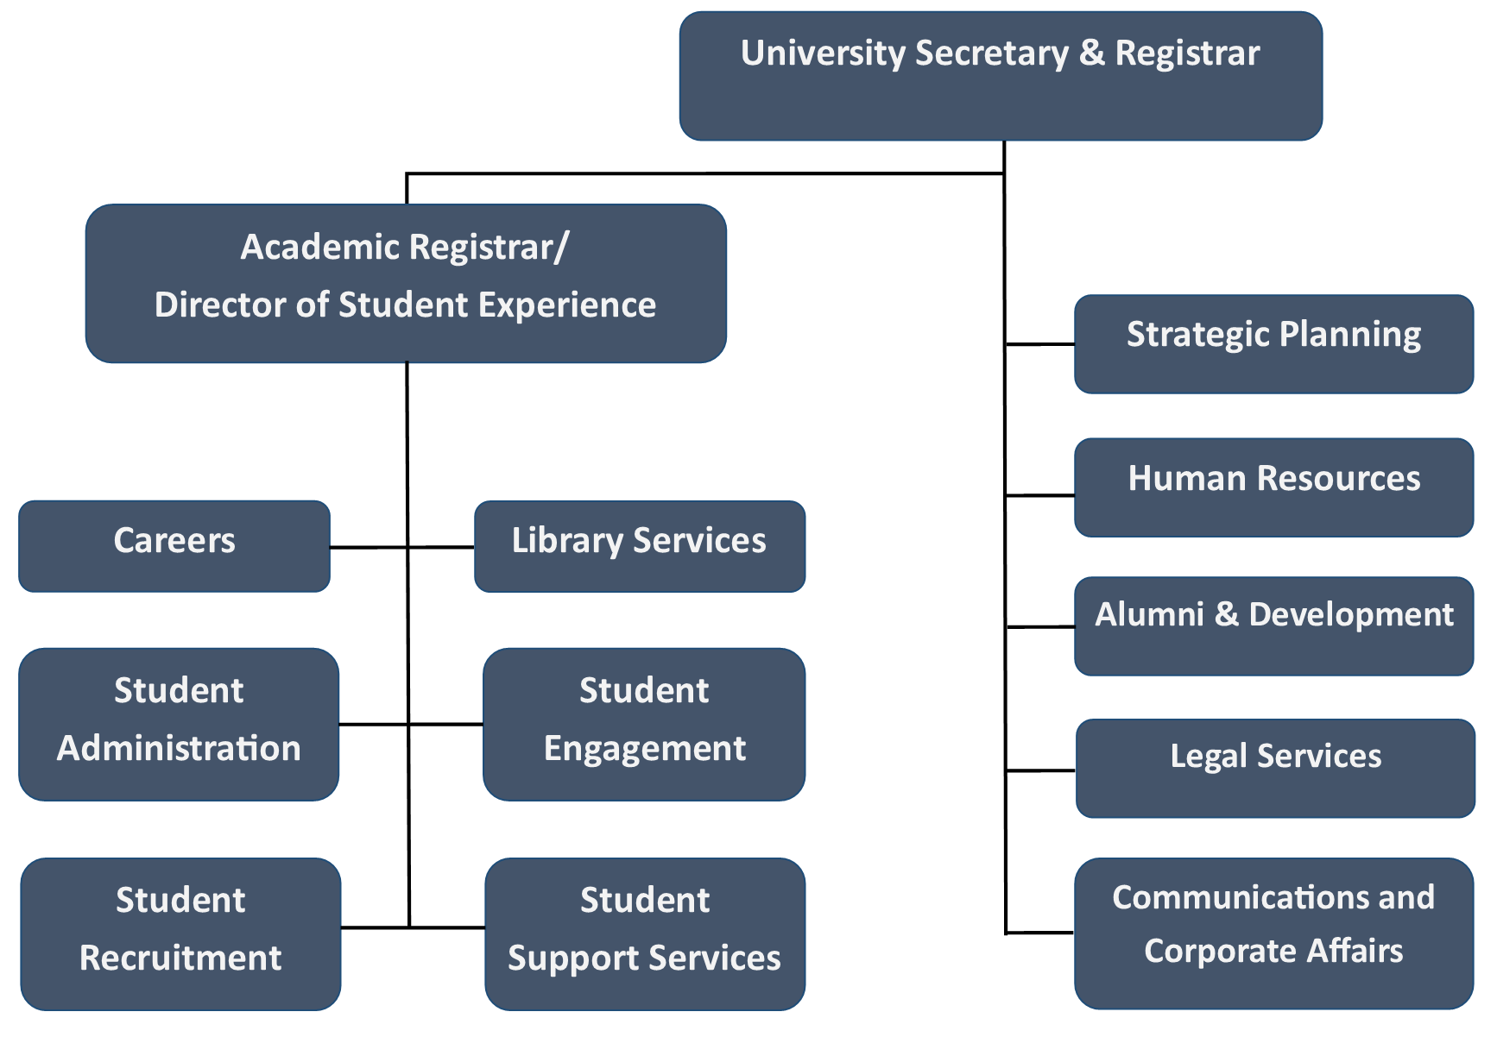
2017 Structure

Slide 5
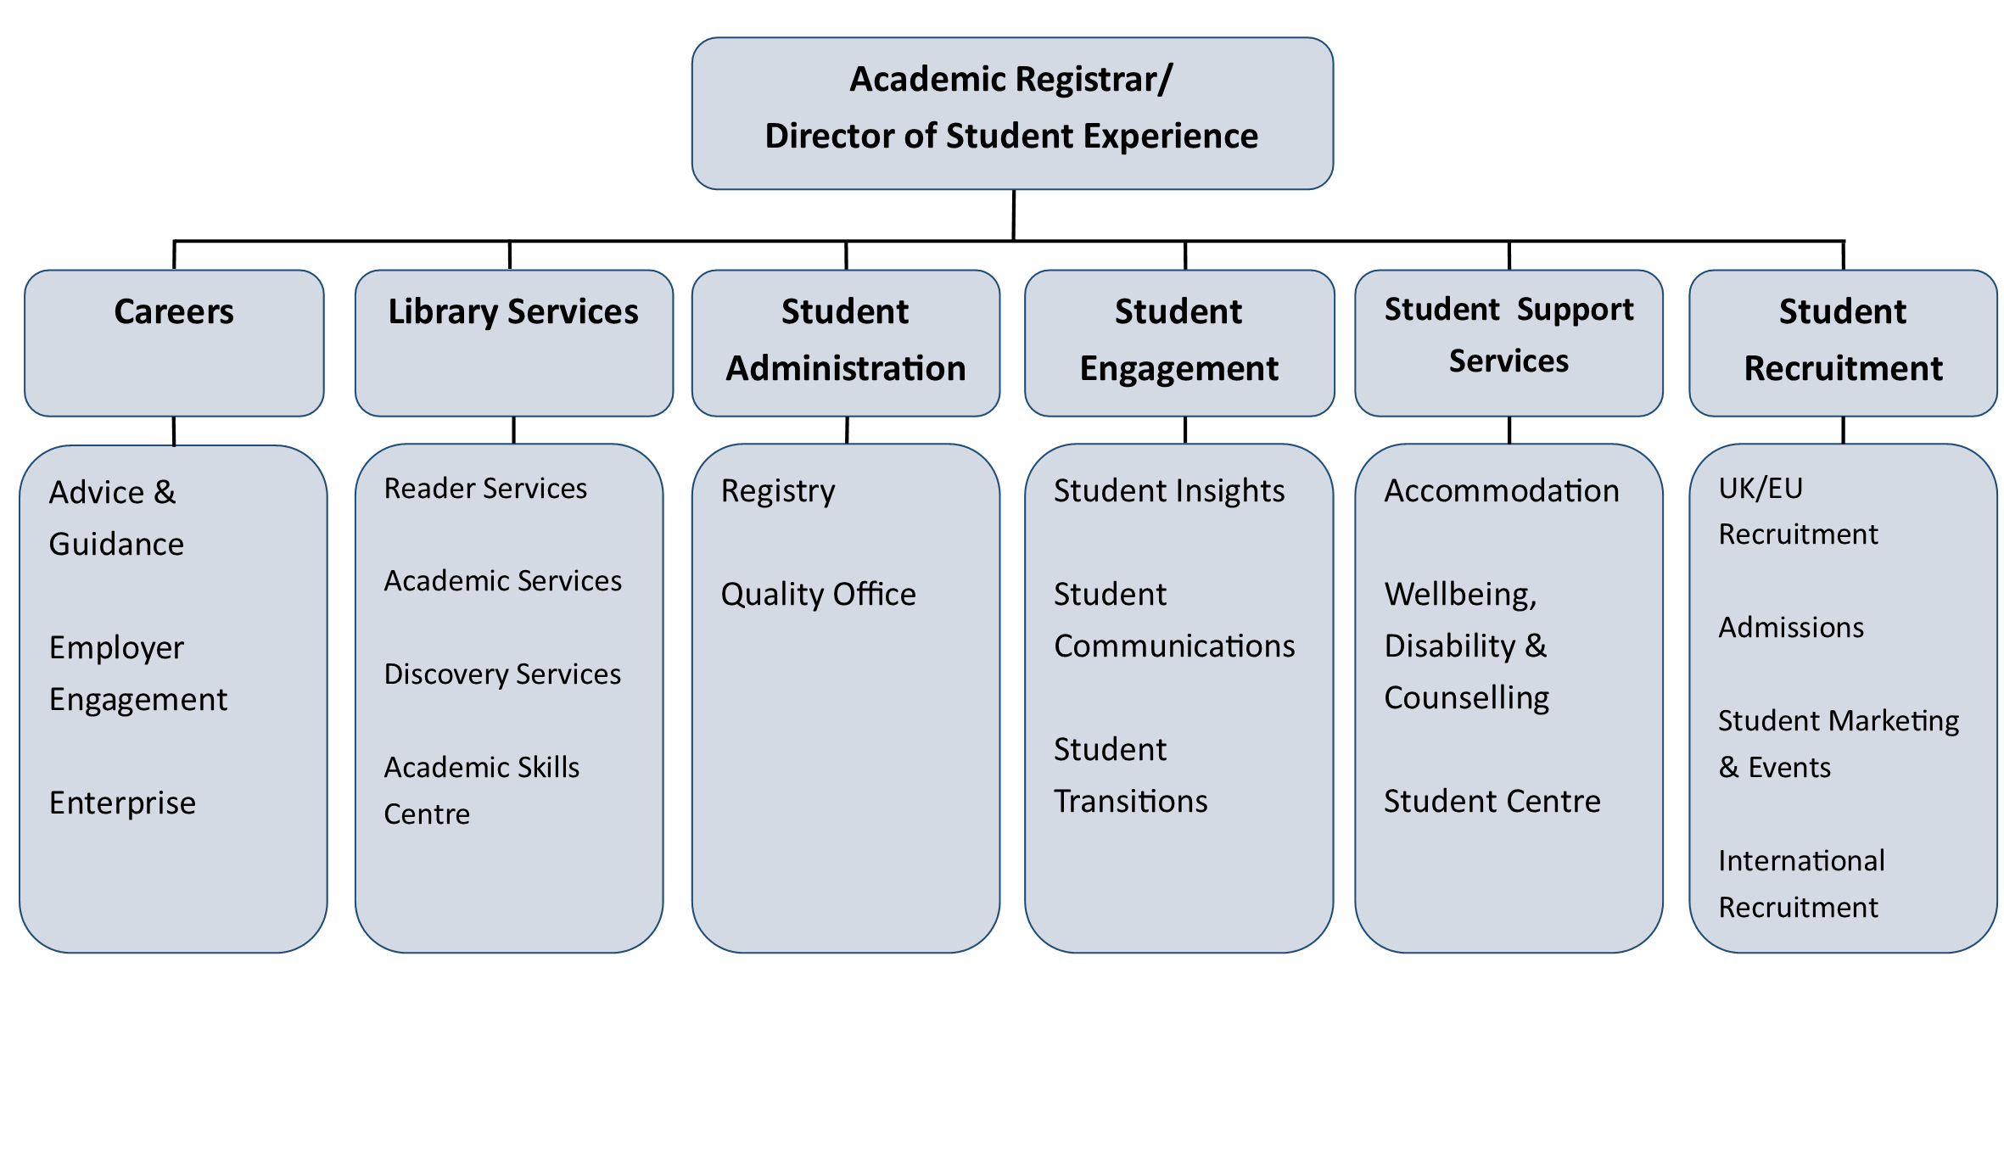
Student Experience Directorate

Slide 6
Forming a New Directorate
What do we have in common?
Students
Customer Service Excellence – use as a framework to assess and audit where all departments within SED are in respect of customer service and their approaches to providing services for students (and other customers)
Student Experience Leadership Group
Leadership and Management principles – use L&M framework to assess and audit the leadership and management within each department and to consider collective approaches to leadership and management development and behaviours
What are our collective values?
Enhancing Student Experience
Collaborative
Ambitious
Professional
How are we managed?
Inclusive
Continually improving

Slide 7

Customer Service Excellence
Customer insight – identification, engagement, consultation & satisfaction.
Culture of the organisation – leadership, policy and culture, staff professionalism & attitude.
Information & Access – range & quality of information offered, access, co-operative working with other providers partners & communities.
Delivery – delivery standards, achieved delivery & outcomes, are problems effectively dealt with.
Timeliness & Quality of Service – timeliness and quality standards, timely outcomes & timely delivery.

Slide 8
Key Deliverables
Identify and develop insight into all customer groups and their needs and preferences including platforms for the engagement and involvement of all customer groups
Establish and develop reliable and accurate methods to measure customer satisfaction on a regular basis
Empower and encourage all employees to actively promote and participate in the customer focused culture of Student Experience
Set standards which are challenging (and feedback on performance)
Ensure consistency in approach in customer service across SED
Ensure that responsive and clear feedback channels are available

Slide 9
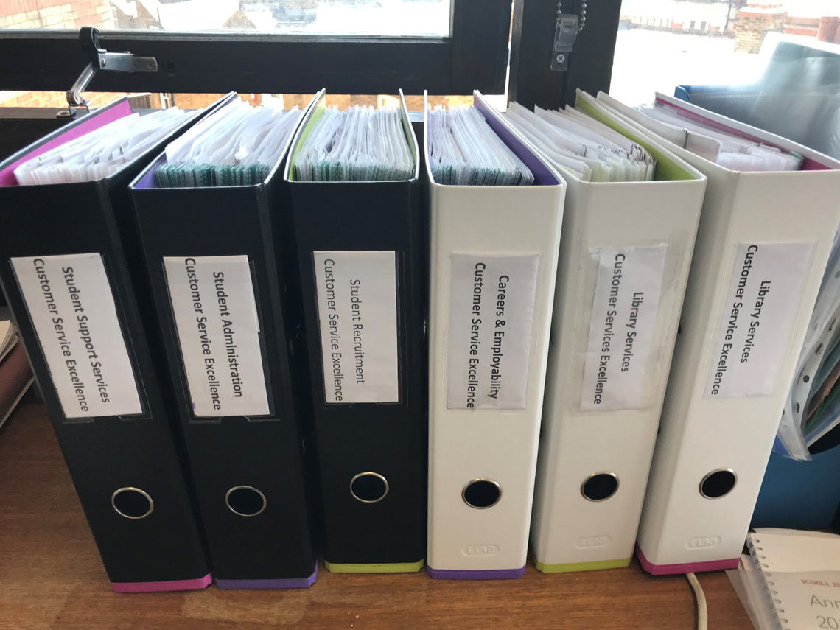
The portfolios!

Slide 10
Leadership & Management
Principles:
  Strategic positioning
  Leadership principles
  People engagement
  People development
  Recruitment & selection
  Financial & commercial awareness

Slide 11
What did we do
CSE Steering Group / Student Experience Leadership Group
Information about Services
Standards & Commitments
Contact Resolution
Reward & Recognition
Student engagement
Developing values
Strategic planning of SELG
Staff engagement & development
Managers forum
Stakeholder engagement
Information about Services
Standards & Commitments
Contact Resolution
Reward & Recognition
Student engagement
Developing values
Strategic planning of SELG
Staff engagement & development
Managers forum
Stakeholder engagement
Leadership and management development
Communications strategy
SED-wide staff training and development

Slide 12
Workstreams
Information about Services | SED Customer journey maps Audit of SED communications (to students) Sharing best practice sessions Review of Web based information Review of print based information
Reward & Recognition | Convene staff focus groups to establish how empowerment and reward could be embedded Review current practice and share best practice Produce values guidelines and recommendations regarding reward for SED departments
Student engagement | Training for all SED staff involved in student engagement activity Presence on all the task and finish groups, with a view to advising how the work stream can be responsive and ensure that students are involved, where appropriate

Slide 13
Workstreams
Standards & Commitments | Each SED department has a set of internal facing KPIs Each SED department has a set of outward facing customer service standards All are transparently measured and reported back A SED approach allows for consistency
Contact Resolution | Audit of SED communications channels Standard approach to service oriented communications (consolidate communication points) Enquiry and referral guidelines and training Evaluation protocol (including mystery shopping) Standard approach to handling complaints

Slide 14
Shared Values
Committing to inclusivity for everyone and striving to meet the needs of individuals
Being ambitious in our delivery by setting high standards and putting our students and staff at the fore front of our approach
Providing professional services where staff are knowledgeable, respectful, supportive and ethical
Offering an excellent experience by continually innovating and improving our services
Working collaboratively to provide effective and responsive services

Slide 15
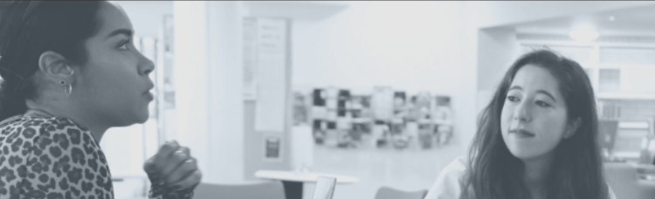
Shared Customer Service Charter
Relationships and communications
Continuous improvement ad feedback
Information and Knowledge
Professional and Respectful
Solution-orientated

Slide 16
Shared Standards
Customer Service Standard | Performance for January - July 2019
We will maintain our advertised opening and contactable hours 100% of the time at our helpdesks and our offices | We were open 100% of our advertised opening hours
Our websites and online services (Library Website and Library Search) will be available 24/7 100% of the time (excepting periods of advertised maintenance) | Our websites and online services were available 100% of the time
We will acknowledge and respond to all written enquiries and feedback to library@gold.ac.uk within 3 working days | 100% of email enquiries were responded to within 3 days
80% of face to face enquiries will be resolved at first point of contact and the remainder referred to appropriate colleagues | 86.3% of face to face enquiries were resolved at the first point of contact

Slide 17
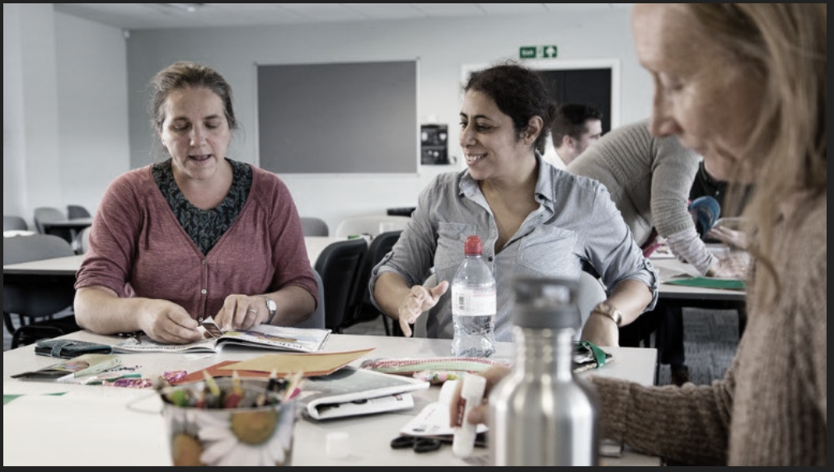

Slide 18
L&M Principles Audit
How do we define our aspirations and purpose of the organisation?
  Goldsmiths?
  Student Experience?
How do we define the Goldsmiths approach to the market and the culture needed to deliver the above aspirations?
How do we ensure the culture and our values (Inclusive, Ambitious, Professional, Ever improving, Collaborative) are right for us, and how do we live them?
What is our process for evaluating the quality of our services and improving our performance?
What’s missing?

Slide 19
Staff Development Work Stream
  Ensure that awareness of SED activity and delivery is embedded across all SED directorate
  Develop and deliver a programme of staff development preparing all SED staff for CSE:
    ‘A Day in the Life of SED’
    ‘A day in the Life of a Goldsmiths Student’
    Enquiry handling and Referrals
    Customer Service Commitments and Customer Service Standards
    Overview of CSE Process

Slide 20
Double Assessment
3 ½ days on site
Both assessors on site
Programme for the site visit:
  Structured approach to stakeholder meetings and interviews
  Phone call conversations with SED partners
  Random interviews with staff and students
  Staff presentations and Q&A
Portfolio videos, strategy documents, case studies meeting criterion

Slide 21
Strengths of SED
Customer insight and understanding
Student engagement and partnership
Staff engagement and empowerment
Commitment to improvement and development
Using the CSE and L&M frameworks to develop the Student Experience Directorate
6 Compliance plus recommendations

Slide 22
What we’re doing next
Student Experience Leadership Group (SELG) now acts as a project board for CSE/L&M
CSE/L&M steering group reports into SELG
Cross directorate Staff Development Group
Work-streams and task and finish groups to address gaps and play to strengths:
  Communications
  Standards / KPIs
  Contact resolution
  Community engagement / partnerships
  Complaints
  Customer journey mapping

Slide 23

Assessment Services Award 2019
Winners of The Assessment Services Award for Using Standards to Support Change

Slide 24
Assessment Services Award Video
https://www.youtube.com/watch?v=ji5eu39UVK8&feature=youtu.be

Slide 25

Thank You…. Questions?

