Slide 1
Lincoln Medical School
Jade Daniels and Sam Greasley
Notes:
Introductions….

Slide 2
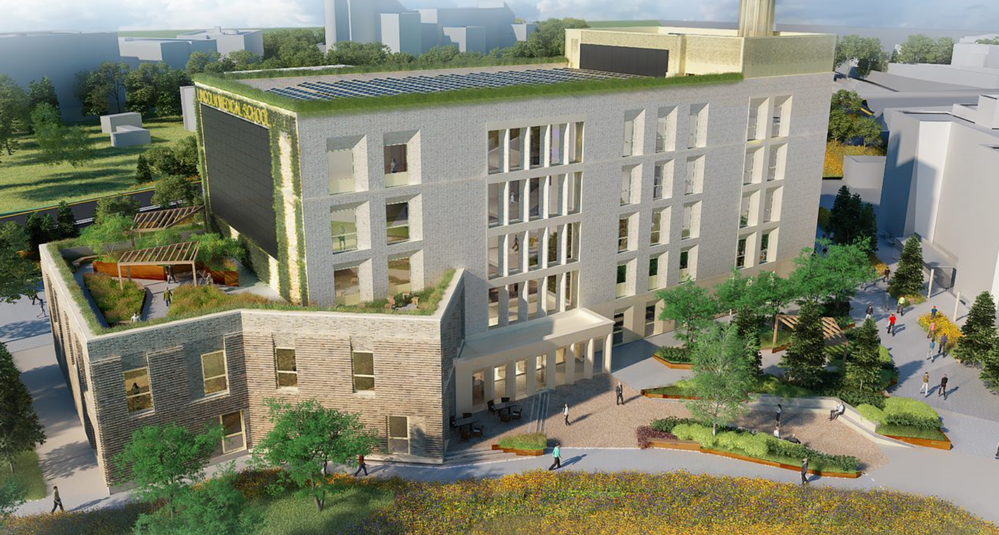
Medical School
Joint partnership with Nottingham University established in 2018
Delivering Medicine BMBS and Medicine with a foundation year over 5 years
Medicine programme taught and delivered at Lincoln
Aim of increasing recruitment of doctors to Lincolnshire and surrounding areas
£21 million medical building with specialist ‘science library’ completion Spring 2021

Slide 3
Library task and finish group
Explore collections, support and services of both libraries
Consistent service at both libraries
Gap analysis undertaken on every aspect of the service
“One seamless service”
Notes:
Senior management part of a wider customer experience group

Slide 4
Project groups..
Workflow group (customer service and processes)
Building space and stock
Induction group
Access to online resources
Subject support
Copyright
Notes:
CST in all groups

Slide 5
Building space
1026.5 meters of books will move over to new building
Subject areas effected
174.2 Medical Ethics
344 Health Law
611 Anatomy
612 Physiology
614.4 Epidemiology
615 Pharmacology
616 Diseases
Notes:
Consulted various people on

Slide 6
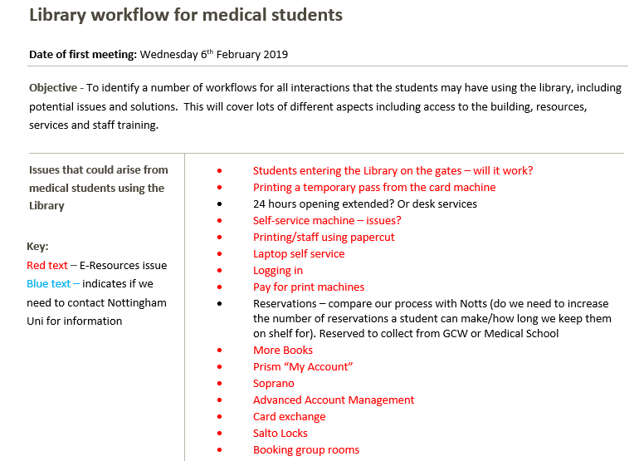
The Workflow group
Subject librarians
Customer Services
E-Resources
Acquisitions
ICT
Notes:
What Involved – visits to Greenfield Medical Library, process mapping, evaluating every detail of service e.g fine policy, loan counts etc

Slide 7
Impact on Customer Services
Increased student numbers
Development of new processes to ensure consistency in student experience
Creation of ‘knowledge portal’ filled with vital information on procedures(checked and updated regularly)
Maintaining customer satisfaction with same amount of space and resources
Notes:
No extra staff Dedicated staff in areas such as Moodle support and ICT Medical collection

Slide 8
Challenges presented for Library Assistants…
Increased demand on operational service
Learning of new system learning portal (Moodle)
Familiar with relevant academic databases and referencing tools
Bespoke Library website
New processes to understand and distinguish from other students
Future challenges ahead once building is complete and staffed
Notes:
Reaching out to team in areas such as evening and weekends to ensure consistent knowledge of processes and procedures

Slide 9
What have we learnt?
Complexities surrounding online access and ICT
Cross-communication between two universities each with different perspectives
Still have a lot to learn!
Notes:
Communication and preparation in order to achieve a smooth outcome of the project

Slide 10
New building..
https://www.youtube.com/watch?v=Jb5ZtWYtCaQ
Notes:
New medical school building

Slide 11
Thank you for listening..
Any questions?

