Slide 1
Food for thought – managing a changing food and drink policy
Rosi Jelfs
Senior Customer Services Coordinator
Durham University Library

Slide 2
Bill Bryson Library – Durham University
Main university library supporting 18,000 students and 4,000 staff
4 floors providing a mixture of silent, individual study; open, collaborative study space; and group study rooms
Building capacity is 1,900, with highest footfall hitting 1,598 in 2017/18
Refurbishment project underway to create more study spaces and a learning café

Slide 3
Food and Drink Policy
Before April 2017 only cold, bottled drinks were allowed in the library
There was pressure from the Student Union to allow food, as well as from the university to provide an area where students could eat on campus
The new policy went through various iterations between April 2017 and October 2018
Cold food was allowed in designated areas, and hot and cold lidded or bottled drinks were allowed everywhere

Slide 4
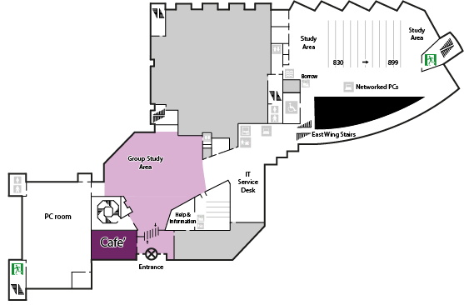
April 2017
Food allowed in area in front of the H&I Desk
Pros: area was obvious from entrance and could be monitored by H&I desk
Negatives: noise

Slide 5
Perception by students – May 2017

Slide 6
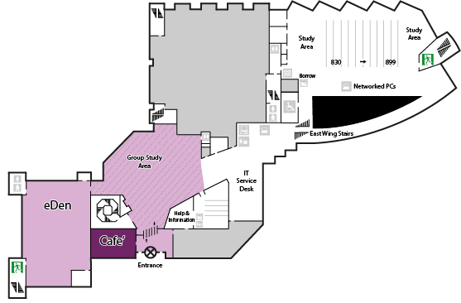
October 2017
Area changed to eDen
Positives: noise contained
Negatives: capacity and noise levels

Slide 7
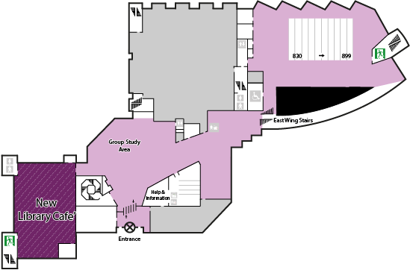
October 2018
Policy was flipped to allow consumption of cold food on L1, L2 and L3, with L4 remaining a food-free zone
You can never please everyone!

Slide 8
Perception by students – October 2018

Slide 9
Perception by staff
Some criticism from academics
Library staff were initially negative but the situation we have now seems to work well
Negative impact on housekeeping staff

Slide 10
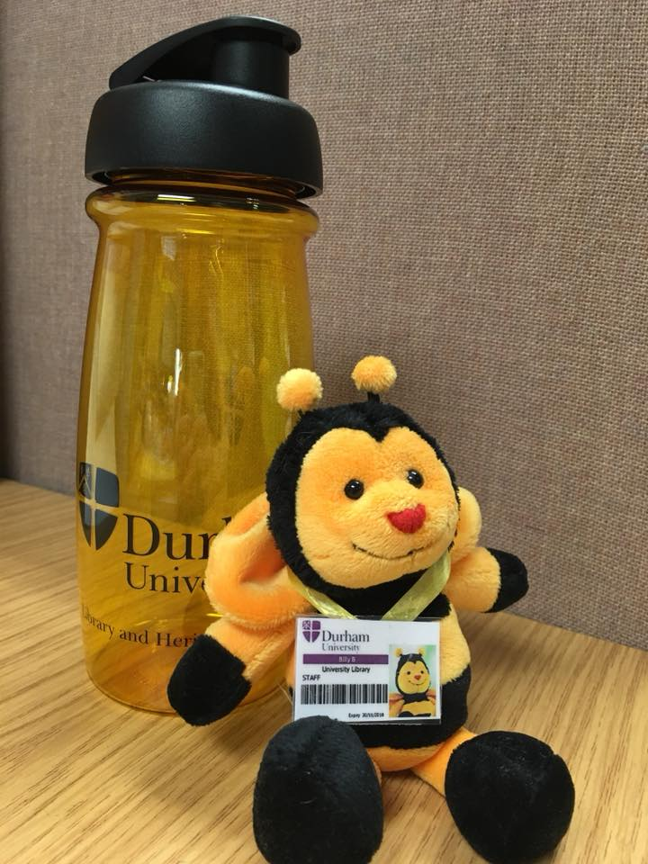
Communications
Freebies – travel mugs and water bottles
Poster and social media campaign throughout

Slide 11
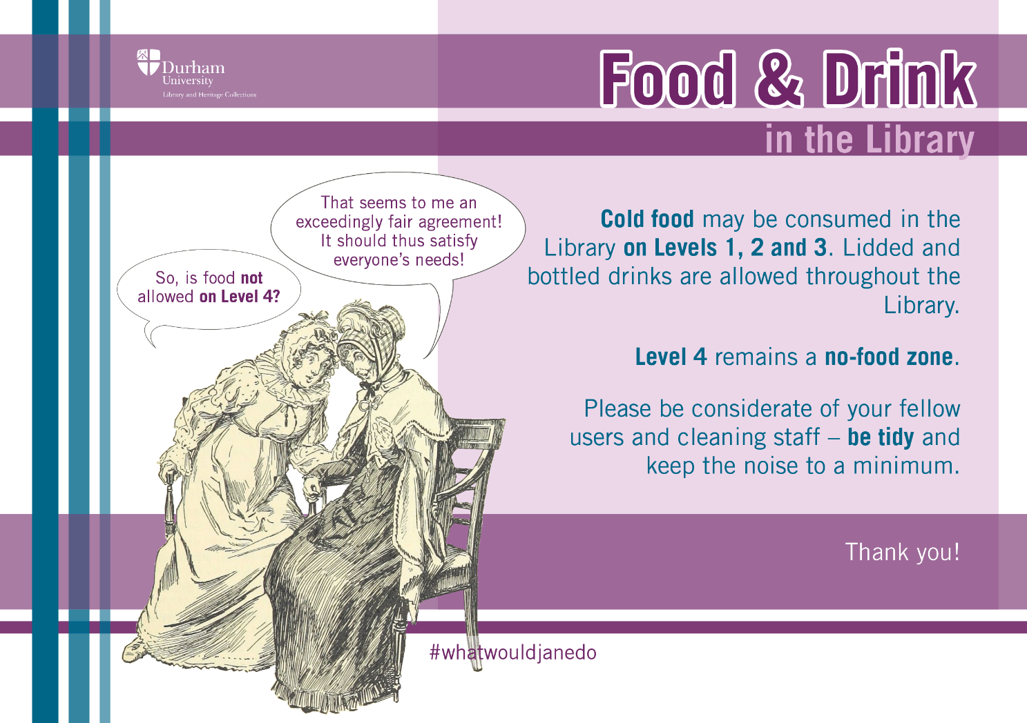
Induction 2018
Policy changes were highlighted in conjunction with Jane Austen theme

Slide 12
Looking back…
User expectations changed along with policy
Current queries reflect confusion
High turnover of students complicates change

Slide 13
Any questions?
Rosi Jelfs
Senior Customer Services Coordinator
Durham University Library
r.a.jelfs@durham.ac.uk

