Slide 1
Relax and Renew at GCU:
supporting the wellbeing of our library users
Julie Smith, Academic Librarian, Glasgow Caledonian University
Kimberly Bryce, Resource Librarian, Glasgow Caledonian University

Slide 2
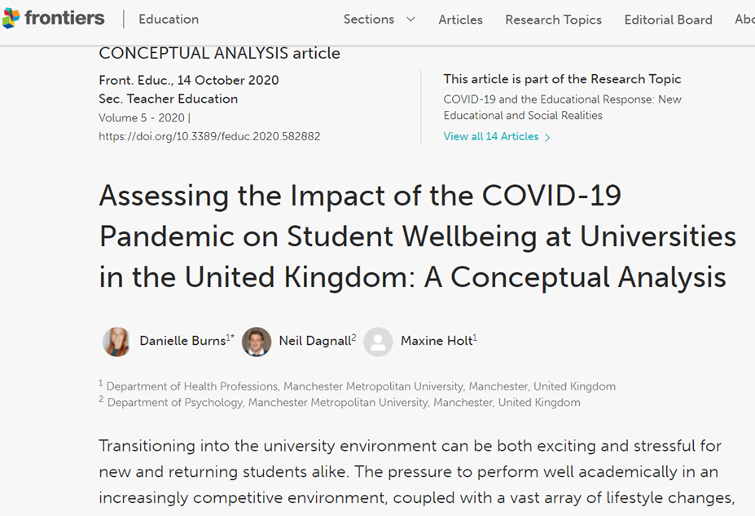
Student Wellbeing
https://www.mentalhealth.org.
uk/our-work/research/thriving-learners
https://www.nus-scotland.org.uk/mental_health
https://doi.org/10.3389/feduc.2020.582882
Notes:
Has working on/developing the R&R space impacted your wellbeing and/or development

Slide 3
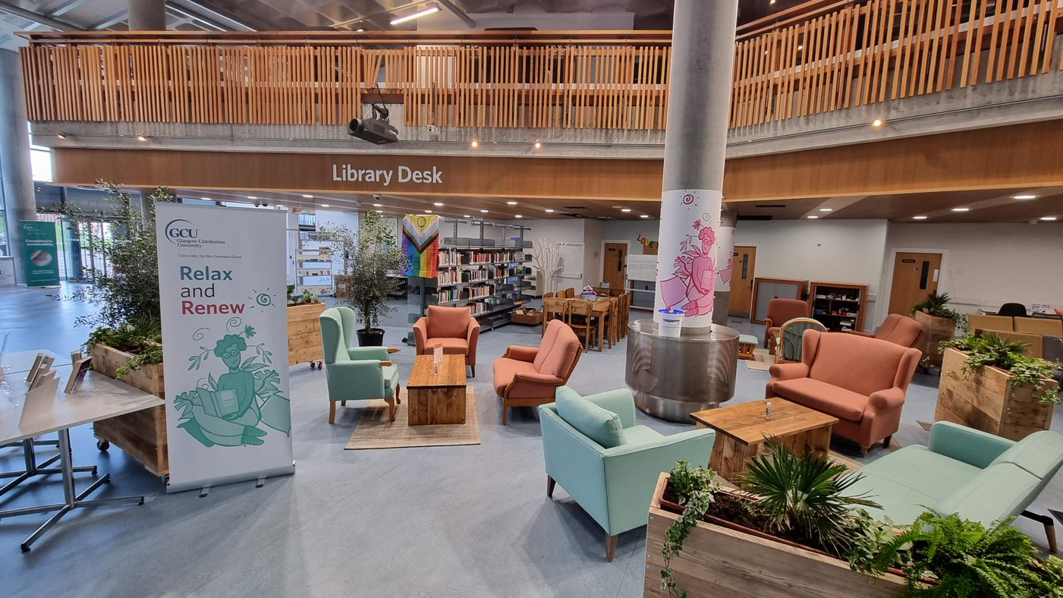
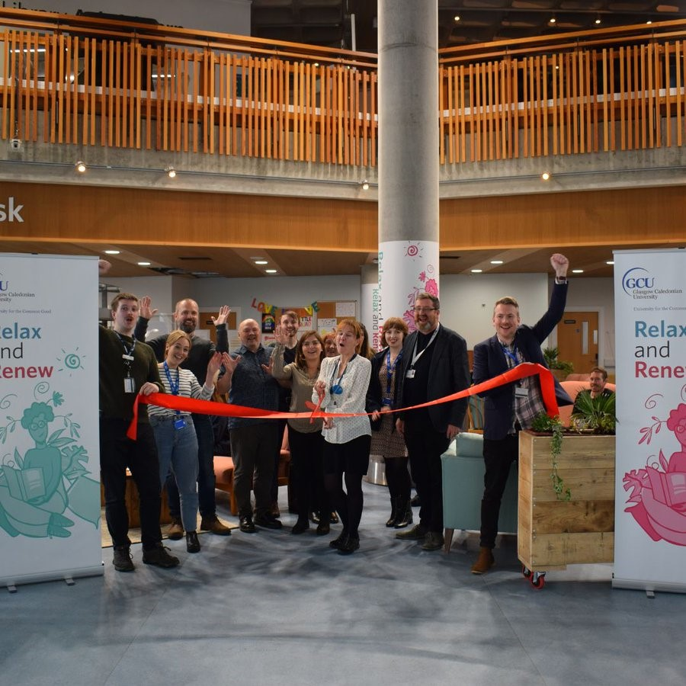
Welcome to our space

Slide 4
Aims of the Space
To enrich the wellbeing of all our users by providing a relaxing, contemplative space to take a break from academic studies or the workday and connect with others from the GCU community
To be a safe space where users can browse and engage with a selection of resources related to mental health and wellbeing, as well as leisure reading resources
To provide a space for workshops and events, helping users connect with others and encouraging a sense of creativeness and togetherness at GCU

Slide 5
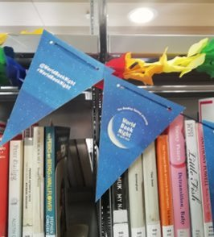
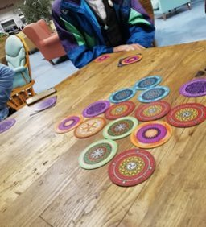
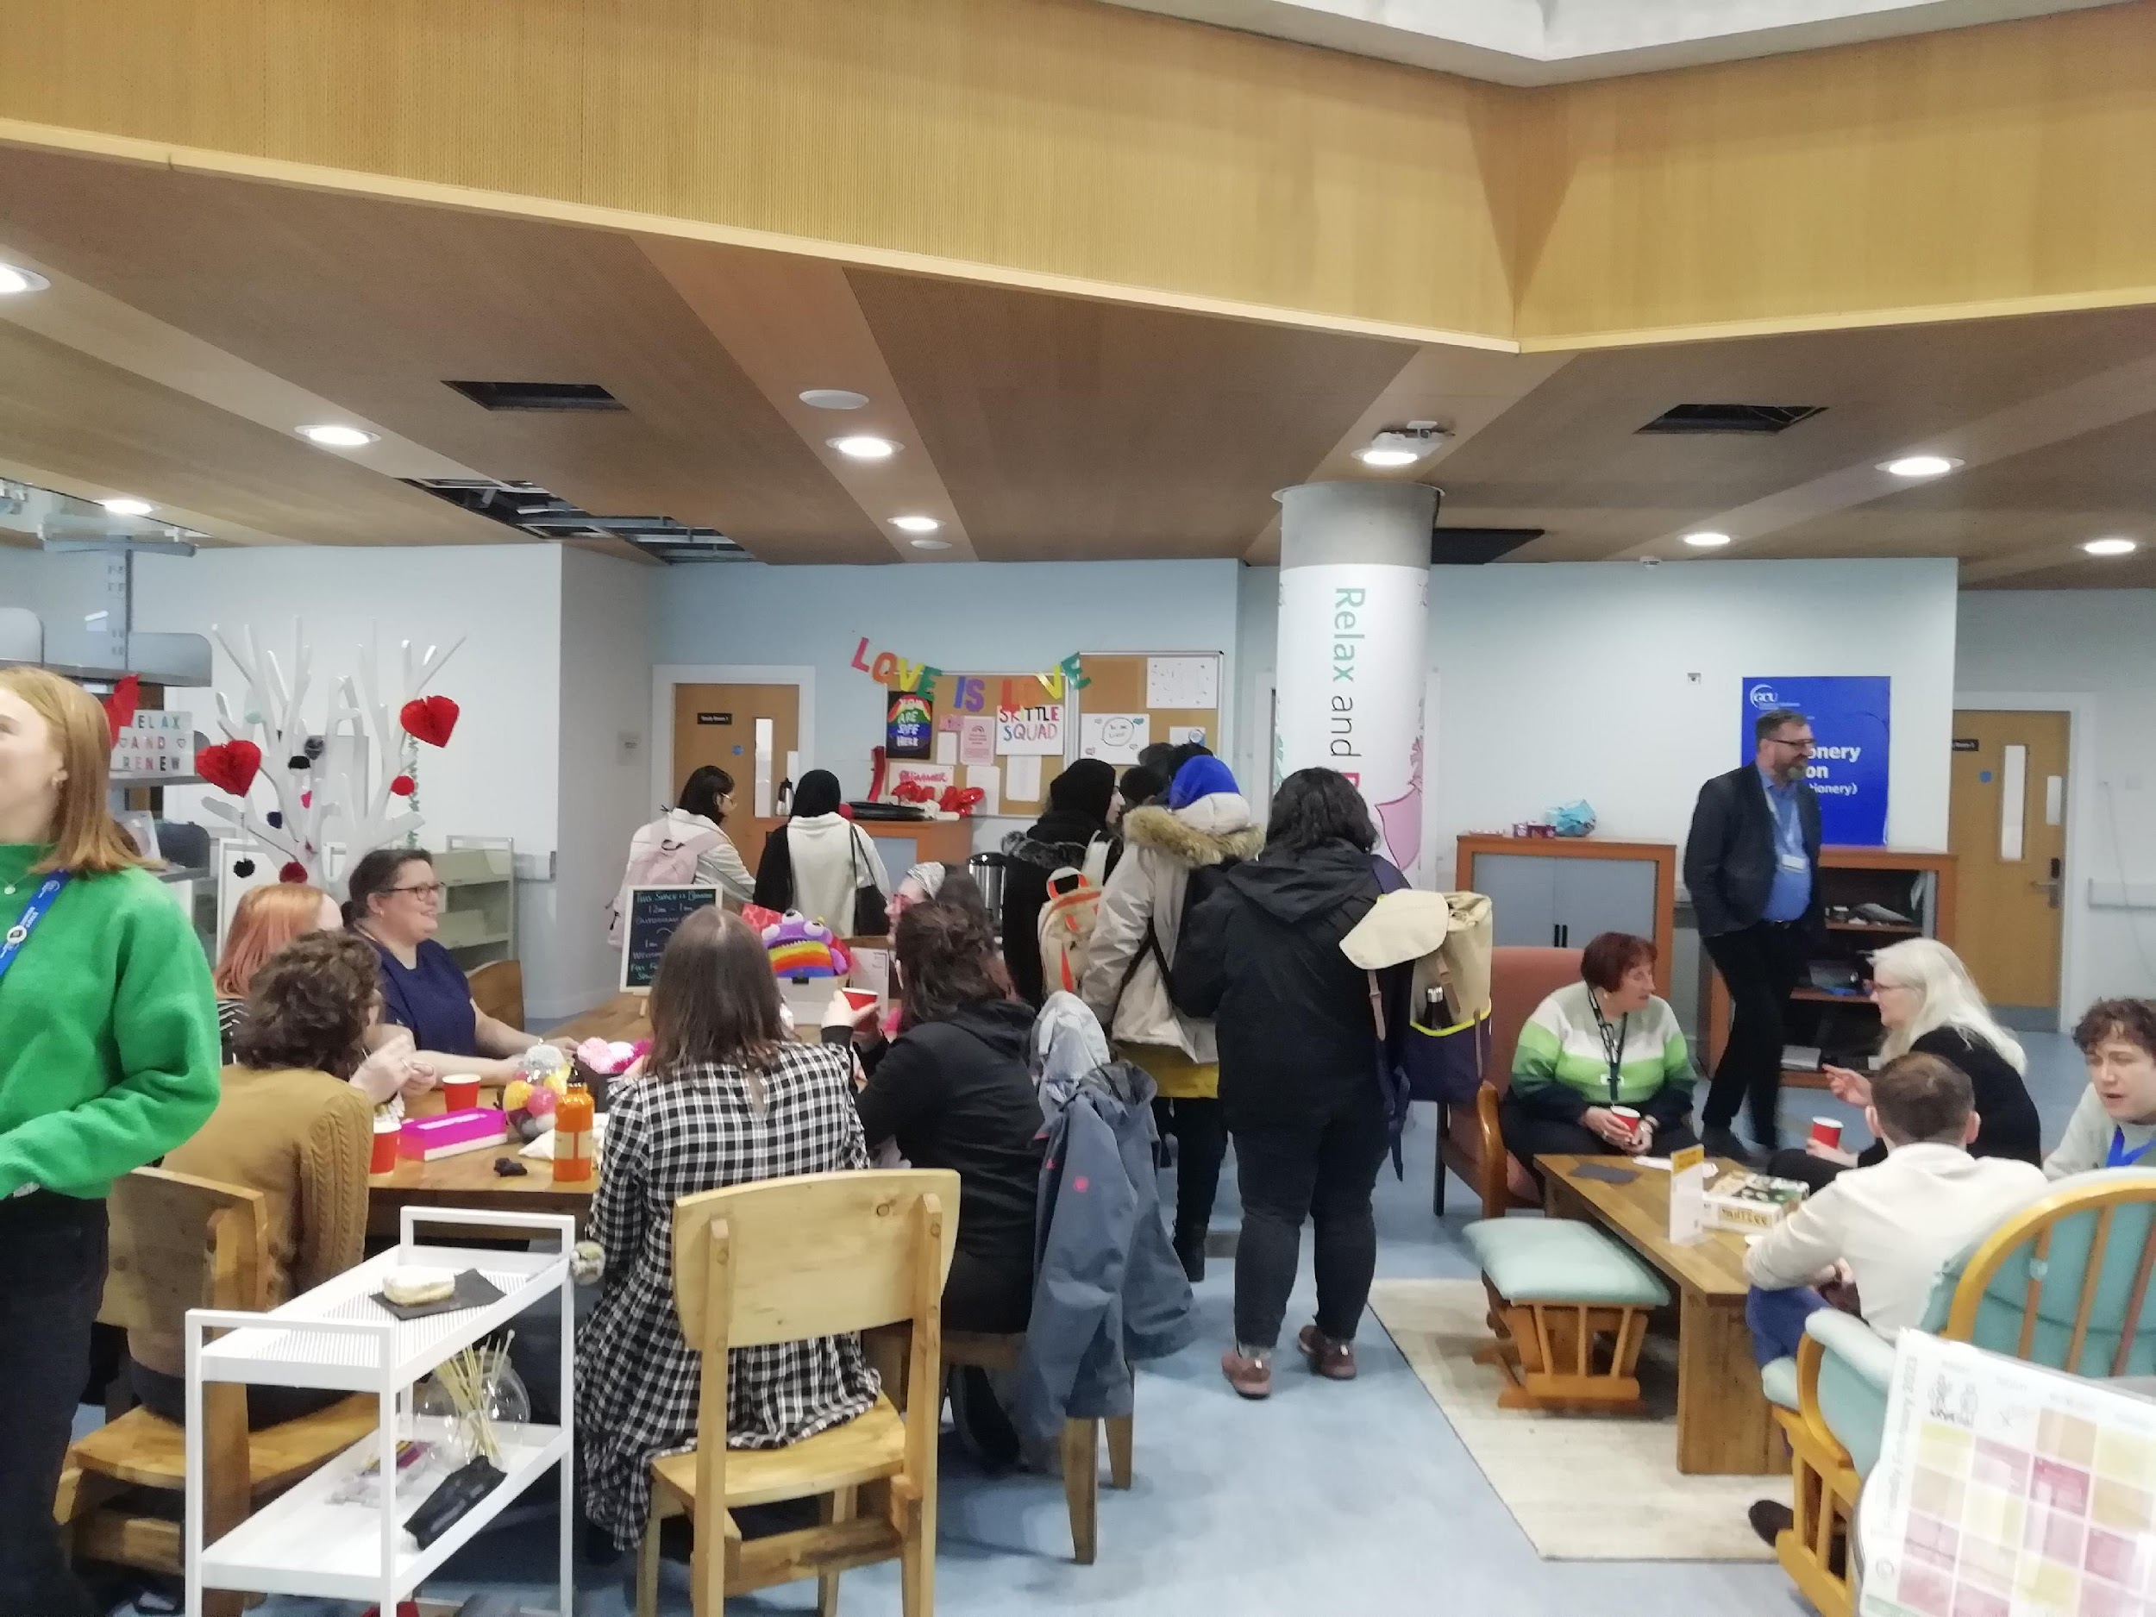
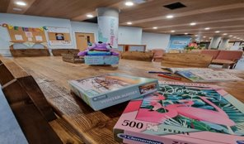
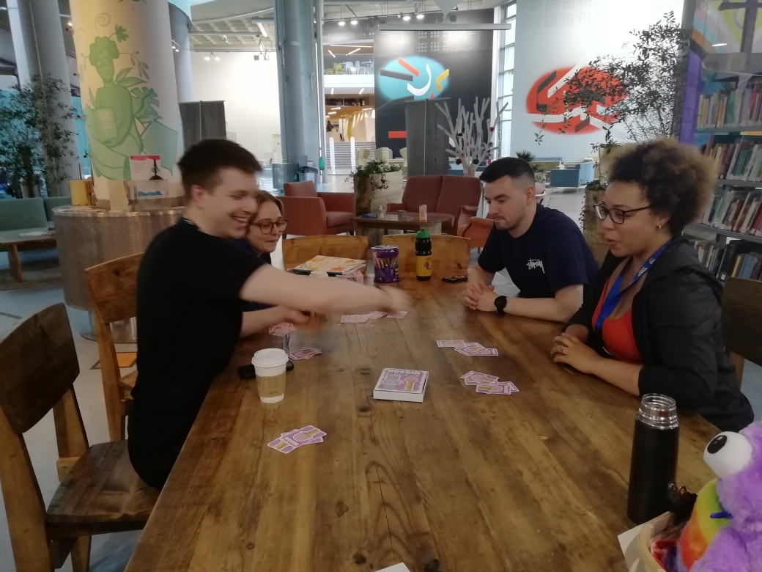
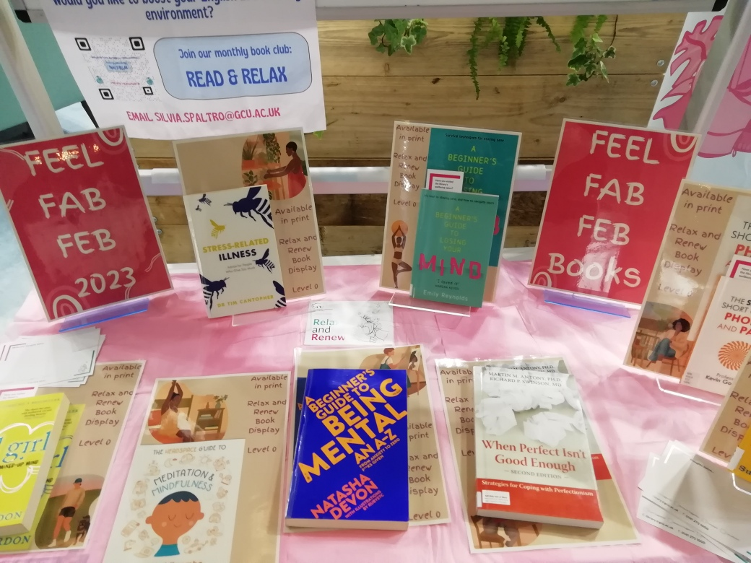
Events in Relax & Renew
Relax and Game On - monthly board game night​
Read and Relax Book Group
Bookbug sessions
Weekly crafting drop in - Caledonian Crafters
Creative Writing group
​Themed events with book displays

Slide 6
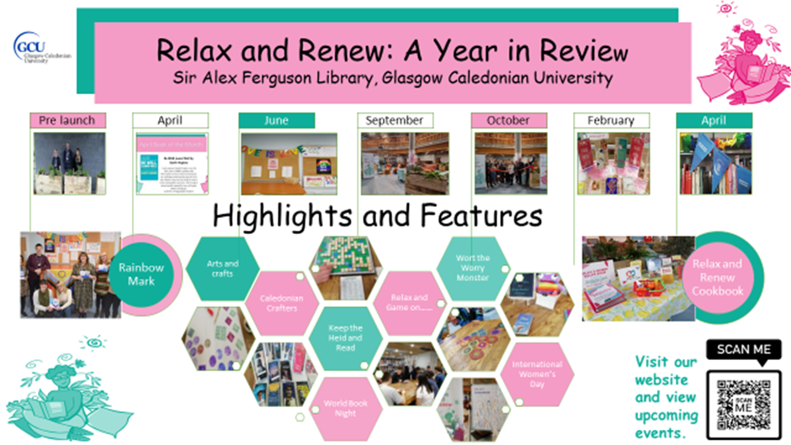
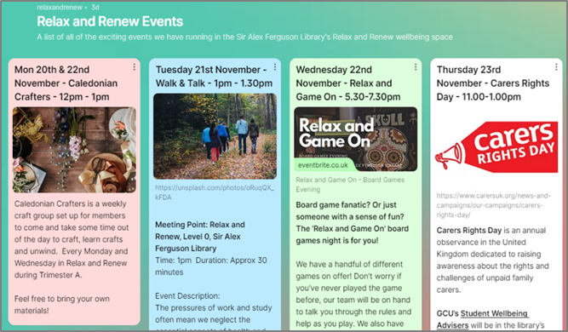
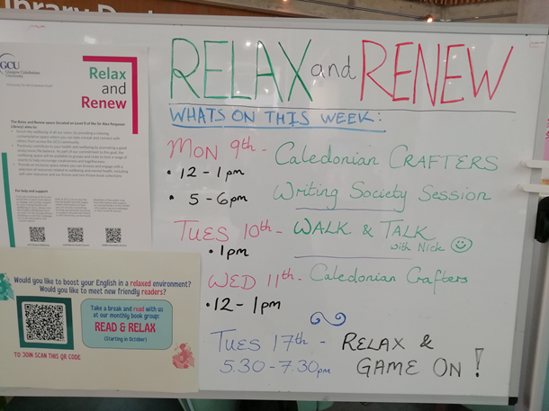
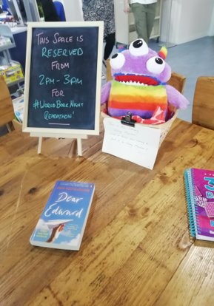
What's happening
in Relax & Renew?

Slide 7
Wellbeing Collection​
Contacted others in the sector who already had wellbeing collections to discuss their resources
Reviewed resources we already had in the library to see if they'd be better suited in the new collection
Gathered feedback from users via social media and padlets and suggestions from library staff
Collaborated with colleagues in our Student Wellbeing team to identify key titles

Slide 8
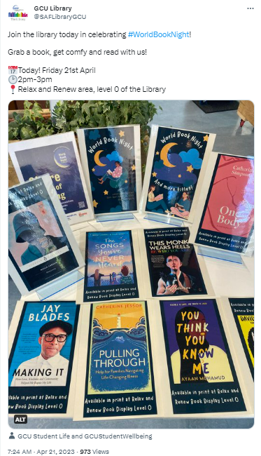
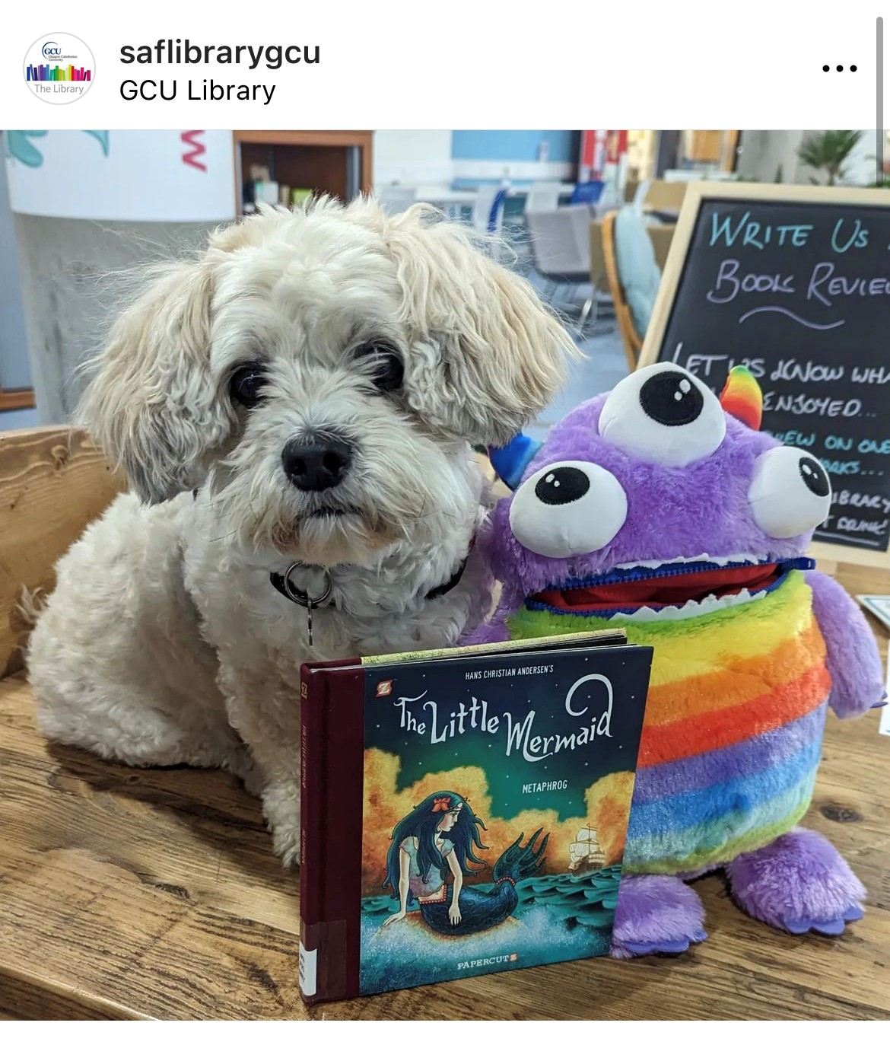
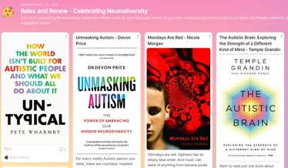
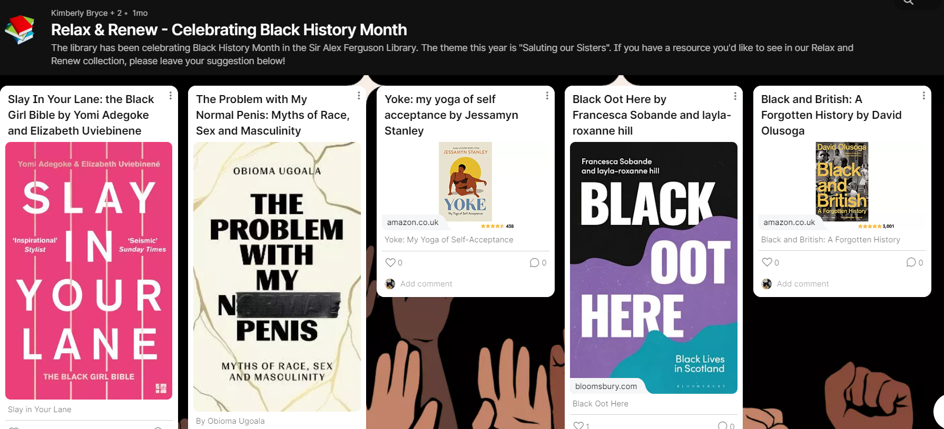
Collection Development
Notes:
Displays
SM content
Posters
Padlet
Eventbrite
Student comms video
Internal staff comms

Slide 9
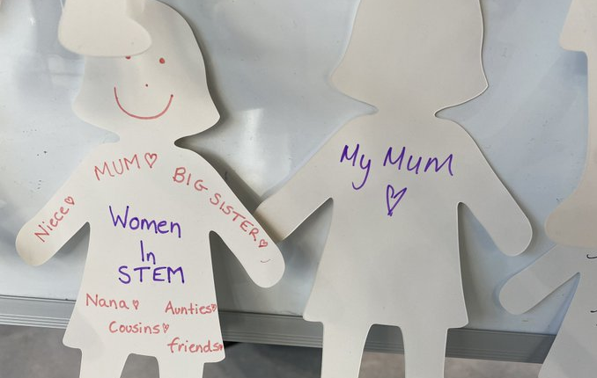
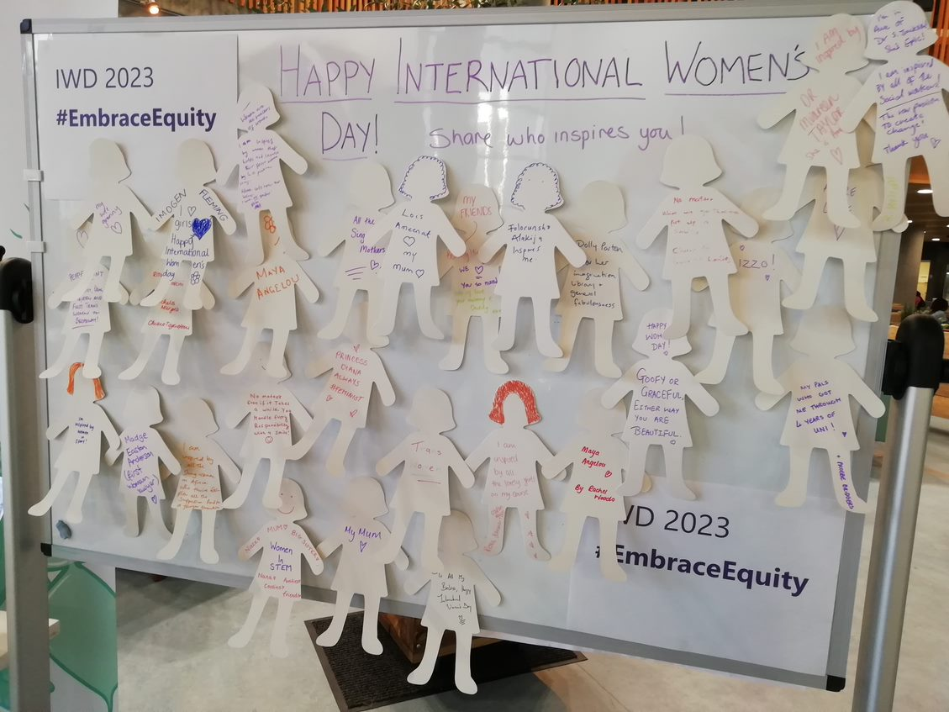
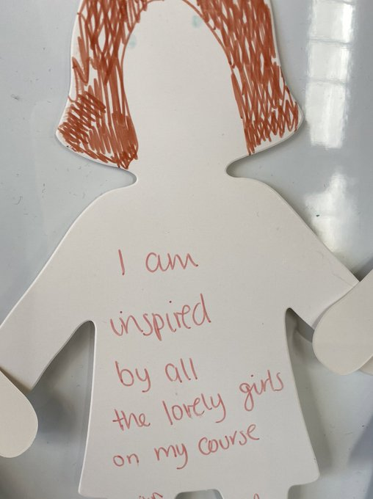
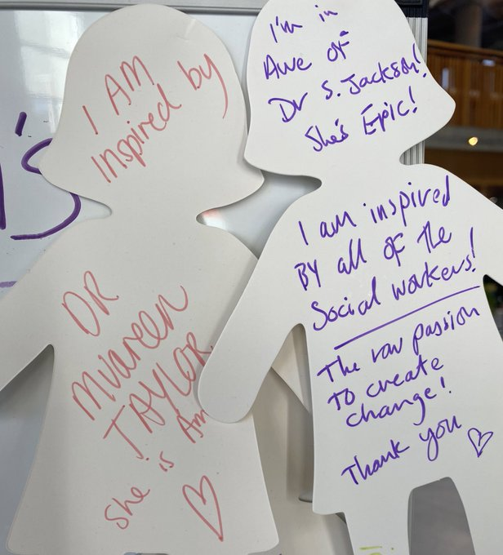
IWD 2023
Notes:
Displays
SM content
Posters
Padlet
Eventbrite
Student comms video
Internal staff comms

Slide 10
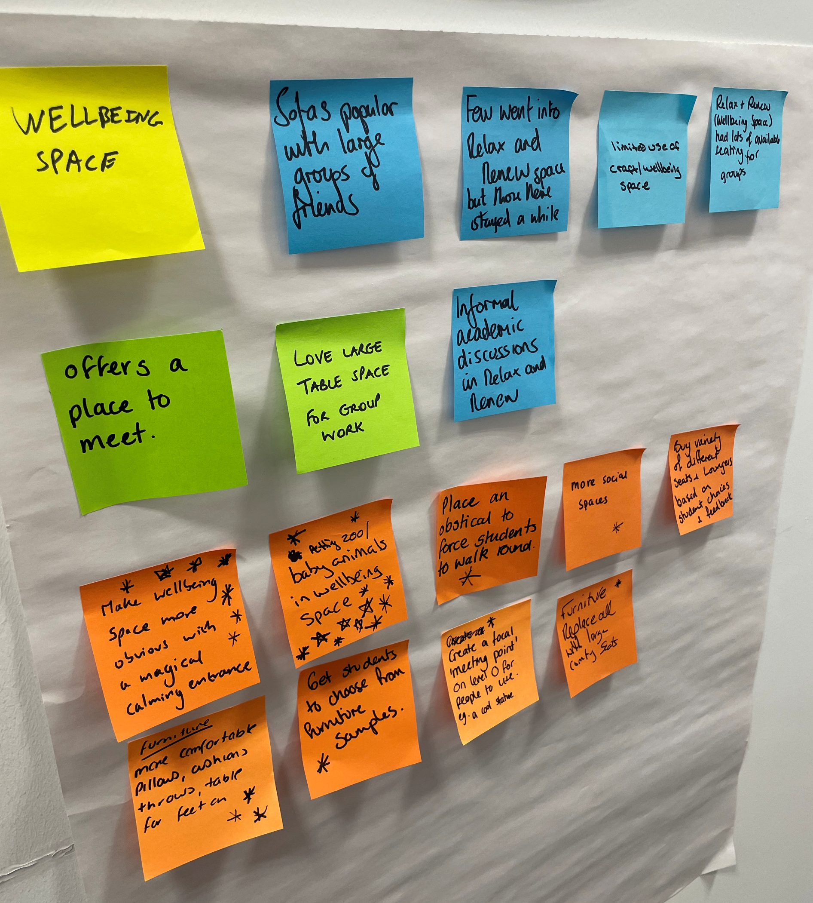
Feedback and UX
"Just loving the [library] space with kids books and colouring in - sometimes it’s the wee things that make [GCU] brilliant! P.s my kids loved it too"
"It was a lovely afternoon. Met new wonderful people who came to have a nice time."
"I loved it and it’s inspired me to make more time for reading during the working day"
"Feels homely like sitting in your granny's living room"
Notes:
*To review placement*

Slide 11
Supporting Staff Development​
Preparing staff for supporting changing user needs
Ongoing development and training
Supporting our own wellbeing
Notes:
Staff support/training
Working with SAMH
Training ran by Student wellbeing team for library staff
Summer sessions
Union Black
City of Glasgow College mental health training

Slide 12
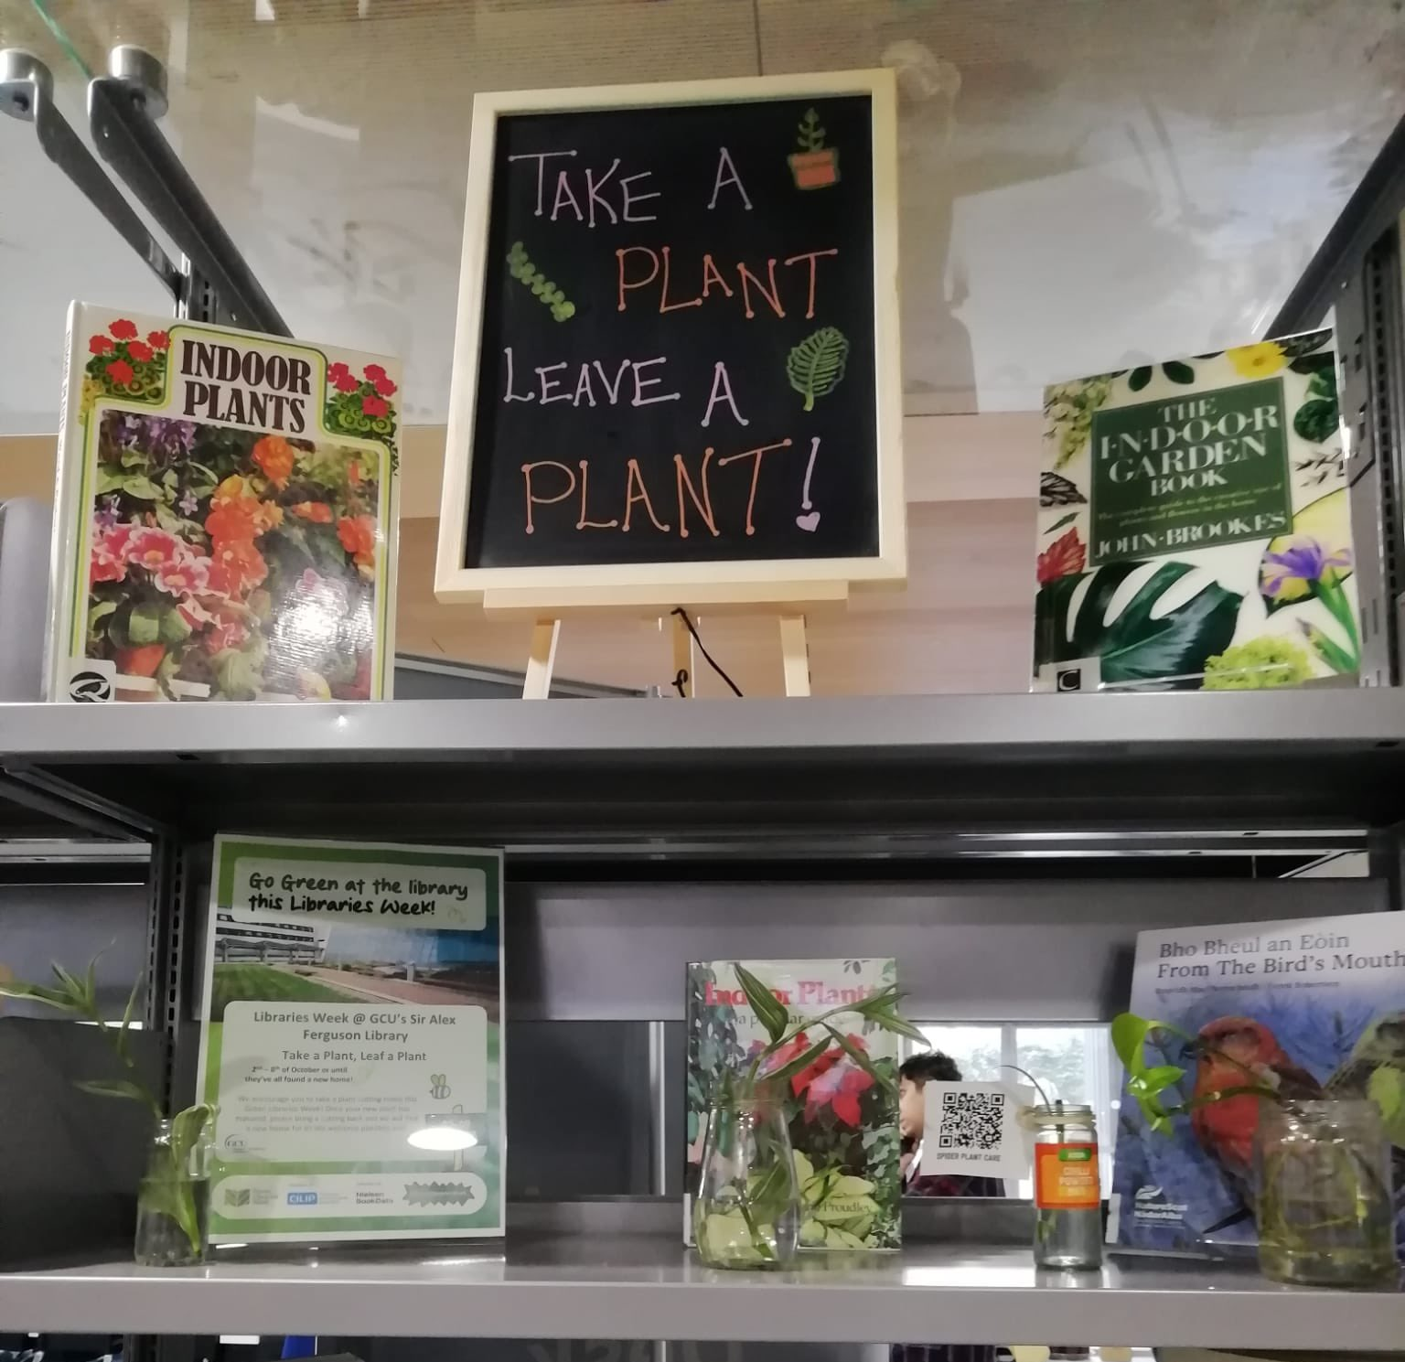
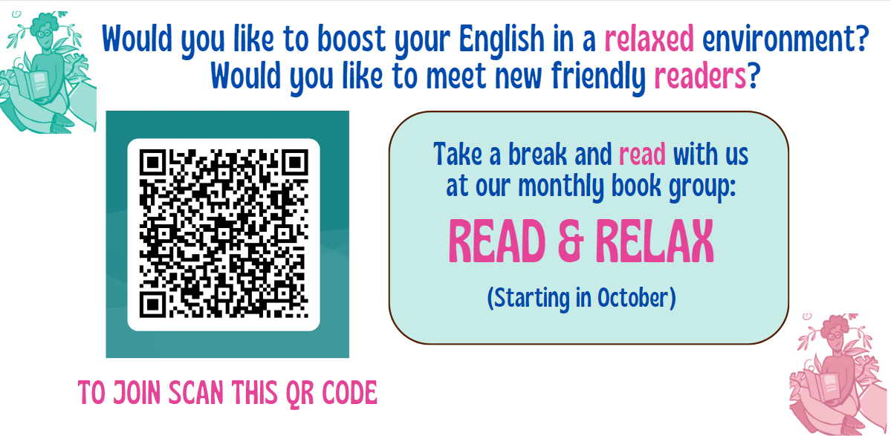
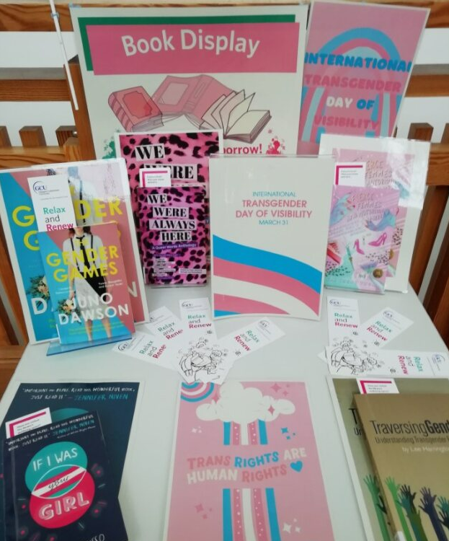
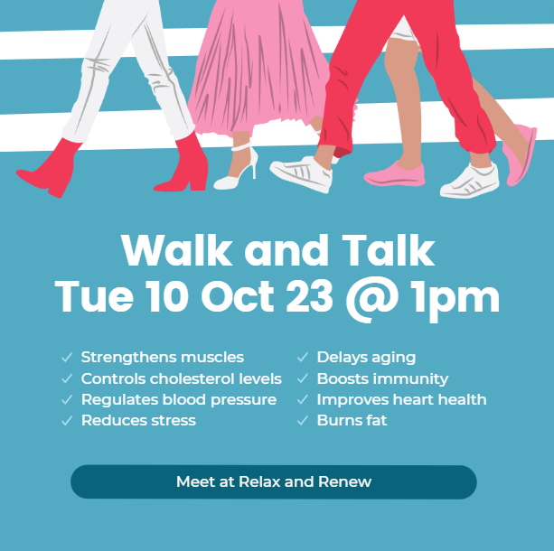
Supporting Staff Development​
Notes:
Harnessing staff talents/supporting development
Walk and Talk
Take a plant/leave a plant
Zine library
Board games
Displays

Slide 13
Staff feedback
"Being part of the Relax and Renew working group and running the Read and Relax book group have helped me growing as a professional, and as a person.
Having a chance to meet our diverse community has given me the opportunity to learn so many things, that I didn’t even know could have been of interest for me." Silvia, RRSG
"Putting together the Relax and Renew book displays has been a hugely enjoyable experience. Not only in getting space to be creative, but to hopefully have a positive impact and impression on our users; be that students, staff or community users.
I also see them as an opportunity to demonstrate our support to our users of their wellbeing, and our support for wider diversity, equality and inclusion within our university community" Erin, RRSG
Notes:
Has working on/developing the R&R space impacted your wellbeing and/or development

Slide 14
Looking to the Future
Creating​
partnerships
Student
facilitated events
Sharing best practice
Schedule
of events
Embedded Collection development
Enhancing student experience
Notes:
Community engagement
Departmental liaison
Summer review for steering group

Slide 15
Takeaway
If you had to share
only one thing with a colleague from
our presentation.....
What would that be?

Slide 16
Time for Reflection
Notes:
Time for questions

Slide 17
Thank you for listening!
Contact us with any questions
@SAFlibraryGCU
relaxandrenew@gcu.ac.uk
Photo Credits: Kimberly Bryce, Julie Smith, Jimi Mitchell, Kristen Nelson, Amanda Brennan and GCU Student Comms Team

