Slide 1
Making an Intranet from Office 365
University of Reading Library
Charli Pinkney, Graduate Trainee Library Assistant

Slide 2
Introduction
UoR Library
LA across LUS and Systems teams
Pilot project
August 2018 – July 2019
PBworks to Office 365
Teams and OneNote
OneDrive

Slide 3
Office 365 as a what now?
Why? … and how?!
Maybe we don’t need to change…

Slide 4
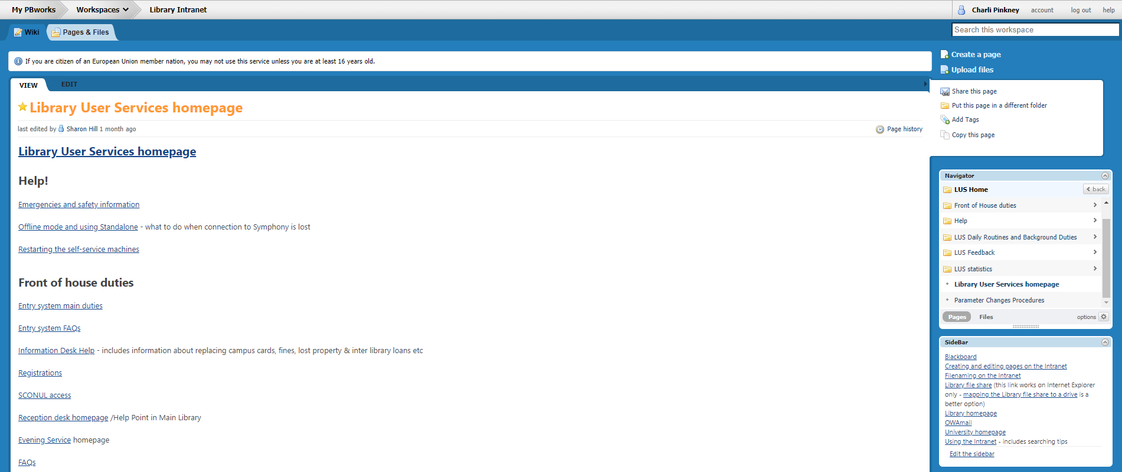
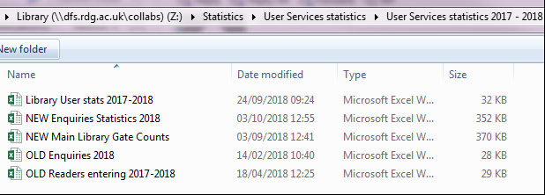
Why?
Time for a reset - content and style
New ways of working
Old intranet: search, navigation, logins, capability – all BAD

Slide 5
Things we needed
Everything in one place
Good search
Page history
Easily accessible
Hierarchy to aid browsing
Improve document speed/download time
Method of gathering your favourite pages
Ability to handle different formats/screen-dumps
Ability to access from any PC, anywhere

Slide 6
Teams
OneNote
Part of Office 365
Chat, share + save files, collaborate
Single sign on
Channels: projects, organisation
OneNote integration
Part of Office 365
Collaborate, work privately, collect and record information
Single sign on
Sections and pages
Outlook integration

Slide 7
What I did
Lots of thinking
Lots of creating
and deleting and editing and moving
Lots of teaching
and presenting and adding new things
and reading and planning and asking stupid questions

Slide 11
What do we do with it?
Communicate – from urgent news to old umbrellas
Keep track - rotas, stats, forms
Ease workloads – automation, group input
Work together…
… Work privately

Slide 12
How has it helped?
Aka “why bother”?
Improved communication – especially keeping track of urgent issues
Improved speed/efficiency of service
Improved knowledge finding – no more “NEW NEW manual”
Improved confidence with technology

Slide 13
Staff engagement
Regular updates
Feedback pages
Training sessions
1-1 ad-hoc support
Encouragement (and TIME) to “play”

Slide 14
Some tips and tricks
Office 365 offers a lot of useful features. We’ve been using:
Flows
Forms
Tags + tasks – aka make use of the integration possibilities
And are looking at using:
Planner
Alerts
Digests

Slide 15
Thanks for listening!

