Slide 1
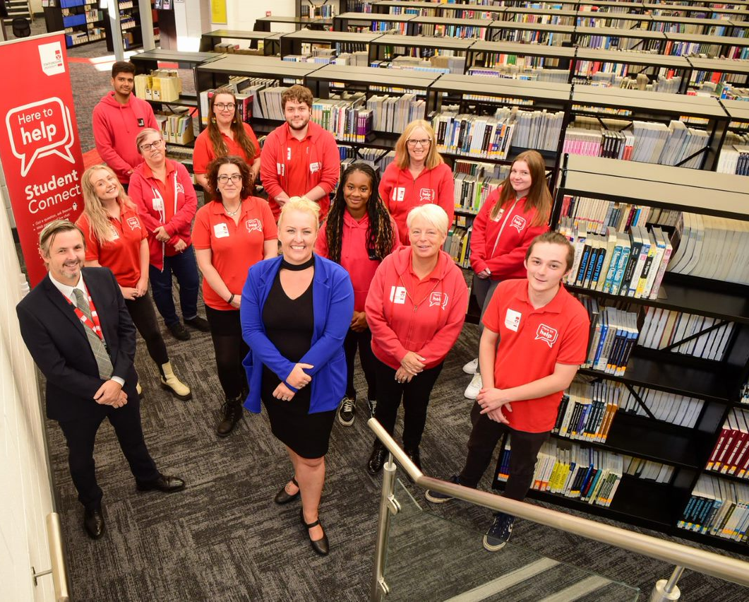

Student Connect
A step change in customer service culture at Staffordshire University
Kirstie Brookes & Paul Mahoney
CSGUK Annual Conference 21/11/22
‘Recruit, Develop, Thrive:
staffing in library customer services’
​

Slide 2
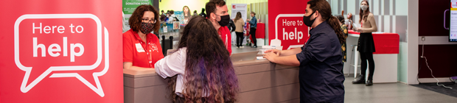
Redesigning Our Service
Meet the Team
Digital First
Developing the Team
Learning Lessons and Next Steps

Slide 3
Redesigning the Service
- Before
Approx 24 FTE + student ambassadors
Over 30 routes to access help
Staff worked in separate teams with separate arrangements
Restricted opportunity for cross team working
Student ambassadors could be restricted to certain tasks or shifts
High degree of fractionality
Notes:
Approx 24 FTE + student ambassadors (excluding IT support)
Over 30 routes to access help services (mail addresses, phone numbers, chat tools etc.)
Team members worked in separate teams with separate arrangements (e.g., hours of service and service expectations),
Worked within fixed and narrow perimeters with restricted opportunity to regularly take on a broader range of tasks (stifling development),
Student ambassadors were frequently restricted to a narrow range of tasks that offered limited chance for personal development and contribution to team development.
High degree of fractionality and significant differences in job descriptions, grades, responsibilities and working patterns.

Slide 4
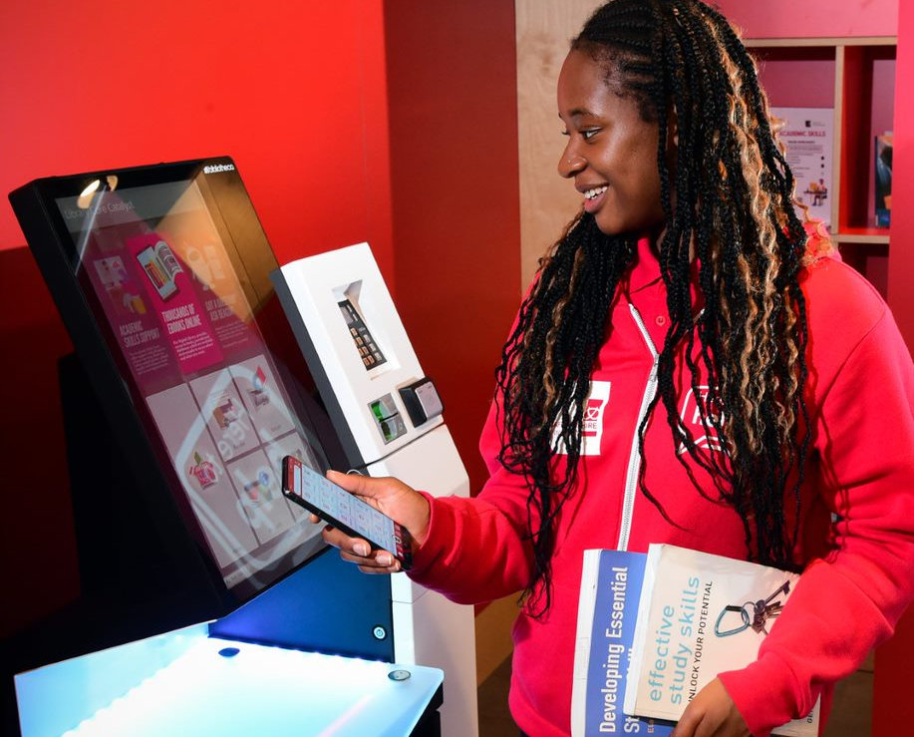
Redesigning the Service - Principles
Designed around technology
Digital On Demand - first port of call rather than as a supplementary service
Broader work experience and opportunities for progression
Redesign to be completed March 2021

Slide 5
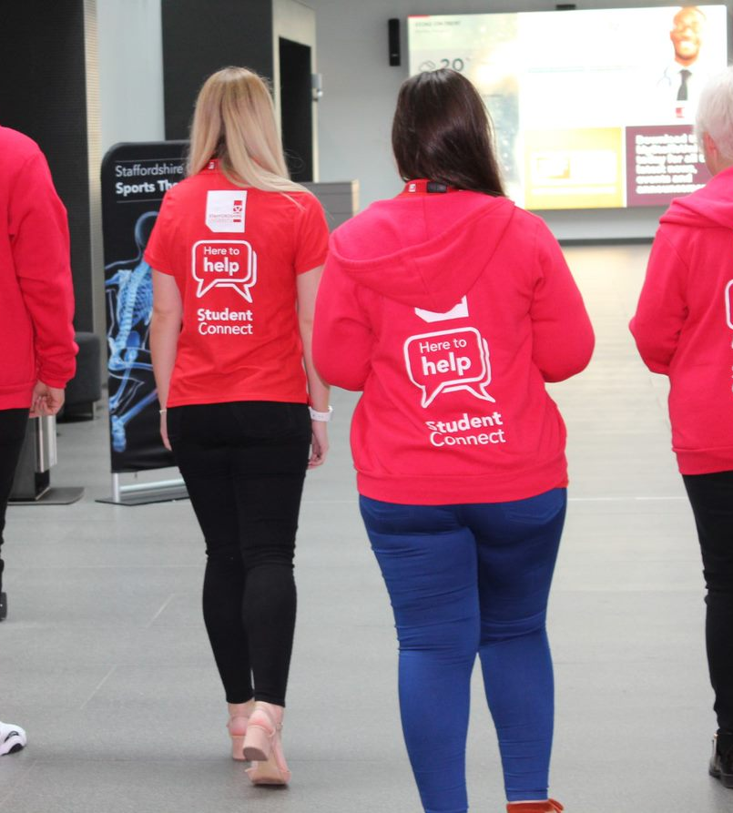
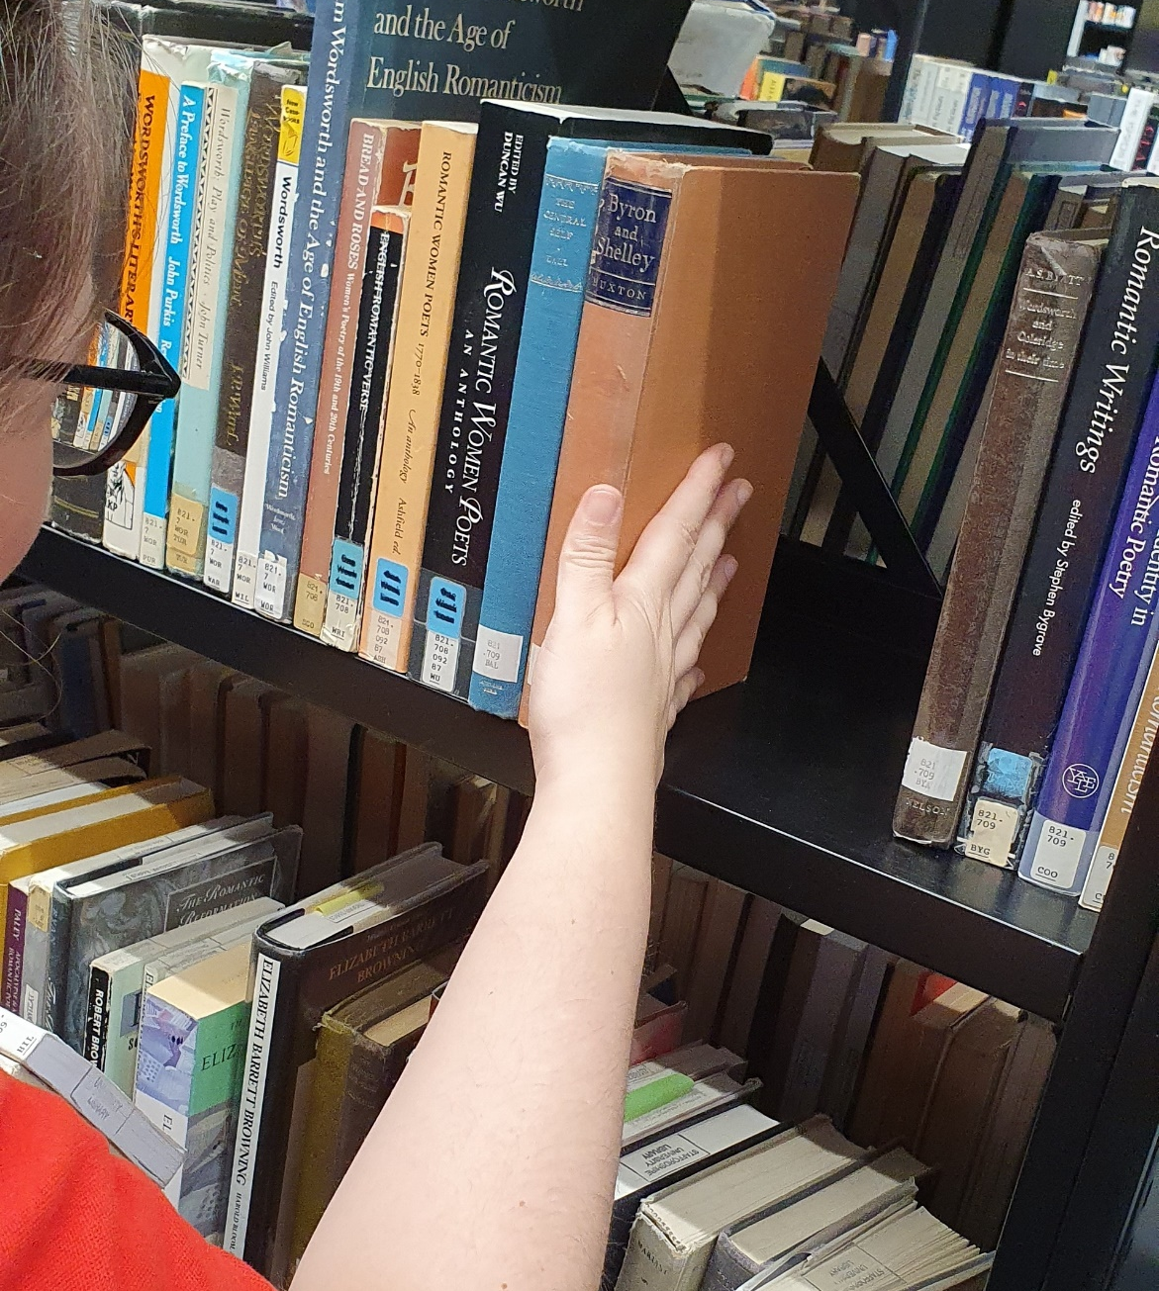
Redesigning the Service - After
Single Library and University front line team
Approx 14 FTE (1 x Manager, 3 x Supervisors, 10 x Assistants, Supplemented by Student Ambassadors and Reps)
Clear/streamlined routes for communication
As well as 24/7 assistance available through the digital assistant, the team can now provide an extended staffed day by incorporating several shifts.
Mobile technologically enabled team

Slide 6
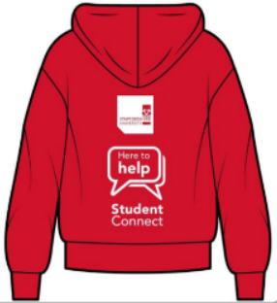


Meet the Team
The Student Connect Team are here to help with any initial enquiries' students might have whilst studying at the University (or staff), offering help and support throughout the day, online and in person, whilst maintaining and servicing University library spaces.
Unsure who you need or where you need to go? Student Connect can help.

Slide 7
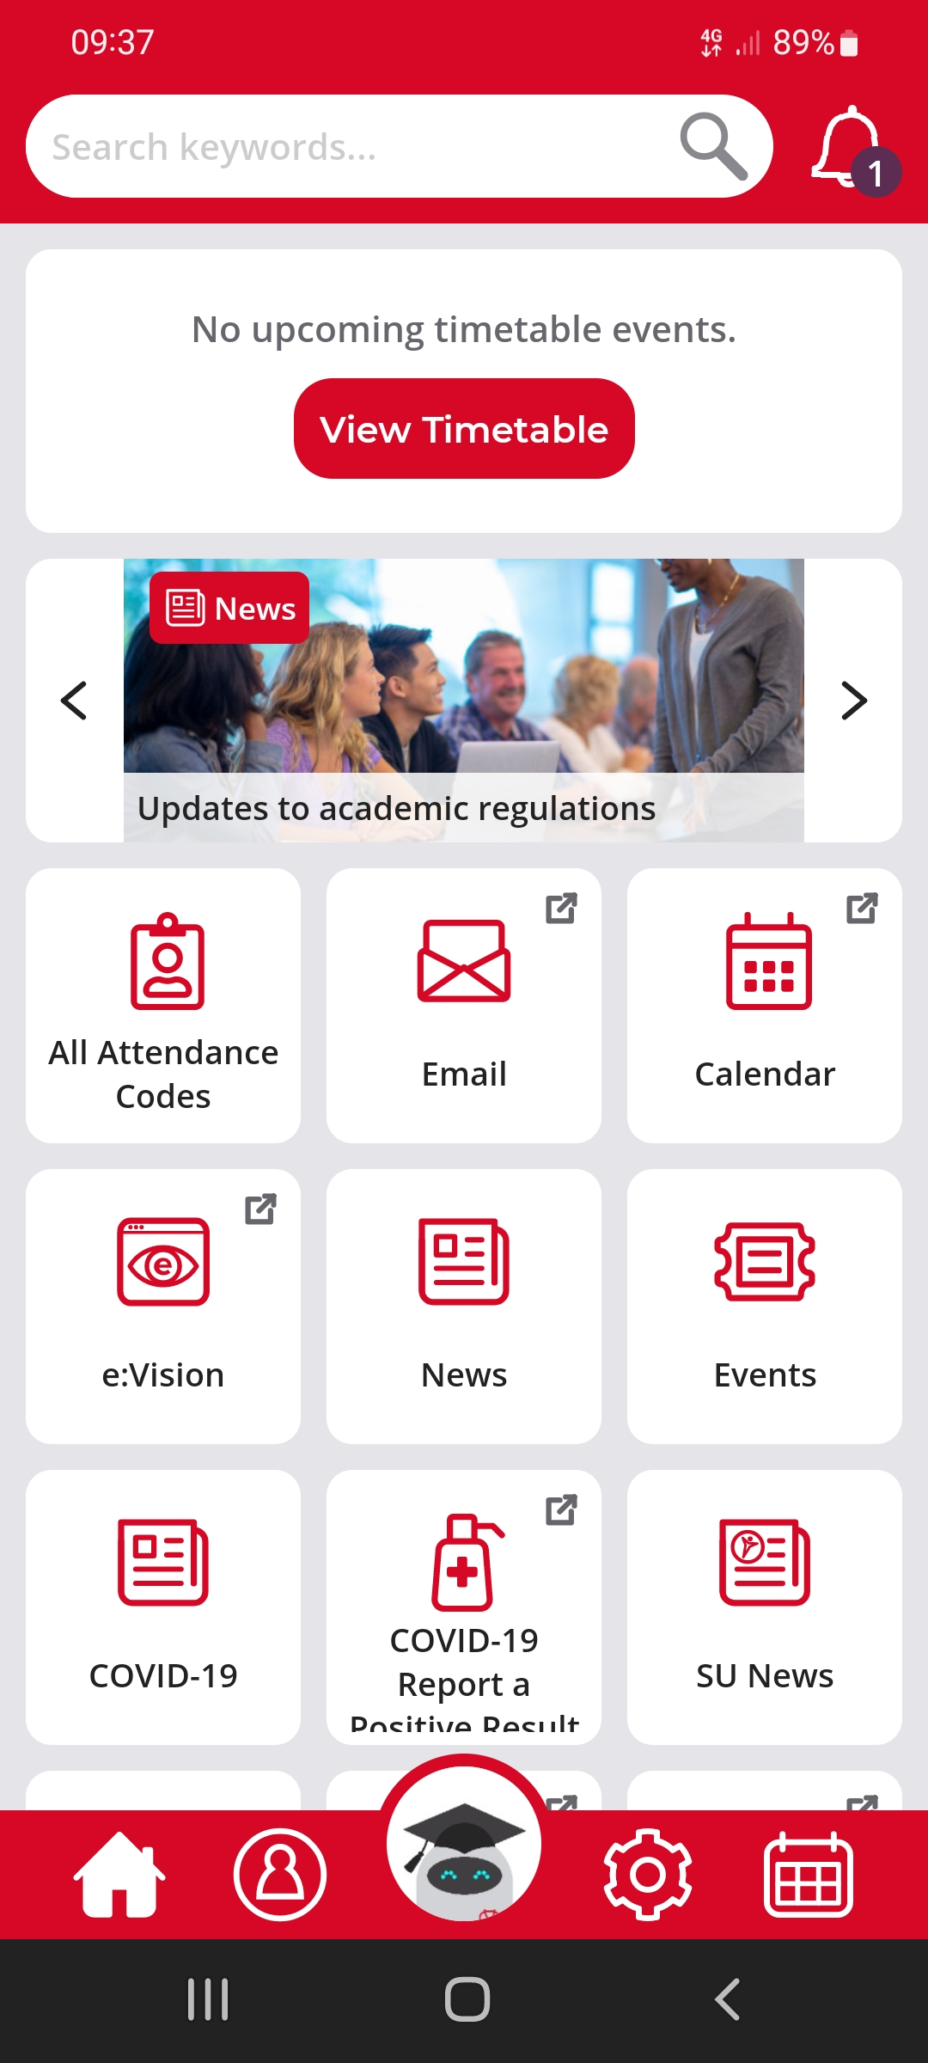
Meet the Team:
What We Support and Continuous Improvement
  Finding Information and Services
  Digital Assistant (Beacon), Website, Wayfinding & Online Maps (teaching rooms, study spaces, family spaces), Events, Digital Help
  Student Support
  Triage and Booking (Safe-Guarding, Wellbeing, International, Money), Report & Support
  Registry
  Online enrolment, Bulk Cards, Communications to Partner Students, Timetabling, Finance & Bursaries, Regulations & Complaints, Awards & Graduation

Slide 8
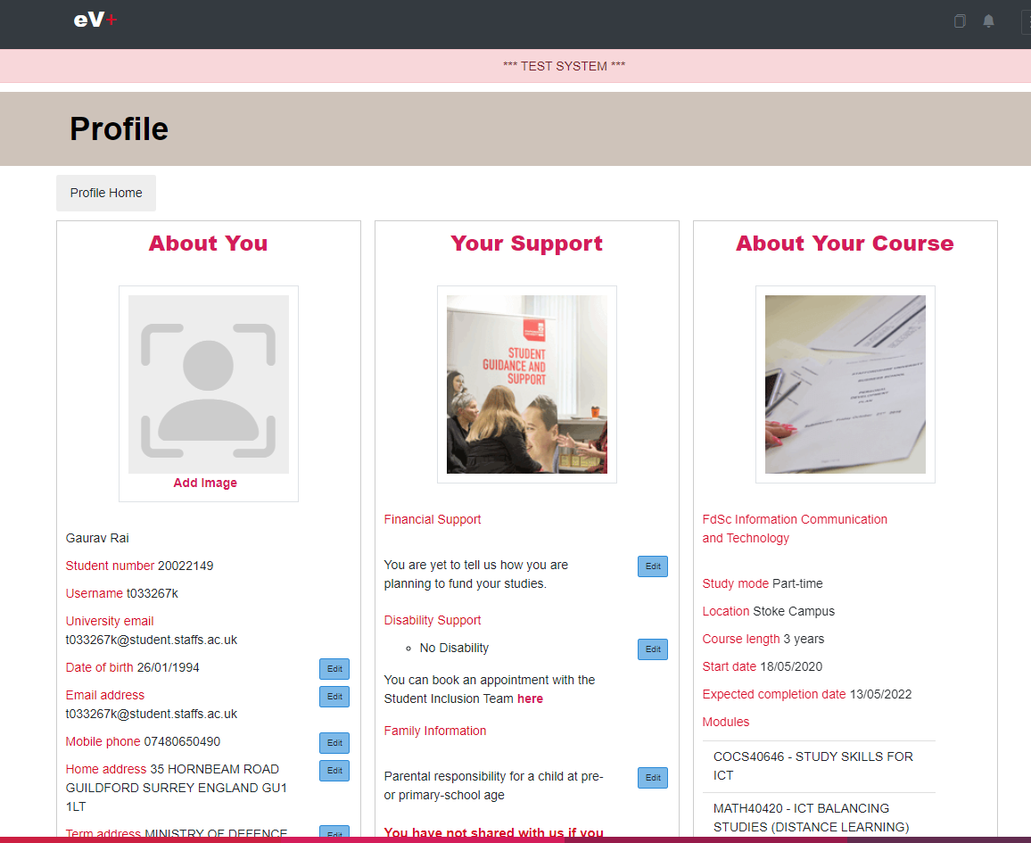
Meet the Team: What We Support and Continuous Improvement
  Library
  Maintenance of Spaces, Reservations, In Person Support, External Library Access (SCONUL and Alumni), Account queries
  Self Service
  Personal Details (inc. picture), Bank/Council/Holiday/Enrolment/Graduation Letters, Course Transfer, Module Changes, Exceptional Circs, Break or Withdrawal, Course Info
  Online Shop
  Replacement Certificates and Transcripts, Library Payments, Replacement Cards

Slide 9


Meet the Team – Contact Us
Live Chat www.staffs.ac.uk/student-connect-team
Email studentconnect@staffs.ac.uk
F2F Regular locations
Phone 01782 294751
Facebook @StaffsStudentConnect
Instagram @Staffs_Student
Twitter @Staffs_Student

Slide 10
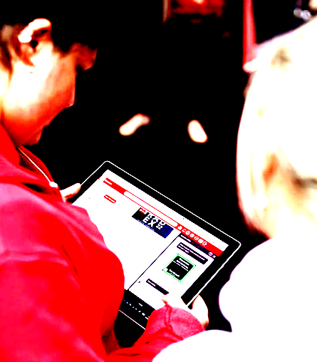
Digital First – Implementation
The AI technology employed in our digital helper is based on MS Language Understanding.
Be realistic about the technology.
Work alongside students to help them navigate the service.
Understand where user and contributor behaviour development is necessary.
Notes:
Mix of technical and human factors in our approach
The AI technology employed is based on MS Language Understanding Intelligence Service (LUIS). Our journey has begun with the use of language and speech APIs, for example, to understand and analyse text and deliver the best matched response. Our development roadmap includes the implementation of translation APIs to support transition for a growing number of international students and identifying device location to return campus-specific responses.
Be realistic about the technology. While it may be able to interpret meaning in typed or spoken questions, it doesn’t devise answers from scratch. This relies on input from the appropriate teams across the organisation. Any user will quickly lose confidence in a technology that doesn’t deliver up-to-date answers so it’s important to make sure the information is current. With any new development there is usually enough initial enthusiasm to make sure the information it delivers is fit for purpose. However, as time passes the updating of information can drop down the list of priorities. It’s not enough to rely on various teams proactively delivering updates so it’s important that ongoing central coordination is put in place.
Work alongside students to help them navigate the service. The app is promoted to students (for example at induction and welcome activities) as essential and time saving, helping to overcome students concerns about downloading extra apps onto their devices (actually now essential as used for attendance monitoring).
Understand where user and contributor behaviour development is necessary. As an example, a student may need to enter a location as a keyword when looking for campus specific information and the department responsible for the information needs to ensure there are campus specific answers put in the system.

Slide 11
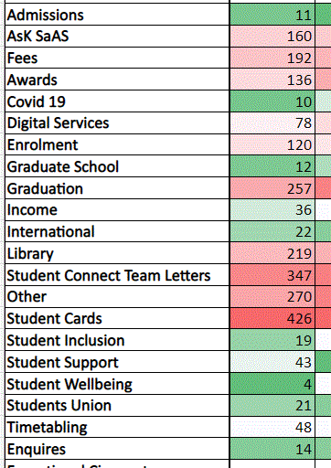
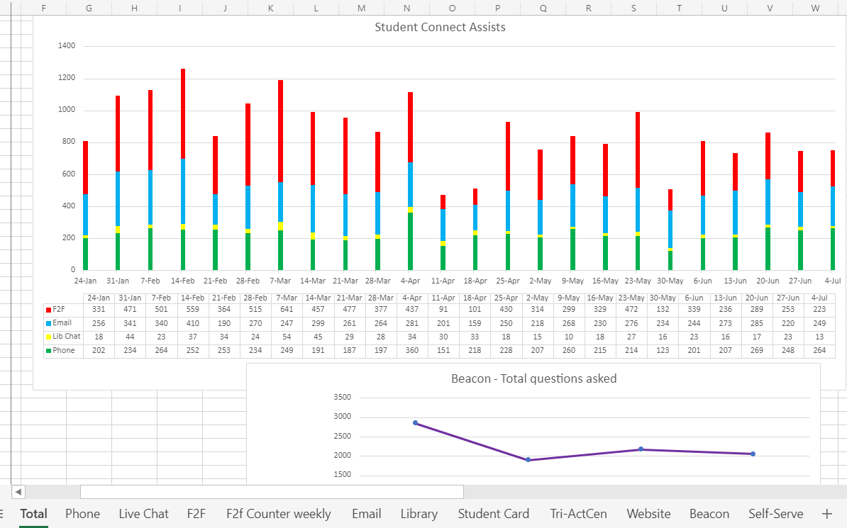
Digital First – Data
Heat maps highlight…
topics that require prioritisation for automation or self-service development
pain points for students
times of the day, week, and year when topics are prevalent
locations and times that require adjustments to rotas in response to demand.
Dashboard highlights…
inbound analytics (volume /themes)
volume/mitigation (e.g. by FLAAG)
Beacon scrutiny (messages), additional info and functionality
  chatbot
  app info
  scalability / data practises
Beacon information and chatbot FAQs (and across the university).
Notes:
The team has developed heat maps for a range of inquiry types, locations, medium and timings. Using these we can target pain points for students and generate ideas for the exploitation of new technologies to solve those problems. For example, at certain times in the academic cycle we can see that funding updates are crucial for students. Students have traditionally taken several routes to find information updates such as academic administration, enquiries, finance, or customer service teams. As an interim, Student Connect co-ordinate a shared finance status spreadsheet which means all teams work from the same information with the next stage being to develop a self-serve component for students to access directly.

Slide 12
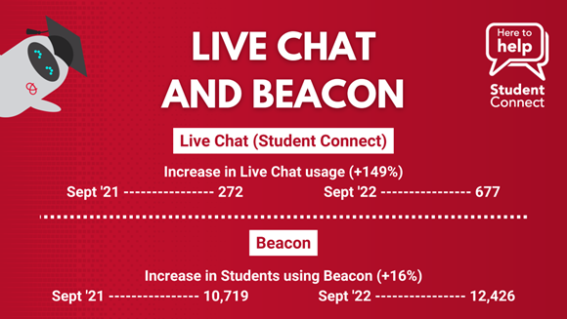
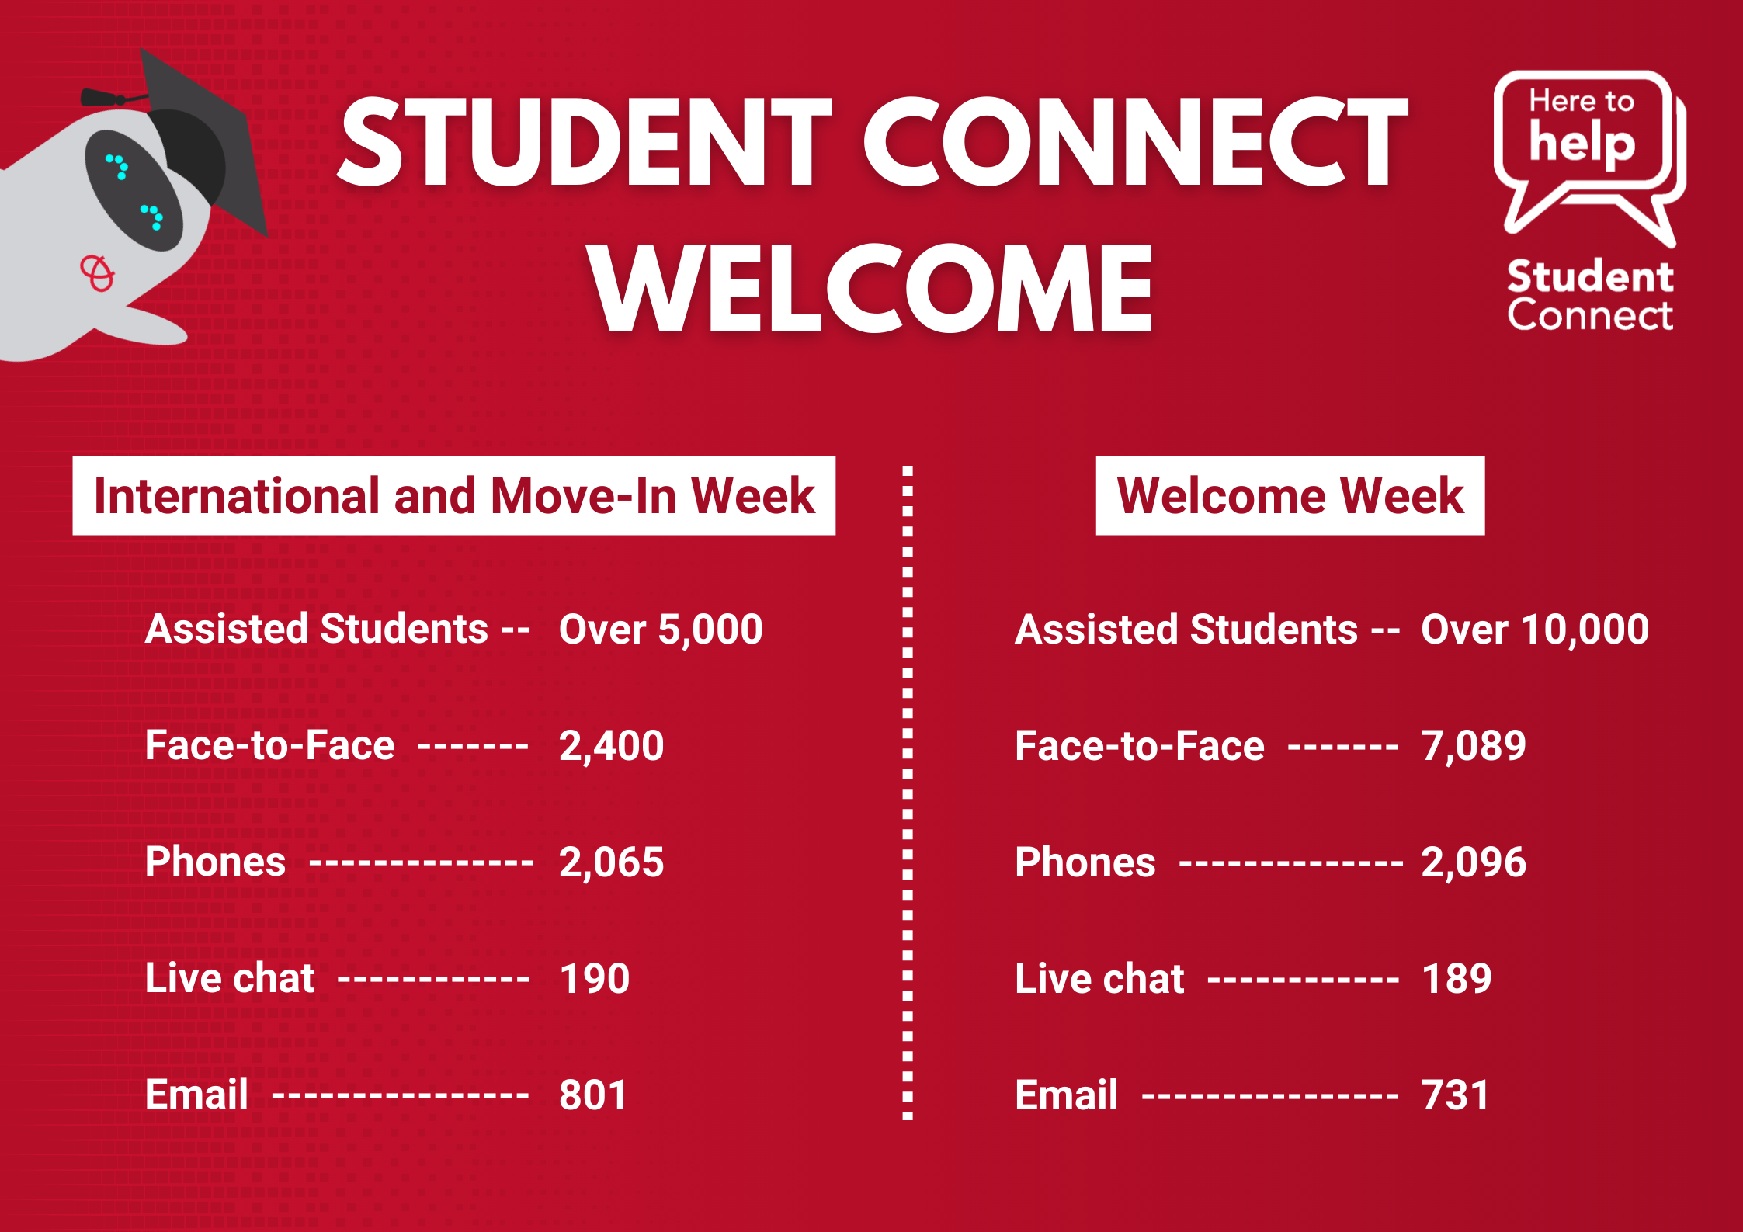
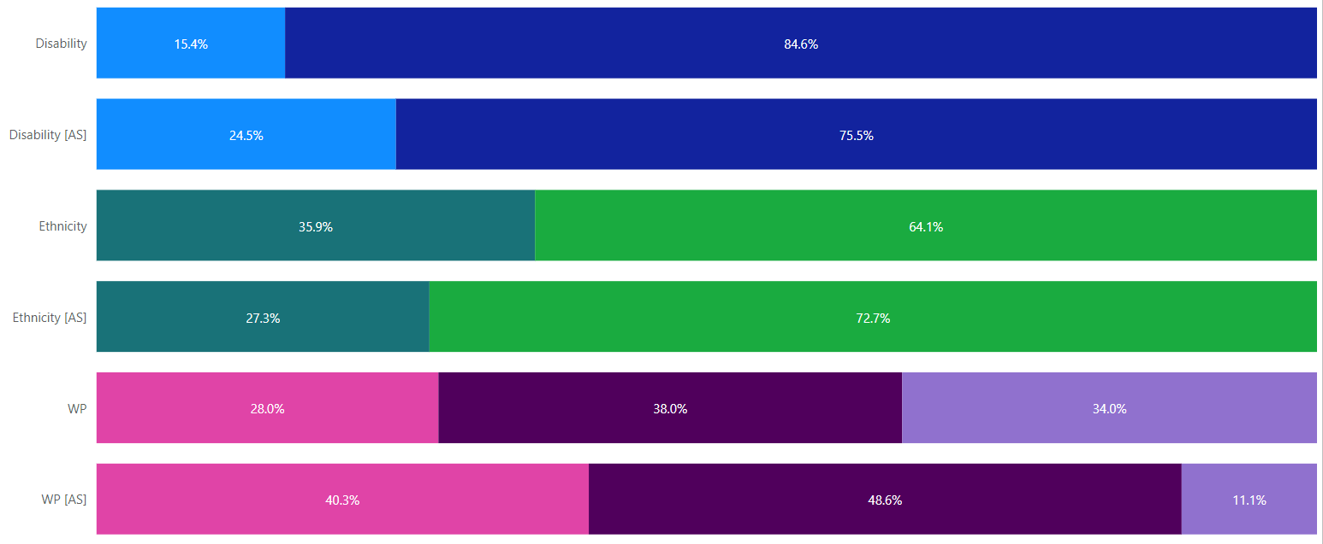
Digital First – Data continued
Demonstrates value
Facilitates planning
Evidence (e.g. new business cases)
Further insights being developed e.g. APP…

Slide 13
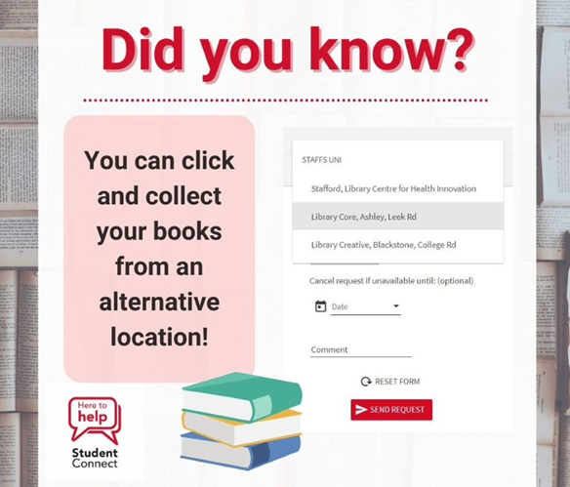

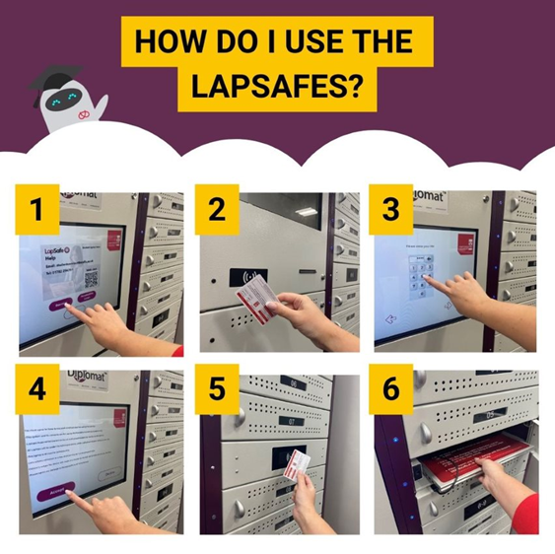
Developing the Team
Working together
  Robust Induction
  Student Connect Weekly Meetings
  Teams – Peer Support
  Training refresher calendar
  Skills Matrix
  Support and training to Student Connect Reps

Slide 14
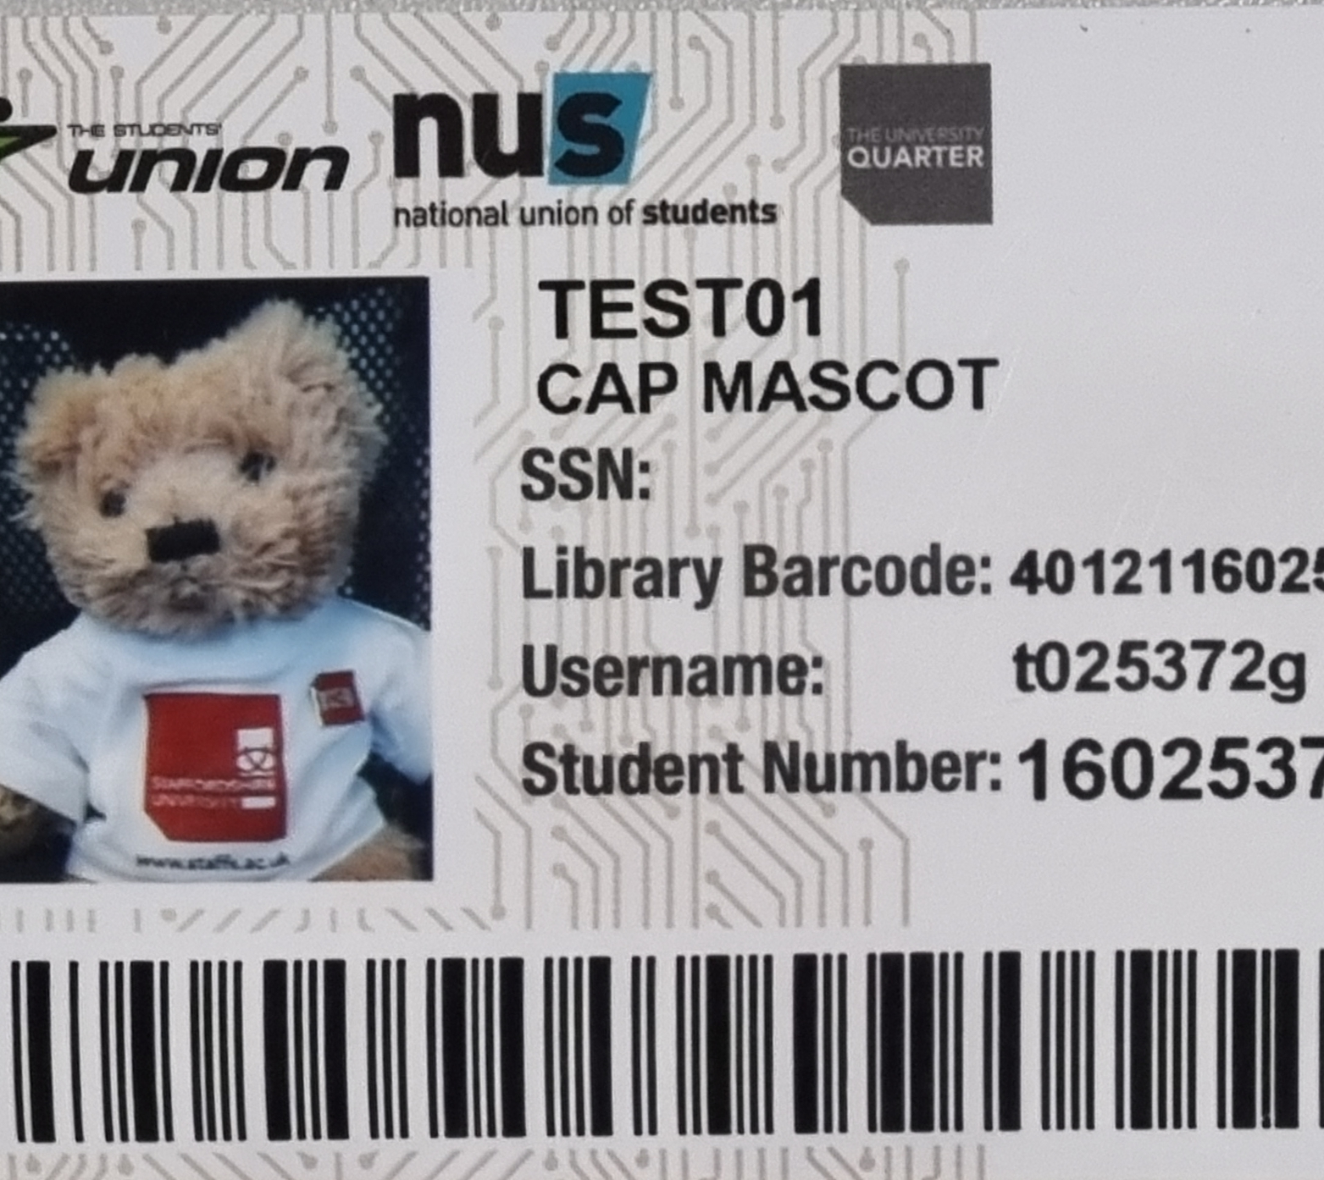

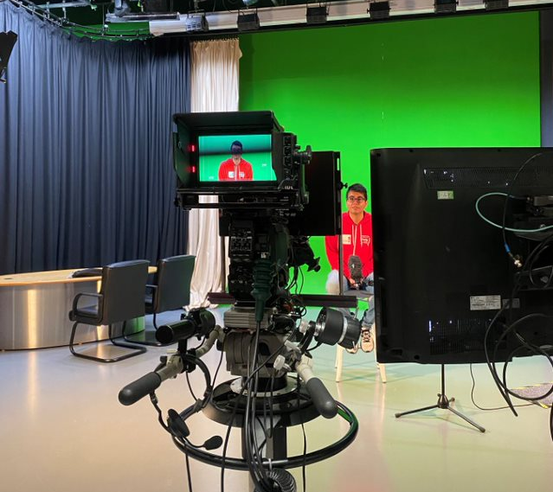
Developing the Team - Workstreams
Content Creation and Social Media
Beacon and Web
Self Serve and Automation
Library
Student Cards
Phone and Live Chat
Email
Face-to Face

Slide 15
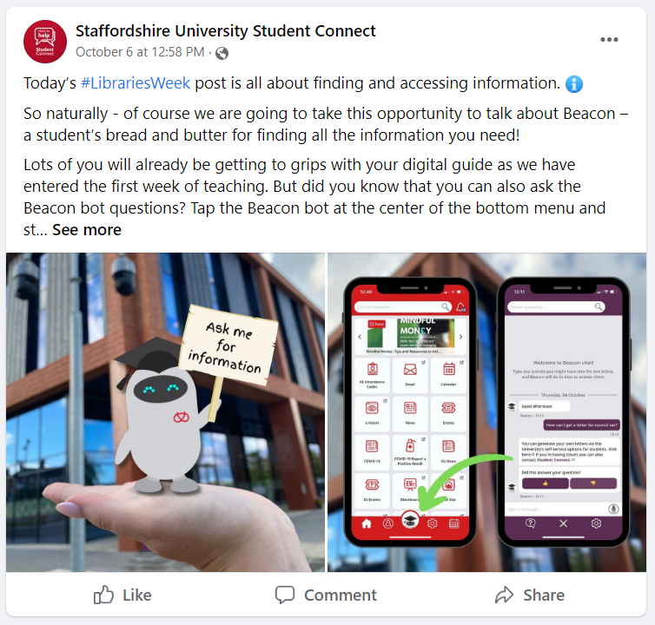
Developing the Team
Example from ’Content Creation and Social Media’. The team is involved in ideation and process review sessions to inform the further development of the service.
Notes:
Here’s an example from content creation and social media
Using all feedback, the full team is involved in ideation and process review sessions to inform the further development of the service.
Their increased confidence with technology and close working with appropriate departments such as marketing and communications means they can effectively create content and utilise available channels to disseminate information for example by the production of content for sharing via the university’s state of the art display system. Internal channels and external social media messages are relayed by working to a plan and with a tone and style that the whole team contributes to.

Slide 16
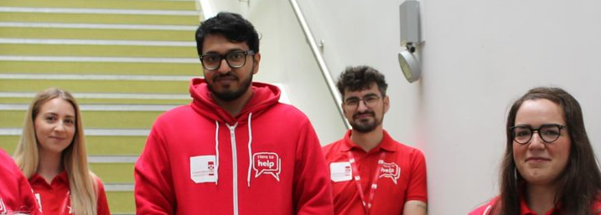
Developing the Team - Recruitment
High turnover - Many progressing within the institution
Challenges with diversity
Student ambassadors essential and valued
Remote working available
Notes:
Challenges with ethnic diversity in recruitment – opening up avenues to promote to local communities e.g. recruitment fairs and localised comms channels
Our student ambassadors provide an essential supplement to the team. As they continue to work in a more integrated way, they provide close insights to the student experience along with developing a broad base of skills that support their employability.
Some shifts can be delivered remotely meaning even front-line staff can benefit from new working patterns without detriment to service. This factor is helpful in engendering cross team unity.

Slide 17
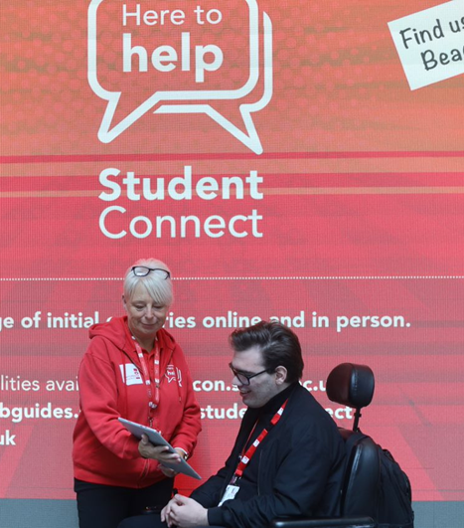
Developing the Team - Institutional Partners
Established Connections with Student Services, Registry and across the University
First Line Analysis / Action Group (FLAAG)
Student’s Union Collaboration
Group Participation –
  Welcome On-Boarding / Oversight / Transition & Belonging
  EDGE
  Learning & Teaching
  Event Planning Group
  Marketing
  Service Social Media Planning
  School Academic Committees
Notes:
Moving to digital first can have implications for organisational partners as well as students, so ensure good communication with other services and departments to discuss the impact. If there is to be a reduction in desk staff at specific locations, then crucial issues need to be thought out such as what happens to distressed students who might normally have presented at those locations. Also consider other unofficial duties desk staff may have carried out and how these might be adapted. If, for example, front desk staff are involved in receiving assignment hand-ins on behalf of an academic department, it may be an ideal point for that department to consider digital submissions.
Wayfinding needs to be up to scratch if staff used to provide a lot of direction information

Slide 18


Learning Lessons and Next Steps
Outstanding Library Team Shortlisted
Creation of new journey maps
Improving technology
Improving cross group working
Improving data
Take the team on the journey
https://www.timeshighereducation.com/campus/digital-first-how-use-ai-enhance-customer-service-universities
Notes:
Creation of new journey maps highlighting technology/team handovers etc.
Technology – language pack to support international transition, improved wayfinding, location detection for better answers
Improving cross group working with outputs such as Finance Tracker
Improving our data – marrying suitable technology solutions with automated data capture into power BI, Better analysis – e.g. APP
Take the team with you on the journey. If using these technologies saves staff time on repetitive duties, use it as an opportunity to develop roles with increased skills and broader duties. By involving colleagues at all levels in developing ideas, analysis of data and providing insights, your implementation will have the best chance of success.

