Slide 1
Journeys & Perspectives from a Junior Staff New to the Profession Teg Bayissa, MMU Library t.bayissa@mmu.ac.uk

Slide 2
Outline
1. My background and how I came to the library profession 2. Brief overview of MMU library and my role as LE Assistant 3. My experiences during orientation/training, and doing the job 4. Some reflections on the training/induction 5. Future aspirations and thoughts on what may come next for libraries/challenges ahead

Slide 3
1. My background and how I came to library profession
Customer Service (retail)
Administrative/clerical
Involvements in libraries
&
Passionate about customer service & higher education

Slide 4
1.1. New role, L.E. Assistant
Restructure in the Library Service
Shelver
Principal Library Assistant
Library Experience Assistant (grade 3)
Senior Library Assistant
Library Experience Advisor (grade 5)

Slide 5
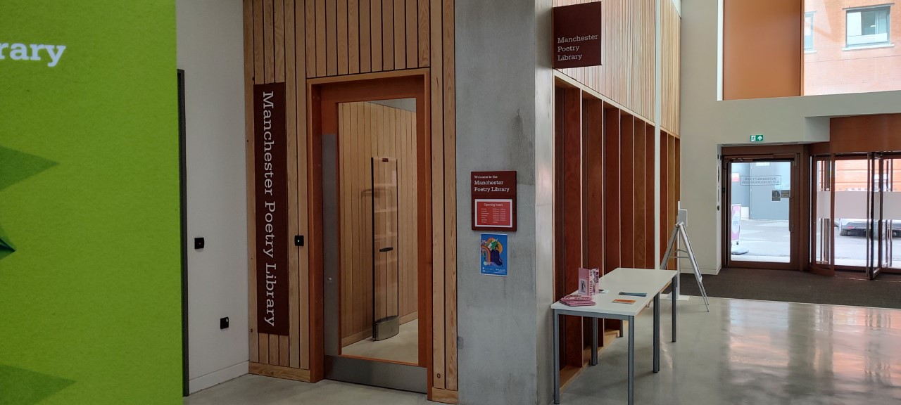
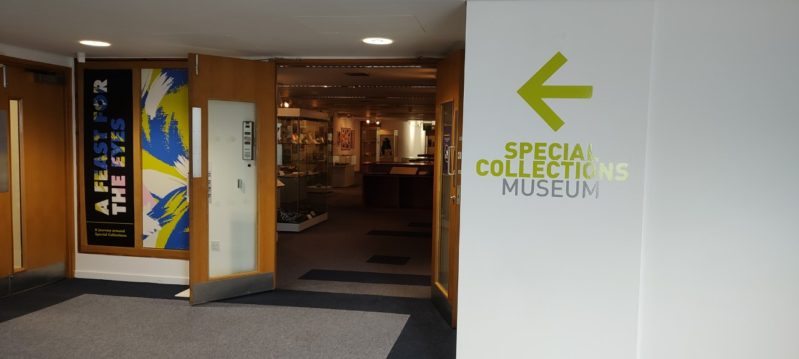
2. Brief overview of MMU library and LE Assistant role

Slide 6
2.1. Library Structure

Slide 7
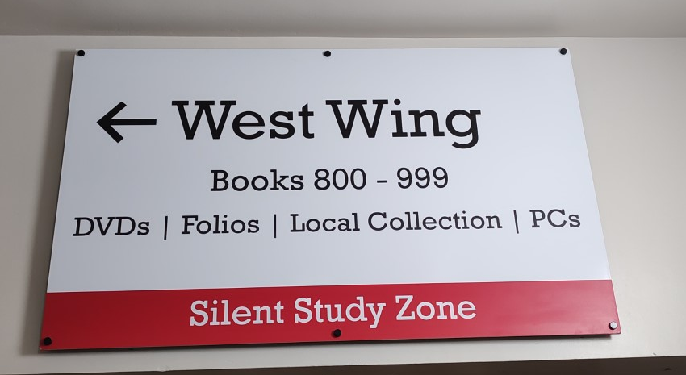
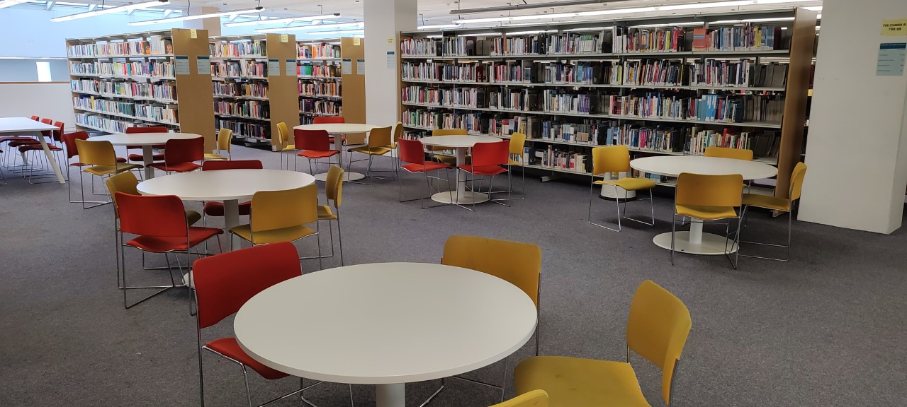
2.2. Library layout

Slide 8
2.3.WorldShare Management System (OCLC)

Slide 9
2.4. LibApps

Slide 10
2.5. Service Points
Reception Desk (AS) & (PL)
Help Desk (AS) & (PL)
Book Sorter
Shelving (AS) & (PL)
Straightening (AS) & (PL)
Roving & security gates (AS)
VH
(Virtual Help Desk –
Chats & Emails)

Slide 11
2.6. Rota

Slide 12
3. My experiences during orientation/training, and doing the job
Induction
Shadowing
Training
Questionnaire

Slide 13
4. Some reflections on training, induction & shadowing
Some of the pros and cons of training on Dashboard via MS Teams:
Social distancing – may give confidence to staff who may feel uncomfortable sitting next to a new person
Screen size and fonts don’t help the trainee to see everything
It’s “second nature”, for permanent staff who’re giving training, they whiz through, but trainee can’t see step-by-step actions.
Some of the pros and cons of shadowing:
Good chance to see how things work
Staff answer queries quickly without giving a trainee chance to have a go.
Different staff have different levels of knowledge, and do things differently, which could lead to blames on trainee for doing things ‘wrongly’, in future.

Slide 14
4.1. Suggestions on training & shadowing
On training:
Training for trainers - to raise awareness of theories & practice of learning & teaching.
Developing a standardised and recognised training material/package, streamlining with the university’s course in Library & Information Management (one that is recognised across academic libraries). Perhaps ALs could work together on this.
Training package to be available in various formats to suit different needs
On shadowing:
Staff to be aware of trainees needs for a chance to have a go.

Slide 15
4.2. Common problems in Library
Hot food
Vaping
Swipe Cards & Security gates
(swapping, tailgating etc)
Noise

Slide 16
4.3. Trends in Library

Slide 17
More PCs stations Less book shelves

Slide 18
More Study Spaces Less book shelves

Slide 19
More Study Spaces Less book shelves

Slide 20
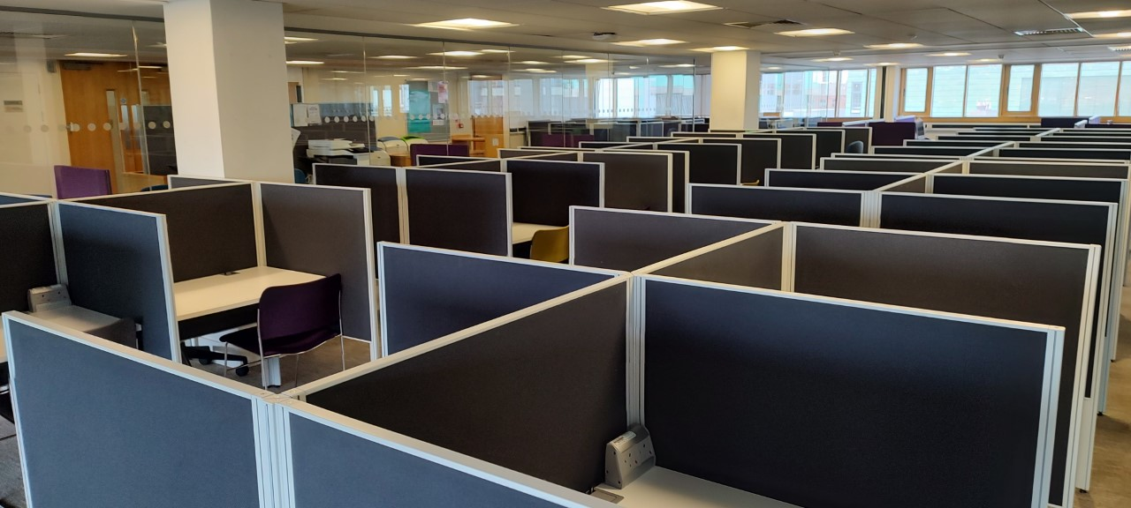
More Study Spaces Less book shelves

Slide 21
4.4 Study ‘Spot’ & ‘Concentration?’

Slide 22
5. Thoughts on what may come next for libraries/challenges ahead
Global education market
Economy (funding, tuition fees, cost of living)
Global health issues
Carbon footprint & pledge
Digital technology
A.I. and the future of education

Slide 23
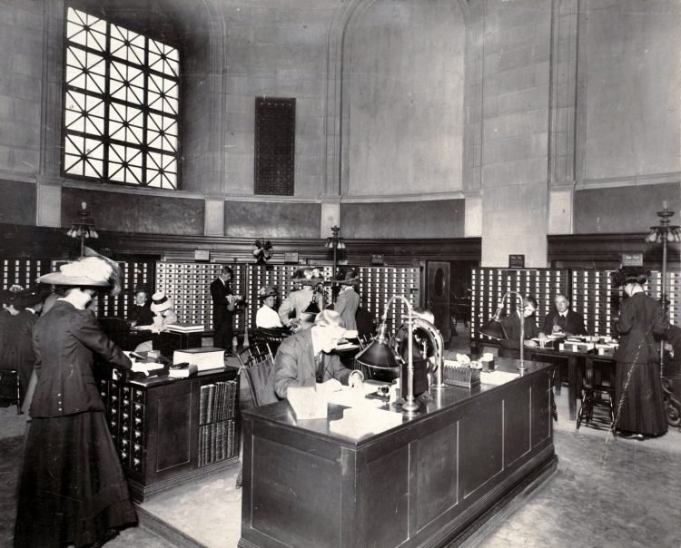
5.1. Thoughts on what may come next for libraries/challenges ahead
Technology

Slide 24
5. 2. Future aspirations
Conference, “Thriving in your career”
CILIP
Qualification
MA in Library & Info, focus on digital service
Research Library

Slide 25
Thank you

Slide 27
Various views

