Slide 1
Hybrid Working
Sally Earney
earneys@cardiff.ac.uk
Cardiff University

Slide 2
“Better Ways of Working” Principles at Cardiff
Professional Services staff
An opportunity to make better use of space, free up space and work differently – ‘smarter’
Business Need is paramount
Different roles will have different requirements for balance of on campus / working from home
Working From Home (WFH) Voluntary – staff can elect to work ALL of their hours on campus if they wish
All staff expected to work some of their time on campus

Slide 3
Customer Services Team – questions we asked
87 Customer Services Staff split across 7 libraries
Includes 29 evening/weekend Library Assistants
Do we have the capacity to offer working from home to all daytime customer staff?
How can we be fair to Customer Services staff who have worked shifts from home during the pandemic?
Will there be sufficient work for staff to do at home?

Slide 4
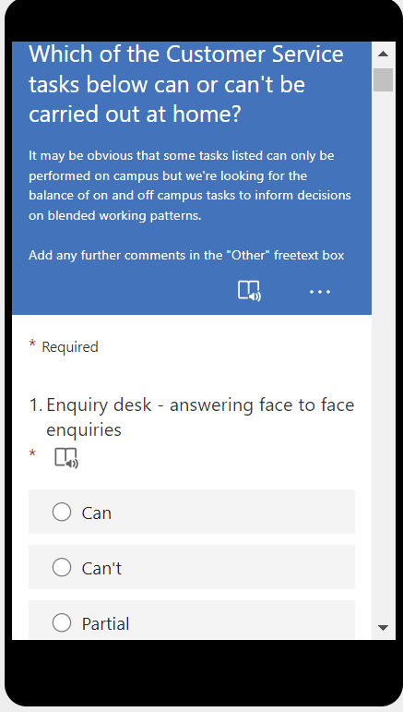
Customer Services Team
29 evening/weekend Library Assistants 100% on campus role – no capacity to offer working from home shifts
Analysed Tasks – what has to be done on campus/what does not – surveyed managers on 67 customer services tasks
Daytime staff 80/20 split (on campus/Working from home)
Part-time might be fortnightly shift off campus e.g. if < 15 hours
Managers 50/50 split

Slide 5
Working from home tasks
During pandemic centralised many operations – Library Returns Team, Postal Loans Team, Ordering Team
Ask a Librarian chat service
Telephones
Generic email accounts
Mandatory and other online training
Updating reading lists
Subject Librarian support

Slide 6
Working from home etiquette
May be called in at short notice
Swapping (only at manager’s discretion)
Checking in

Slide 7
Hybrid Working Survey feedback
1st survey February 22
52 staff responded (39 from Customer Services)
34 (65%) respondents said balance of wfh/working on campus about right
10 (19%) respondents would prefer to spend more time wfh
3 (6%) respondents would prefer to spend more time working on campus
2 (4%) said they had not had the opportunity to wfh
1 (2%) said they had not returned to work on campus
2nd survey August 22
89 staff responded (33 from Customer Services)
59 (66%) respondents said balance of wfh/working on campus about right
16 (18%) respondents would prefer to spend more time wfh
10 (11%) respondents would prefer to spend more time working on campus
4 (5%) said they had not had the opportunity to work on campus

Slide 8
Feedback Customer Services Staff (non-managers)
21 responses
11 staff (52%)respondents said balance of wfh/working on campus about right
9 staff (43%) respondents would prefer to spend more time wfh
1 staff (5%) respondents would prefer to spend more time working on campus
“I really like how flexible Cardiff Uni is, as a whole, regarding working from home.”
“It saves money, petrol costs which are increasing exponentially and other transport fares. Time otherwise spent commuting is more appropriately used in completing tasks.”
“I quite often get asked to come in on my work from home day, which makes it difficult to plan my time and complete tasks.”

Slide 9
Going forward…
Sufficient work to be done off campus?
Staff capacity – especially at key times e.g. start of semester or when large number vacancies
Difficult to take away once embedded – lose goodwill?

Slide 10
Follow up questions?
Contact Sally Earney
earneys@cardiff.ac.uk

