Slide 1
Striving for excellence: managing user expectations and innovating customer services through a library move
Carol Sadlowski – Head of Customer Services
c.sadlowski@rhul.ac.uk
Amy Stubbing - Customer Care (Collections) Coordinator
amy.stubbing@rhul.ac.uk ; @amyodo
Notes:
Introducing us, Carol followed by Amy
Thank you for inviting Amy and I to present at todays Conference. I am Carol Sadlowski and I have been head of Customer Services for the past 10 years and have seen many changes during this decade!!
Amy:
Carol: “Our presentation will explore how we manage user expectations before, during, and after a major library move and how we used this period to innovate our customer services”

Slide 2
Some Background
Notes:
Carol
Royal Holloway University of London is based on a leafy green campus in Egham
Prior to the move to the Emily Wilding Davison building in September 2017, the university had two libraries on campus
The Bedford library was opened in 1993
Founder’s library dates back to the Victorian era when Royal Holloway College in 1886 first cohort of students 28
The two libraries were to serve a student population of 2,700.
Increase in student numbers (currently 9000)
861 study spaces it was evident that this lack of study space was an inhibiting factor for the universities growth and recognition’ within the sector
Staffing of two libraries was achieved by using staff from a variety of teams from within the department
Due to the pressure on spaces it was incredibly important for us to monitor spaces and behaviour, and our role in these libraries was that of enforcers and police of rules, regulations and space
Because of this role we had less opportunity for positive interaction than we would have liked with our users

Slide 3
Before the move
Notes:
Carol
The lack of study space, along with the NSS scores prompted the College to look at innovative ways to create more study spaces within the university by either extending existing libraries or a new build
A new Principle in post funding was approved in 2012. The building would include the 3 professional services from Student Services, Career department and Library
The new building opened in September 2017 and was named after the suffragette Emily Wilding Davison who was a student at Royal Holloway in 1892
The space within the Library can seat up to 1,250 students at any one time

Slide 4
Feedback
Notes:
Carol
In order to understand and manage user expectations its was important to consult and gather feedback from all stakeholders which has continued throughout the life cycle of a new build and beyond
Extensive discussions and consultation meetings with stake holders, both within the university and the local community took place
Consultation period raised questions
where the library should be located
how the new building would be incorporated into the historical context of RHUL
how postgraduate research, disability and dyslexia students would also be catered for
ratio of collaborative versus silent study areas
Feedback highlighted
new building to be at the heart of the campus,
bigger and more spacious
comfortable working space
accessible and inclusive to all

Slide 5
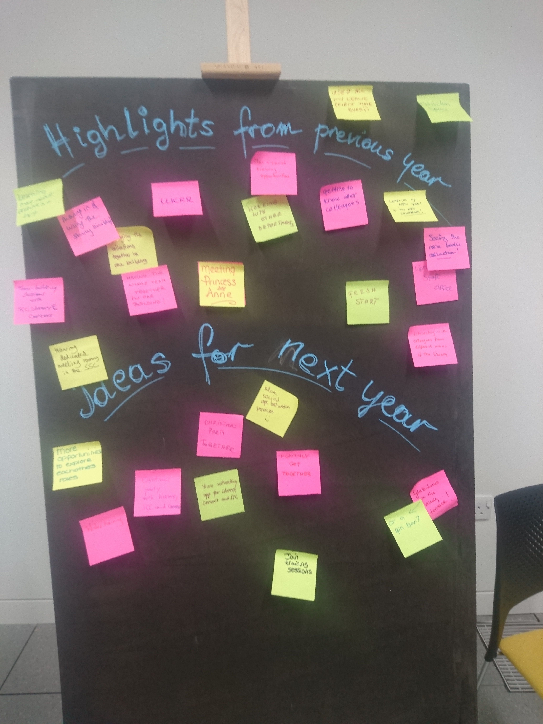
Student First
Notes:
Amy
Major development
Initially 1 meeting to set up training programme for CS in Royal Holloway
3 key professional services used it as a catalyst to come together to tie up our services
In past, poor tie up, pinball effect
So, we took the initiative to create a Professional Services CS working group
Student First was really just a name, but we made it into something useful for our services
Carol and I led this initiative, organising regular meetings with other managers, leading meetings and actions
Introductions to each service – team building, shared what we do, activities
All new members of staff now have inductions
We also worked to genuinely tie up our services
SLAs, KPIs, and Staff Charter

Slide 6
Developing the Team
(1)
Notes:
Carol
Developing the team and innovating our services started with the review of the staffing models within the Customer Services umbrella.
First - weekend and evening teams roles
Work patterns / hours where varied across the teams with the evening teams working until one fifteen in the morning, four days a week
Harmonize the roles in order to deliver a consistent service delivery to library users
One library also enabled me to reduce the number of staff within these teams and the very late working hours no longer existed
Teams are more productive working 6-hour shifts and engaged in project work, alongside their daily activities
Review of Core Customer Services team
Contrary to the trends, Royal Holloway moved away from a dual frontline team by creating a dedicated customer services team who are more focused and dedicated to deliver an excellent front line service
A new staffing model was formed from the existing team
Additional 3 full time staff were employed to make up the loss of colleagues from other teams
Throughout the year, and to help staff through the changes process, staff attended various training events
Regular staff updates, working groups and input to looking at our ideal vision of excellent customer services.

Slide 7
During the Move
Notes:
Amy
While the processes before the move were mostly focused around understanding the user expectations, during the move it was much more about attempting to meet and managing these expectations.

Slide 8
Services Offered
Notes:
Amy
Knew that we wouldn’t be able to offer same service if there wasn’t a move
Lots of fear around not having access to books
PGR and PGT feeling at a disadvantage
Wanted to work to manage expectations and change habits yes (as we couldn’t offer the same), but really we were focusing most on attempting to exceed these expectations with an alternative service. Aiming for the sky and if we fell short it was still a good shot!
First step, offering services to mitigate some of the issues that would arise
Longer loan lengths
Higher loan limit
Additional study spaces
Fetching service
Part of this was managing expectations around these new services to make them work
Going to staff and student meetings and events
Twitter/ social media
Posters
It is arguable that expectations were low
Think we achieved in exceeding these expectations
Thought wouldn’t have access to books/ study spaces but we went extra mile
Fetched over 800 items during a 4 week period on active building site
Geared up, staffing logistics, fetching logistics, safety of our staff, negotiating with builders
Still we ran twice daily service, went over additional times for urgent requests and despite not always finding what they needed, users were genuinely grateful (verbal feedback)

Slide 9
Communications
Notes:
Carol
A huge part of making these services work, and managing user expectations throughout the move was having a really strong communication process
One of the things that made the process so successful was having a dedicated communication person in the Library
Lots of stakeholders, high profile building, frequent changes in dates and information
Having dedicated communications person meant changes were kept on top of, communicated through one person so information wasn’t lost
Customer Services team played a key role in the communications to individuals, keeping the dialogue open and dealing with issues from things not going as planned
Meant that we could manage expectations and that user morale and attitudes were kept up despite issues
Because of the frequent changes and delays we needed to be thorough
Variety of mediums including Social media
Posters / communication at the desk
Dedicated webpage
Communications was also important for getting users invested in changes
Exciting for them too
Letting them be a part of the move and the occasion
Sharing sneak peaks
Sword of the stone – many tweets

Slide 10
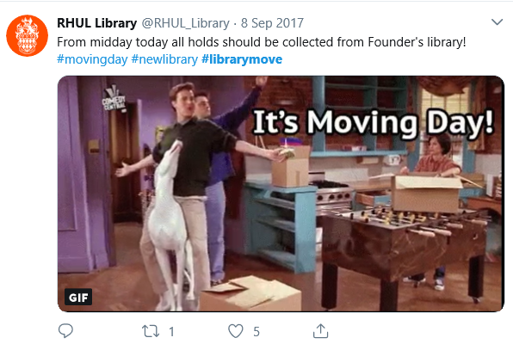
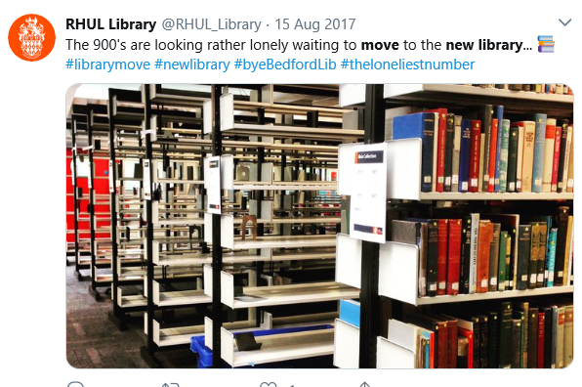
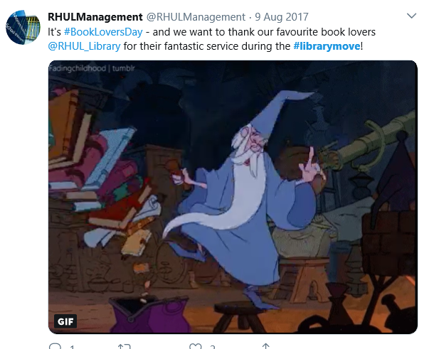

Slide 11
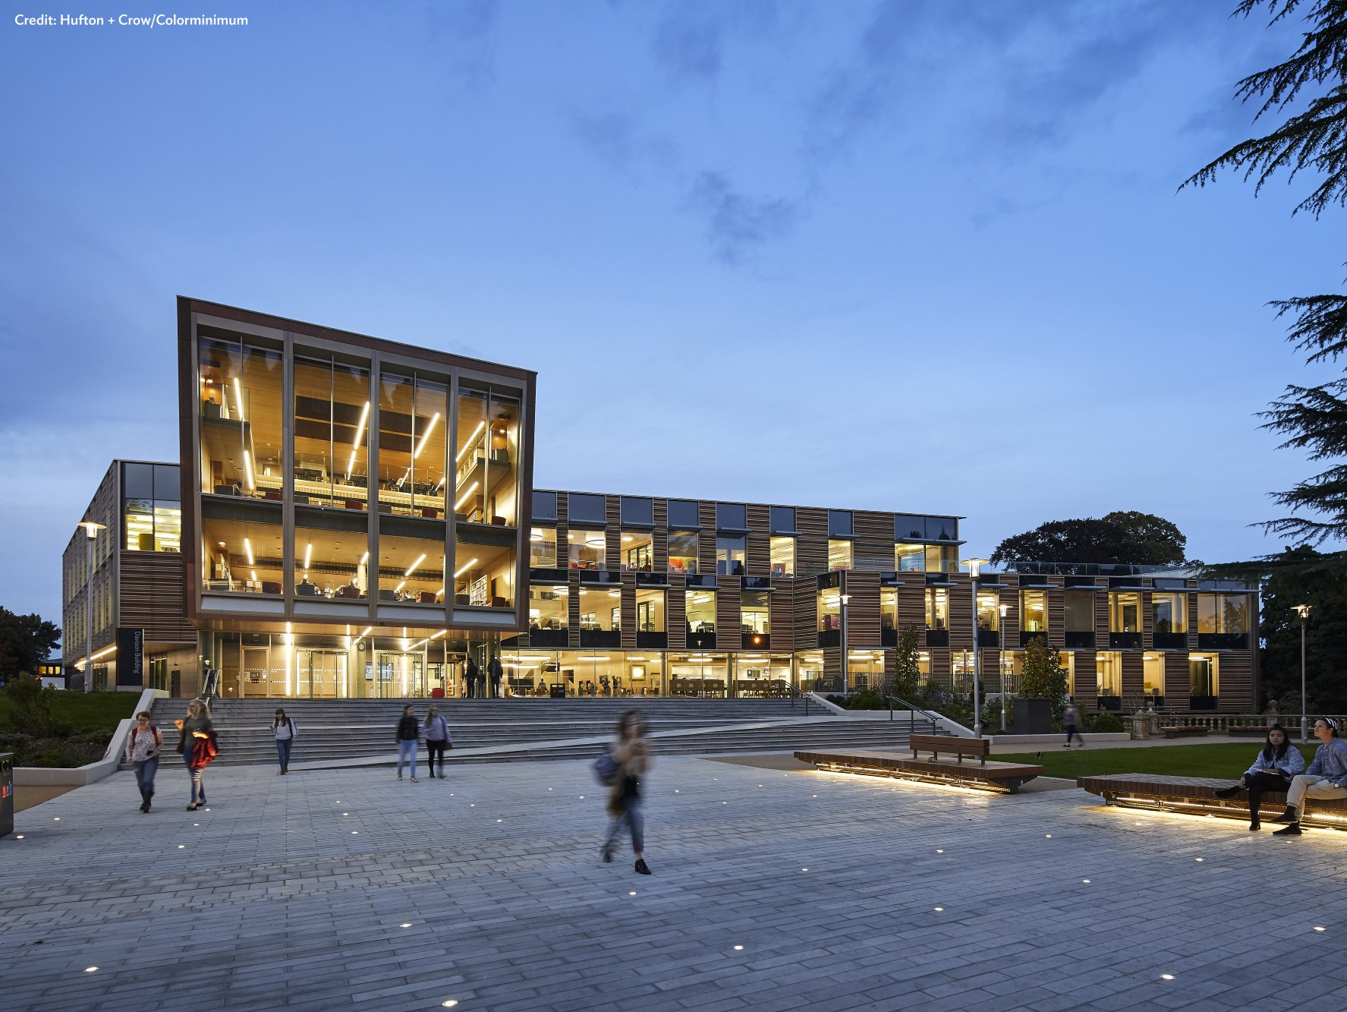
After the Move
Notes:
Amy
Following the move, we had to focus on managing and meeting expectations, yes, but it was also the first time we could aim to exceed our user expectations.

Slide 12
Complaints and Feedback
Notes:
Amy
After moving in we needed to find out how people were actually responding to the new build building, how the new service was actually being received
Feedback boards – also wanted to capture feedback after the initial excitement
Set up lots of feedback options
UX studies (map how space is used)
Monitoring social media
Continuing feedback boards
Complaints over positive
Rolling stacks, noise/zoning, amount of study spaces
Petitions
Found that it was a small number of students
Space was being used as expected
Not once been at full capacity
Lots of advertisement on this £50,000,000 building and it set the user expectations sky high
Kept communication going, open dialogue to change the culture and manage our user expectations, using data to show the real situation
Need to work with team to keep up morale during this

Slide 13
Developing the Team
(2)
Notes:
Changing culture within the teams was also important
Moving away from the dual roles / changed the rapport within the team
Staff had a Positive attitudes and approach to students and how they interact with the student population
Built a more positive relationships with the student population
The spacious environment has enabled us to be the enablers rather than policing
Built a more positive relationships with the student population
Taking pride in our library and service and embracing change – being part of a flagship project of the University
Focus on Customer Services and professionalizing their roles:
Creating consistency across the teams (extended hours, SMAs and weekday)
Making use of the strengths of all teams and sharing best practices
E.g modeling the revitalized information assistant role on the supervisor role in the weekend and evening
Supporting the teams more, exploring new ways to train/share information
Being more fluid in our roles/team
Through the use of technology and innovating our customer services team , we have developed our staff training for the teams
Information literacy training
Social Media Training/ development
Through the CSGUK Information Assistants have engaged in planning and hosting visits that took place over the summer vacation
Study space assistant is employed spring and summer term to manage space within the revision and exams period our students make the best use of this space.
Photo shoot - Our staff also wear ‘here to help’ sashes when roving / on the helpdesk which has made a real difference to how often people actually approach our staff.

Slide 15
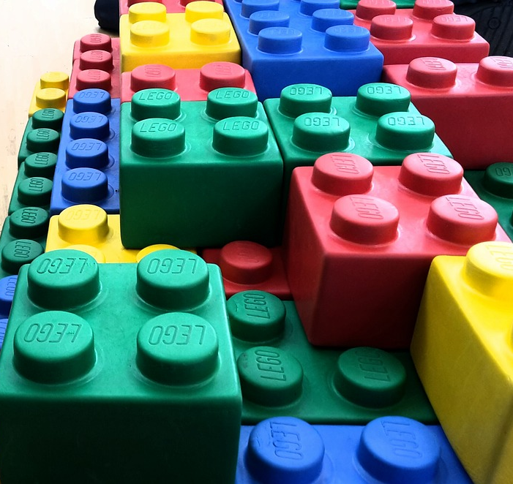
Developing Services
Notes:
“Innovating our services to meet and exceed user expectations”
Information literacy training
Soft touch information literacy skills
New services such as live chat
Tying in with IL training
Engaging in new ways
Data Collection and analysis
What we collect
Google apps
Google database
SMA for staffing structure
Alma development
Conferences (hosting)

Slide 17
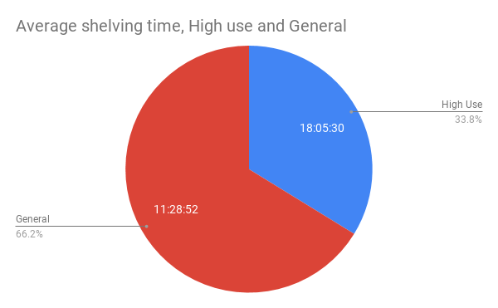
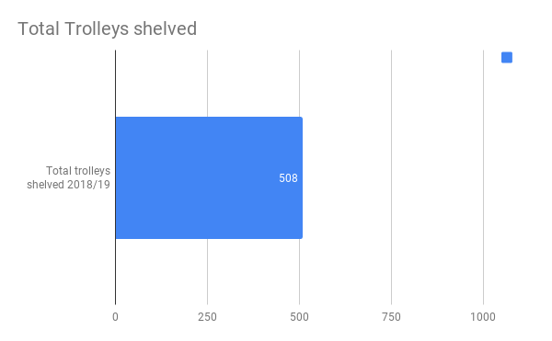

Slide 19
Key Take Aways
Engaging staff in all decisions
Engaging users throughout the process
Data collection
Never rest on your laurels
Embrace Change

Slide 20
Any Questions?
Carol Sadlowski – Head of Customer Services
c.sadlowski@rhul.ac.uk
Amy Stubbing - Customer Care (Collections) Coordinator
amy.stubbing@rhul.ac.uk ; @amyodo
Notes:
Thank you very much! Do we have any questions?

