Slide 1
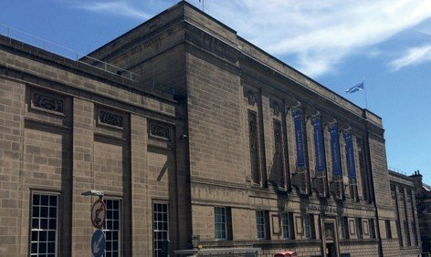

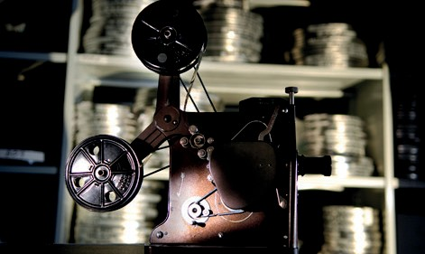
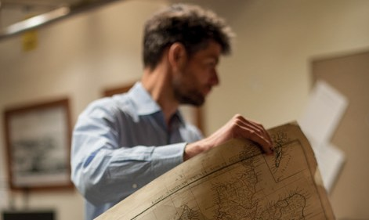
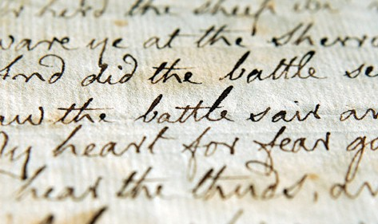
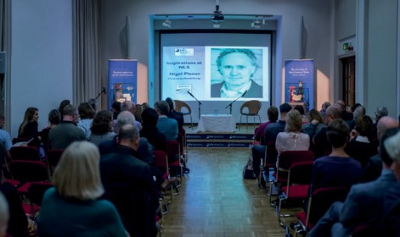
From Onsite Visits to Online Workshops:
Digital Outreach at the National Library of Scotland
Laragh Quinney, Maps Reading Room Manager
November 2021

Slide 2
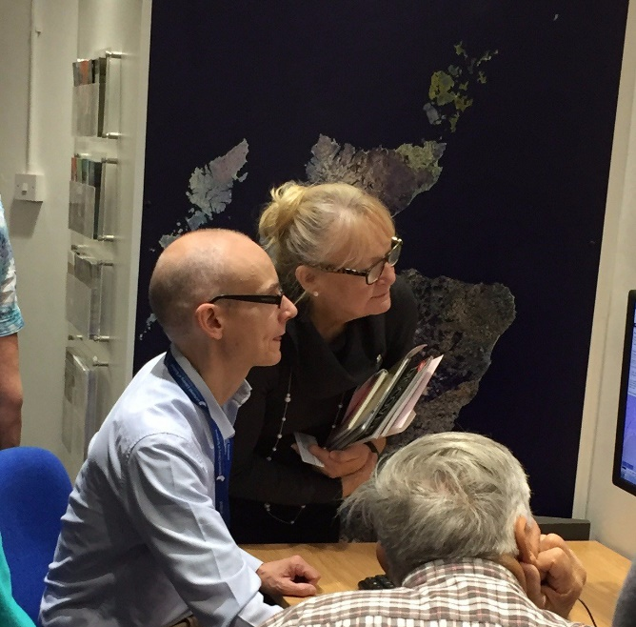
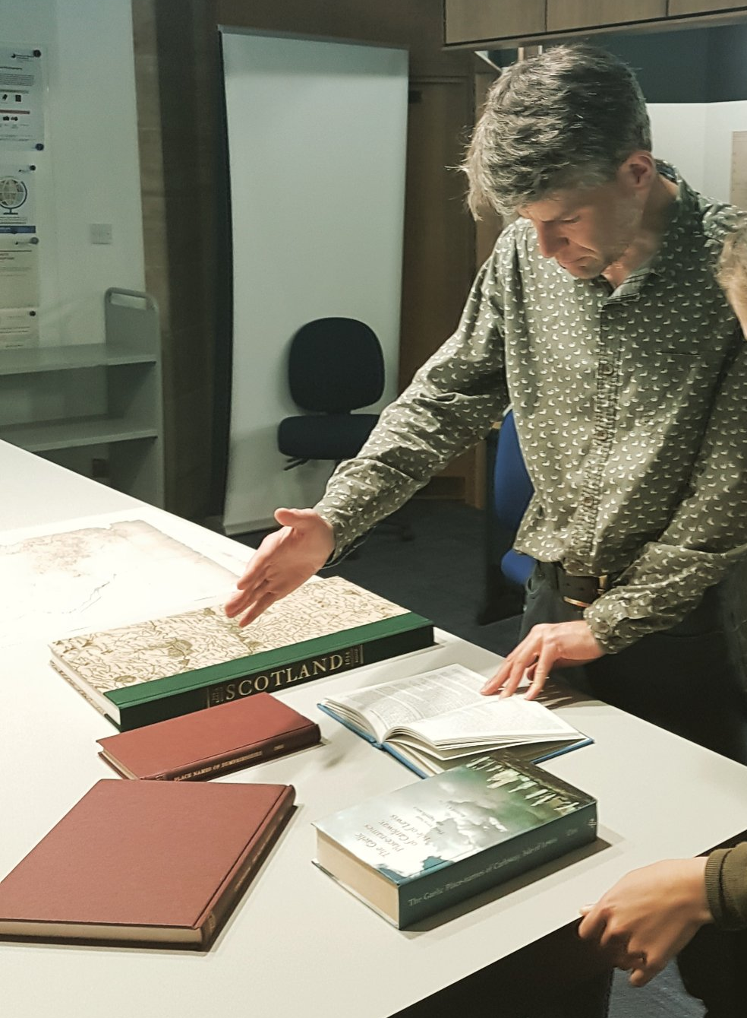
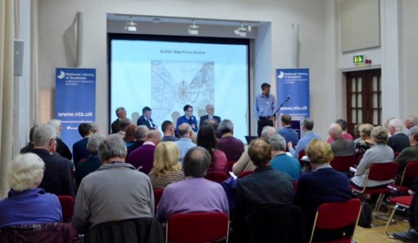
Our Pre-Covid Offer

Slide 3
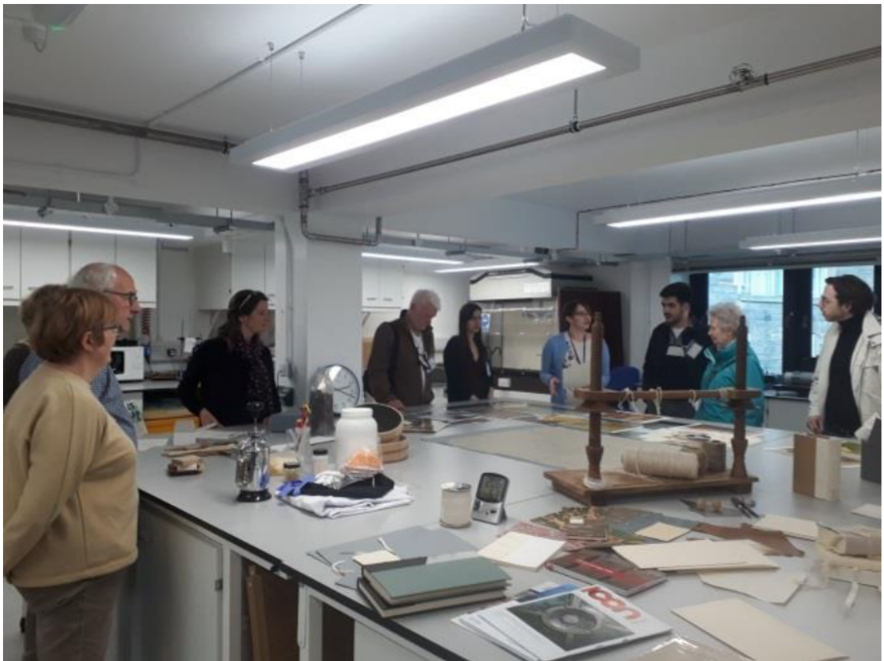

Slide 4
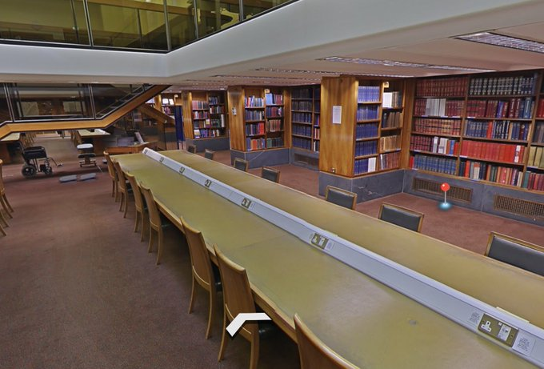
The National Library of Scotland Reading Rooms closed on 18th March 2020
#LibraryFromHome

Slide 5



Slide 6
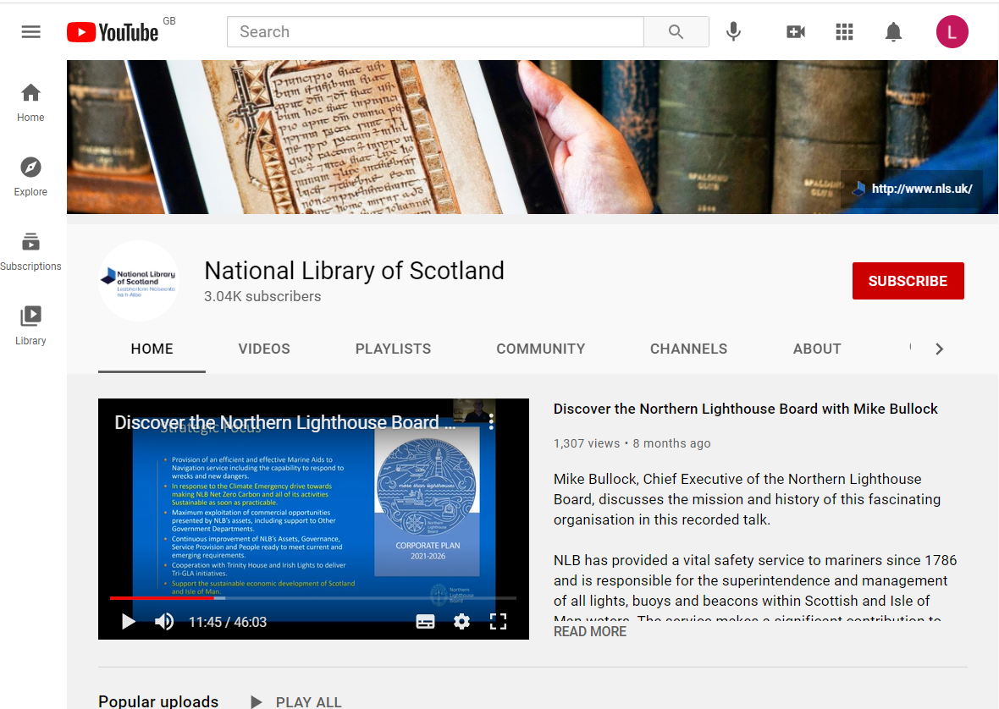

Slide 7
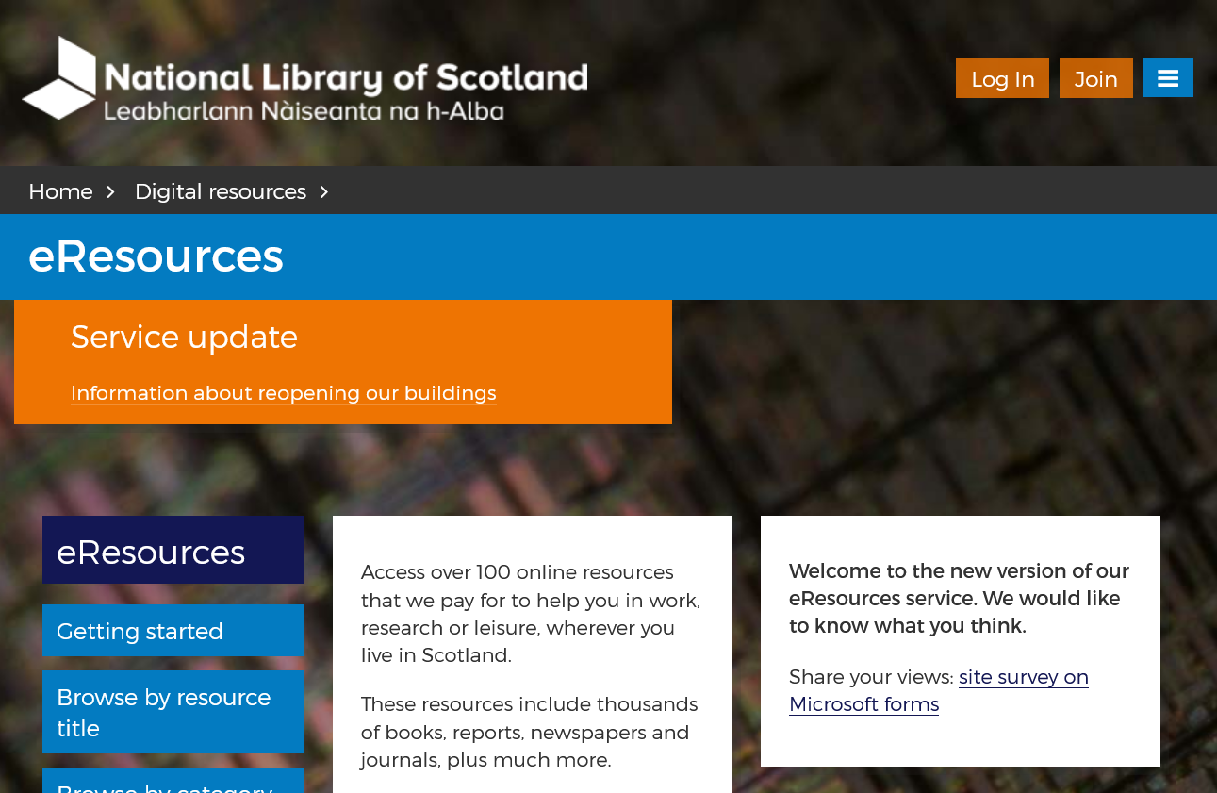
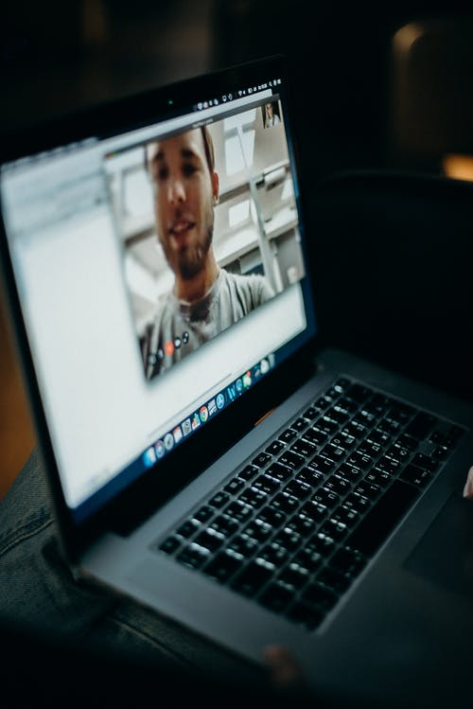

Slide 8


Slide 9
Reaching new audiences

Slide 10
Satisfaction scores from Workshop Participants (on a scale of 1 to 5)

Slide 11
Enhanced usage of online resources

Slide 12
Comments
“Online workshops should definitely continue once the lockdown is over as it allows people to join you from all over Scotland - and from all over the world!”
“The online workshops are very handy and in this day and age will prove a godsend as travel/safety is suddenly compromised!”
“I loved the interactive aspect of getting participants to do it and see for themselves. I'm off to try some more now.”

Slide 13


Slide 14
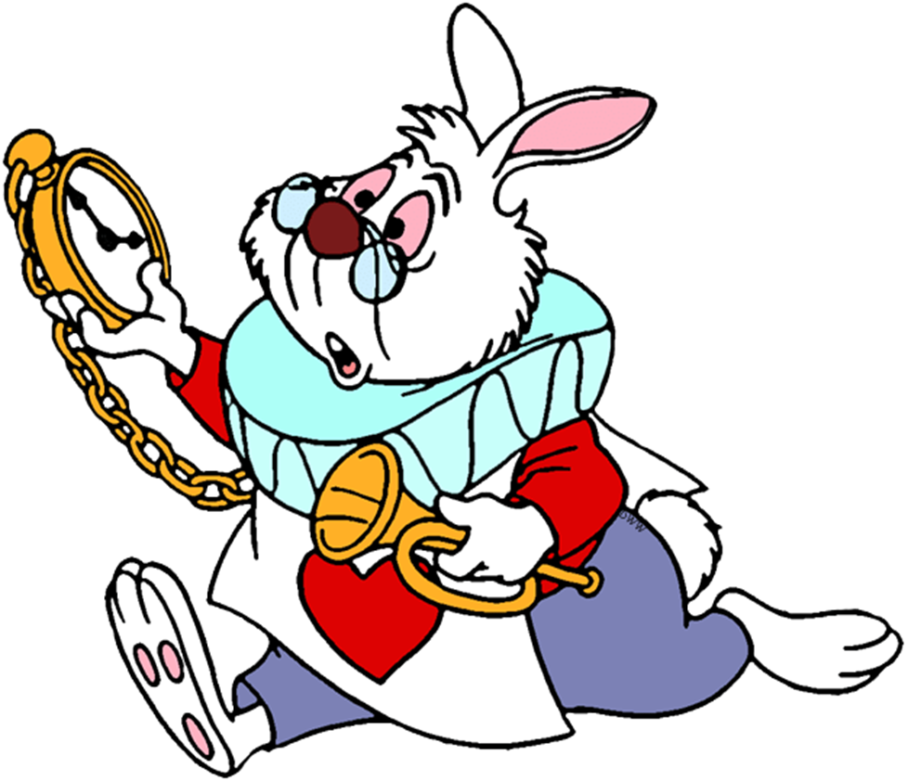

No Shows… and Late Shows

Slide 15

Participation?

Slide 16

Audience Profile

Slide 17


Slide 18
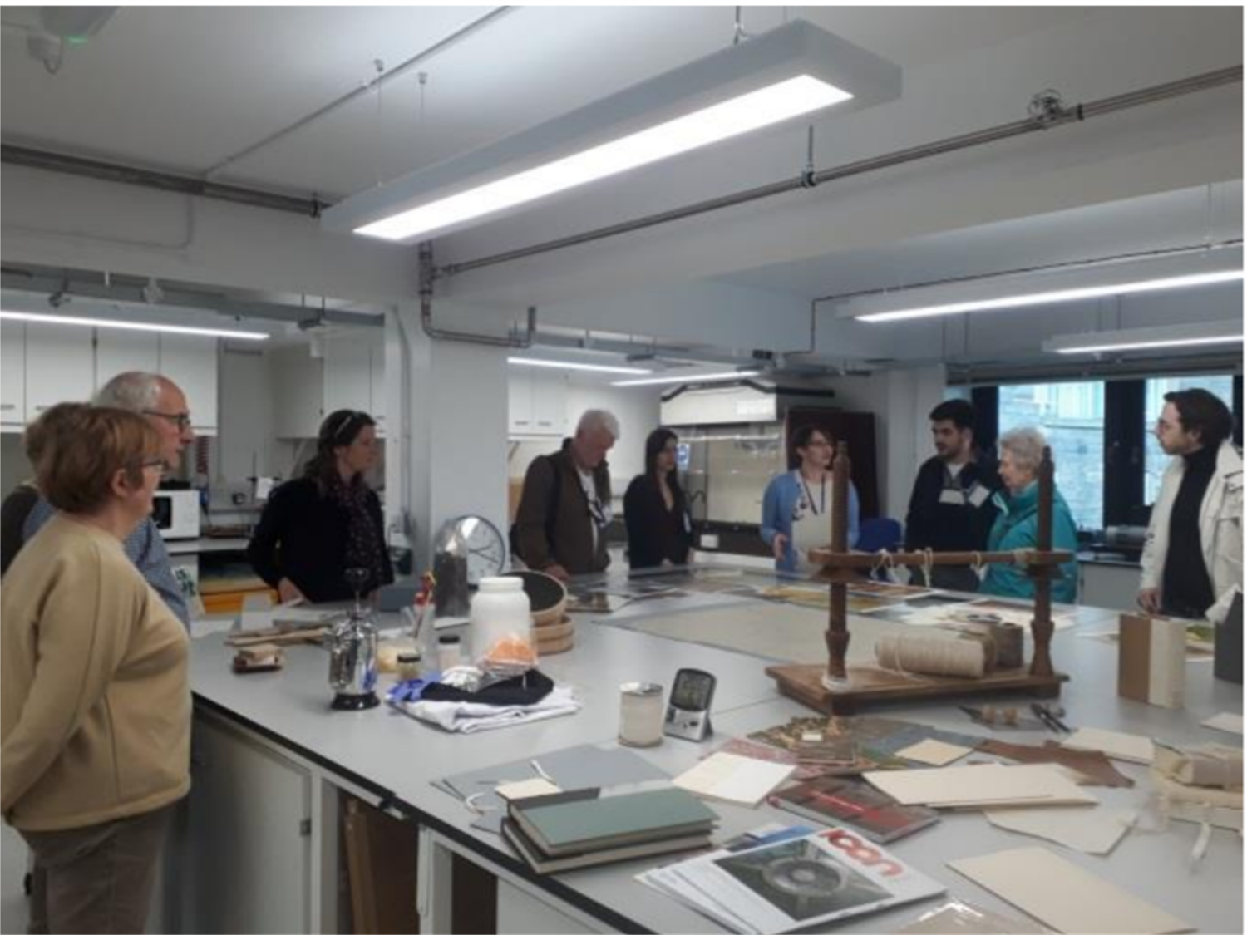
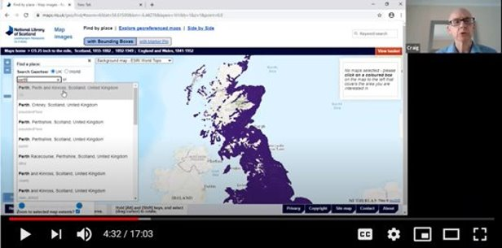

Slide 19
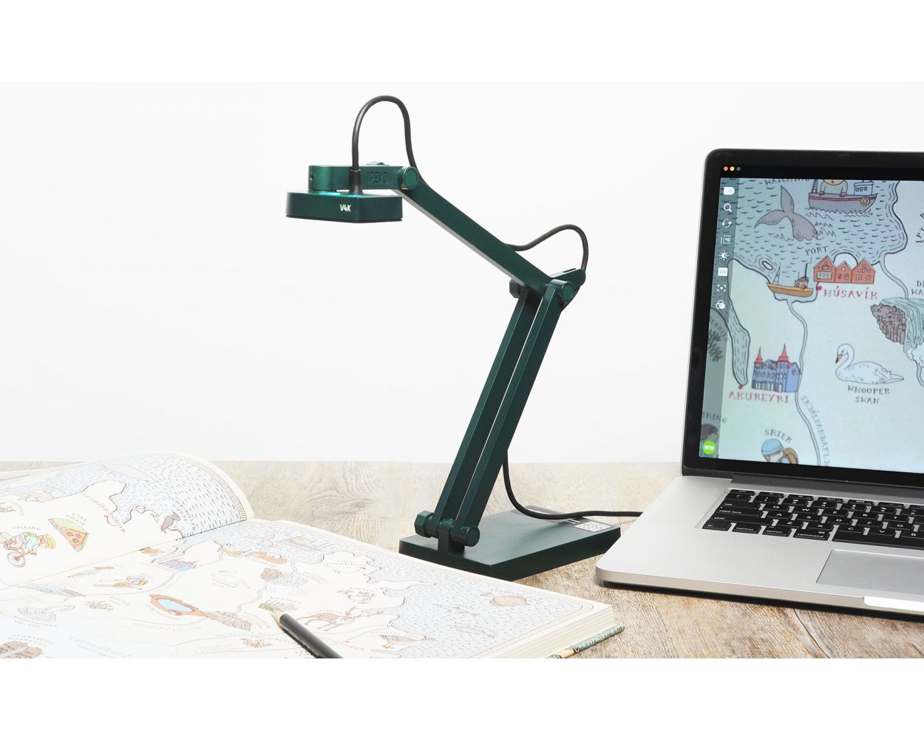

Slide 20
THANK YOU
Laragh Quinney
l.quinney@nls.uk
/NationalLibraryofScotland
@natlibscot
@natlibscotmaps
Except for images or where otherwise stated this presentation is © National Library of Scotland and is licensed under the Creative Commons Attribution 4.0 International Licence. To view a copy of this license, visit: http://creativecommons.org/licenses/by/4.0/

