Slide 1
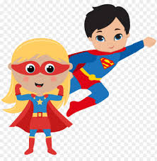
Superchat!
Anne Rowlands
University Librarian
Regent’s University London

Slide 2
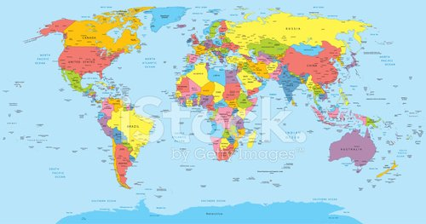
International Students 74%

Slide 3
What did we need do?
Cover all time zones
Respond to users as quickly as we could – service standards –CSE
Be able to respond to all queries whether we knew the answer immediately or not

Slide 4
What did we do?
All staff on the chat rota from Library Assistants to me!
Designed some “canned” messages
Used Microsoft teams along side LibChat

Slide 5
Microsoft Teams and beyond!
Improvement in response time to queries
Improved knowledge
Remember teams can be used in lots of different ways
Superchat! or just responding and improving our services?

Slide 6
Thank you!

Slide 7
Reference
World map available at: https://www.clipartlogo.com/istock/world-map-with-countries-country-and-city-names-360104.html accessed 23/11/21

