Slide 1
Newcastle University
Chat experiences 2020-21

Slide 2
Outline
Libchat at NU
Changes made during 2020
Co-op collaboration
Looking forward post pandemic
Notes:
We at NU have been using Libchat for nearly 10 years now so I'd like to give you a brief background to context at NU, then we'll look at some of the ways we adapted during 2020 in response to the Pandemic restrictions.
I'd like to talk a little about how we work with the global cooperative who provide out of hours libchat coverage for us and finally some thoughts about how we plan to take the libchat service forward following some of the lessons learned during the last 14 months

Slide 3
Background: Chat service at Newcastle University
Libchat launched May 2013 and rolled out as 24/7 chat using QP co-op as our out of hours service
Different variations of timetabling over the years
All assistants are timetabled for chat NOT a specific team
Now considered a core Library service
Notes:
We have a long established chat service at NU which has always existed as a 24/7 service though initially out of hours chats were covered by the Question Point service, which was recently brought into the Springshare Library Chat product.
Our chat service was typically managed 8:30- midnight pre-pandemic 7 days per week, though during the pandemic period this rounded off as 8:30- 8pm
Currently we would usually have anywhere between 2-12 assistants working from home – and between 2-3 will be on a rota to look after chat for 2 hours at a time. Weekends and evenings assistants would work longer periods on chat due to their being fewer staff around.
In essence the schedule isn't too dissimlar to pre-pandemic- couple of assistants on chat for a couple of hours at a time.
We don't have a specific team for chat, all of our assistants are involved and while it was perhaps seen as one of the less desirable duties, it is now very much considered a core service and of course it is still the main channel through which staff are able to communicate with our library users.

Slide 4
Changes to chat delivery during pandemic
More timetabled hours on chat with staff working from home
The times staff have managed chat has shifted to adapt to working from home and gradually being back on site throughout the year
Queries about new services predominantly coming through chat
We've used co-op librarians a bit more
Notes:
With staff WFH, we have been able to timetable regular short stints on chat and help so staff expect on every shift they will have some of their time allocated to chat, previously they might have had a pattern of one or two specific days where they knew their chat time would fall.
We have asked staff to be very flexible with when they cover chat and this has worked well.
We run a MS Teams 'hub' chat everyday which is the main method of communication between those WFH with each other and with anyone working on-site.
We are finding that staff assigned to chat will post questions in the Teams hub chat when they require support or need to check the latest version of a process.
This is also working very well as with the different levels of restrictions we have had to tweak library processes for click and collect, smartcards and study space, to name but a few – naturally it can be difficult at times to keep up and so library assistants definitely seem to be utilizing their colleagues more when fielding chat queries.
Our new services such as click and collect and booking study space have contributed to placing more demand on the chat service.
We've always had students use chat when on campus – this has continued and chat has become the prominent way for us to deal with the majority of queries about things like study spaces –
sending a chat when they are at their seat but can't check in for example.
As mentioned, we have seen more cooperation between staff – ask for advice over Teams hub chat / pass chats to each other if 2-3 picked up / transfer to coordinator rather than make a ticket

Slide 5
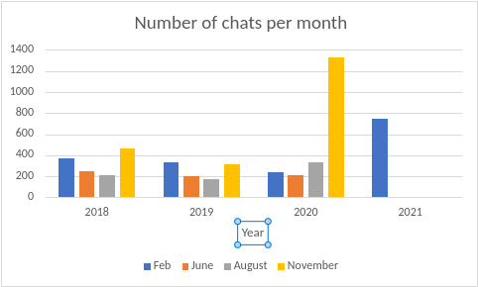
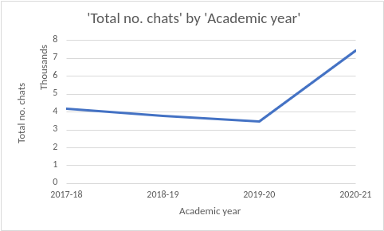
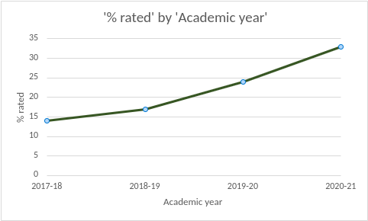
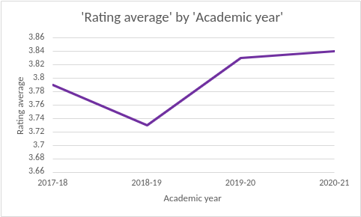
Changes to chat during pandemic
Notes:
In stats, the top left chart is the no. Of chats per month over the last 3 years- the uptake in chats is most noticeable in August and November 2020 and you can see that is likely to continue for the remainder of 2021.
The total no. Of chats by academic year also shows the sharp trend upwards.
What is interesting is we have noticed we are reciving more feedback from patrons- in 2017 academic year just 14% of chats were given a rating compared with 33% in our 2020-21 acemic year so far.
And we can also see in the bottom right chart that whilst the number of chats received and rated is going up our overall rating average is also rising

Slide 6
Working with the cooperative
Overall, great for flexibility
Auto transfer when all NU staff logged out
Auto-tagging of Springshare 24/7 chats
Can check quality of co-op chats
Have provided feedback to co-op chats
Improving FAQs available to 24/7 cooperative
Notes:
There are a lot of benefits for us working with the global coop librarians,
- It means we can keep the chat service open for patrons – it is well reported that many people have faced isolation and have suffered from increased anxiety over the last 14 months - it is really positive to be able to offer our library users an 'always open' channel to get in touch
- It's extremely easy to hand over to the coop as we now have auto transfer to the coop once all of our assistants are logged out
-Keeping track of tickets generated from coop chats is easy; a 'coop' tag is automatically applied so a quick filter search will collate these. And makes periodic checks for quality straightforward
It is part of our plans for the service to try and improve the links to useful pages we provide for coop staff to help them answer our queries – we're looking at improving FAQs particularly around closure periods such as Christmas and during exam periods o help field some of the more common queries for those specific times
With this in mind I also am looking at providing feedback on coop chats that need improvement. This is easily done from the chat transcripts page. Unfortunately we can't see when feedback has been read however, Springshare have informed us they are planning some improvements to make the feedback more of a 2-way conversation, so that the person receiving the feedback has an opportunity to respond. We've been advised to keep an eye on the blog and the Springshare lounge .

Slide 7
Post-pandemic chat service
More skilled assistants – we want to build on this
Likely to have chat shifts back on site
More confidence to switch to co-op when needed
More emphasis placed on the value of chat both as a skillset for assistants and as a communication channel for patrons
Notes:
Experiencing a pandemic has been challenging– it would be a shame to hasten back to long desired normality without acknowledging some of the fantastic skills developed over this period – most of our assistants, if not all would say they are more confident using chat than pre-pandemic – we need to look to build on this.
A few years ago we began celebrating our own staff when they received positive comments and ratings from their chats. I collect feedback every couple of weeks and email staff to let them know they are doing a great job.
We are in the midst of mapping all of our training for the LibApps services and will be updating our training plans and looking at how we can create different routes to materials such as quick how to videos amd grab and go self service learning – these will be aimed at people who have been away from work for a while or who want to test their knowledge to try and keep skills sharp.
The University has recently held a review into blended working however, as a customer-facing team it's uncertain how much of that could be incorporated into how we work, yet we may want to recreate the onie support that has grown when WFH back on-site.
I mentioned we are looking into the quality of co-op chats as we want to foster confidence in turning on to co-op when needed and for our patrons to get the same excellent customer service.
And finally with our attention fixed on building on the quality of the chat service both in house and with the co-op we really want to embed best practice in how we work to foster the value placed on virtual enquiry services.

Slide 8
Thank you Any questions?
Sarah Hornby, Newcastle University

