Slide 1
Creating Book Displays at Leeds Beckett Library
Laura Green & Tom Lennox – Leeds Beckett Library
Notes:
Laura Green & Tom Lennox – Leeds Beckett Library
“I See It, I Need It!” The Joys Of Impulse Borrowing
Creating Book Displays At Leeds Beckett Library
We’ve all fallen for the impulse buy. From a pack of chewing gum at the supermarket checkout, to those shoes that just happened to be on sale when you were walking past on your way home from work. So what are the common traits of the impulse buyer?

Slide 2
Impulse Buyer
They are driven by emotion
They will take risks
They are competitive
They defy logic
They respond visually
They insist on instant gratification
Notes:
Here’s a list of common characteristics of the impulse buyer, identified by Jeremy Smith, an expert on marketing and user psychology:
They are driven by emotion.
They will take risks.
They are competitive.
They defy logic.
They respond visually.
They insist on instant gratification.
(Smith, 2015)
The retail sector exploits these vulnerabilities, utilising marketing materials in stores to motivate it’s customers to buy a product or service that caters to their current emotion. While an impulse purchase may satisfy an immediate emotional need, buyers do not always consider the possible consequences of their spending. In retail this can also lead to buying mistakes and needless spending.
This is undoubtedly a complex area, with some major ethical questions. Nevertheless, the power of impulse purchase sales points, to seemingly address an immediate need, has many useful applications outside the retail sector. Some of you might notice that the characteristics of the impulse purchaser, closely match the kind of behaviour a large proportion of our student population exhibits, especially around peak periods in the student calendar when they are experiencing the pressure of deadlines and need to work, but are overwhelmed by the scale of their task. Understandably, our universities suddenly become full of an emotional, risk taking, competitive, logic defying group of young people - a digital generation, who respond to visual communication and certainly expect instant gratification for their £9000 a year fees.
So what can we learn from retail merchandising practices that might directly address our students emotional needs? At Leeds Beckett Library we have translated some of the retail practices employed by impulse driven marketing to suit an academic library context, with the aim of enhancing the student experience. We have introduced a rolling programme of book displays, targeted directly at identified student groups, to communicate directly with them and help provide them with the resources, support and skills they need, when they need it. We would like to talk to you today about some of the things we’ve learnt.

Slide 3
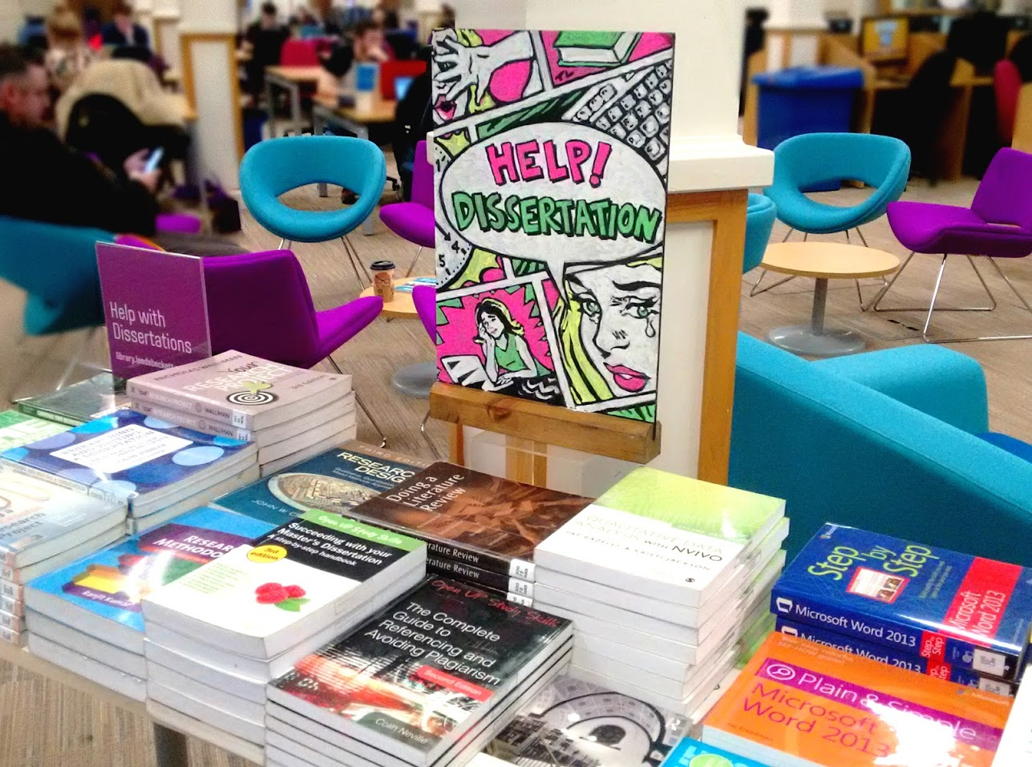
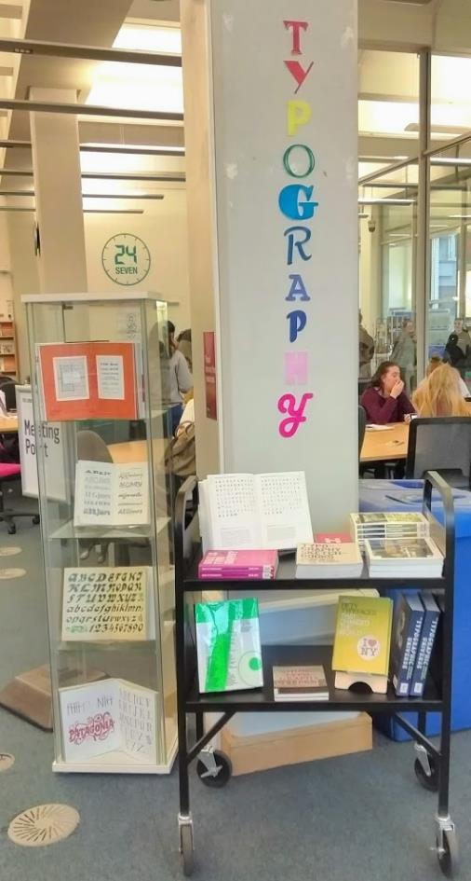
Notes:
Over the last two years, we have established display teams at each campus library and have experimented with different approaches to using physical library displays to engage students. The formation of teams of library staff contributing towards display planning and creation has meant that with limited time and resources, varied and attractive displays can be produced on a regular basis.
A well planned book display, in the right place, at the right time, can offer a helpful starting point for work, or when inspiration is required. They are a reassuring physical point to go to in an increasingly digital, and potentially isolating, world and can inspire research paths, bringing together disparate elements of a diverse collection to navigate complex topics.

Slide 4
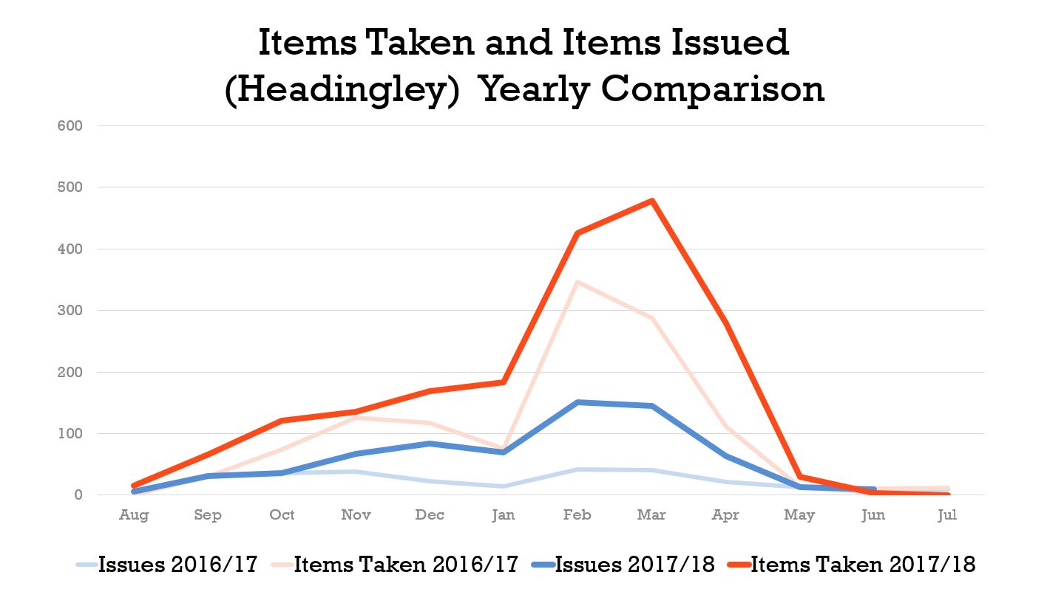
Notes:
Studies have shown that displays in libraries result in more issues and our own findings back this up, but we’ve noticed that a lot of our students like to use the display books in the Library, perhaps as an alternative to reference items, or simply because it's easier than carrying them home! For us, it doesn’t matter too much whether the items are issued or simply used in the Library - what matters is that the right resources have reached the right people.
Chart – for one campus (pilot) – thick red lines shows books used this year and thick blue line shows borrowed this year

Slide 5
Notes:
Librarians often speculate on whether students are aware of the wide range of materials - fiction, films, games, travel books etc. - that we carry. A display is the perfect way to highlight the more eclectic areas of the collection.

Slide 6
Most Successful Displays 2017/18
Position | Display Title | Campus | Items Taken | Display Type
1 | Help! Dissertation | Headingley | 557 | Study Skills
2 | Writing Up | Headingley | 280 | Study Skills
3 | Dissertation Preparation | Headingley | 279 | Study Skills
4 | Dissertation | City | 229 | Study Skills
5 | Analysing Data | Headingley | 220 | Study Skills
6 | Academic writing/first assignment | City | 131 | Study Skills
7 | Data analysis | City | 105 | Study Skills
8 | Study Skills | Headingley | 70 | Study Skills
9 | Psychology | City | 66 | Subject
10 | Sport Business Management | Headingley | 59 | Subject
11 | Marketing | City | 58 | Subject
12 | Exam Success | City | 56 | Study Skills
13 | Women's history month | City | 51 | Awareness
14 | Focus On Autism | Headingley | 47 | Awareness
15 | Employability | City | 35 | Study Skills
Notes:
However, our display engagement statistics suggest that whether students are aware of the extent of the collection or not, they are primarily focused on study items.
Table
Once we started to discover what kind of displays work, we began focusing our display strategy. We have arrived at a two-tiered approach:

Slide 7
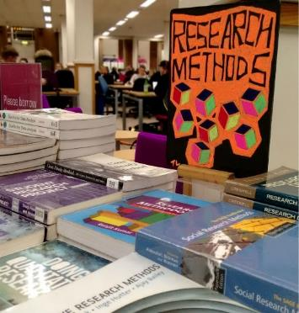
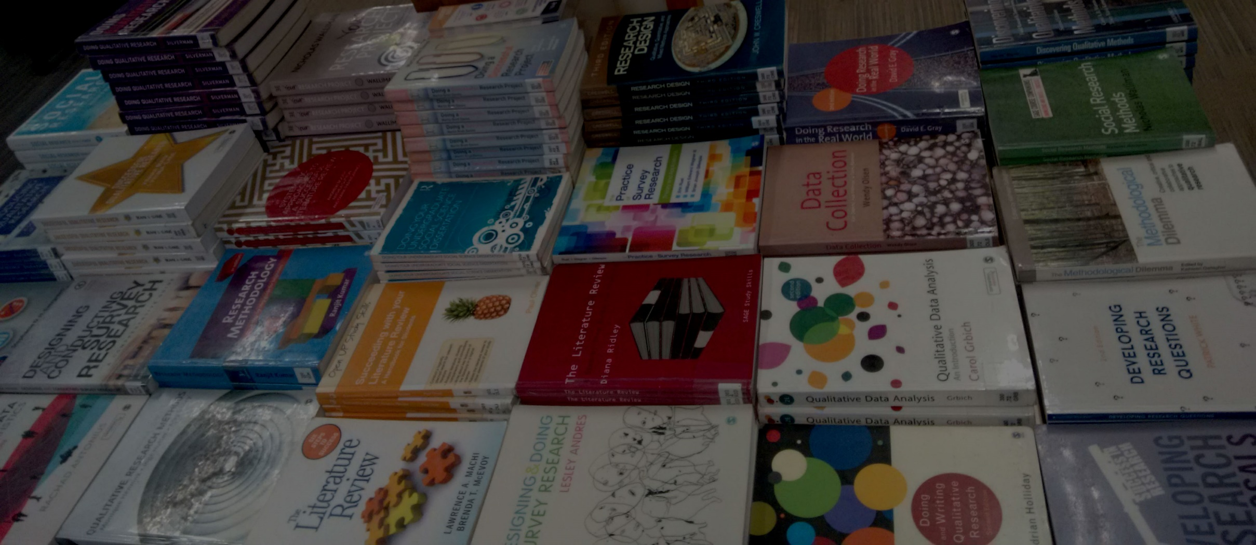
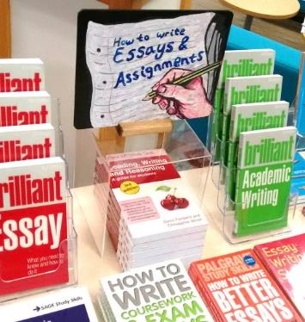
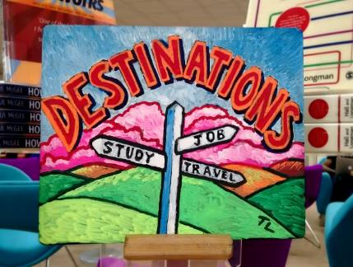
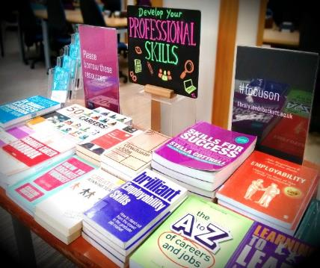
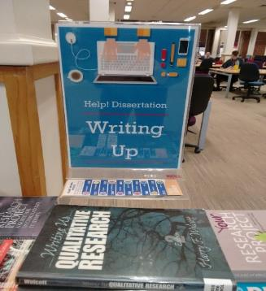
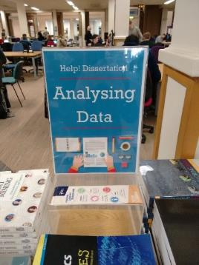
November
December
September
October
January
May
April
March
February
Notes:
Tier 1 – Firstly, the student population as a whole - These displays support students by creating initial awareness of our resources via front of house book displays, offering students instant access to topical and relevant items. We run an ongoing programme modelled around the student lifecycle and university calendar, which is designed to be relevant to all. These sorts of displays encourage our students to think about important events and anticipate resource demand.

Slide 8
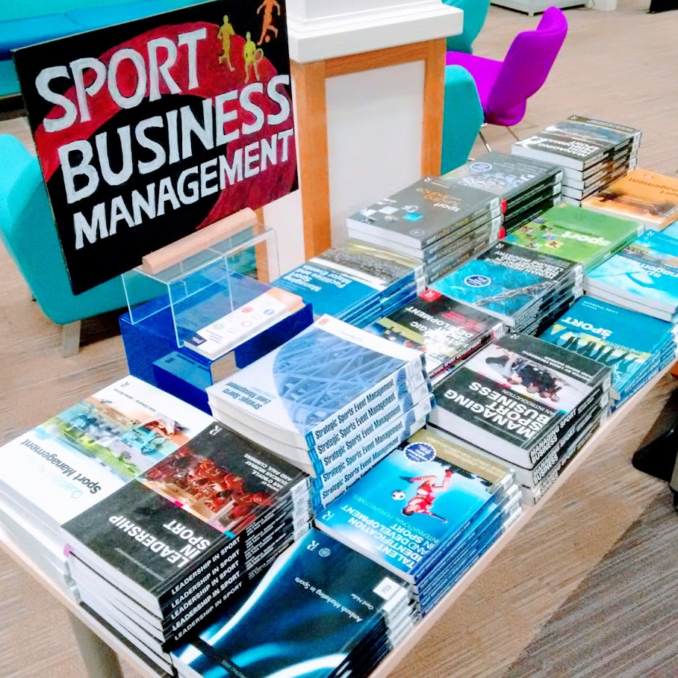
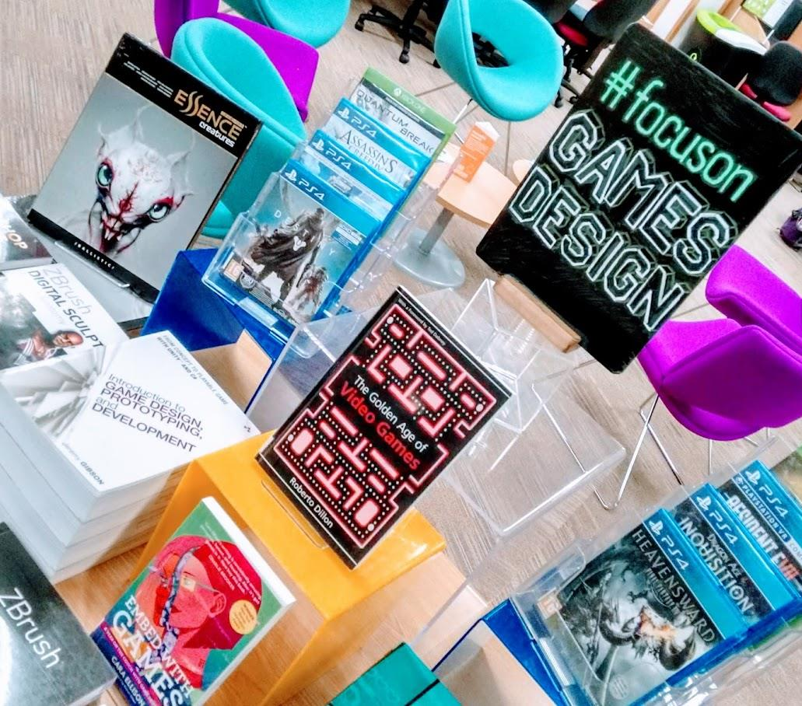
Notes:
Tier 2 -Secondly, targeting identified user groups - We also target particular user groups in order to get the right resources to the right people. This includes a dedicated programme of displays and web resources aimed specifically at students on low NSS scoring subjects, where students may perceive library resources to be poor. These types of displays ensure the Library is seen to be visibly responding to these issues, by highlighting the quality resources and subject support we provide. The Library sees a high level of footfall, possibly more than any other area of the University, so we’re an important weapon in keeping student satisfaction high.

Slide 9
Notes:
In retail, cross-merchandising is where products from different areas of the store are displayed together because they compliment each other, for example, beer and snacks (dotActiv, 2018).

Slide 10
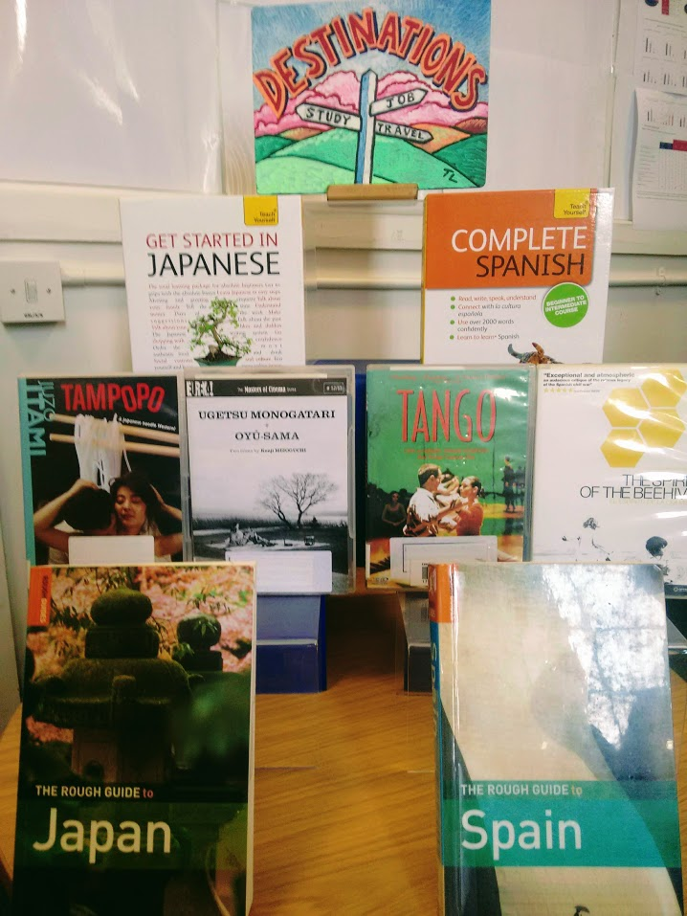
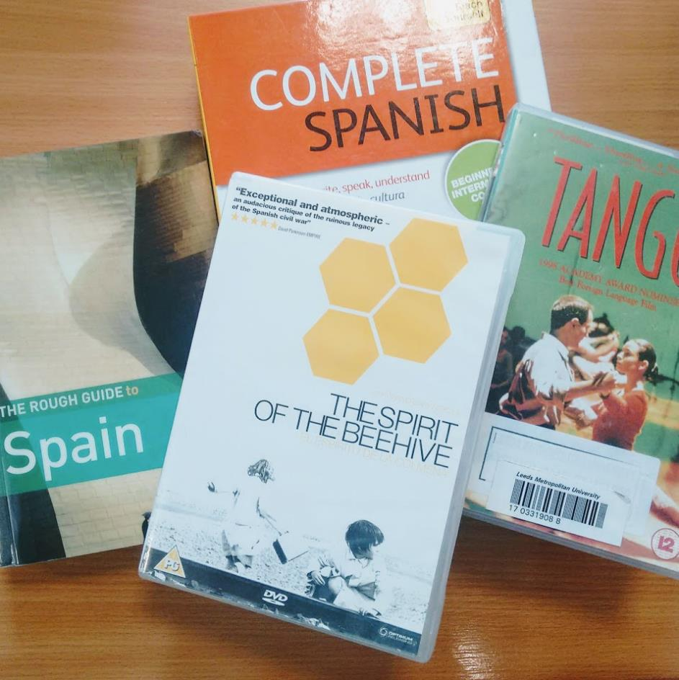
Notes:
A good example of cross merchandising can be seen in Headingley Library’s ‘Destinations’ display where travel guides, language packs and foreign films were displayed together to promote overlooked areas of the Library’s collections and add value to the user’s experience.
Interesting gems in our collections lay hidden in endless rows of library shelving. The Dewey Decimal System may allow us to maintain a sense of order, but it is a fixed order which does not enable more instinctive groupings of resources, or allow us to organise our stock in the way our students actually want to use it. Retail concepts of grouping like with like can help liberate library staff from the restrictions of Dewey and enable us to reframe our collections, giving students a chance to see the best items from our collections in a fresh light, freed from those dusty shelves.

Slide 11
Lifetime Loans of Issued Display Items 2017/18
Notes:
Library displays offer positives for the Library itself, most obviously an opportunity to market library collections, increase circulation, and raise the profile of our service. With tighter budgets, we need to make our existing collection work harder and our displays allow us to promote previously underused resources to students.
Pie Chart - 17% of display items previous issued 5 times or less.

Slide 12
Notes:
Our book displays allow us to provide a dedicated space for physical resources in parts of the Library that are book-free, such as the ground floors at both campus libraries. Adding eye-catching displays in these study areas, which also act as corridors to the rest of the Library, can transform ‘passive’ spaces into opportunities for knowledge discovery and address the risk that books become ‘invisible’ in modern academic libraries where many resources are now available only online. Book displays can add warmth and personality to the Library.

Slide 13
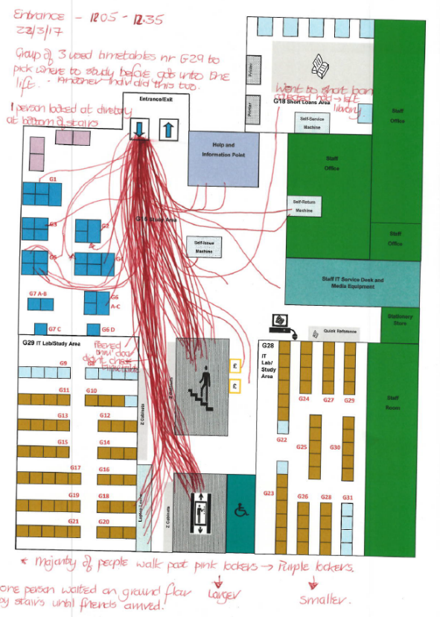
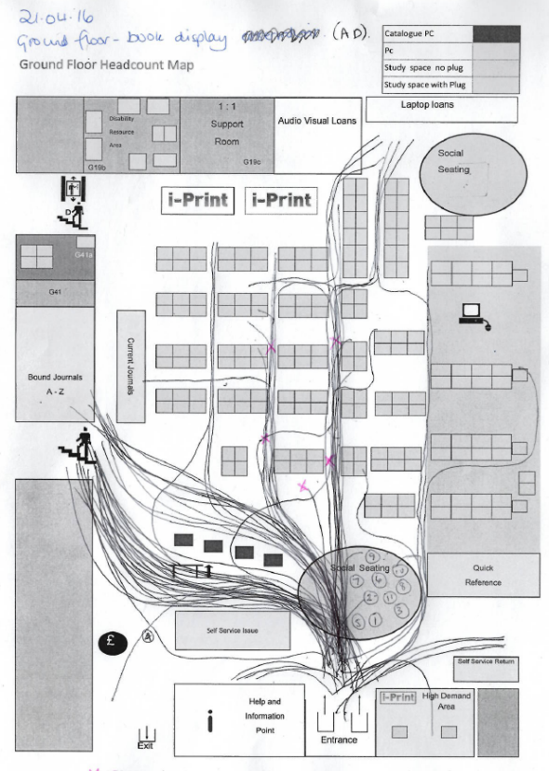
Behavioural maps of Ground Floors at the Sheila Silver and Headingley Libraries courtesy of Jenny Morgan, Pippa Wood and Alison Davies
Notes:
Carried out UX to establish – optimum place for displays to attract attention and enhance study space
User experience research has also been undertaken to establish the most strategic positioning of displays to attract the attention of Library users and to best enhance study space. Headcounts and observations have been carried out in order to track frequent paths used by students and display points moved accordingly, to ensure user access to display resources is both straightforward and intuitive.

Slide 14
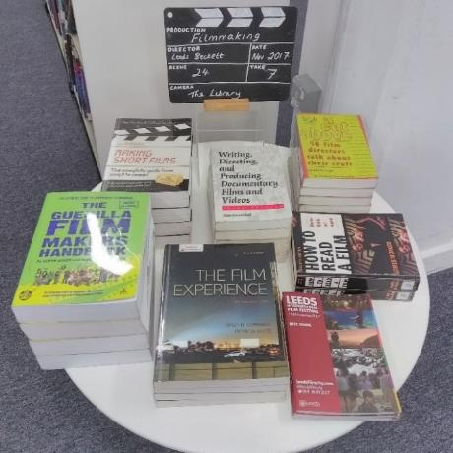
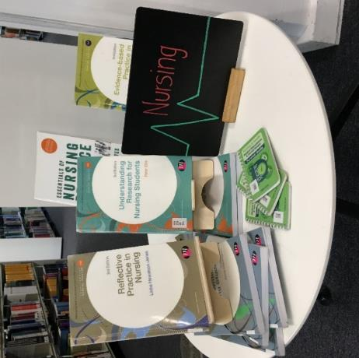
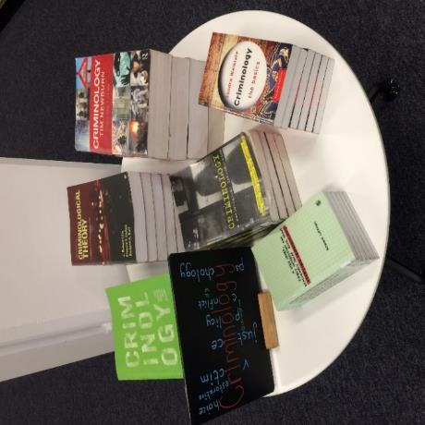
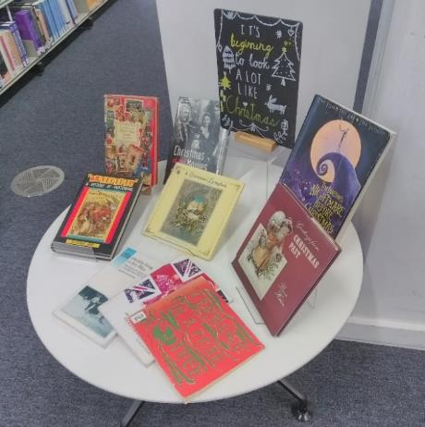
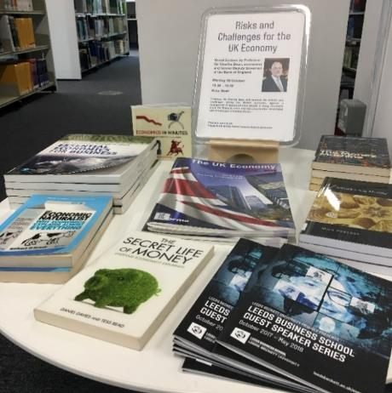
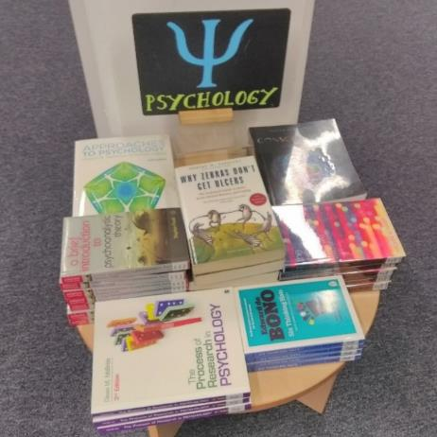
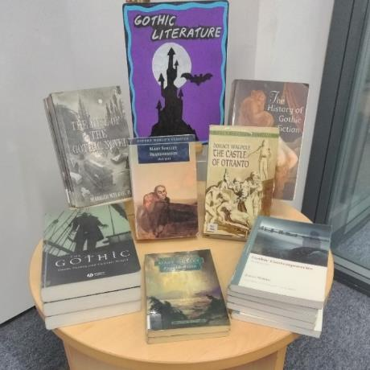
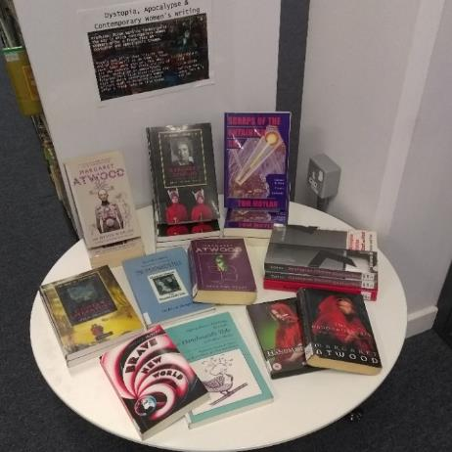
Notes:
At Sheila Silver Library, we’ve introduced mini displays in our book rooms to highlight specific areas of stock on each floor, for example, subjects chosen by Academic Librarians or low NSS scoring subjects.

Slide 15
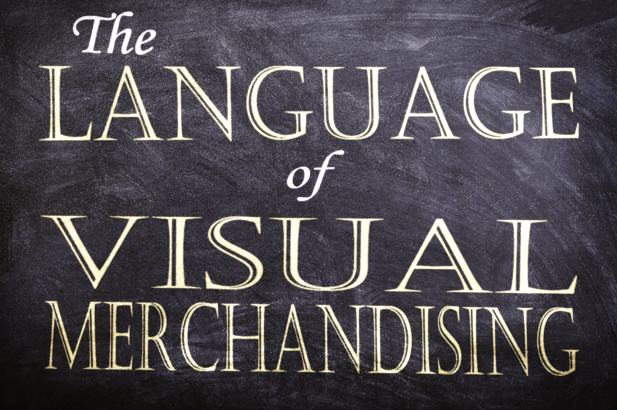
Notes:
Visual merchandising involves displaying your stock and decor in a way that shows off a positive image, which is easily understood and gets customers’ attention.

Slide 16
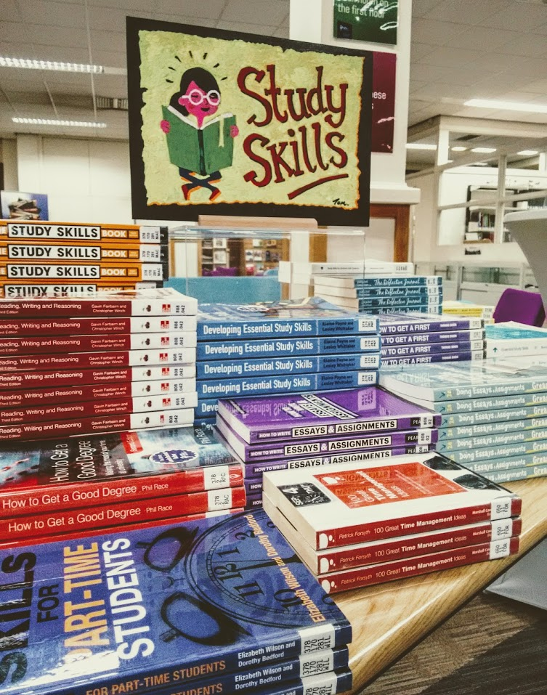
Notes:
Certain retail practices are universally understood by customers. An in-store display carrying a single item of clothing is there to be looked at and not touched, but the same installation, with a rack of multiple outfits invites the customer to touch, try and buy. In our displays, simple initiatives, such as stacking multiple copies of titles on tables utilise these familiar retail language shortcuts. Our students understand that we want them to pick up these books and take them away, meaning that the display feels much more accessible to them, because we have invited them to share ownership of our display space.
We were lucky to have team members with experience working in a range of bookshops, which helped broaden our perspective on how to approach planning our displays. Our early discussions focussed on team members retail experience and the display techniques which could be translated from a retail to a library environment. The team followed this up by carrying out observation visits to a number of book shops and similar retail establishments to see what we could learn from their visual merchandising practices.

Slide 17
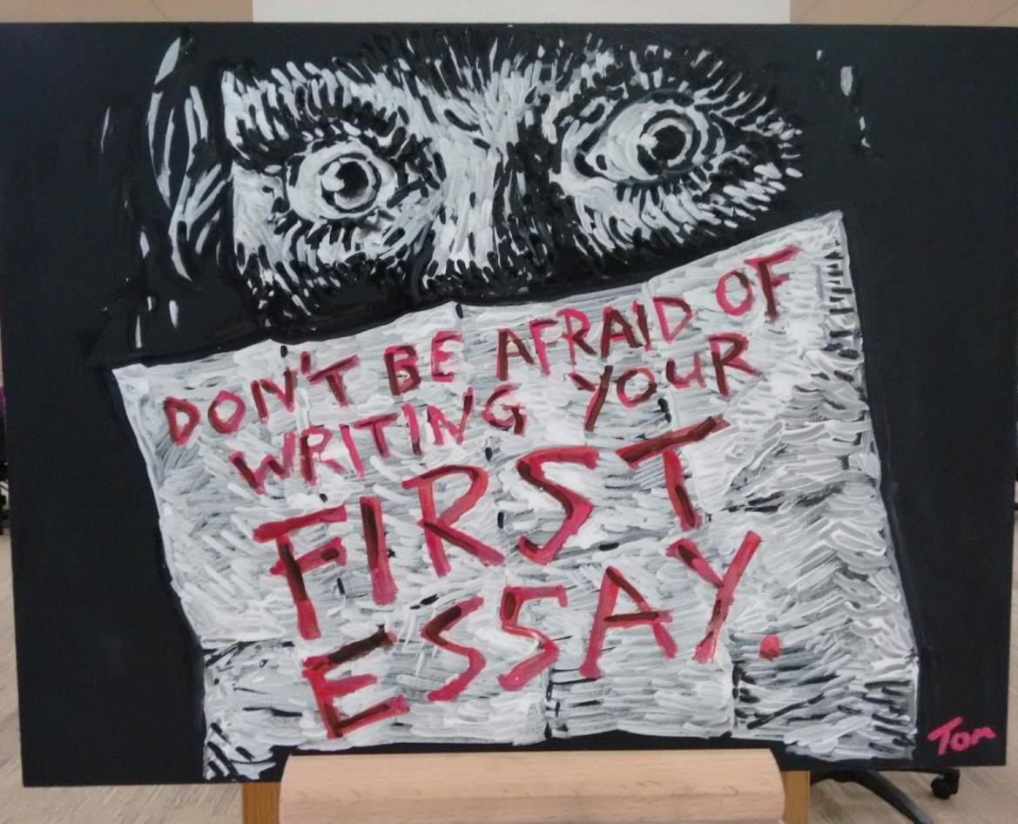
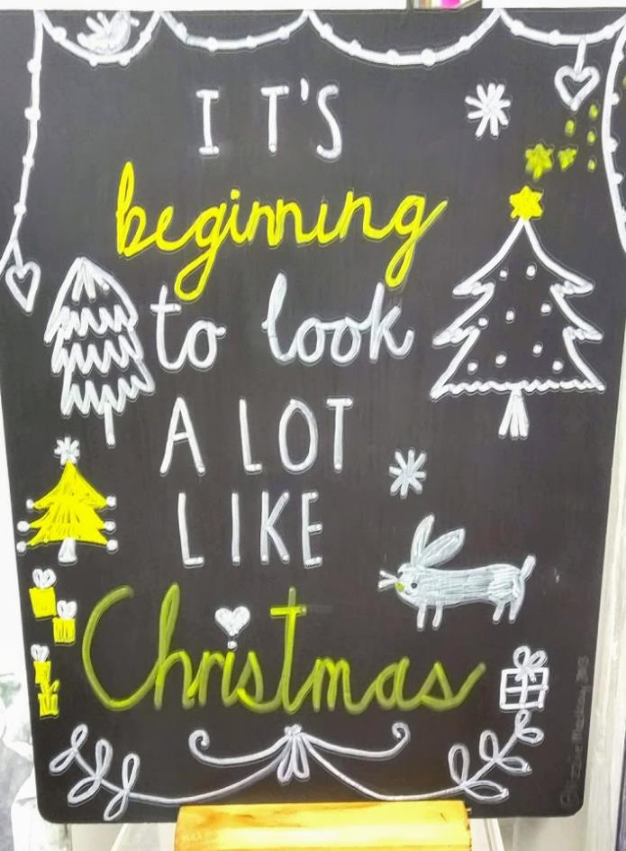
Notes:
A successful idea, inspired by a visit to a branch of Waterstones, was the introduction of chalkboards in displays, instead of more formal signage. Our chalkboards have been used to add a more informal, friendly, human touch to otherwise dry academic subjects. These have proved to be a particular success, frequently getting positive comments from library users, as well as being enjoyable for staff to produce.
An important rule of visual merchandising is to ‘keep things fresh’. This doesn’t necessarily mean constantly pushing only the newest lines. In retail it’s common practice to move old merchandise to new display areas of the store as a clever way of making customers think it is newly arrived, so they give it fresh attention.

Slide 18
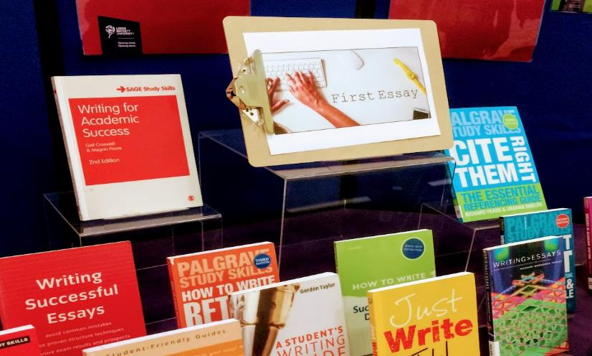
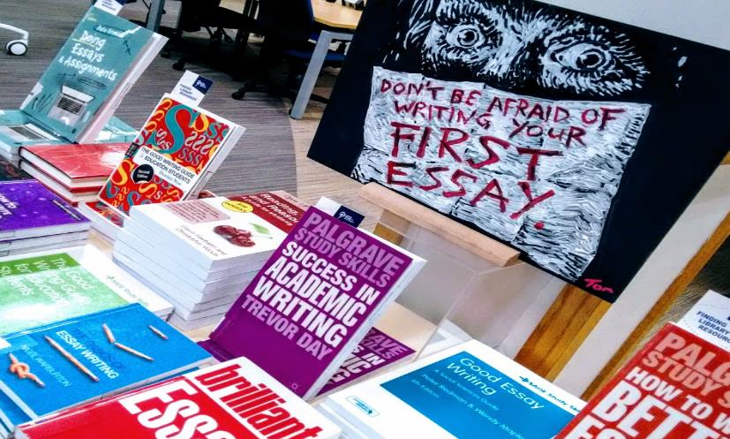
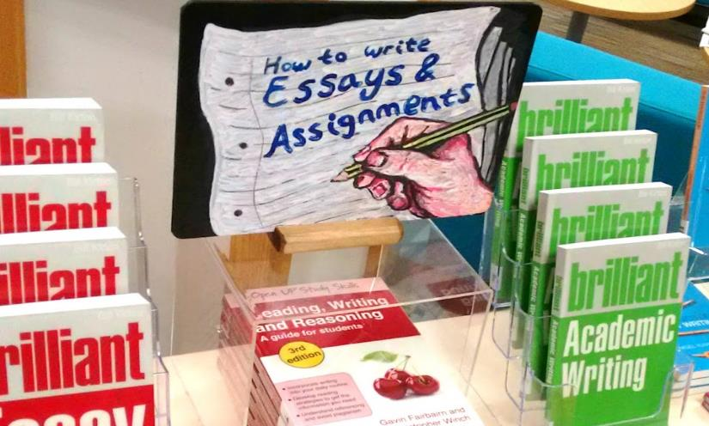
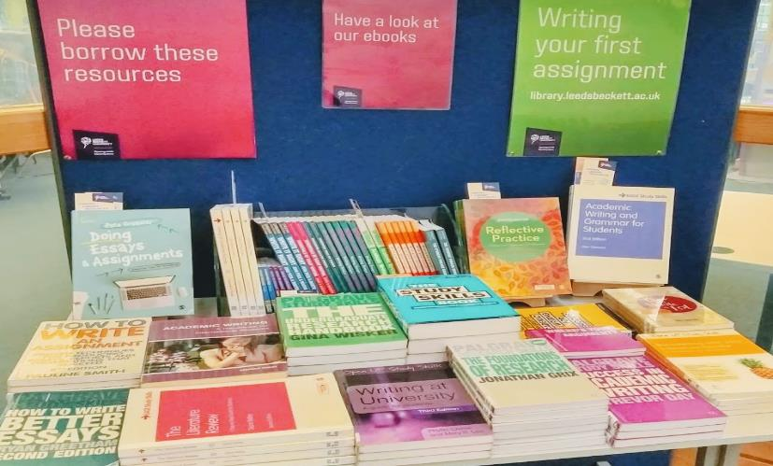
Notes:
In libraries, limited collections budgets mean we don’t have unlimited shiny new stock to showcase, so it is often necessary for us to also repurpose the same stock again and again in different permutations. A continual, repeating study calendar means the same display topics keep coming around again and again. September is always study skills month; in October it’s writing your first essay; November is research methods and December is exam preparation skills, etcetera, etcetera. It’s good to have an array of posters and paraphernalia to reuse and cut down on staff time when preparing a display, but we also want to have enough options to keep things looking new and different, so second and third year students don’t just think we’re putting out the same display as last year and they give our new displays their fullest attention.

Slide 20
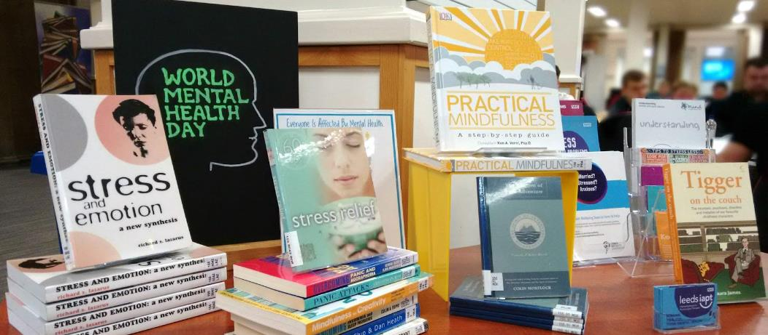
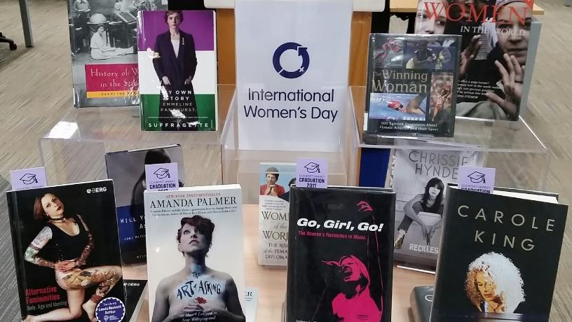
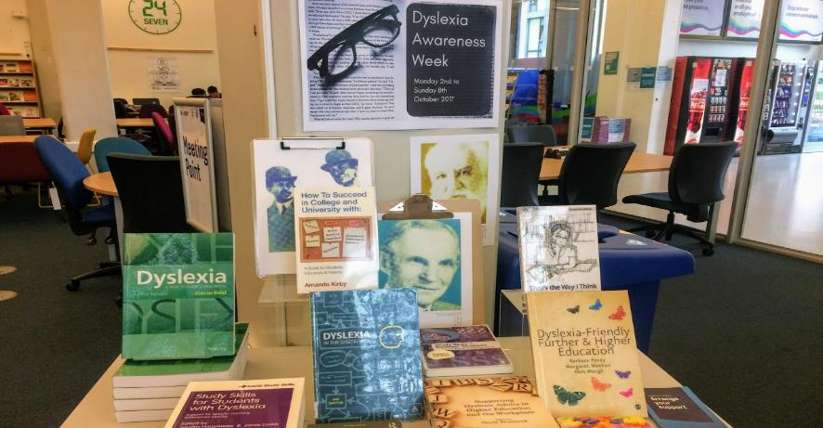
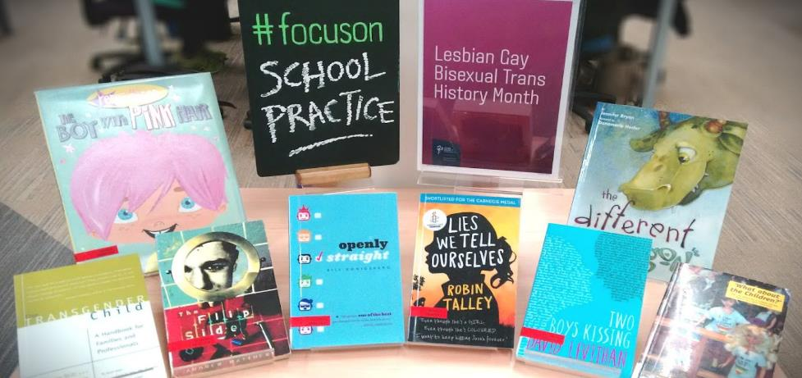
Notes:
We regularly create displays to publicise local and national awareness days, weeks or months, which reflect the university's values, or may be of interest to our students. These ‘awareness’ displays generate mixed levels of interest. Recent successes include our displays for Women’s History Month, where 56% of the display stock was borrowed and our Focus On Autism display where 70% of the table was issued. Other displays see more mixed levels of student engagement, however, we continue to run new and varied awareness displays, as they provide an opportunity to demonstrate both the University and the Library’s commitment to recognising and celebrating these areas, as well as providing support for our students
We have initiated and developed relationships with external organisations to help promote shared values and create an inclusive community. These include LGBT History Month, Global Accessibility Awareness Day, and Leeds City Council. These relationships have resulted in the providing of materials, support and cross promotion of activities.

Slide 21
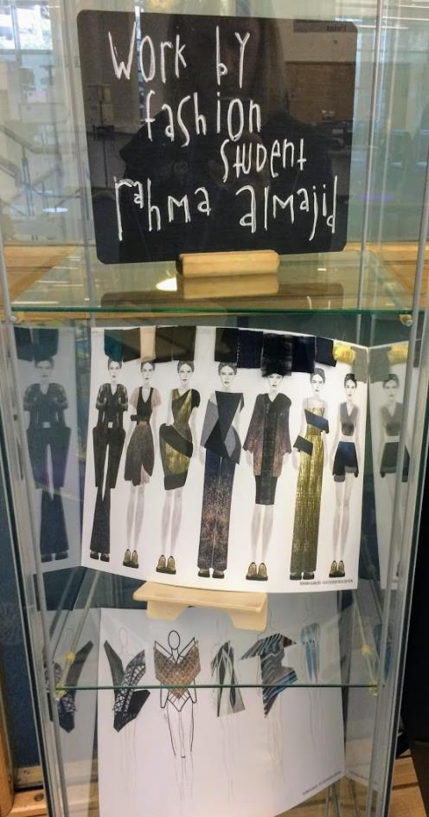
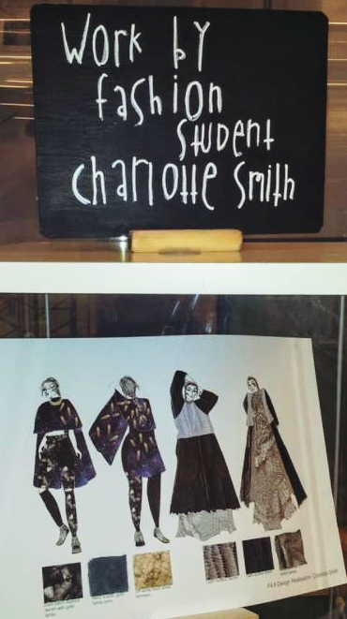
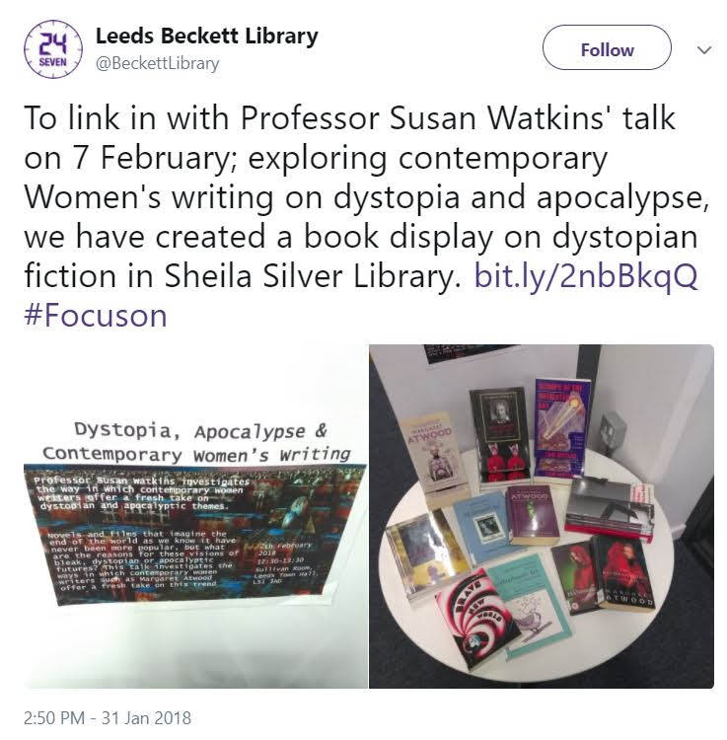
Notes:
We encourage staff and students to create their own displays. A great example of a student initiated display was our fashion exhibition at City Campus Library, where students used our display spaces and materials to showcase their own work. We also work closely with academic staff and successful displays have been linked to University talks and conferences.
High demand for display space means we need to carefully manage and continually evolve our strategy. Our Displays team is part of a larger group - the Learning Resources Publicity Group. At our group meetings, we discuss proposed topics and make use of our individual knowledge and specialisms to decide the most appropriate way of presenting a concept. Is there research to showcase? Do we have appropriate resources to do the theme justice? Would this topic work best as a display, or instead as a web page or some other format?
We are exploring new ways to maximise the effect of the work we do. We utilise previous usage statistics, reading lists, and the skills and knowledge of academic librarians to curate display content which results in higher display use. We have started to explore merging displays with our study skills guidance pop-up events. We’ve also begun linking narrower focused displays, such as our low NSS score subject displays, to more popular ones to encourage greater footfall to both displays and also highlight the relevance of study skill themed displays to students on particular courses.

Slide 22
Notes:
We’ve talked about libraries from a more commercial slant, but one of the great strengths of libraries is that they’re non-commercial - our goal is not to drive impulse sales, but to provide guidance and support in gaining information literacy skills, which enable our students to find, evaluate and utilise high quality resources. These capabilities feed directly into assignments, degree classification, employability and life skills. Because we are not motivated by profit we are able to utilise the many positive elements of visual merchandising, to help enhance the overall student experience, without any of the more negative consequences of targeted impulse marketing.
One of the big questions we keep asking ourselves is do our displays help create a culture of dependency where students are unable to perform their own literature searches? This is not an easy question to answer. A good display can offer a starting point and help to clarify a complex topic.

Slide 23
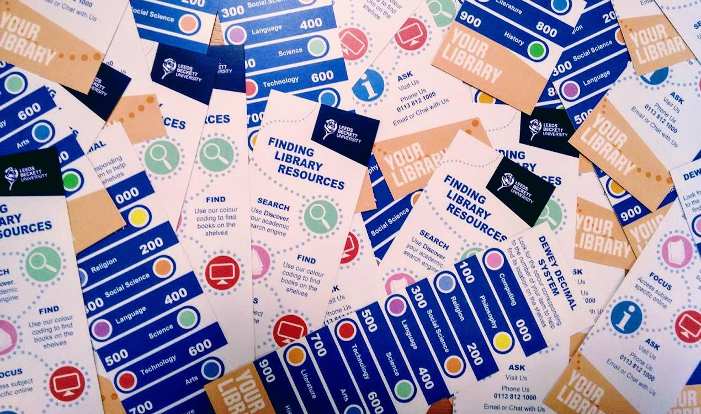
Notes:
We try to ensure our displays also motivate information searching and browsing skills by using simple initiatives such as creating our own ‘Finding Library Resources’ bookmark to place in display items to encourage students to explore our book stock further.
It’s important to remember that student expectations have changed - and rightly so. With higher study costs and an increasingly competitive job markets, today’s cohort of students face greater pressures than we ever did leaving university. Students expect a greater level of support, and any help we can give them to access the high quality resources we offer can surely only have a positive effect on the standard of the work they produce. Leeds Beckett Library, like many others, is trying to lessen potentially stressful areas of the student experience, offering auto-renewals, a shelf retrieval reservations service, providing free Interlibrary Loans, as well as many other initiatives. Displays are yet another tool we use to engage our students and enable them to study in a way that suits them; displays provide a pathway, to help guide students to the best resources available; a starting point on a journey of skills and knowledge discovery.

Slide 24
“I was just walking past and I saw this book ... I still have it, I borrowed it then and took it home and read everything in it and it was really helpful. I wouldn’t have known where to find it actually if it was on the shelves … but when you display it where they can see it … I think I need this.”
Student feedback captured during a Library interview exercise
Notes:
Here’s a nice piece of student feedback captured during a Library interview exercise, which perfectly illustrates how displays can help students discover resources they wouldn’t otherwise find on the shelves:
“I was just walking past and I saw this book ... I still have it, I borrowed it then and took it home and read everything in it and it was really helpful. I wouldn’t have known where to find it actually if it was on the shelves … but when you display it where they can see it … I think I need this.”

Slide 25
References
Bright Pearl (2017) Double trouble: how introducing cross-merchandising can increase sell-through. Available at: https://blog.brightpearl.com/double-trouble-how-introducing-cross-merchandising-can-increase-sell-through (Accessed: 25 June 2018).
Camacho, L., Spackman, A. and Cluff, D. (2014) Face Out: The Effect of Book Displays on Collection Usage. Journal of Business & Finance Librarianship, 19(2), pp.114-124. Available at: https://www.tandfonline.com/doi/abs/10.1080/08963568.2014.883874 (Accessed 28 June 2018).
dotActiv (2018) 9 examples of cross-merchandising. Available at: https://www.dotactiv.com/blog/examples-of-cross-merchandising (Accessed: 25 June 2018).
Larkin-Lieffers, P. A. (2013) Informational Books, Beginning Readers, and the Importance of Display: The Role of the Public Library. Canadian Journal of Information and Library Science, 1, pp. 24-39.
Learn.org (2018) What is visual merchandising? Available at: https://learn.org/articles/What_is_Visual_Merchandising.html (Accessed: 25 June 2018).
Maloney, M. M. (2012) Cultivating community, promoting inclusivity: Collections as fulcrum for targeted outreach. New Library World, 113(5/6), pp.281-289. Available at: https://www.emeraldinsight.com/doi/10.1108/03074801211226364 (Accessed 28 June 2018).
Smith, J. (2015) How to Sell to The Spontaneous Buyer. Durham, NC: Jeremy Said. Available at: https://www.jeremysaid.com/blog/sell-spontaneous-buyer (Accssed 28th June 2018)
TalentEgg (2018) 6 words to add to your retail lingo dictionary. Available at: https://talentegg.ca/incubator/2014/03/17/6-word-add-retail-lingo-dictionary (Accessed: 25 June 2018).

