Slide 1
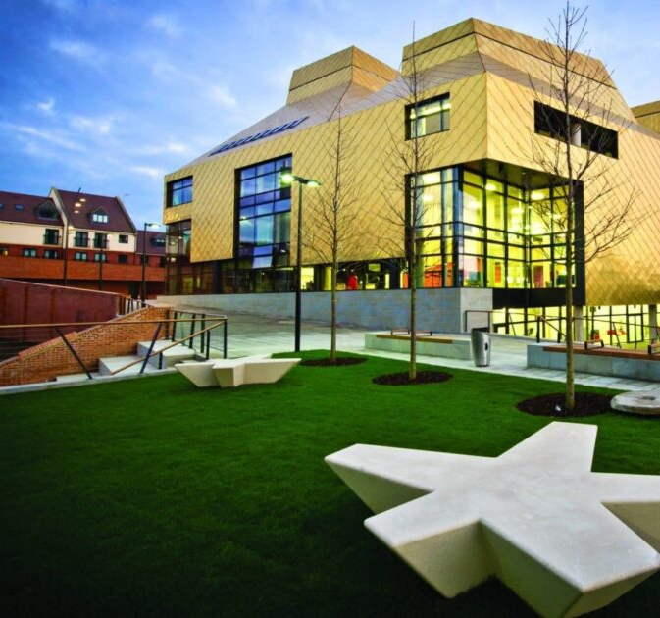
The Hive
How do we know what we need?
Notes:
This presentation will cover how we identify the skills needed to deliver excellent customer service in The Hive and Worcestershire LIbraries and how we have developed and trained our staff to be able to do this consistently and with confidence.

Slide 2
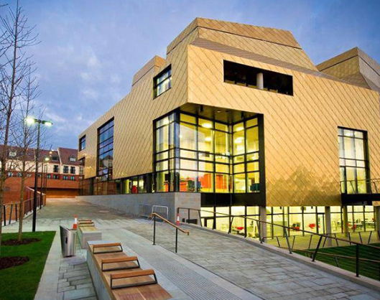
The Hive is a Partnership
The Hive is a partnership between the University of Worcester and Worcestershire County Council
We are collocated with the Worcestershire County Council’s Archive and Archaeology Service
We are also home to the Youth Hub, a further partnership between WCC Learning and Skills team and Department of Work and Pensions to deliver training and employment opportunities from ages 15-24
The Hive and the Library Service is open 7 days a week, 8:30am-10pm.

Slide 3
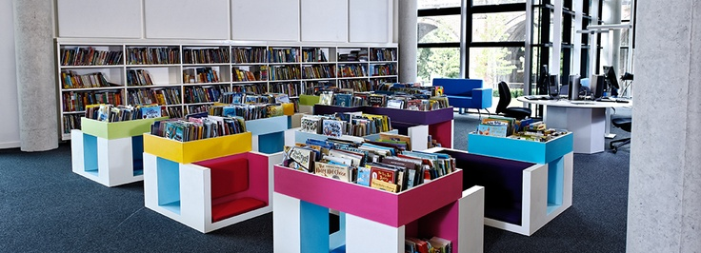
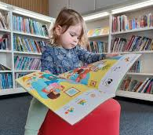
Children’s Library
Largest Children’s Library in Europe
Offer school visits to children of all ages - from nursery all the way through to University
Themed storytimes, Bounce and Rhyme sessions and stay and play sessions run throughout the week

Slide 4
Adult Events and Exhibitions
Professorial Lectures
Author talks
Exhibitions
Cultural and artistic events
Library Service at Home
Ask for a Book pilot library
BIPC Centre

Slide 5
Students
Student population at University of Worcester is approximately 11,000
The Hive is the sole academic library for the University of Worcester
Over 850 study spaces
Onsite IT student helpers
Opportunities for work placements and employment

Slide 6
Customer Base
Extremely wide and diverse
Demand for our staff to be flexible, adaptable to any and all situations
Demand for excellent communication skills
Over 13,500 square feet over 5 floors – team work is essential
Customer focus – proactive customer service is both recruited for and trained

Slide 7
What are we looking for when we recruit?
Passionate about delivering truly excellent customer service
Excellent communicators and listeners
Proactive in promoting our services - “up selling”
Able to interact with people on all levels without prejudice
Energetic, positive, upbeat and confident
Great team players
Resourceful, resilient, flexible and positive about change
Creative and innovative (desirable)

Slide 8
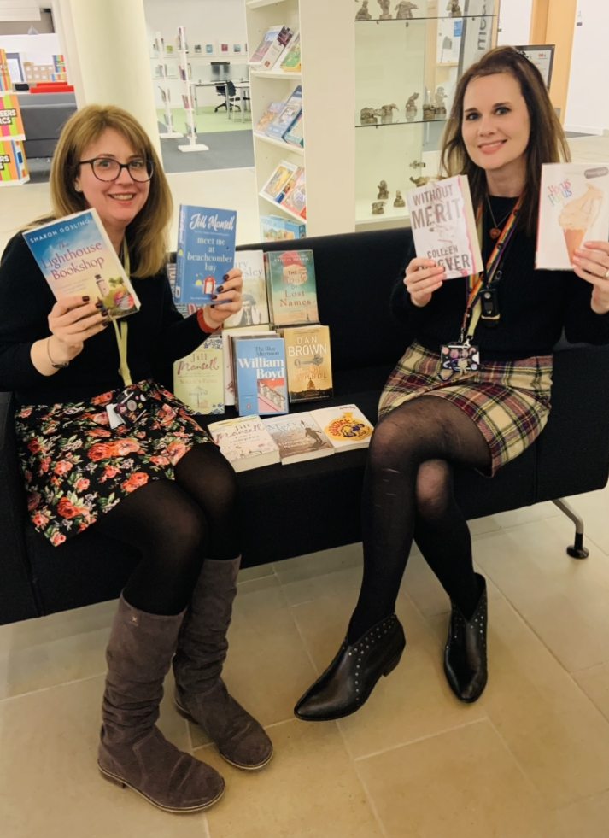
How do we identify this?
We have changed and developed the recruitment procedure to allow for a group element which allows us to:
See more people at interview
Test conclusively for team skills
Test for confidence in communication
Followed by a formal interview which has a number of real-life scenarios for candidates to work out.

Slide 9
How do we develop staff to deliver excellent customer service?
3 month induction process (3 month and 6 month probation reviews)
6 weekly 1:1s (2 weekly in their first 2 months)
Customer Focus Training
Customer interaction Training (Behaviour and Safeguarding)
Training from First Point and University Student Services as part of induction
Additional training for Team Leaders in de-escalation, safeguarding providing clear escalation route for Library Customer Advisors

Slide 10
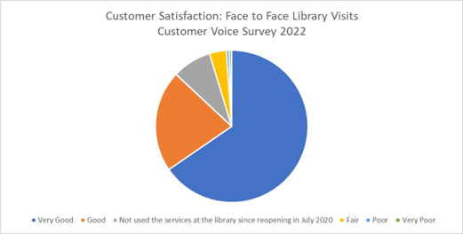
What are the results?
98% of people who had used the library again after Covid felt that the standard of face-to-face customer service was either very good or good
Library Services continues to perform excellently in the NSS
“This week the staff have been superb, helping me with several problems. I am most deeply grateful. Everyone has been so patient, kind and understanding. And I felt at my ease and reassured by their highly professional approach and manner.”
“What a fantastic space and facility! Met by a delightful young woman called Amanda, who could not have been more helpful. She kindly guided me to the best floor to do my work, with a friendly manner and a smile.”

Slide 11
Any Questions?

