Slide 1
ibrarians in training
A Graduate Library intern’s insight
Hannah Carson: University of York Graduate Library Intern

Slide 2
Why I became an intern
Graduated with a Masters
Job opportunities
Career development
Full time and well paid
Library job experience necessary

Slide 3
Our role as an intern
This role can vary widely from library to library, but the main goals include
developing knowledge of library services
experience how libraries are developing their systems, user engagement and skills on a daily basis.
Gain knowledge about the information profession

Slide 4
University of York Library
Mentors to support throughout
Split post role
Customer Services
Collections (behind the scenes section of the library)
Cataloguing
Purchasing and inter-library lending
Reading Lists
Subscriptions (journals)

Slide 5
External engagement
Our training status lets us observe different departments and visit libraries which we then use to:
Improve our knowledge
Improve collaboration for projects
Feedback ideas and experiences
Increases networking skills
Notes:
including IT , archives, and departmental services.

Slide 6
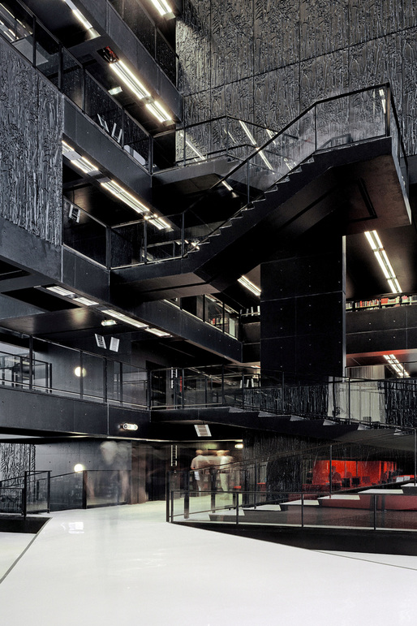
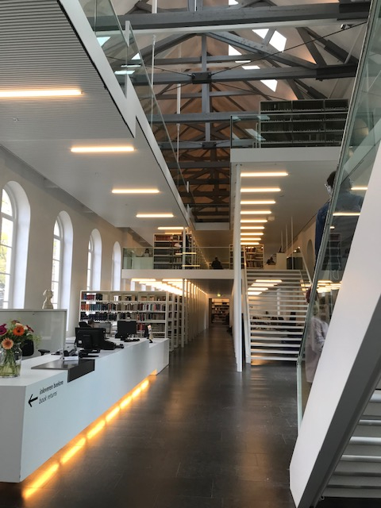
2018/19
Hannah’s Erasmus+ Staff training at Utrecht University Library
Used to promote the University of York Library alongside own professional development.
Insight into European standards and information developments
Knowledge exchange and reporting back

Slide 7
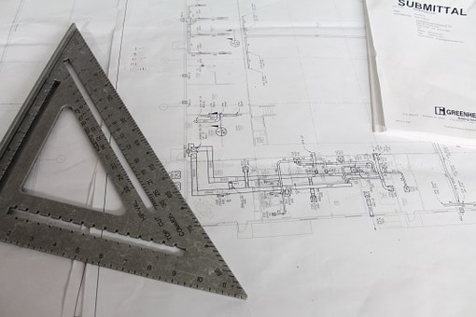
Projects
Improve library service
3 months
Decided by you, mentors and library
Knowledge exchange/Report

Slide 8
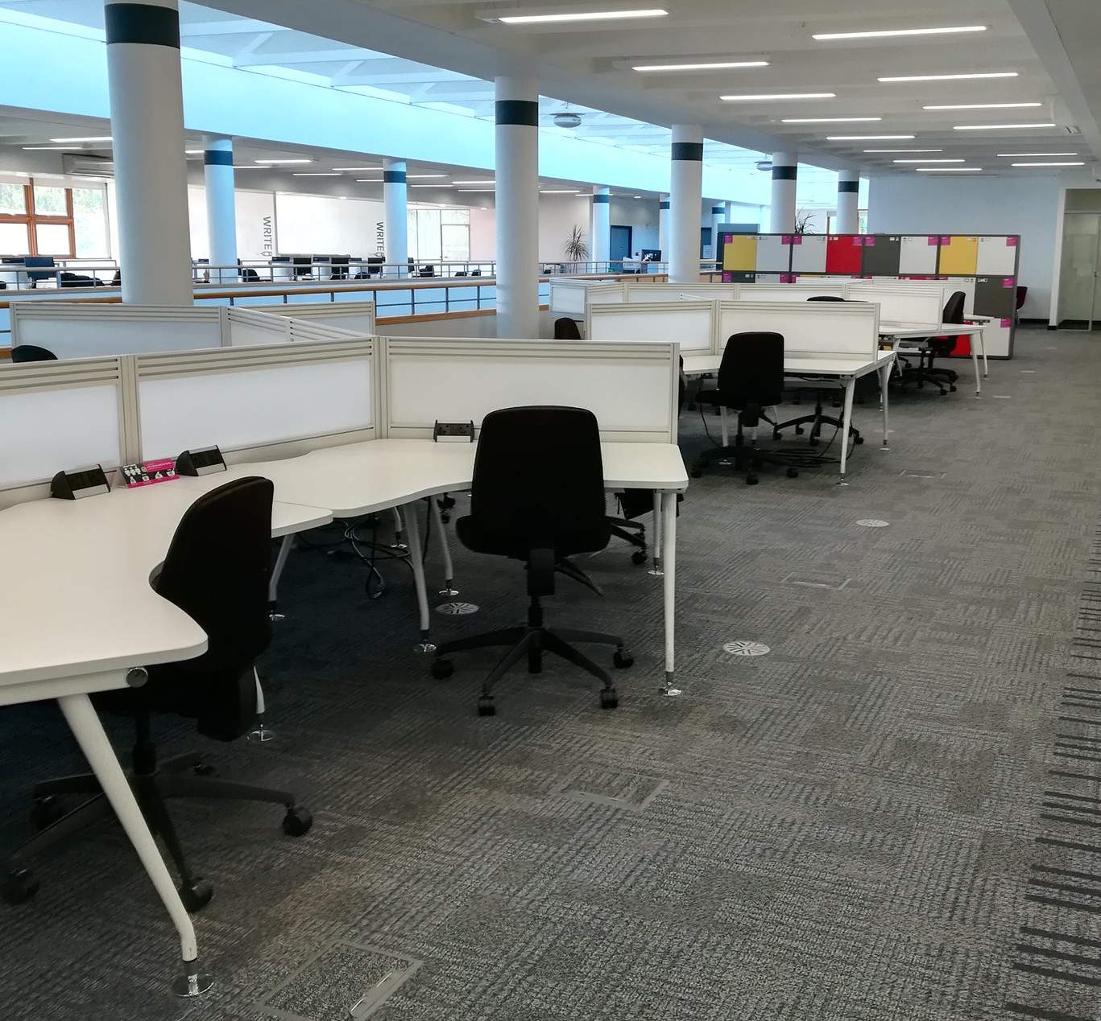
2017/18
Isabel’s project:
invested research into the postgraduate study areas in the library
UX methods, engaged with Postgraduate research and taught students about their use of the library.
Silent study area for researchers open to postgraduate taught students.

Slide 9
Personal experience
Reflective practices
Exhausting
Confidence in self and skills
Fun!
Notes:
Always pushing self in mental capacity - for instance this presentation was my personal development to improve my presenting skills away from internal events.

Slide 10
What’s next?

Slide 11
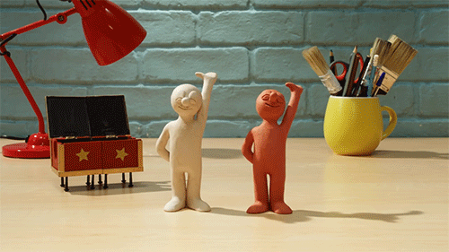
Thanks for listening!
Twitter @HeCarson
hannah.carson@york.ac.uk
Gif ©️ aardman animations

