Slide 1
The importance of inclusivity in front-line service
Ariana de Groot
Antonis Sideras
Library Assistants
Wimbledon College of Arts
University of the Arts London

Slide 2
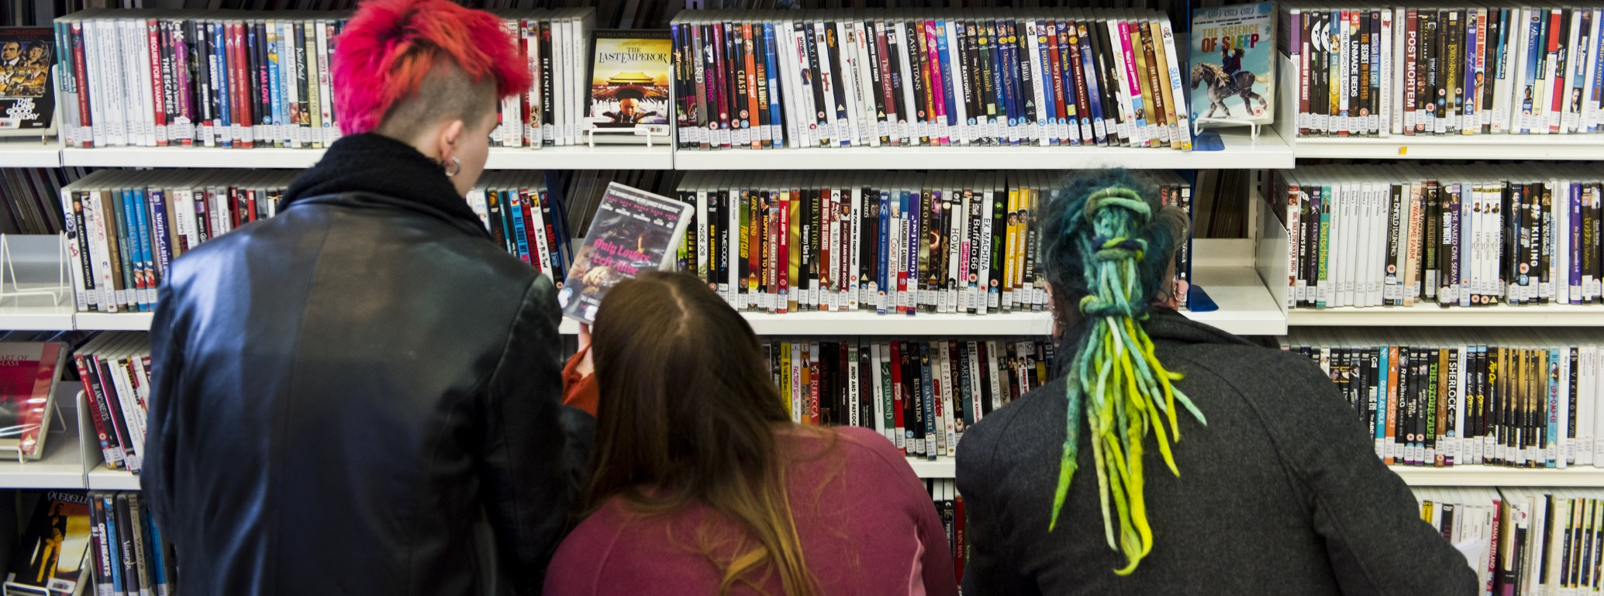
Inclusivity
It involves
Invitation for participation
Respect
Representation
Safety
Seen as a
Practice
Quality
Procedure

Slide 3
Why is inclusivity important?
Important to acknowledge that the UK is a diverse place
Strive for fair representation
Intersectionality - people may face discrimination from multiple sources of oppression
Diverse groups may have different views on topics
Celebrating difference

Slide 4
Inclusive Framework
Student Diversity at UAL
Staff at UAL
Trans student support
Lesbian, gay, bisexual and trans (LGBT)
Access for disabled students
Students with caring responsibilities
Student pregnancy and maternity
Faith observance
Students interested in race in arts Higher Education
age
disability
gender reassignment
marriage and civil partnership
pregnancy and maternity
race
religion or belief
sex
sexual orientation

Slide 5
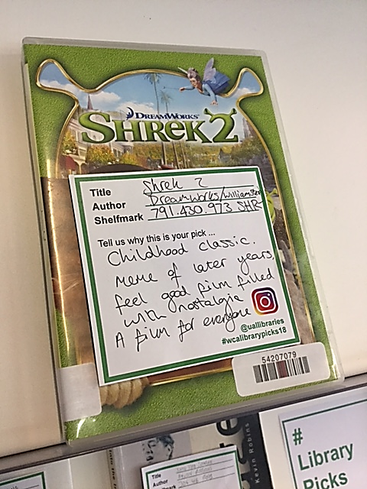
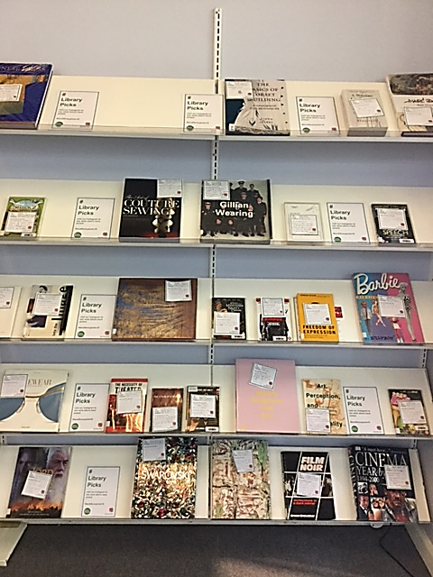
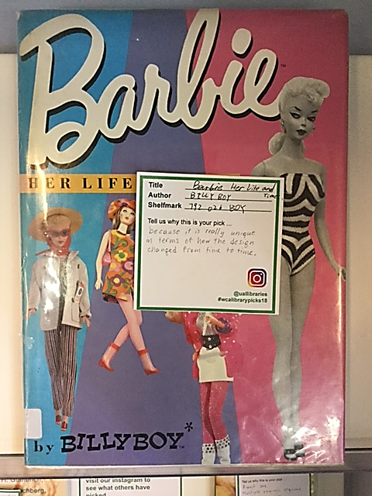
Library Inductions 18/19
Library Picks
Groups of 2-3 students
Pick a book or DVD and tell us why
Created a display with the items and shared on social media
Interesting picks to do with race, gender, feminism and more
Cooperation and ice-breaker for new students

Slide 6
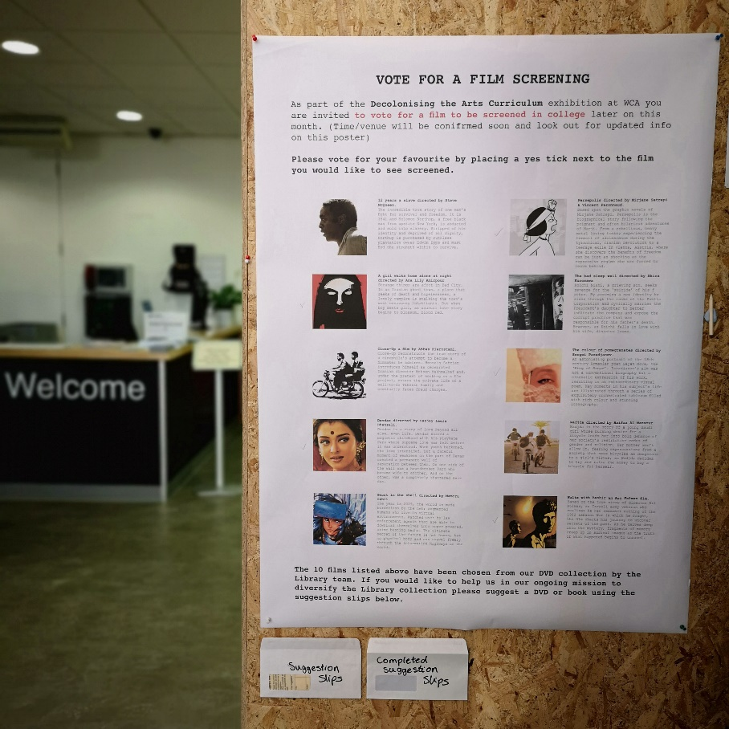
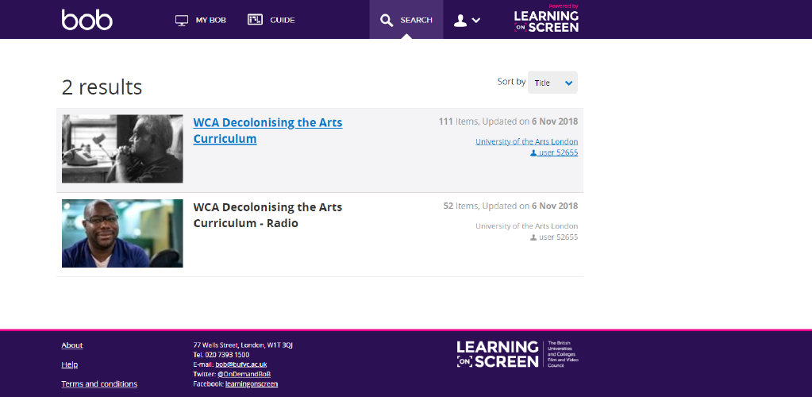
Decolonising the Arts Curriculum
Library Display
Created playlists on BoB
Vote for Film Screening
Screened ‘Ghost in the Shell’

Slide 7
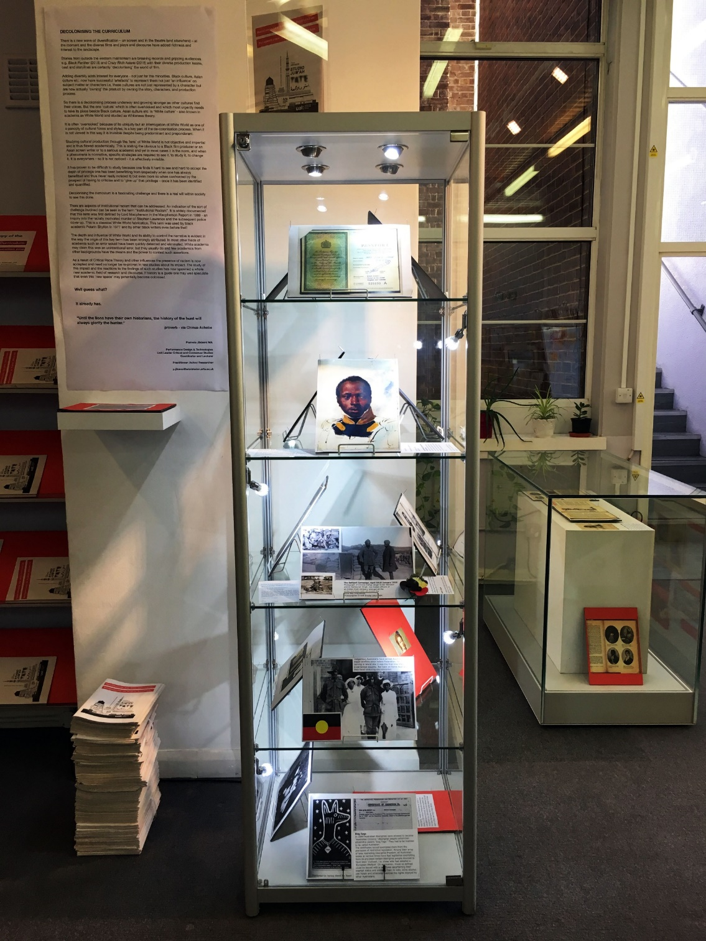
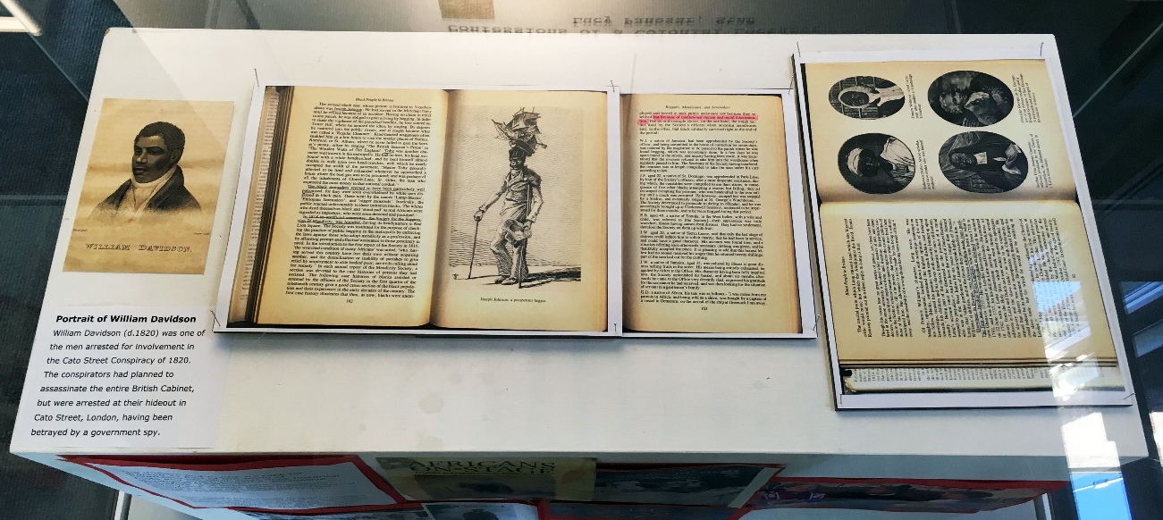
Pamela Jikiemi’s exhibition
Pamela Jikiemi
Theatre & Screen Academic
Exhibition tying in with Decolonising the Arts Curriculum containing:
Texts & Images from PhD research
Personal family photographs
Family member’s passport

Slide 8
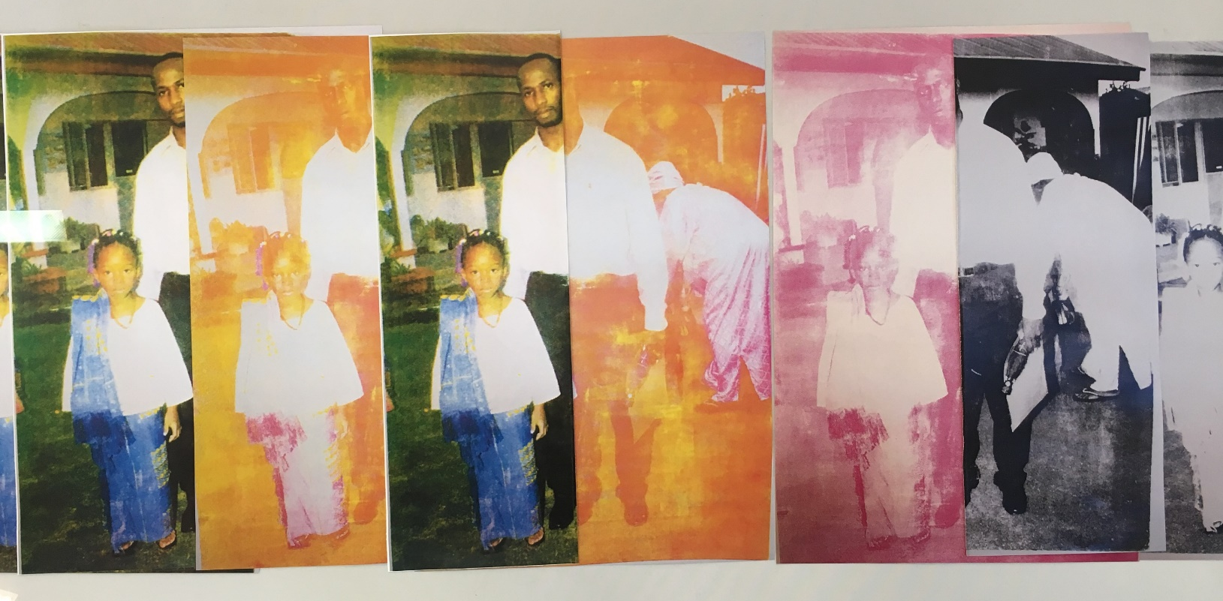
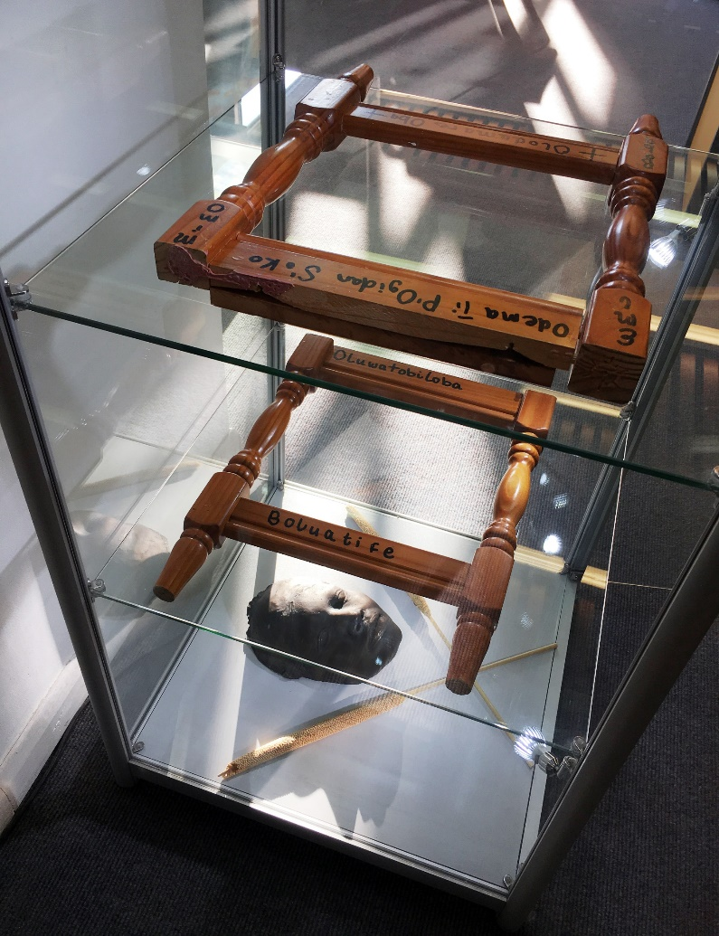
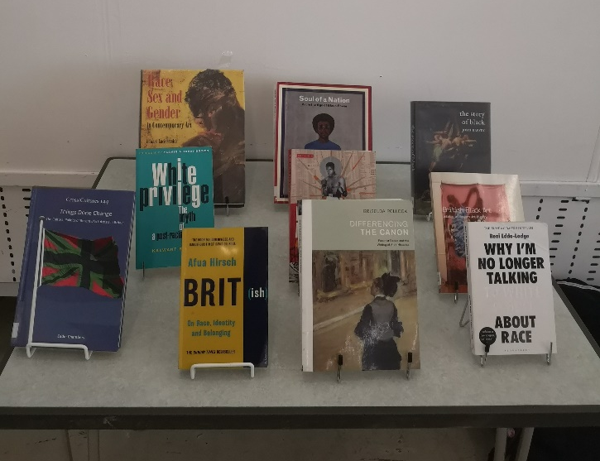
Alexandra Falade
Alexandra Falade, BA Fine Art Painting
Shadow Selves
family photographs
collage
printmaking
sculpture
installation
REPRESENT Event
platform for POC artists and recent graduates from UAL
diversify and represent histories of women of colour artists in art school curriculums

Slide 9
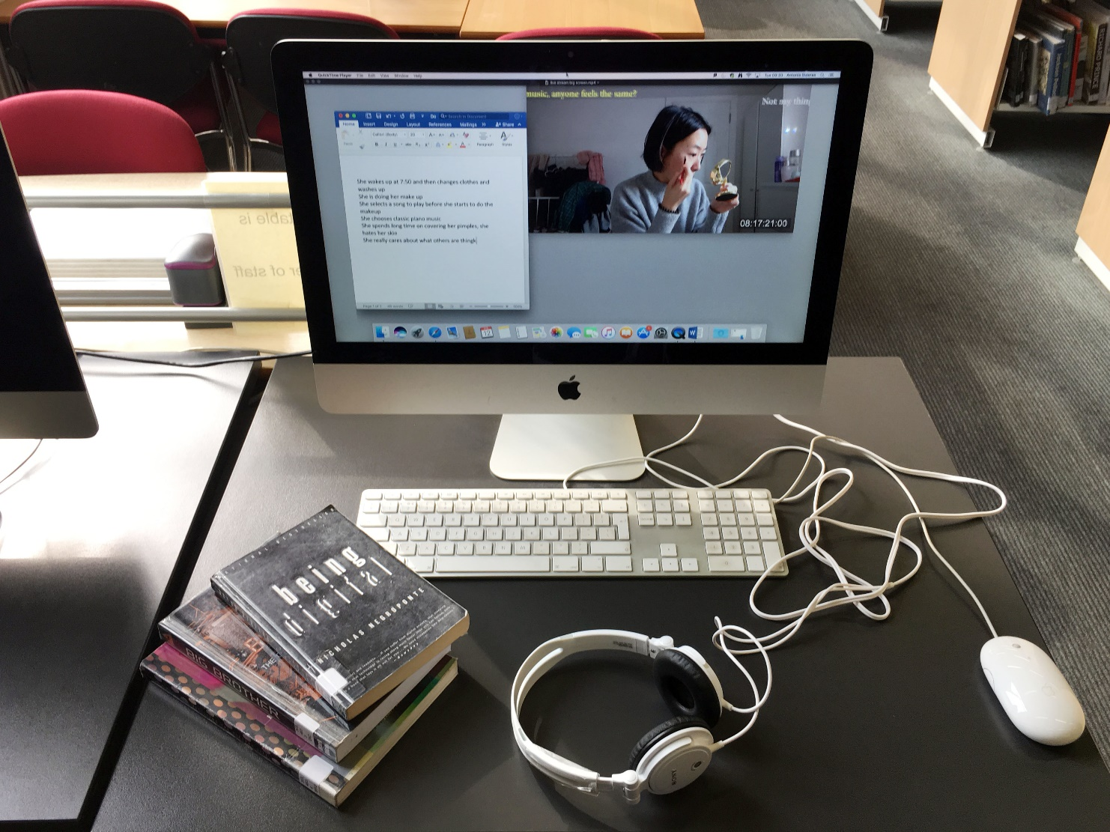
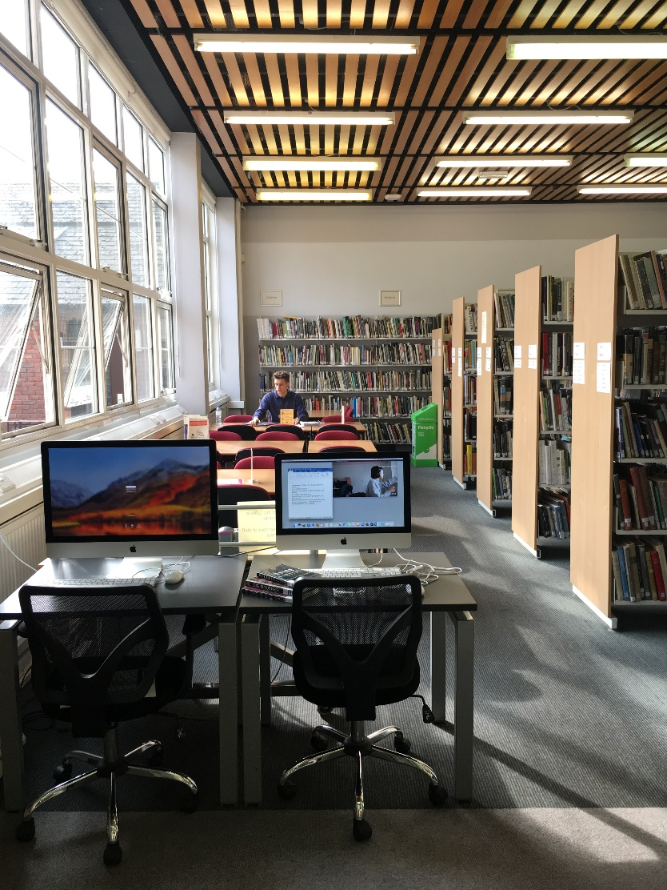
Minqi Xu
Life Stream
Site specific video installation in the library
Reserved study space in disguise
Video blending to iMac start-up screen
Broadcasting moments from the life of an international female student
Minqi Xu
MFA Fine Art

Slide 10
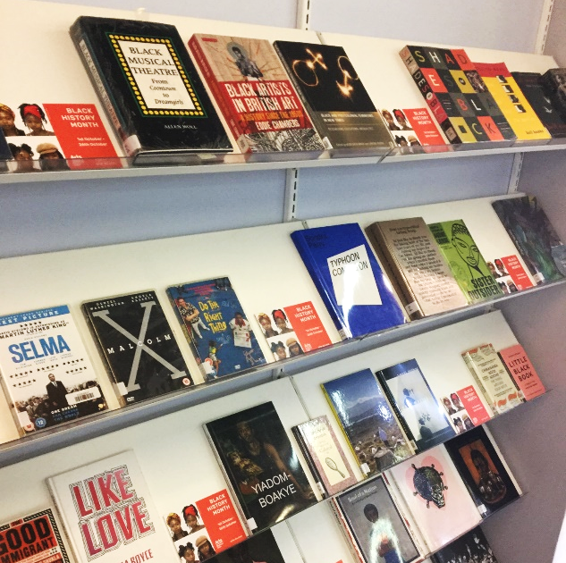
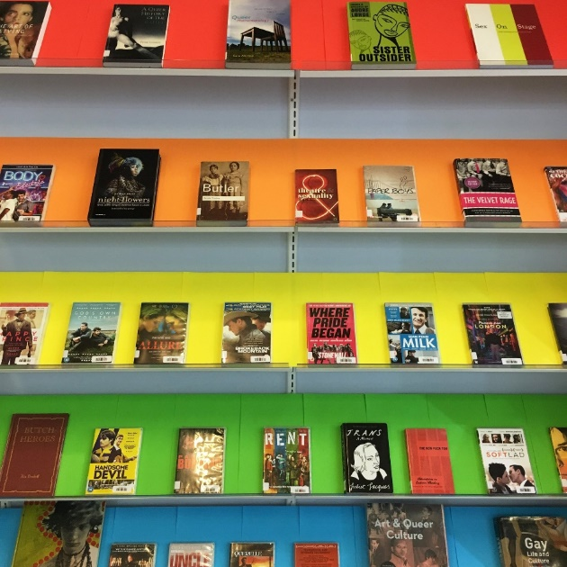
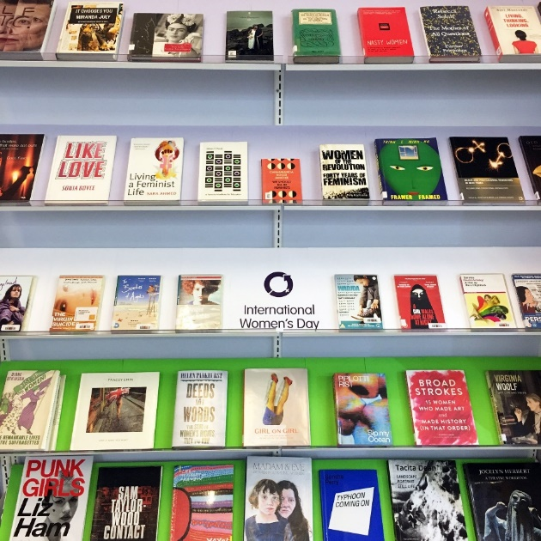
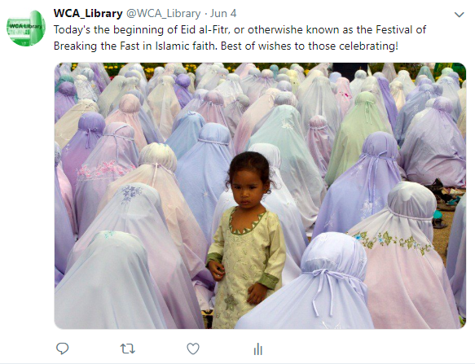
Library displays for important dates
Black History Month
LGBT+ History Month
Women’s History Month
Representation of individuals from underrepresented groups
Showing that we are passionate about inclusivity
Breaking barriers
Social media visibility

Slide 11
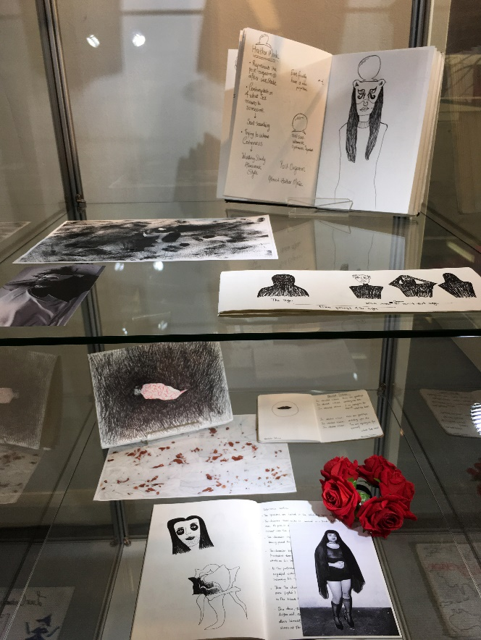
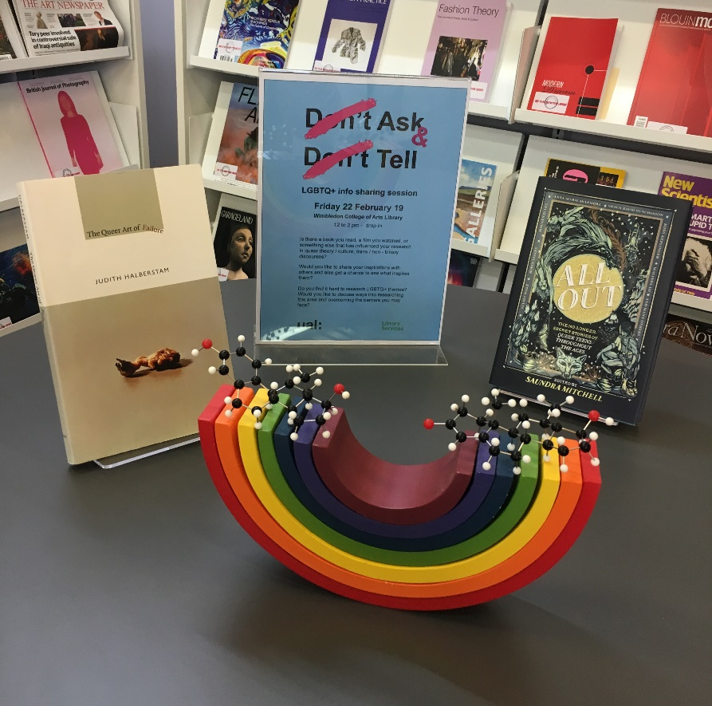
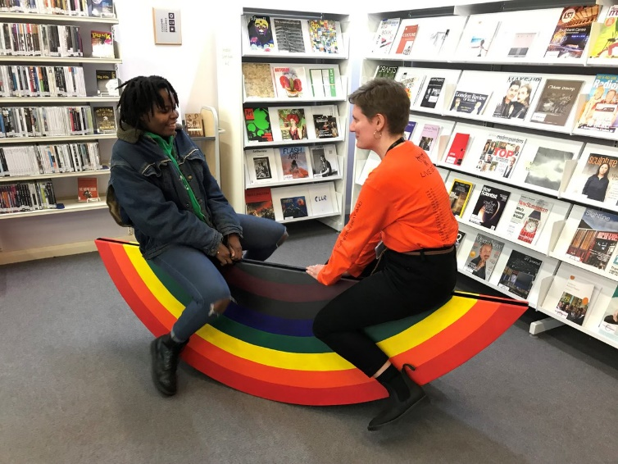
LGBT+ History Month Activities
Ta-dah!
Library Exhibition
Ask & Tell:
Info-share sessions
Gender Seesaw Pop up display
Hamish Pringle

Slide 12
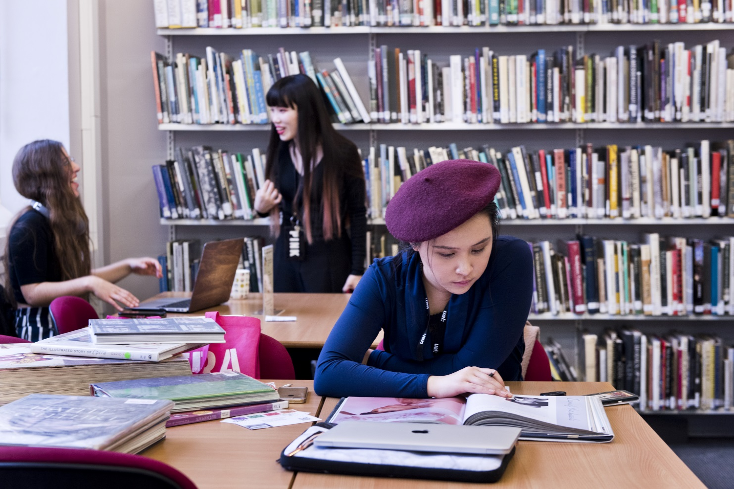
Practical Tips
The power of representation
Be kind
Use inclusive language
Be open-minded
People are created equal, but not the same
Assumptions are dangerous
Practice counter-stereotyping
Acknowledge bias

Slide 13
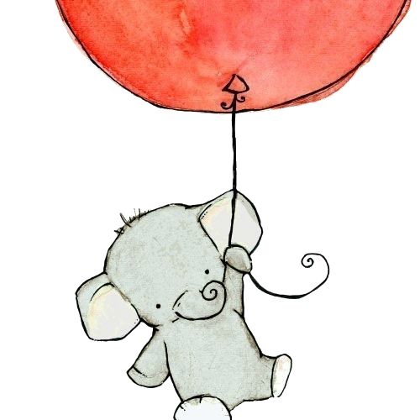
Thank You

