Slide 1

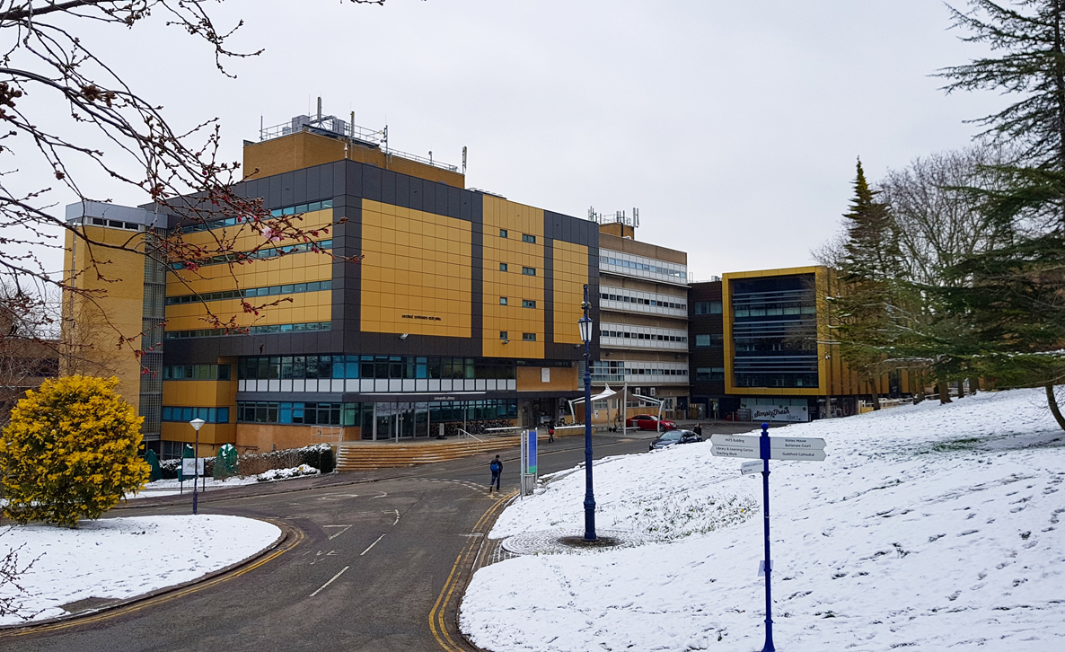
Embedding welfare in the Library:
Supporting student wellbeing with limited time and resources
CSGUK
“Inspired ideas from the sharp end”
University of Bristol,
6 February 2020

Slide 2
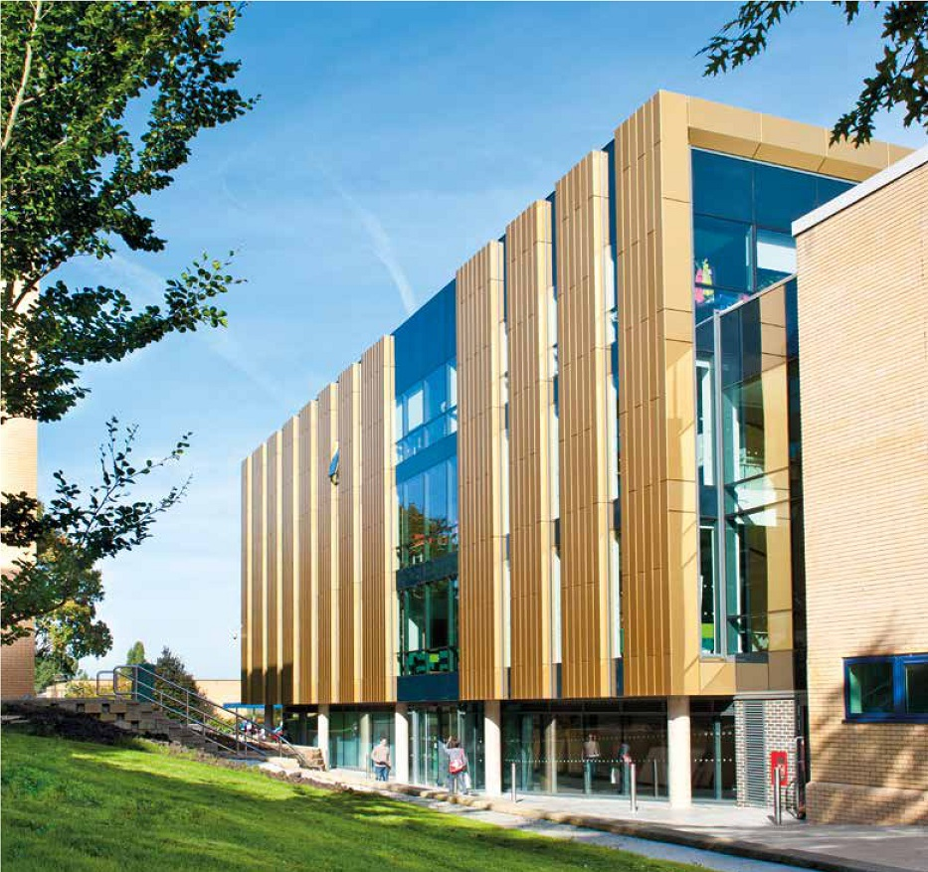
Wellbeing:
the state of being, healthy, happy, or prosperous; physical, psychological, or moral welfare.
www.oed.com

Slide 3
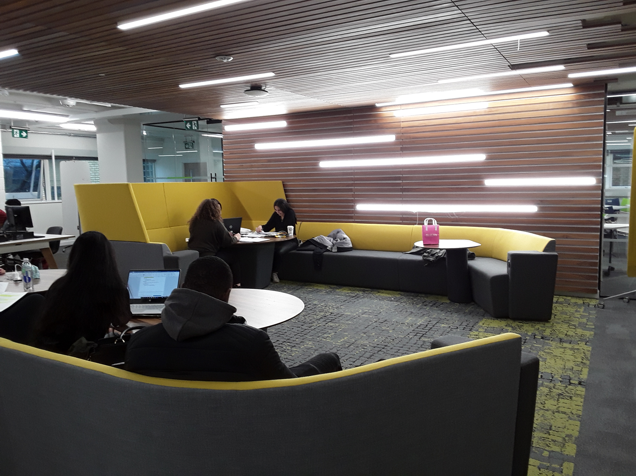
The Library as third place
‘Hangouts at the heart of a community’
Ray Oldenburg, The great good place
(1989)
‘The library continues to fulfil its role as the heart of the university’
SCONUL, The value of academic libraries (2012)

Slide 4
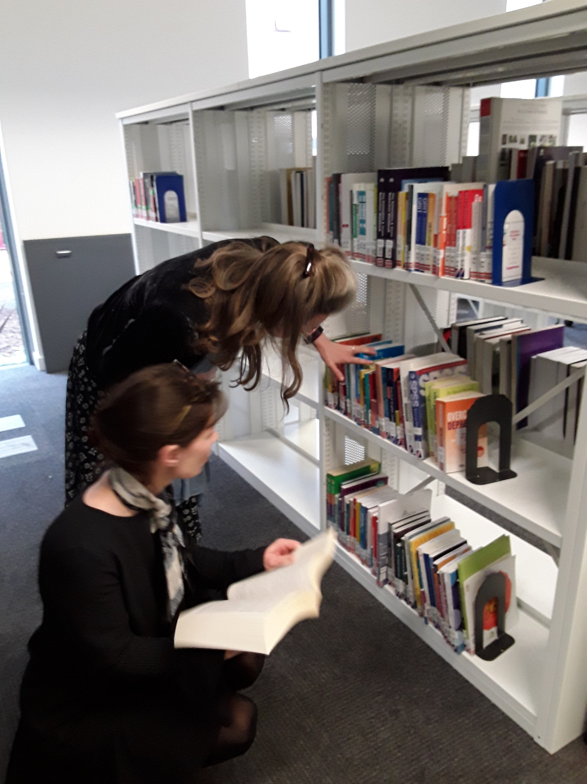
The Student Wellbeing Group comprises:
Library Customer Services
Academic Skills and Development
Faculty Engagement Librarians
Reporting to:
Head of Engagement and Enhancement

Slide 5

Objective
The purpose of the Student Wellbeing group is to ensure that LLS spaces and services are designed and operate in such a way that they support student wellbeing and healthy study.
LLS student welfare and wellbeing initiatives will be fully integrated with other university initiatives and services.

Slide 6

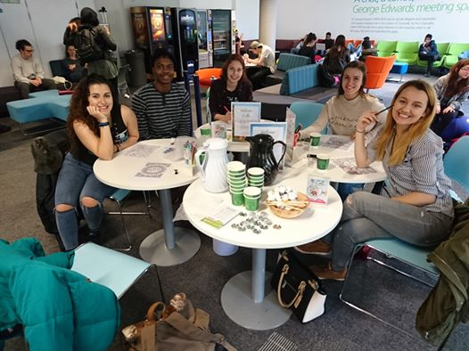
Collaboration with the Centre for Wellbeing
Hosted in the social study space at the entrance to the Library on Level 1

Slide 7
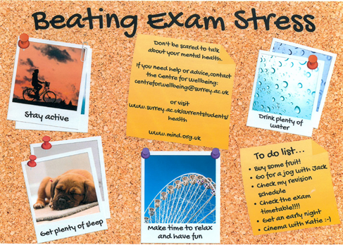
Posters produced by the Library Customer Services team

Slide 8

Promoting services sponsored by the University of Surrey and USSU

Slide 9

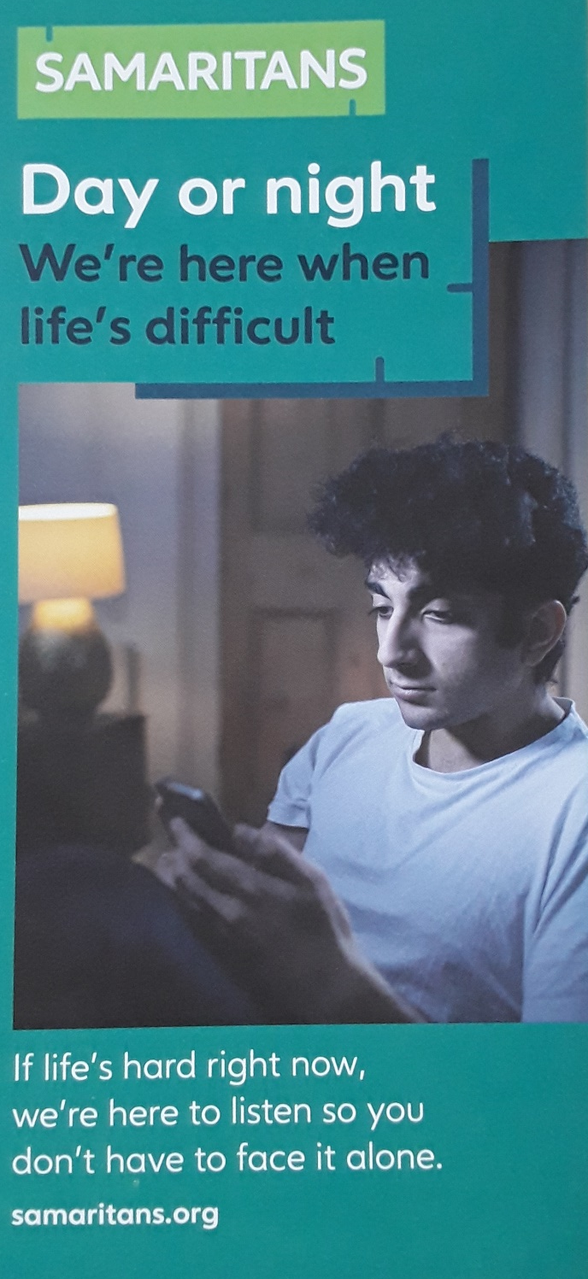
Promoting charities offering services to our students

Slide 10

Promoting national campaigns

Slide 11
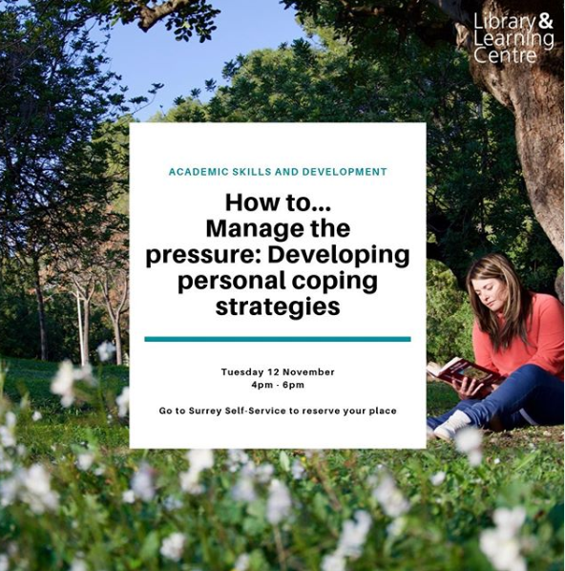
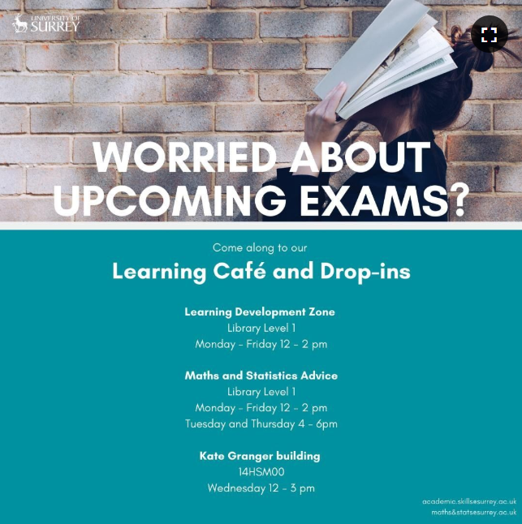
Collaboration with Academic Skills and Development

Slide 12


Collaboration with Disability and Neurodiversity
Promotion of the support group run by Disability and Neurodiversity
Purchase of SAD lamps for use by supported students
Disability awareness postcards

Slide 13
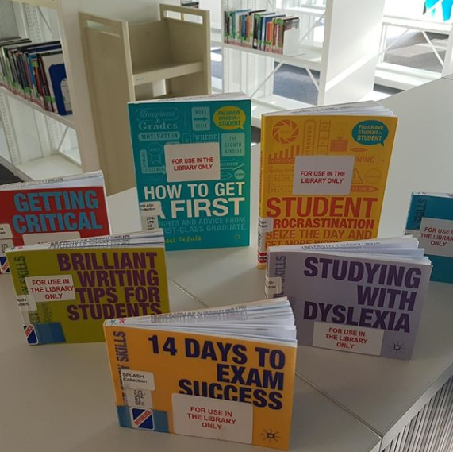
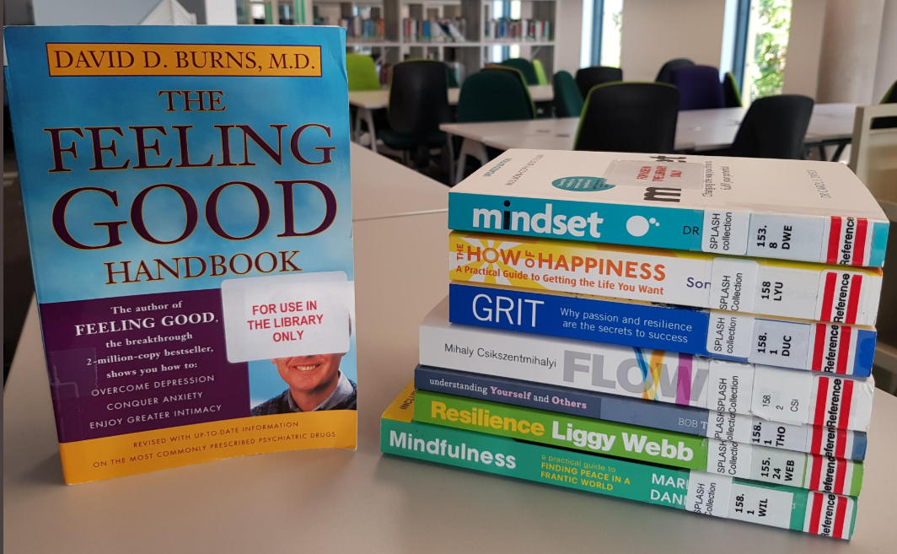
The Self-help Collection

Slide 14
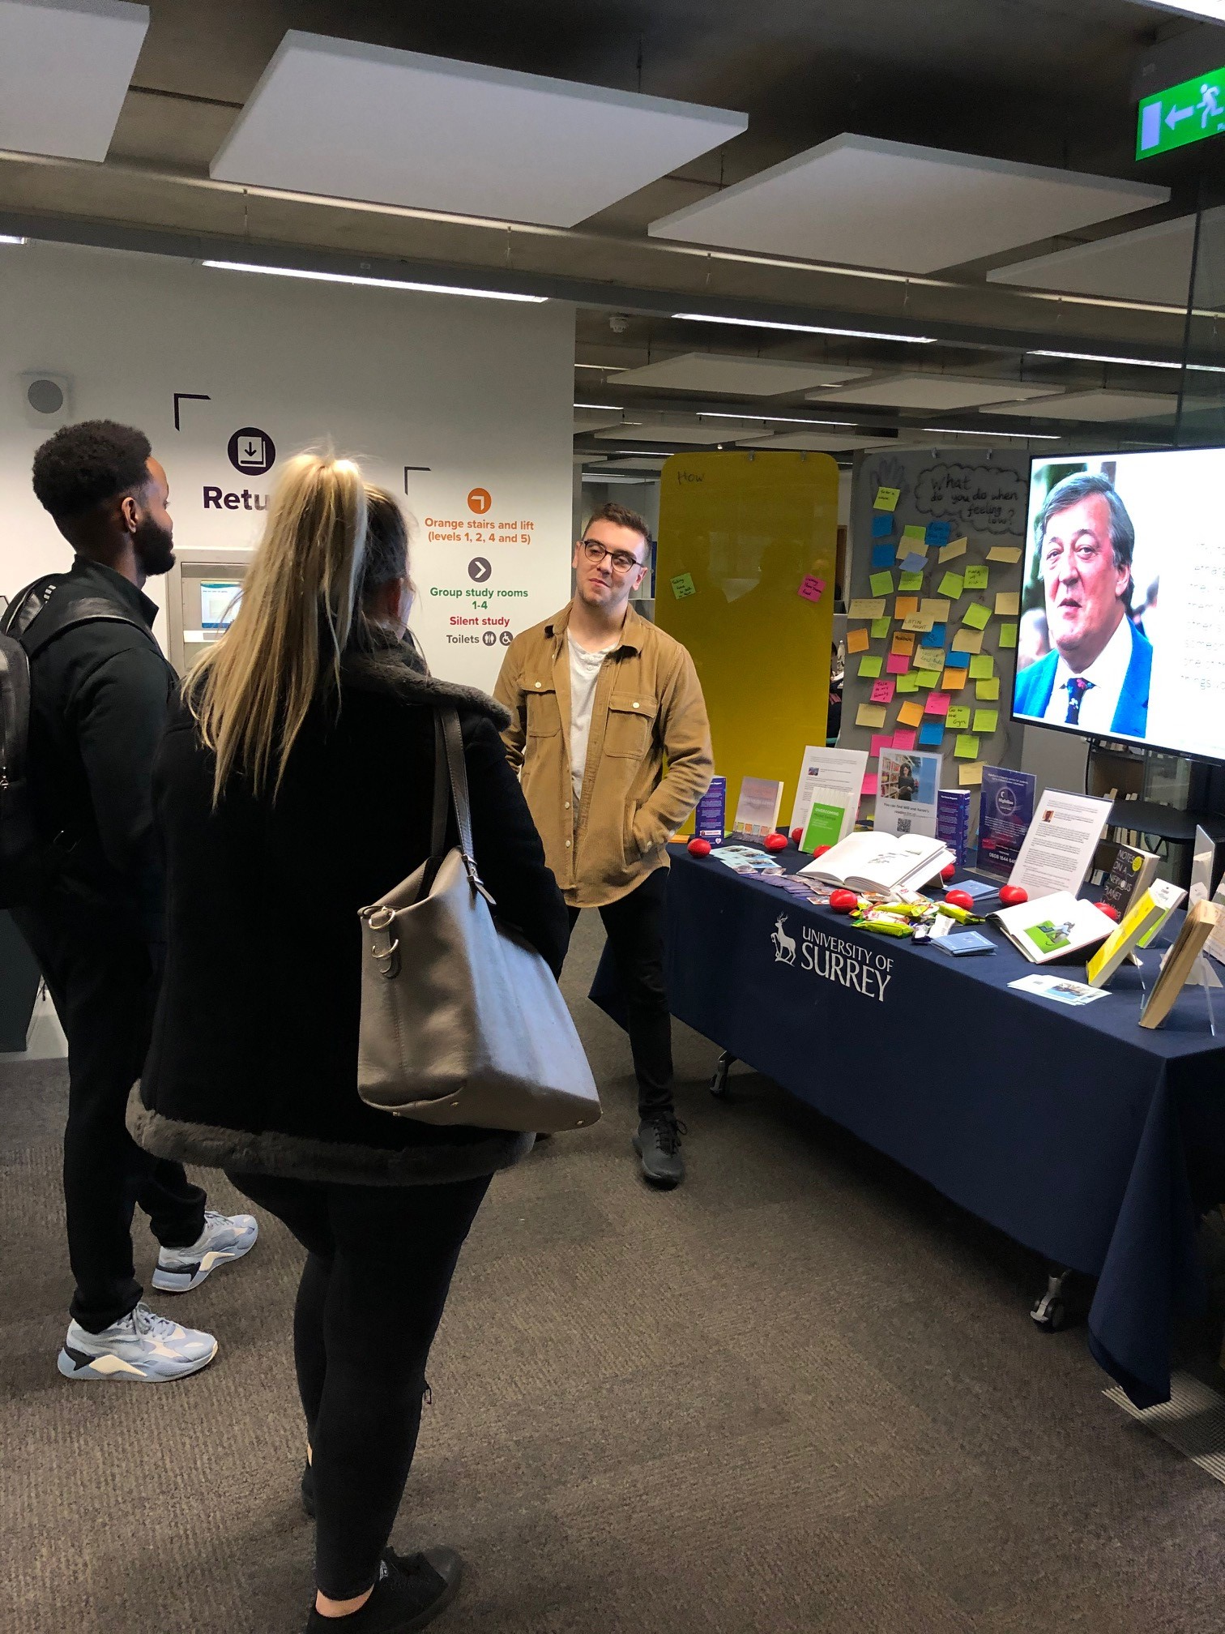
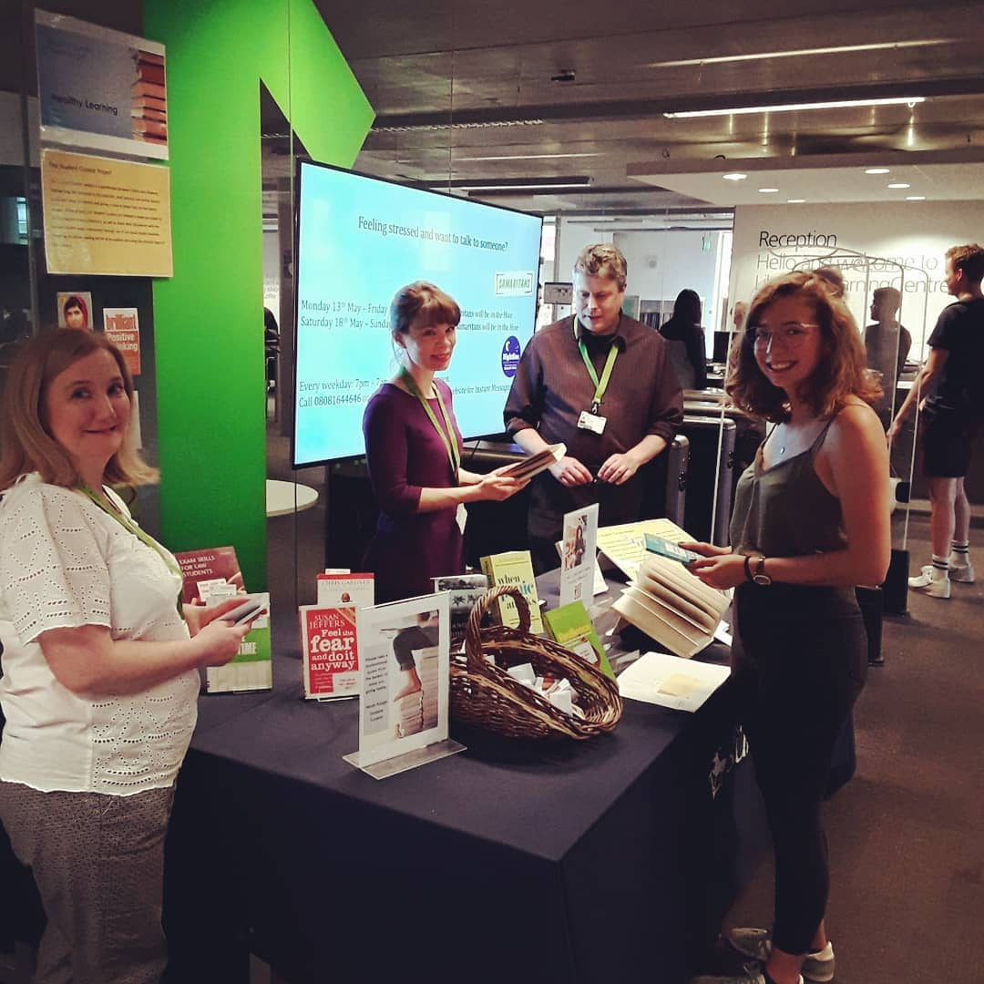
Collaboration with Faculty Engagement Librarians – Student Curator projects
Talking about mental health
Healthy learning
https://rl.talis.com/3/surrey/lists/E948126A-4A95-12EA-A2F3-1823EC03F8E5.html
https://rl.talis.com/3/surrey/lists/C94B6803-3EF7-3D0D-314B-77DA78CD6610.html
https://open.spotify.com/user/vnb1hnvr8ofsi9m842mr0svcf

Slide 15
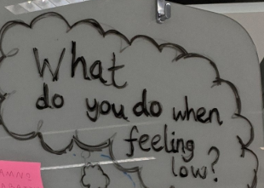
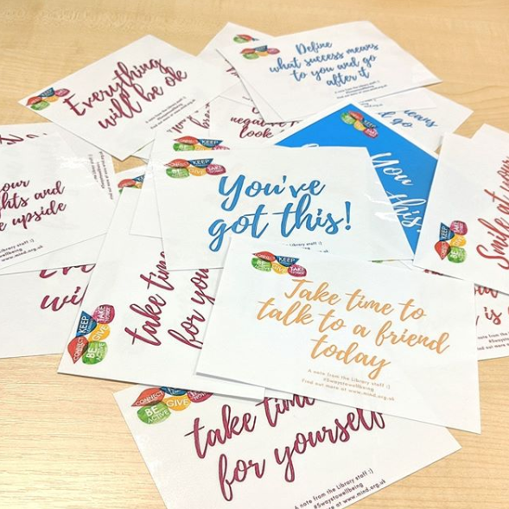
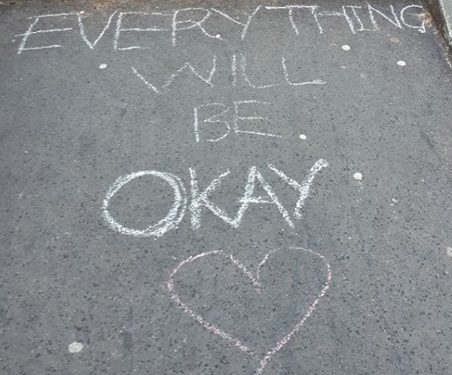
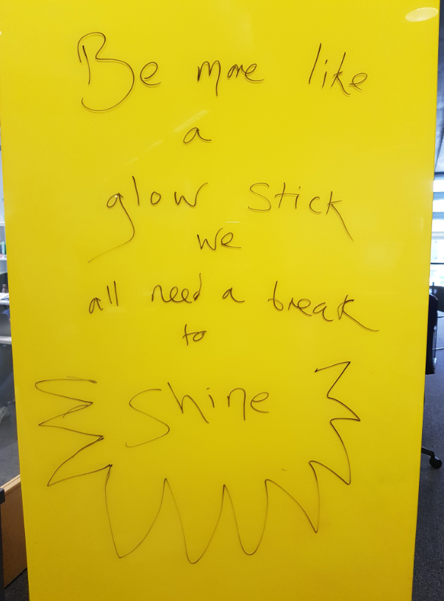
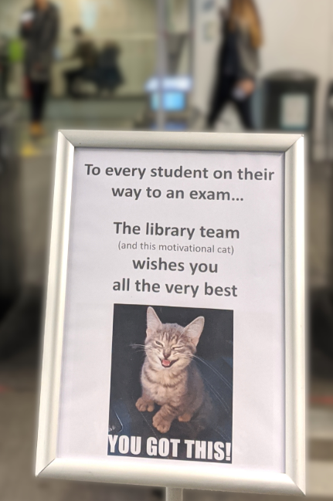
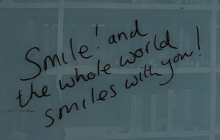
Inspiring messages - postcards, noticeboards, outside the building and social media #wellnesswednesday

Slide 16
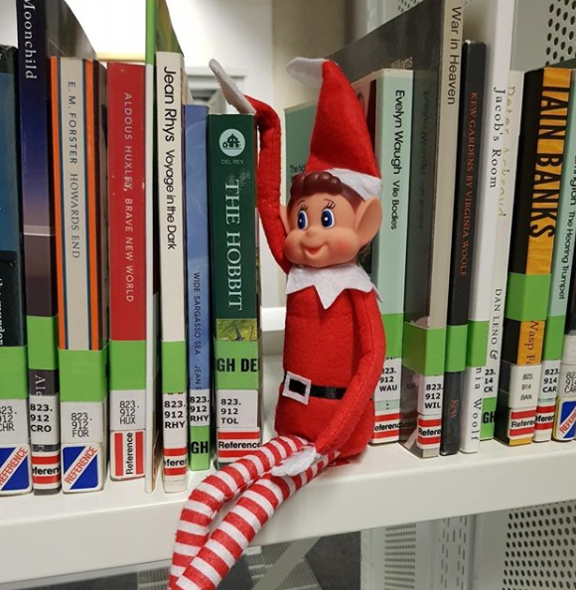
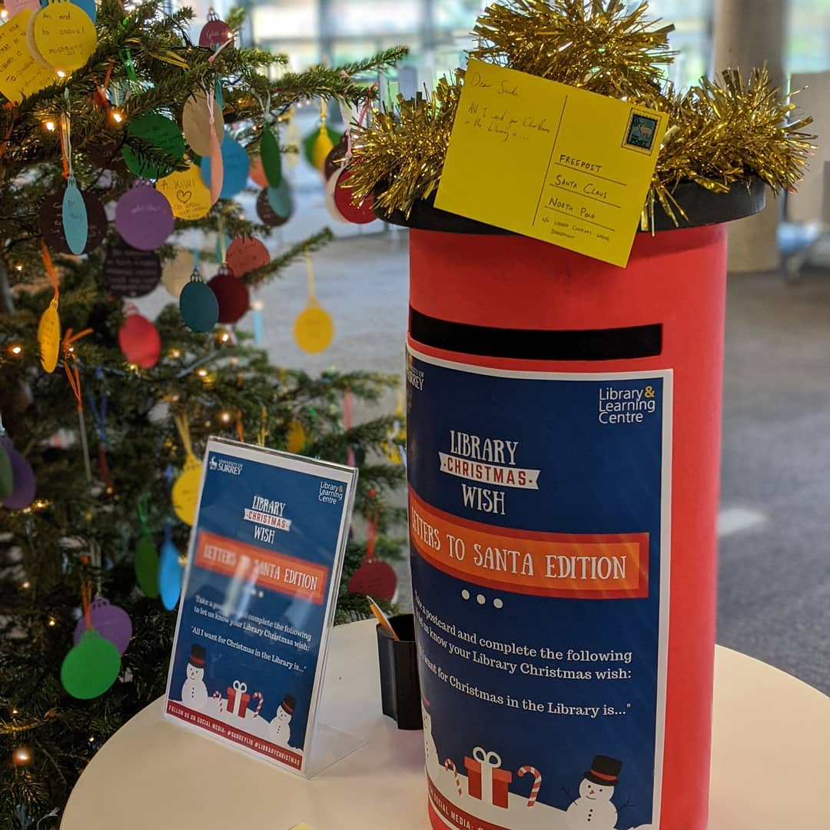
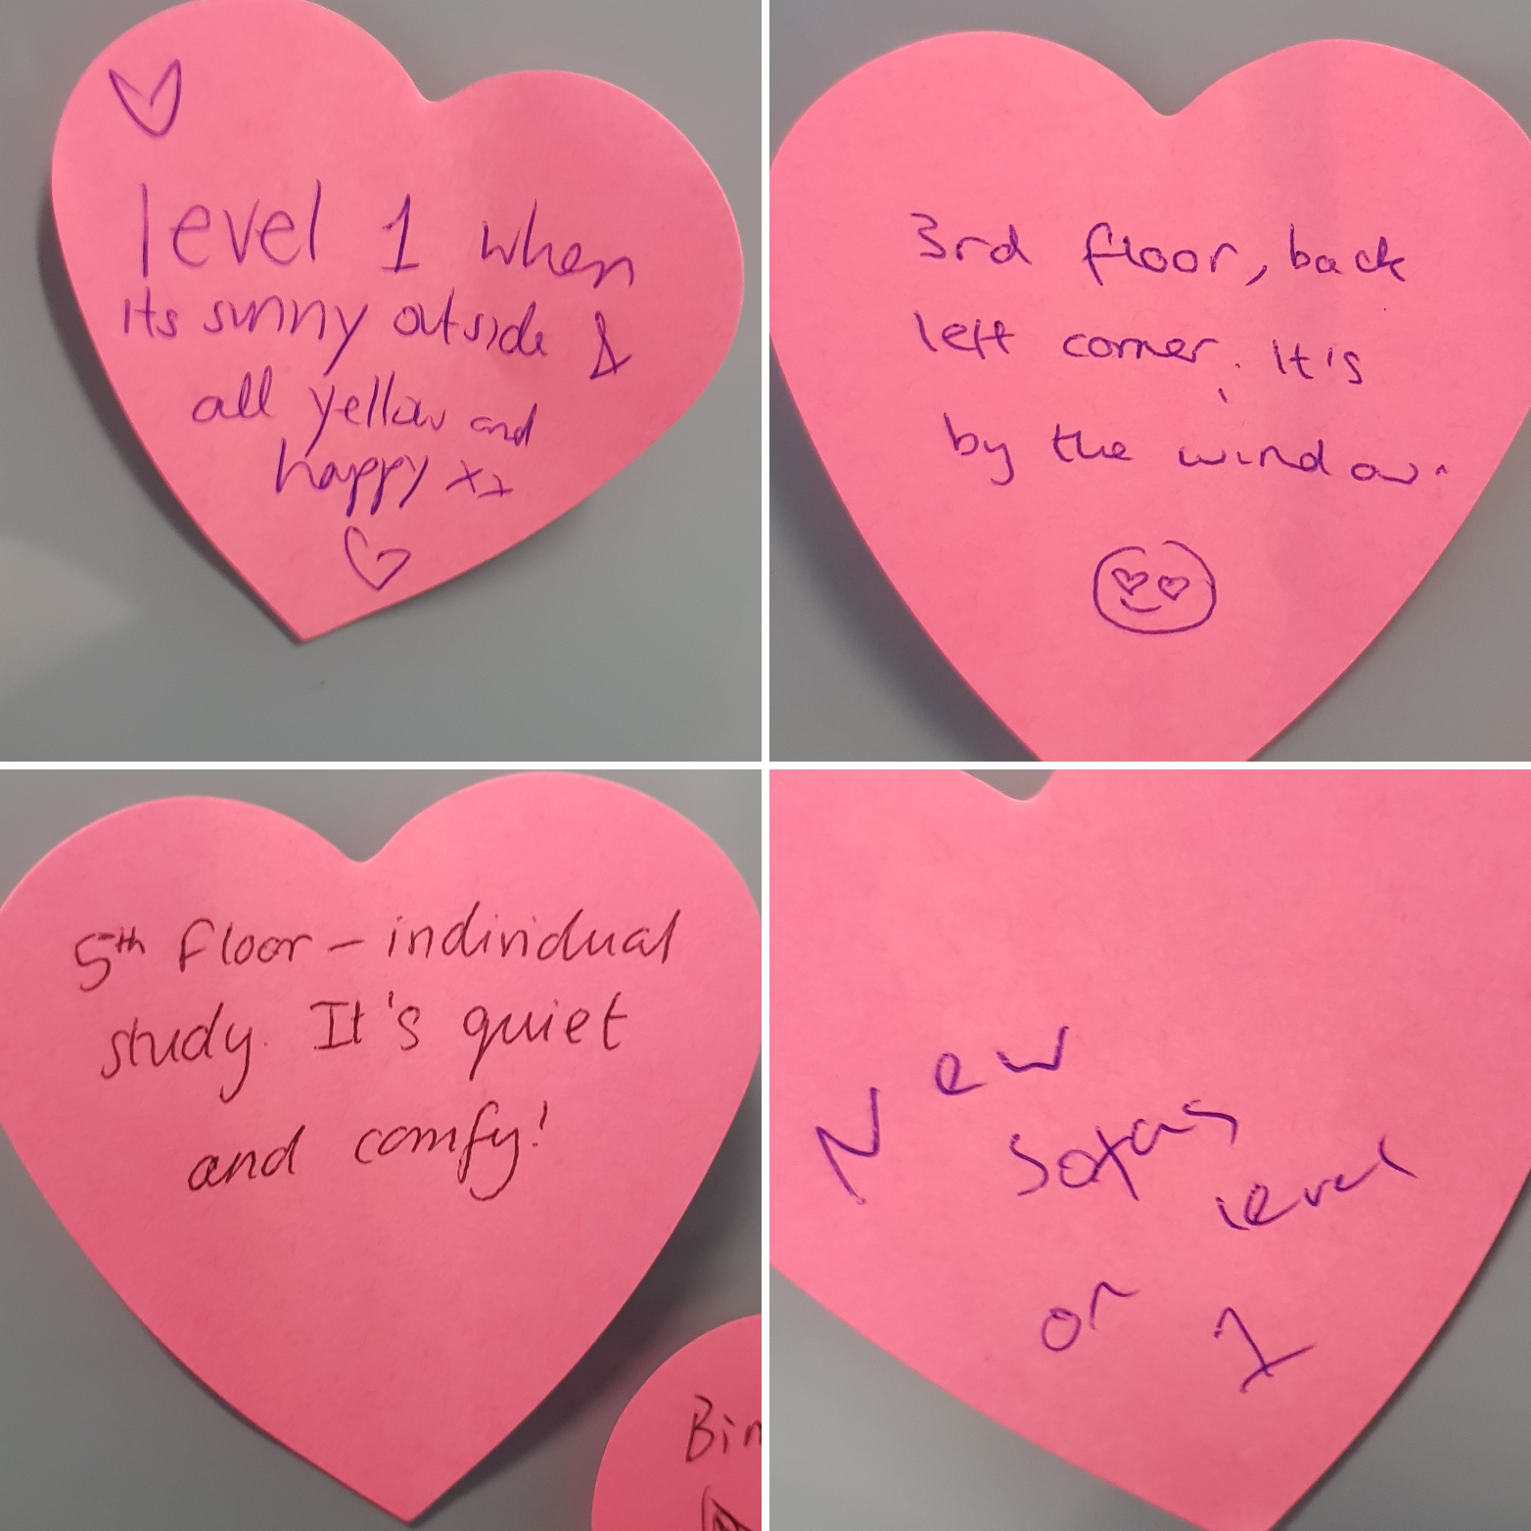
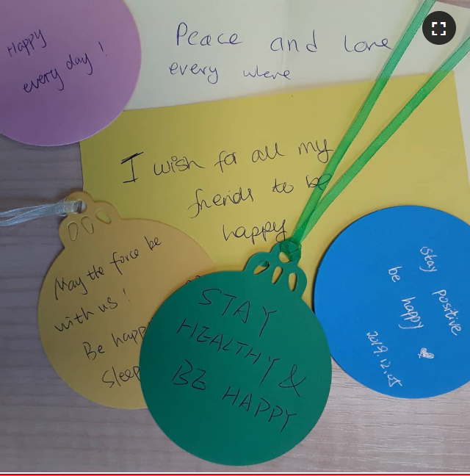
Engagement campaigns in the Library and on social media
#twelfdaysofchristmas
#LibraryChristmas - wishes and letters
#lovemylibrary

Slide 17
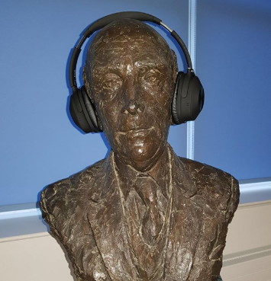
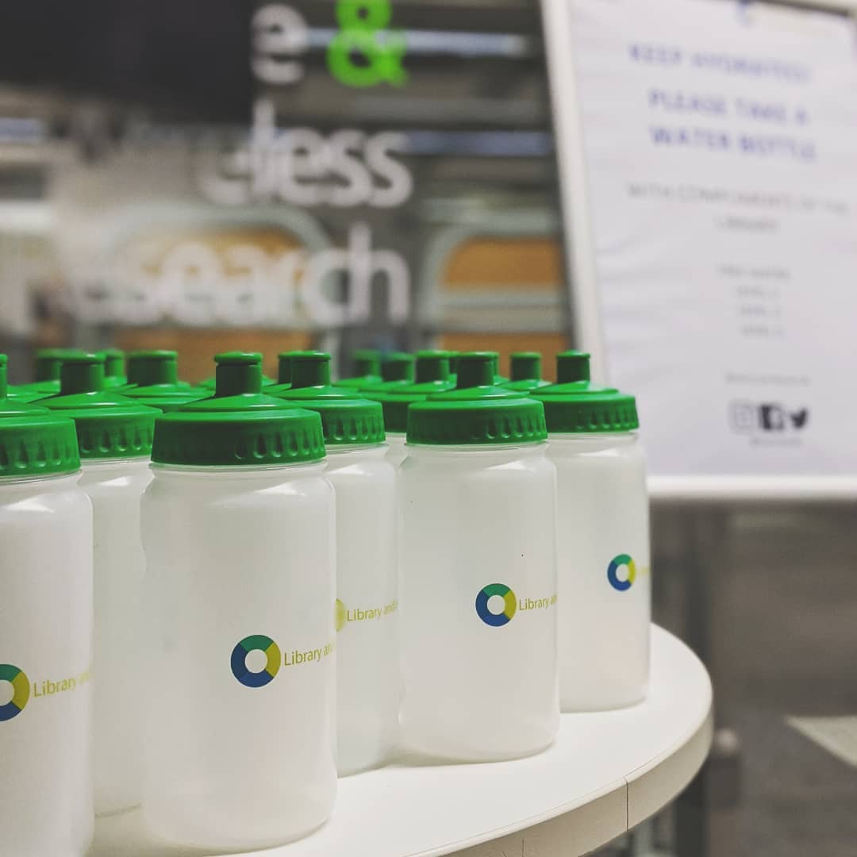
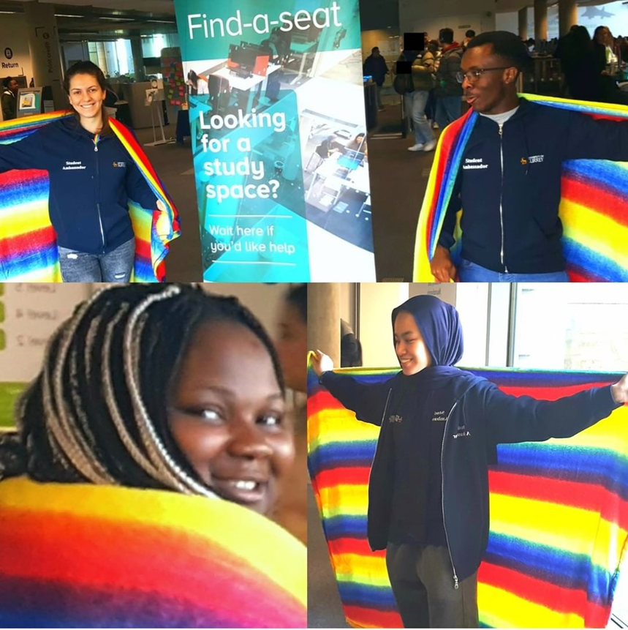
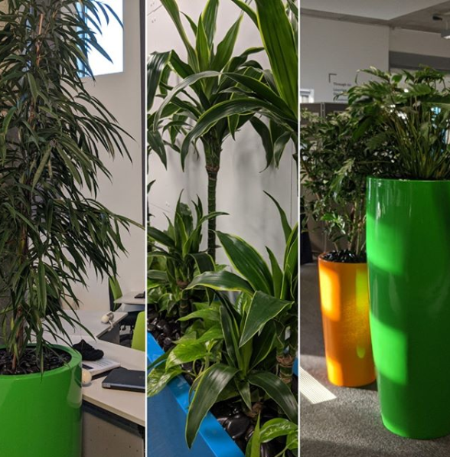
Latest initiatives
Noise cancelling headphones
Support from student ambassadors to
‘Find a Seat’
Library branded water bottles
Green plants in colourful pots
Cosy rainbow blankets
Notes:
: Instagram latest initiatives water bottles / bottles blankets headphones

Slide 18

Susan Hill
s.r.hill@surrey.ac.uk
Marion Lewis
m.lewis@surrey.ac.uk
Customer Services Advisors,
University Library

