Slide 1
#thatsbetter
The “I’m Taking a Break” Card Story (or how we managed exam season at Birkbeck)
John Mason & Tim Spring

Slide 2
What are we going to talk about?
Exploring the history of Birkbeck and the issues we face.
A look at some older campaigns we tried.
Designing the “Taking a break” card.
How we used the cards and social media.
Feedback and Questions.

Slide 3
Notes:
So, a Brief History of Time
About 15 billion years ago, the Big Bang caused the Universe to be formed,
which has been expanding at a rate of 42 miles per second ever since.
After about ten billion years, the Earth began to form.
Nothing much happened then – until November 1823 …

Slide 4
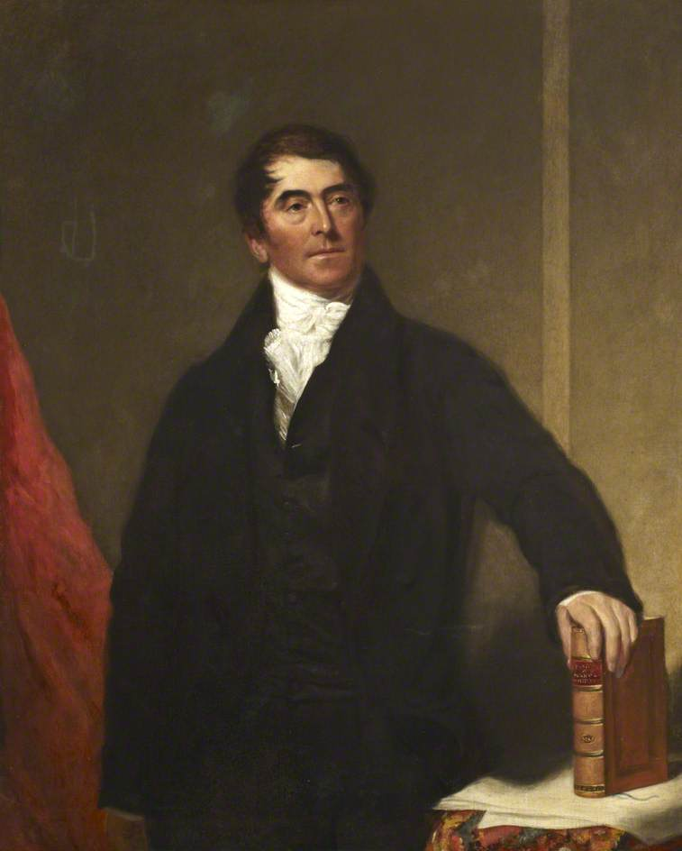
A Little Bit About Birkbeck…
Founded in 1823 by George Birkbeck.
Evening course specialists (and always have been).
Average student is considered ‘mature’ – 21-45 years old.
Notes:
A very quick history of Birkbeck – we were founded in 1823 as the London Mechanic’s Institute by George Birkbeck – an evening school for working people in London.
Incorporated to University of London by 1920 and have always been one of the only UK higher education institutions that specialise in evening education. This is still a big part of our identity today!

Slide 5
Notes:
Alexis Sanchez, the Manchester United and Chile forward
Birkbeck Library Communications & Marketing Group
One gets a rumoured three hundred thousand pounds a week – the other Nil
No budget means “Comms” – as we call them – has historically had to produce publicity and information materials in-house
And to scale our ambitions accordingly.
However, small flowers crack concrete, as the phrase goes
We do manage to progress and develop though
And we also always run what is known as an Etiquette Campaign – focussing on acceptable behaviour
This runs each examtime, which – as you know – can be a particularly fraught and tense time for library users, particularly at Birkbeck, given its unique status.

Slide 6
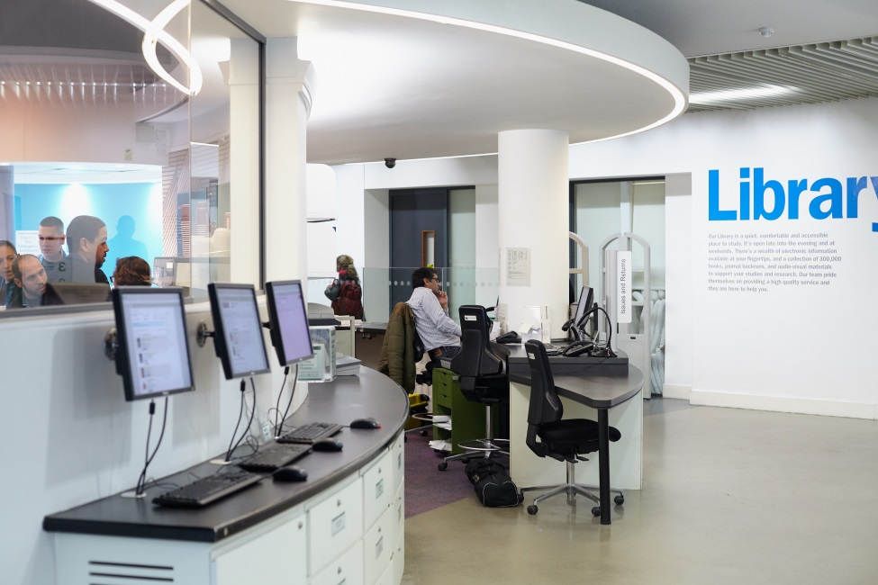
Statistics and the Library
Birkbeck has approx. 9,000 students (and 6,000 external users)
The library has 452 study spaces available.
Approximately 1,100 visits per day
Notes:
as a result of being an evening university we have a unique demographic and also face some unique challenges:
Our student base is mostly mature students ranging between the ages of 21-45 – this includes lots of people who for reasons such as work would not normally be able to attend a traditional university.
The downside to this is we often see a rush to use the library between 4 and 6 – e.g. the time between finishing work and attending classes.
Library has 452 study spaces for 9,000 students (and 6,000 external users such as alumni, other students) with approx. 1100 visits per day – not much space for quite a lot of people.
There is a constant issue and pressure at Birkbeck to provide adequate space for students this is especially so during exam time when study space demands are higher than usual.

Slide 7
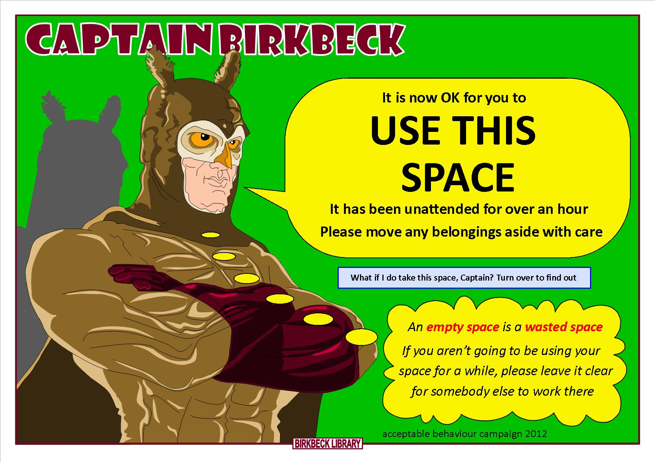
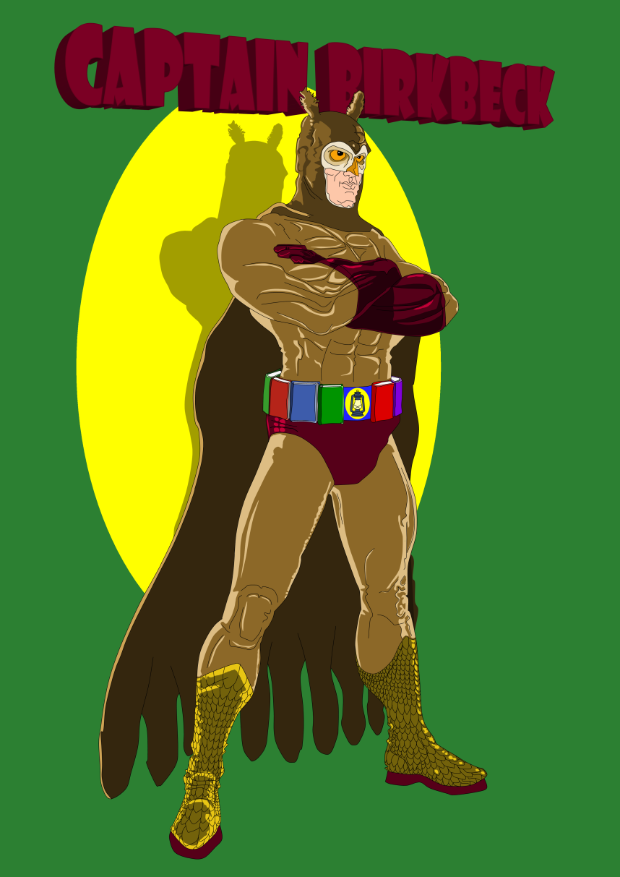
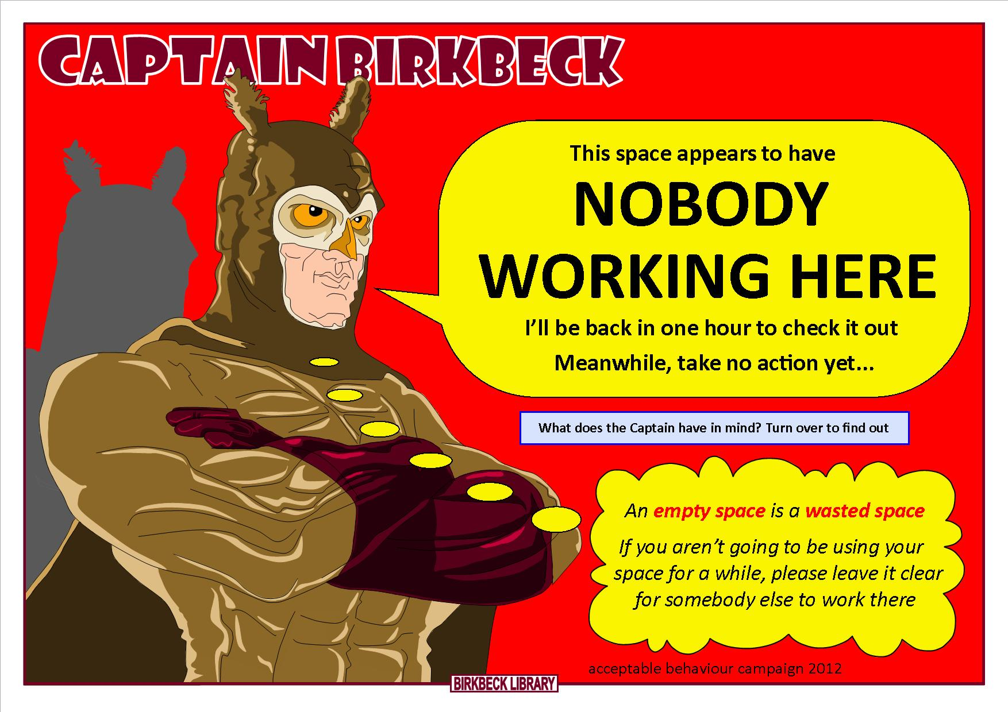
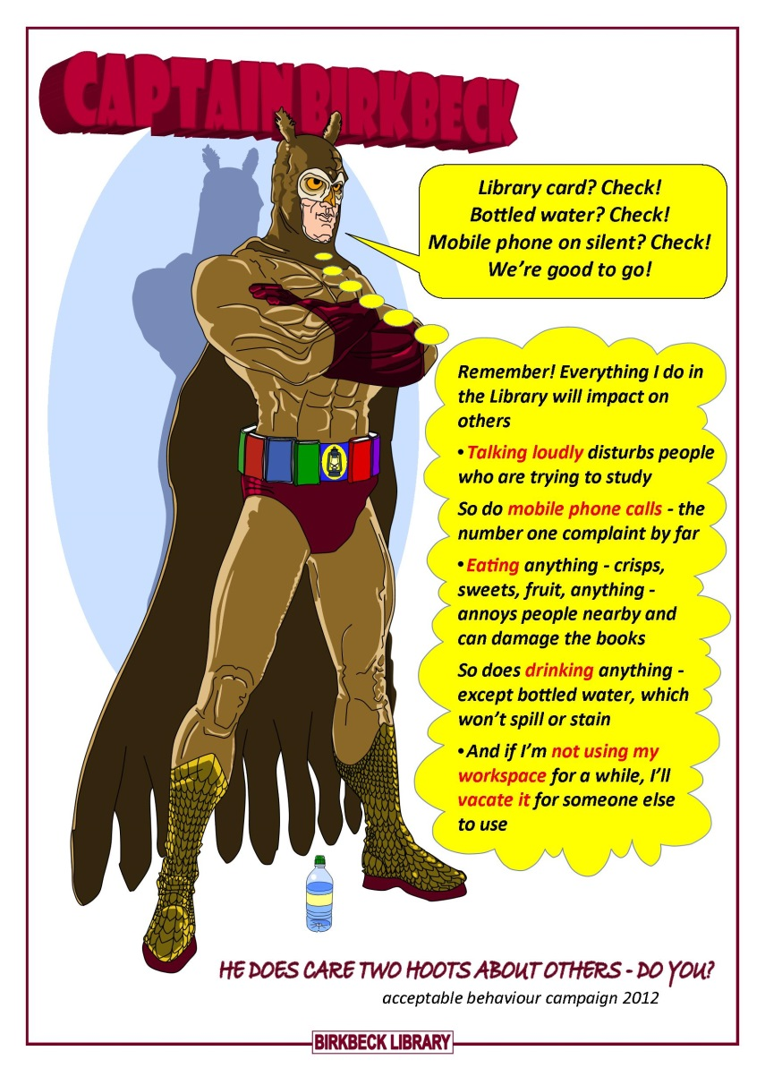
Campaigns from the Past
Notes:
in 2012, Comms heard that another library had run a campaign using a cartoon character
So this fellow was created
Captain Birkbeck
You have to know that the Birkbeck symbol is an owl and the corporate colour burgundy
This was the first addressing of space-hogging, a source of many complaints at examtime
We get especially busy after four, which is exacerbated at examtime with our limited capacity
So we made these laminated A4 cards in red and green versions
Members of staff would patrol looking for spaces empty but saved by belongings
And place the cards there
Red was for we’re aware this user is away but do nothing yet
With a reverse side too
Green was for It’s OK to now take this space – over an hour later
This is the A4 flyer
We’ve come on a long way from this early effort
Experience has shown – Don’t use more words than you have to
These do
Mixed reactions to this campaign but it showed users we were actively addressing a perceived problem
But it did create its own problems
It involved touching other people’s property

Slide 8
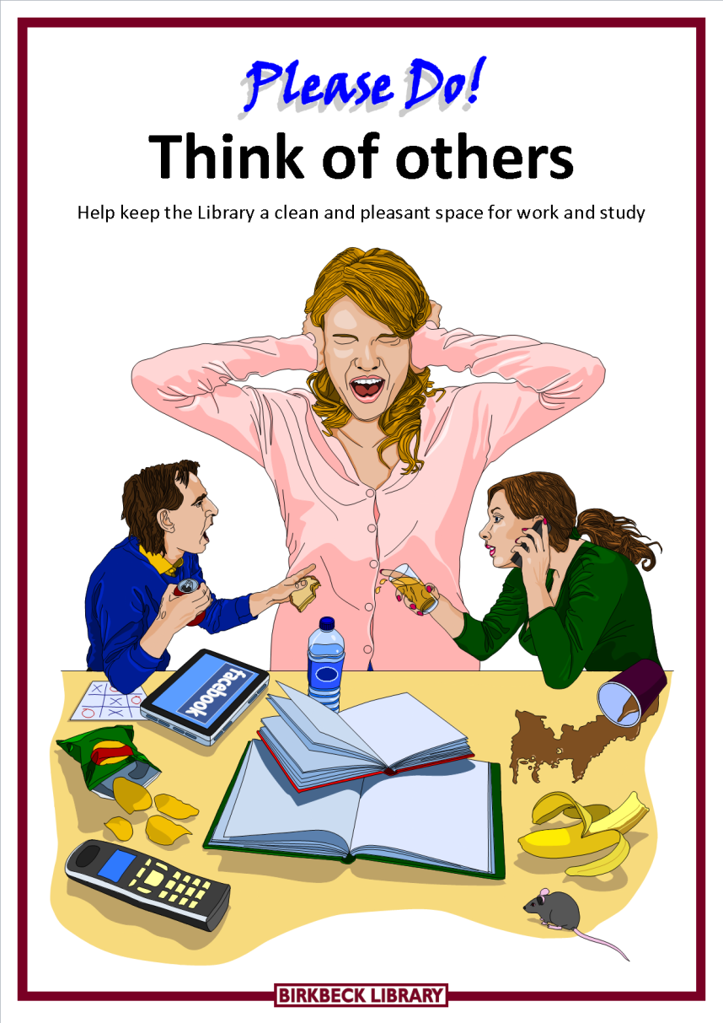
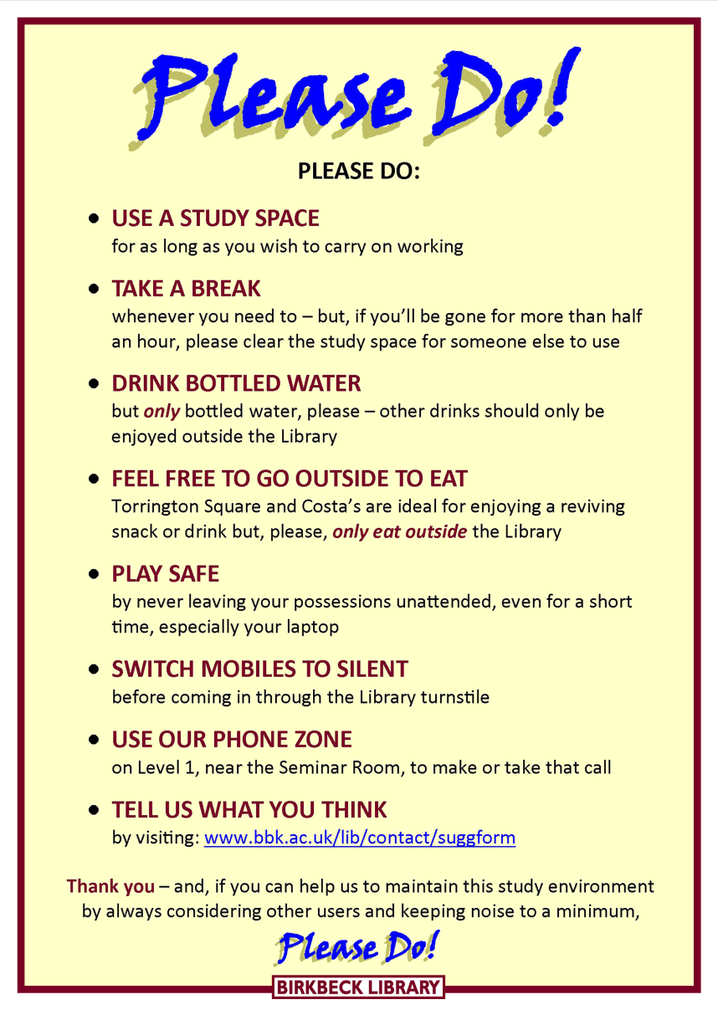
Campaigns from the Past II
Notes:
2014 featured the Pink Madonna
Followed on from Captain BBK, we had the ‘Please Do!’ Campaign
The idea here was to use positive language, excluding phrases like DON’T, CAN’T, NOT, ETC. and instead focus on what you CAN do.
You can see on the reverse side of this card, it’s got some pretty common rules and etiquette we ask our students to follow but put in a more positive, friendly way.
(For any design aficionados out there, this is how it was created. The original idea came from another library (UCL?) but credit to John for his modelling and artistic skills on our own campaign.
A few things changed after this campaign...
First, we started looking at accessibility issues, ensuring we complied as fully as possible
Guidelines for this included left-aligning text not centred, no italics, no all caps text, friendly fonts and so on
We also had to deal with the handy redesign of Birkbeck College’s Visual Identity – this is when the Library’s “corporate colour” became green (just like the slides. Very clever of us).
This meant changing a lot of signage in the library and also had to be considered for future campaigns we ran. A big task but this finally brings us on to the Taking a Break Card…

Slide 9
I’m Taking a Break Cards
Notes:
By the time we get to this campaign the Comms group had gained enough recognition to at least access funds – still no actual budget
This meant we could now use a commercial printer to produce these cards
This was important as we wanted this to look “proper”, as it were, something people would want to use
They could also supply it in a heavyweight paper that would stand up
We still do a lot of our material in-house
But thanks to funding we can now use 160gsm paper for material
This means flyers and leaflets don’t flop over in the perspex stands
It’s off-white so it’s more accessible
And it feels classier
Back at the I’m Taking A Break card
This came from an original idea by Bristol University, which we again borrowed
This approach turned the emphasis from us policing space-hogging to one of getting the user to engage and to show they were willing to share fairly
We tinkered with the green we’d been given to make it cleaner, brighter and more friendly
Compare the two greens in the slide
We fixed on thirty minutes allowed
We anticipated some liberty-taking
Thus an hour could easily become ninety minutes
Less than thirty minutes wouldn’t be enough
The user simply writes in what time they left
Rather than when they’re due back
As it’s more easily verifiable

Slide 10
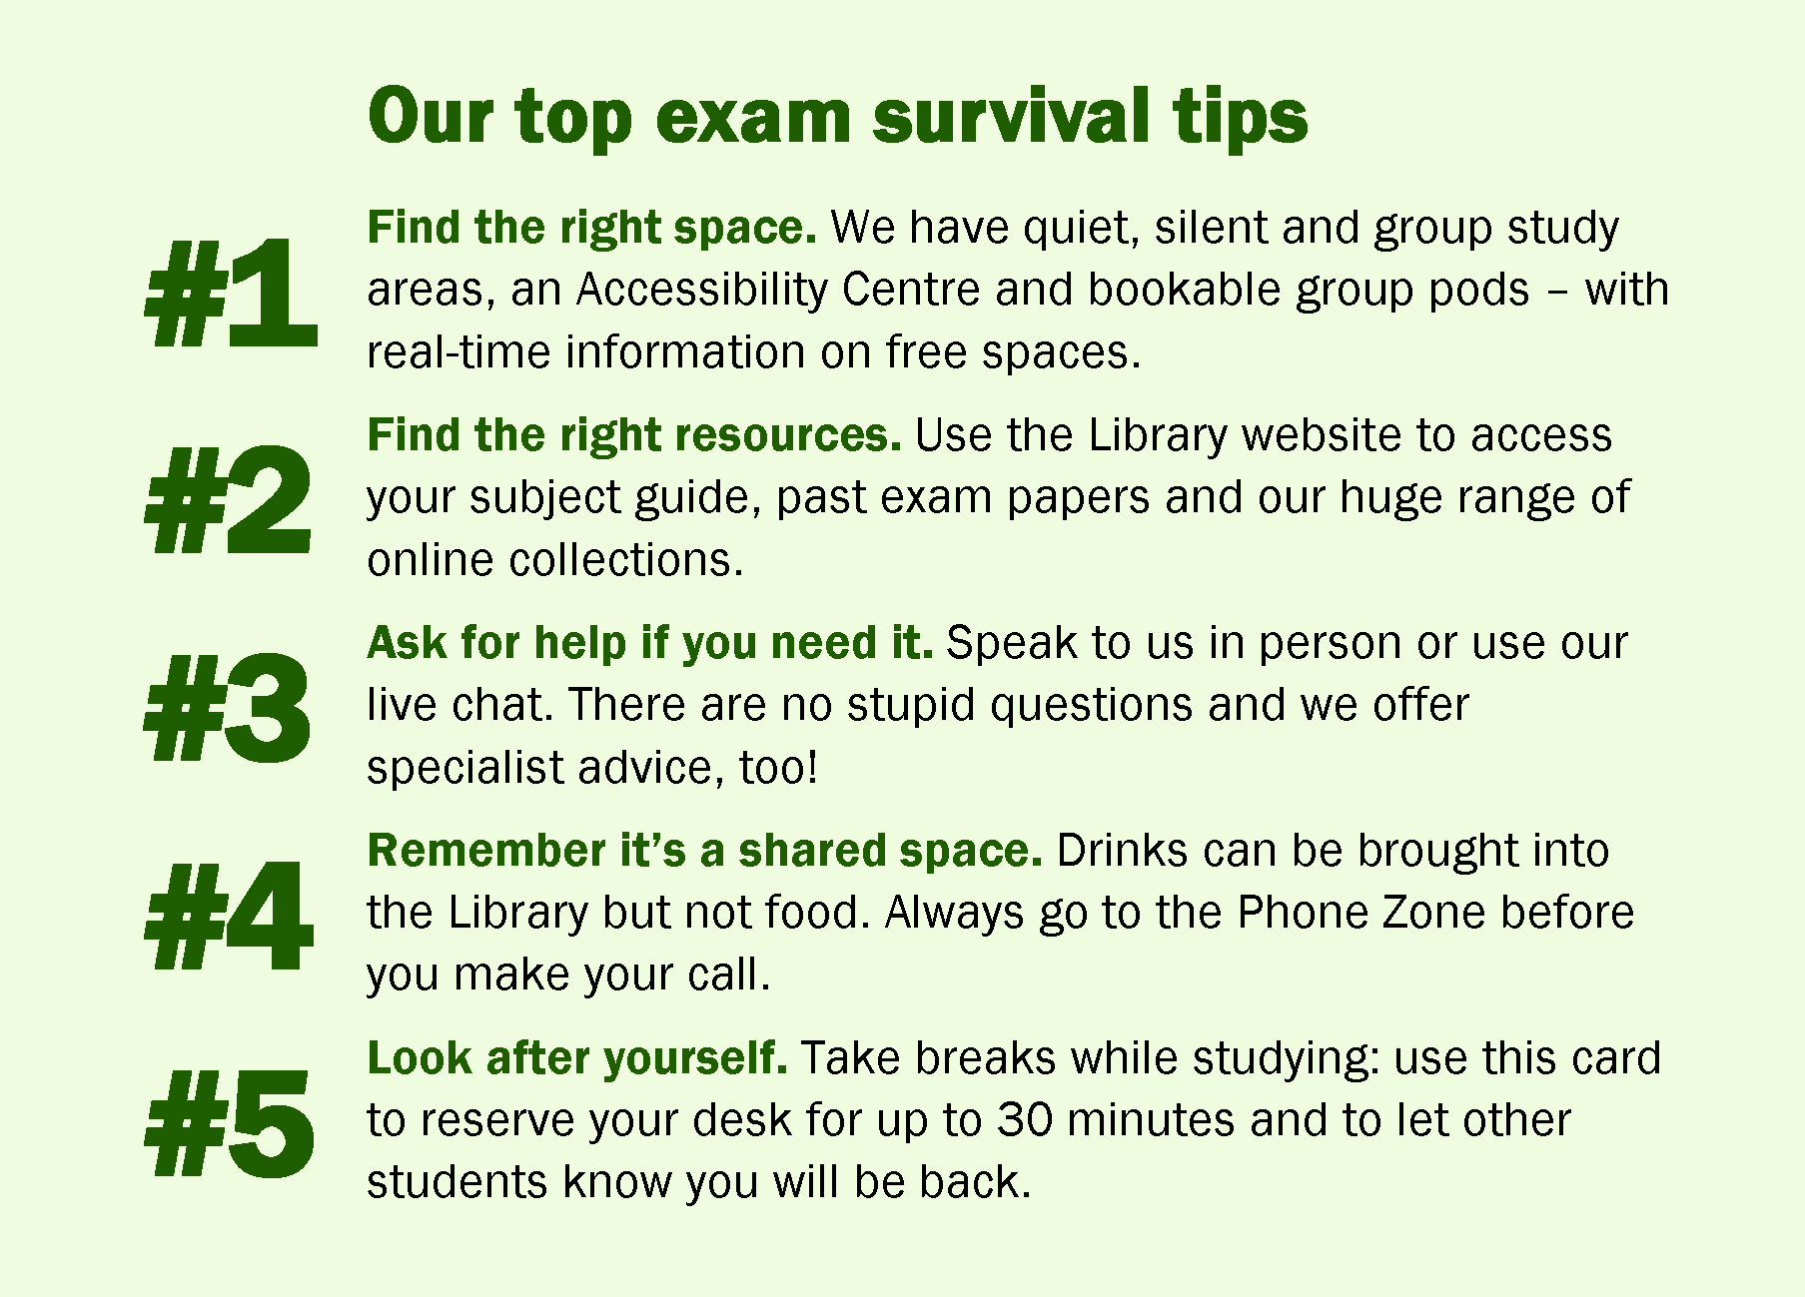
Exam and Study Tips
Notes:
On the back of the card, we listed some ‘exam survival tips’.
Had a mix of tips that we thought people new and old to the library might find helpful.
E.g. the first tip explains the different type of study areas we have available.
Other tips too such as a reminder to speak to the staff if people need help – this tied in with a roving campaign we ran during this period, with staff being available throughout the library during peak hours not just at the help desks.
Also have examples of rule enforcement such as no food or phones in the main library.
Finally, just a bit of a reminder to actually look after yourself. Treat yourself to a break sometimes!
We also tied some of these tips in to our social media accounts which I’ll come to shortly…

Slide 11
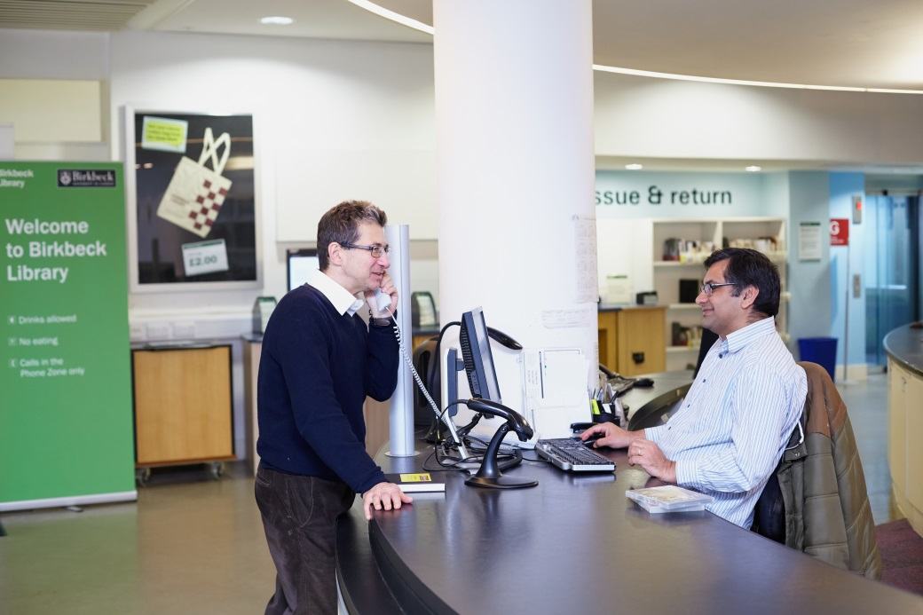
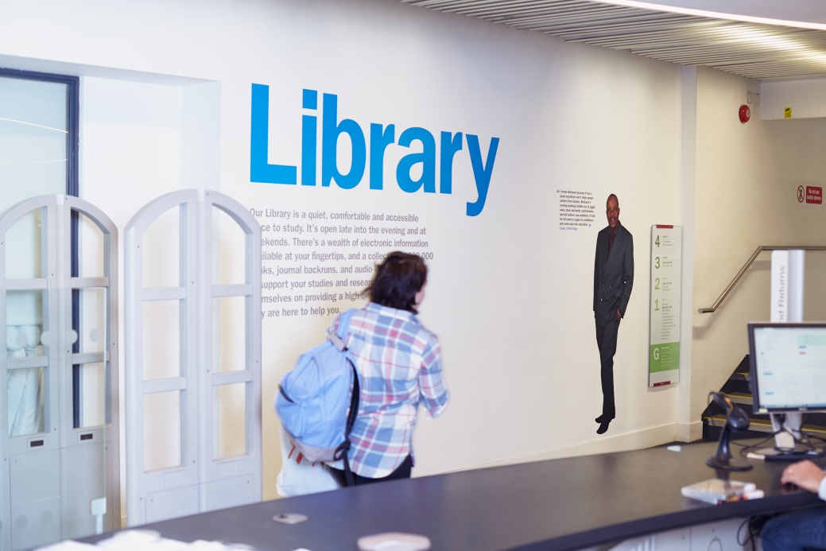
Implementing the Cards
The cards costed £418 in total to make.
Notes:
Cards cost us £418 to get printed (approx. £200 both times we got them printed).
Quality of the cards was pretty good actually and people would even return them if they didn’t use them.
Our admission desk is a looooong desk with lots of empty space. We basically filled this desk up with cards and a big display of these lime green cards when you come in to the library stood out quite a lot.
This encouraged people to grab a card on their way in and also let us engage with people about it if they stopped to have a look (e.g. answer questions, explain why we have them).

Slide 12
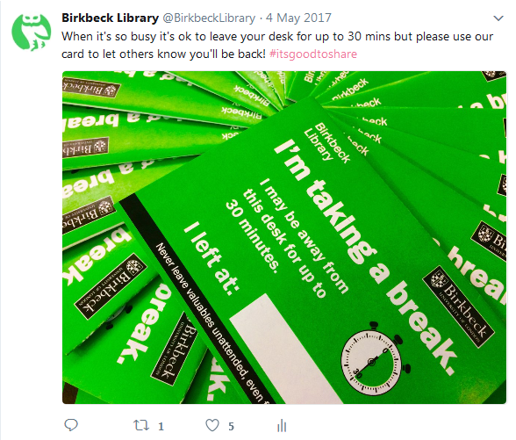
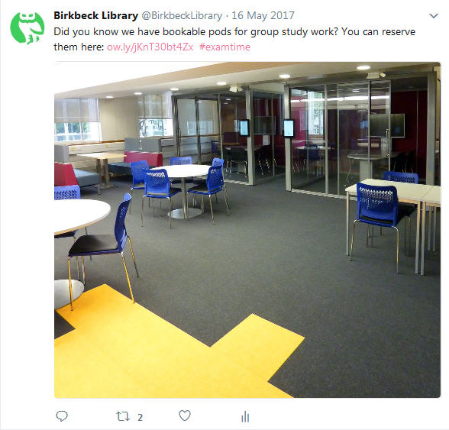
Social Media
Notes:
With our tips in mind, we also tied this in to our social media.
We have a Facebook and Twitter account (@BirkbeckLibrary) with approx. 4000 followers (do follow us…).
Used tags such as #examtime #therightstuff and #thatsbetter (like the title…) to promote the campaign (more of that shortly).
Tweeted a few times a day with tips for the library or useful links such as subject guides, room and study space booking, etc.

Slide 13
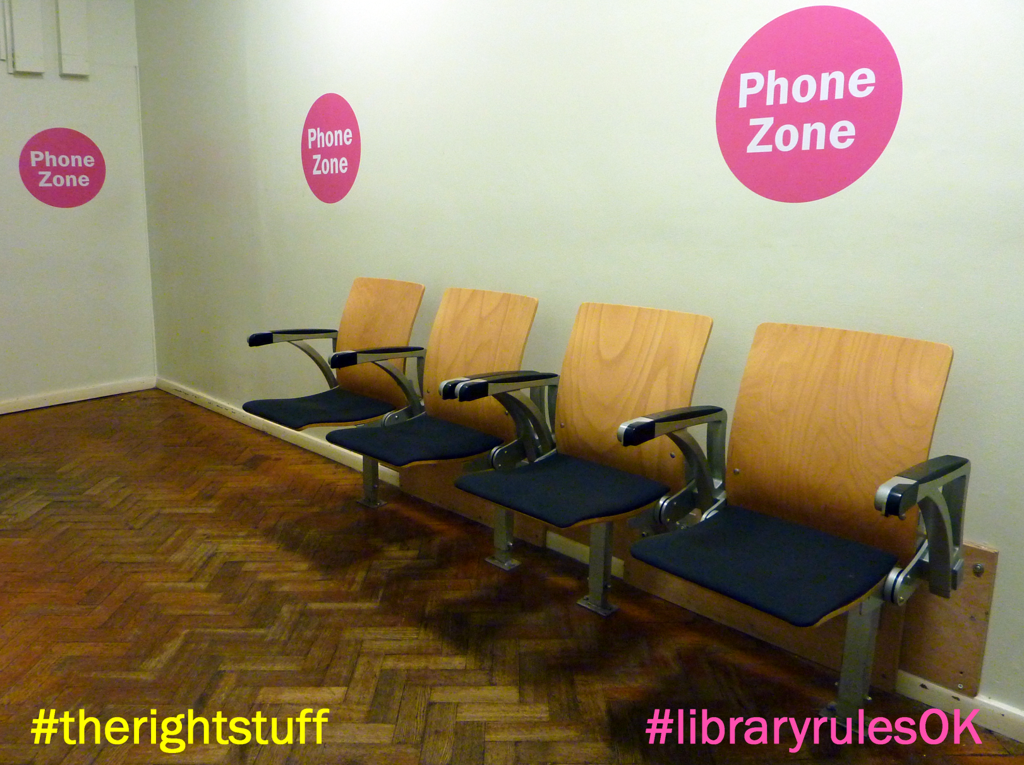
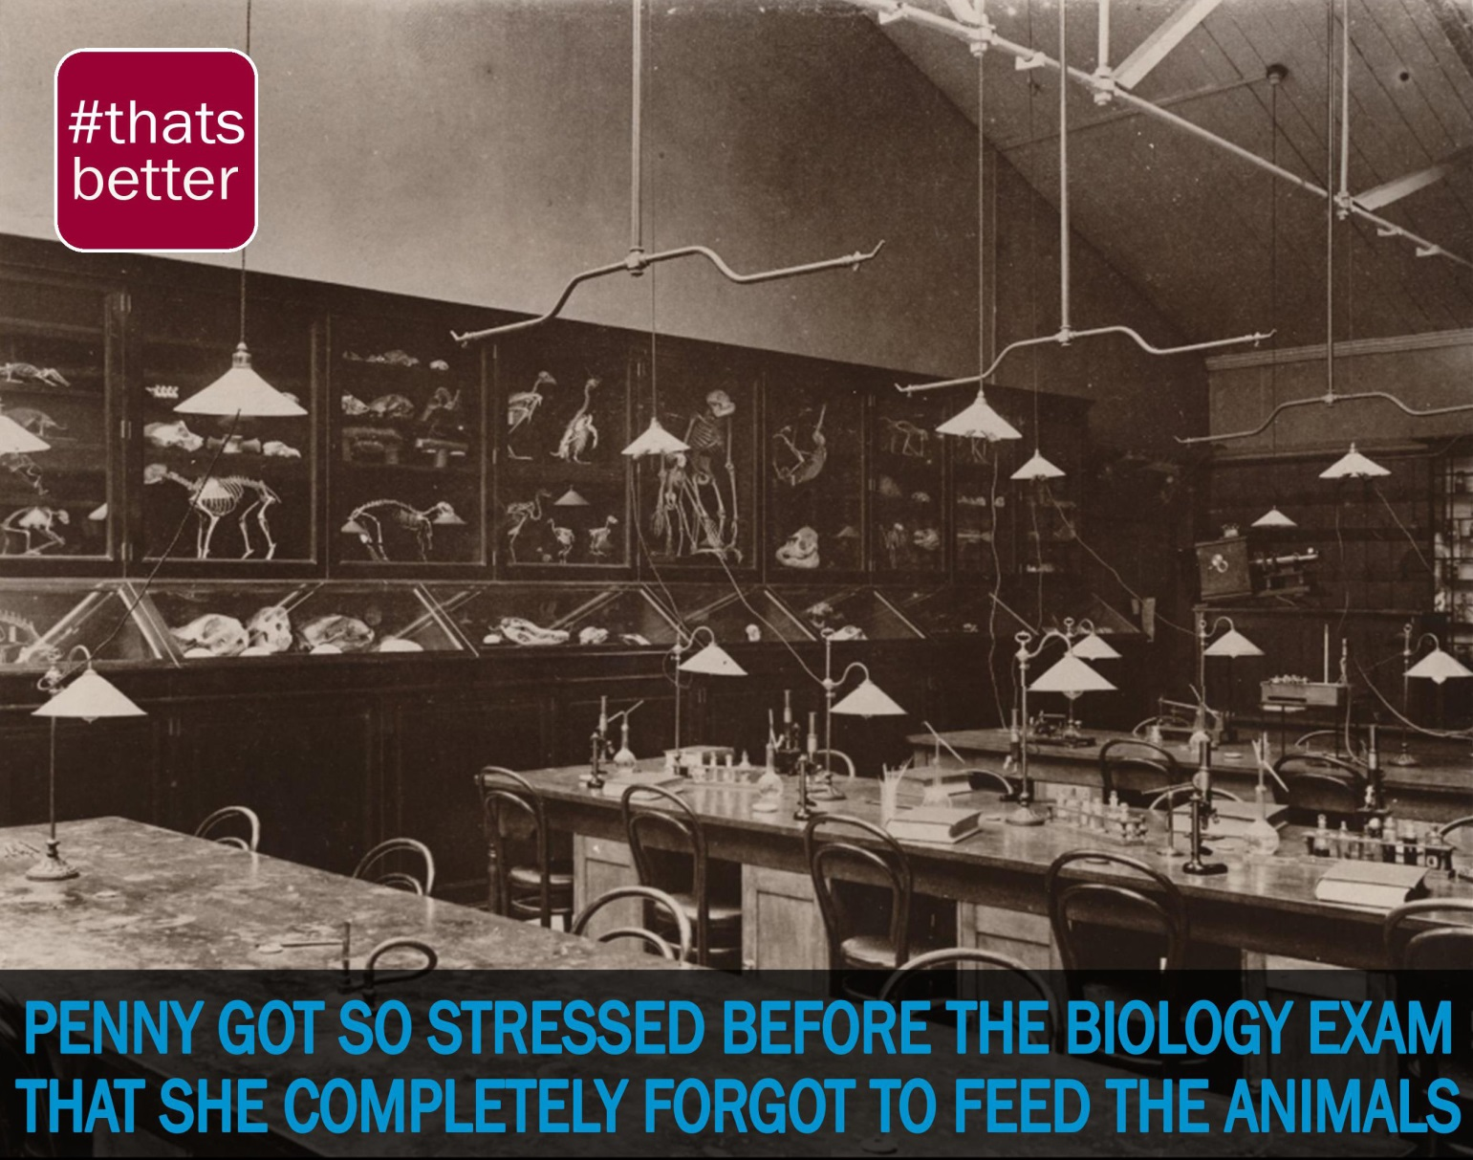
Social Media
Notes:
We use various hashtags to tie in with different campaigns
#thatsbetter – improvements we’ve made, later used by Asda
An early one also highlighting the Birkbeck Library picture collection that users can access via our website
#therightstuff highlights facilities we provide, like our Phone Zone
#libraryrulesok – reinforcing rules for behaviour, such as going to the Phone Zone before making your call
A very early one – non-accessible with capitals and shadow!
Tied in with a Science Week campaign
Showing these things can be fun too

Slide 14
Results, Impact, Feedback, etc.
Good feedback in person from students.
Multiple batches reprinted due to popularity.
Requests to bring the scheme back after the exam period too.
Notes:
We didn’t get exact quantitative feedback such as a survey but there was a notable impact on the library. We had a lot of demand for these cards and had to get a second batch reprinted.
We also received a lot of good verbal feedback in person, with lots of students saying they thought it was a good idea and appreciating that we were trying to address the problem.
There were also requests for the cards after the exam period was over as people liked the idea and wanted it to continue.
On top of this, we have also made plans now to bring this campaign back for the 2018 season.

Slide 15
Any Questions?

