Slide 1
Sensory Study at the Library
‘Inspired ideas from the sharp end’ CSG UK
Wednesday 27th February 2019- University of Leicester

Slide 2
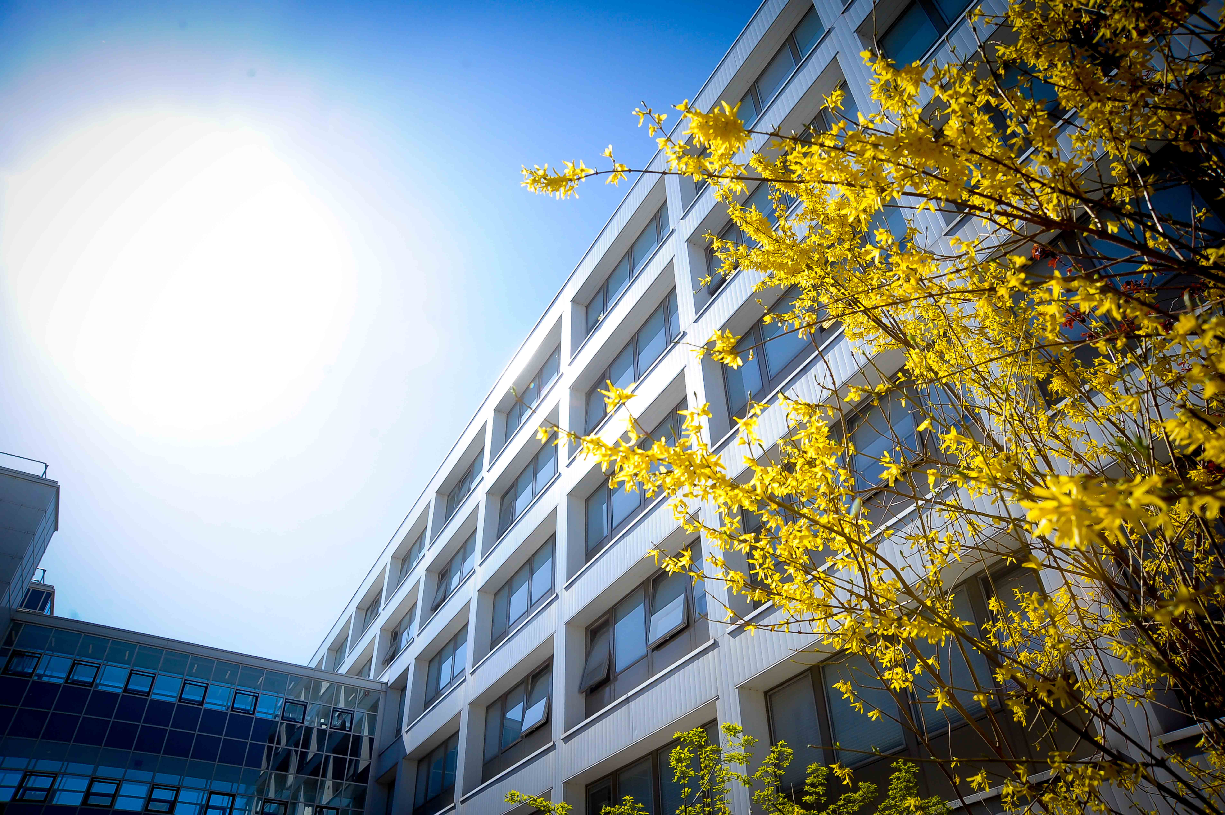
Background
Library Disability Support Officer post created in response to government DSA cuts.
Remit included development of the physical library space, including our Accessible Study Rooms.
Accessible Study Rooms are individual study rooms bookable by students registered with the University’s Disability Services.
Attendance of CSG UK 2016 Annual Conference.
“Equipping customer services staff to provide accessible and inclusive services”

Slide 3
Accessible Study Room- Before
Busy carpets
White or bright blue walls
White desks
Fluorescent lighting (automatic in some rooms)
Noticeboards behind the desks
Poor student feedback

Slide 4
After
Wood finish desks
Plain charcoal carpets
Pale soft coloured walls
Mead Gallery art installations
Double screens
Fully dimmable LED lighting and lamps
Soft seating recovered
New signage designed by central marketing

Slide 5
What else can we do?
Equality Challenge Unit- ‘Sensory Access in Higher Education,’ Guidance Report 2009. (5.13 Recommendations: estates managers)
‘’Designate a sensory/quiet room for students on the autistic spectrum and those with sensory impairments. This quiet space might assist students to overcome any anxiety that their surroundings may be causing them.’’
http://www.ecu.ac.uk/wp-content/uploads/external/Sensory-access-in-higher-education-guidance.pdf

Slide 6
The Sensory Study Room Before
Low usage numbers
On quiet floor
Consultations across departments
DSSD
(Library IT)
Disability Services
Students Union

Slide 8
Sensory Study Room
Seating: rocking chair, bean bag, soft seating, wobble cushion
Lighting: coloured LED strip lighting, bubble tube, colour changing lamp
Sensory/relaxation music
Yoga mat
Sensory objects and aroma cubes
Ear defenders

Slide 9
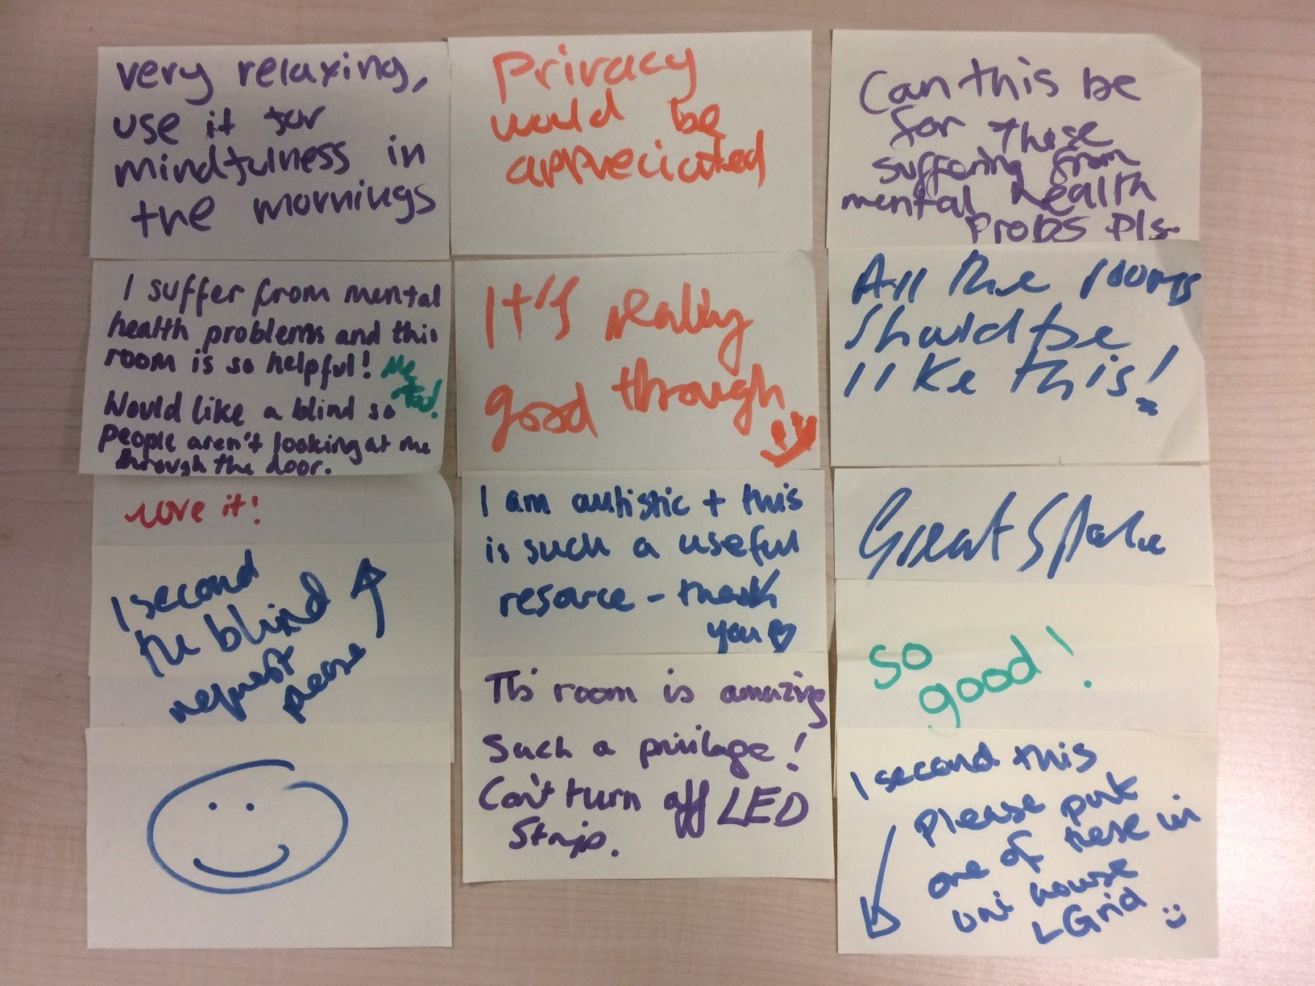
Very relaxing, use it for mindfulness in the mornings
Privacy would be appreciated
All the rooms should be like this!
I am autistic and this is such a useful resource- thank you

Slide 10
Sensory Study Room 2….
What works well?
What could be improved?
Student feedback?

Slide 11
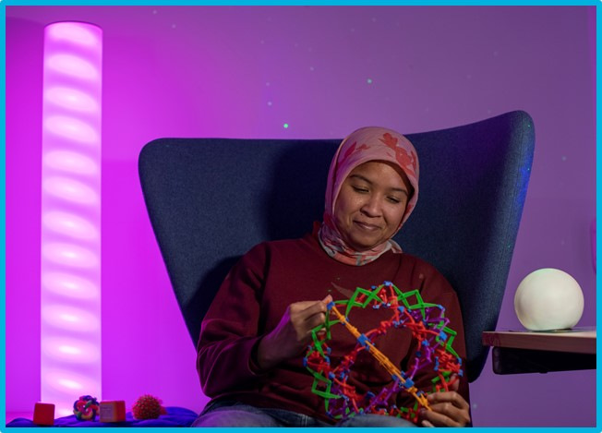
“My most productive hours are those I spend in those rooms all by myself. Once I switch on a star projector, I feel like I can do anything,”
Student quote, November 2018.

Slide 12
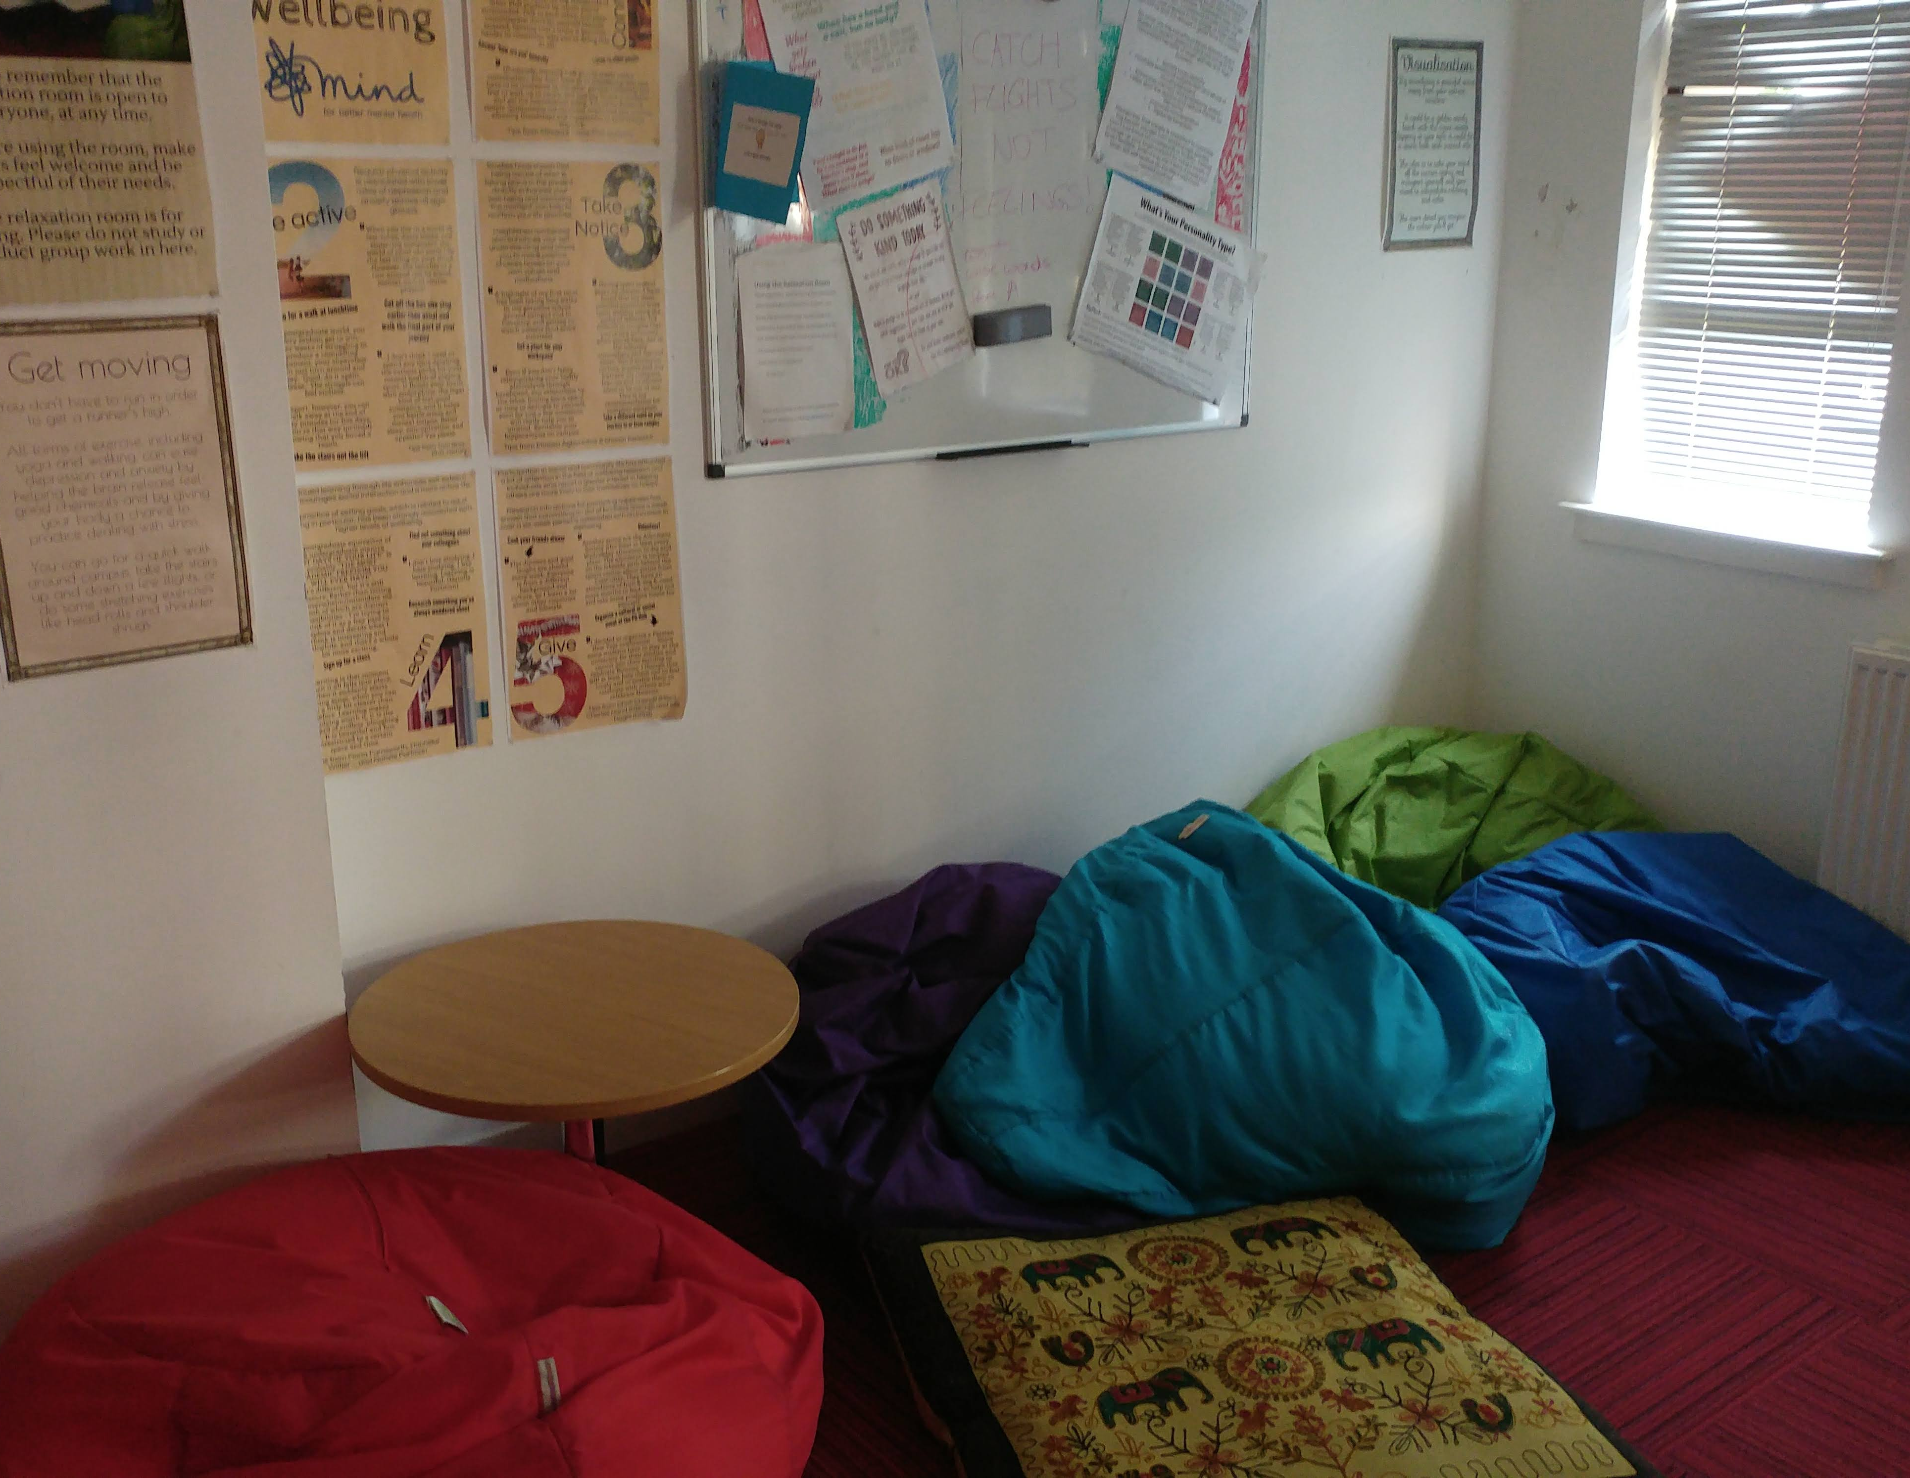
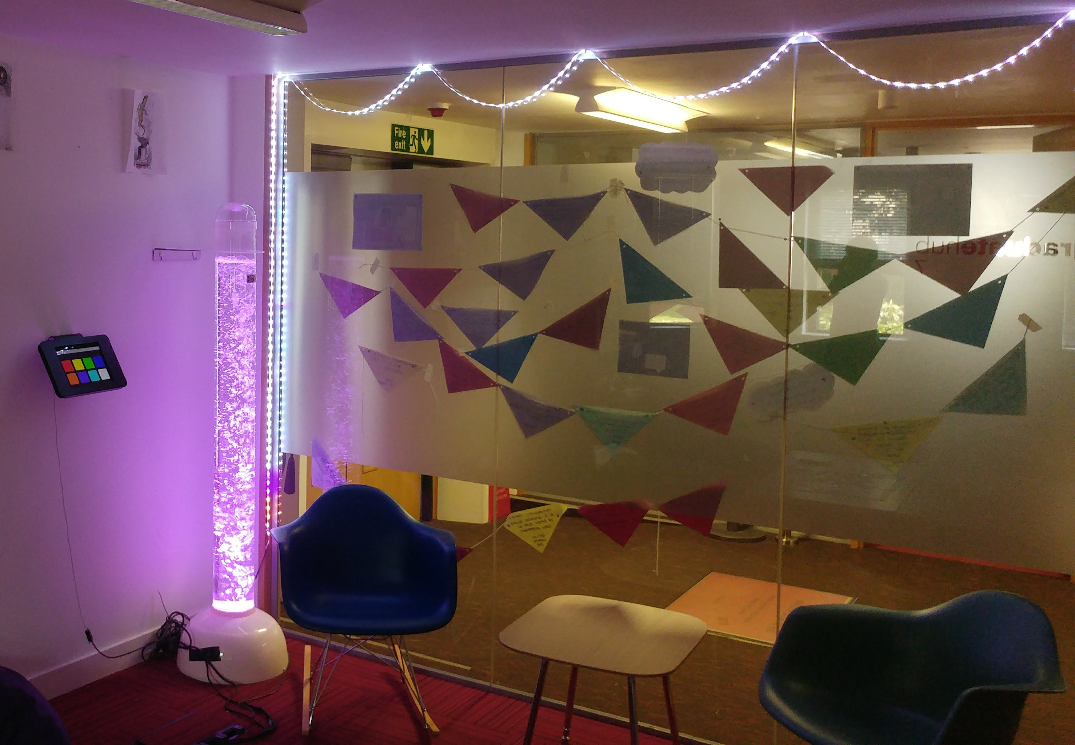
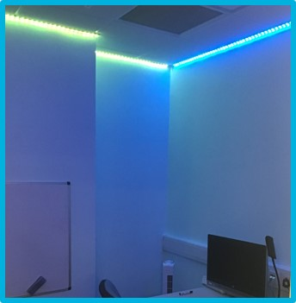
Sensory adaptations to the Relaxation Room @ the PostGrad Hub, Library Learning Grid and Accessible Study Room @ LG2 University House, Library Learning Grid.

Slide 13
Sensory Refresh
Cross departmental collaborative inclusive student event.
Wellbeing Advisors
Disability Support Officer
Community Engagement Teams

Slide 14
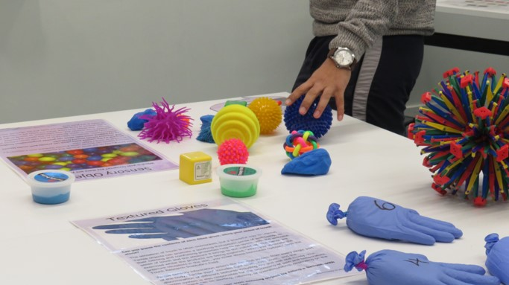
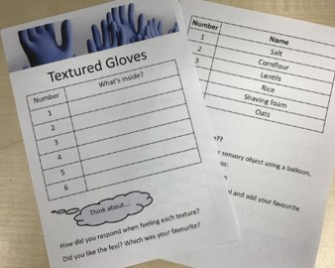
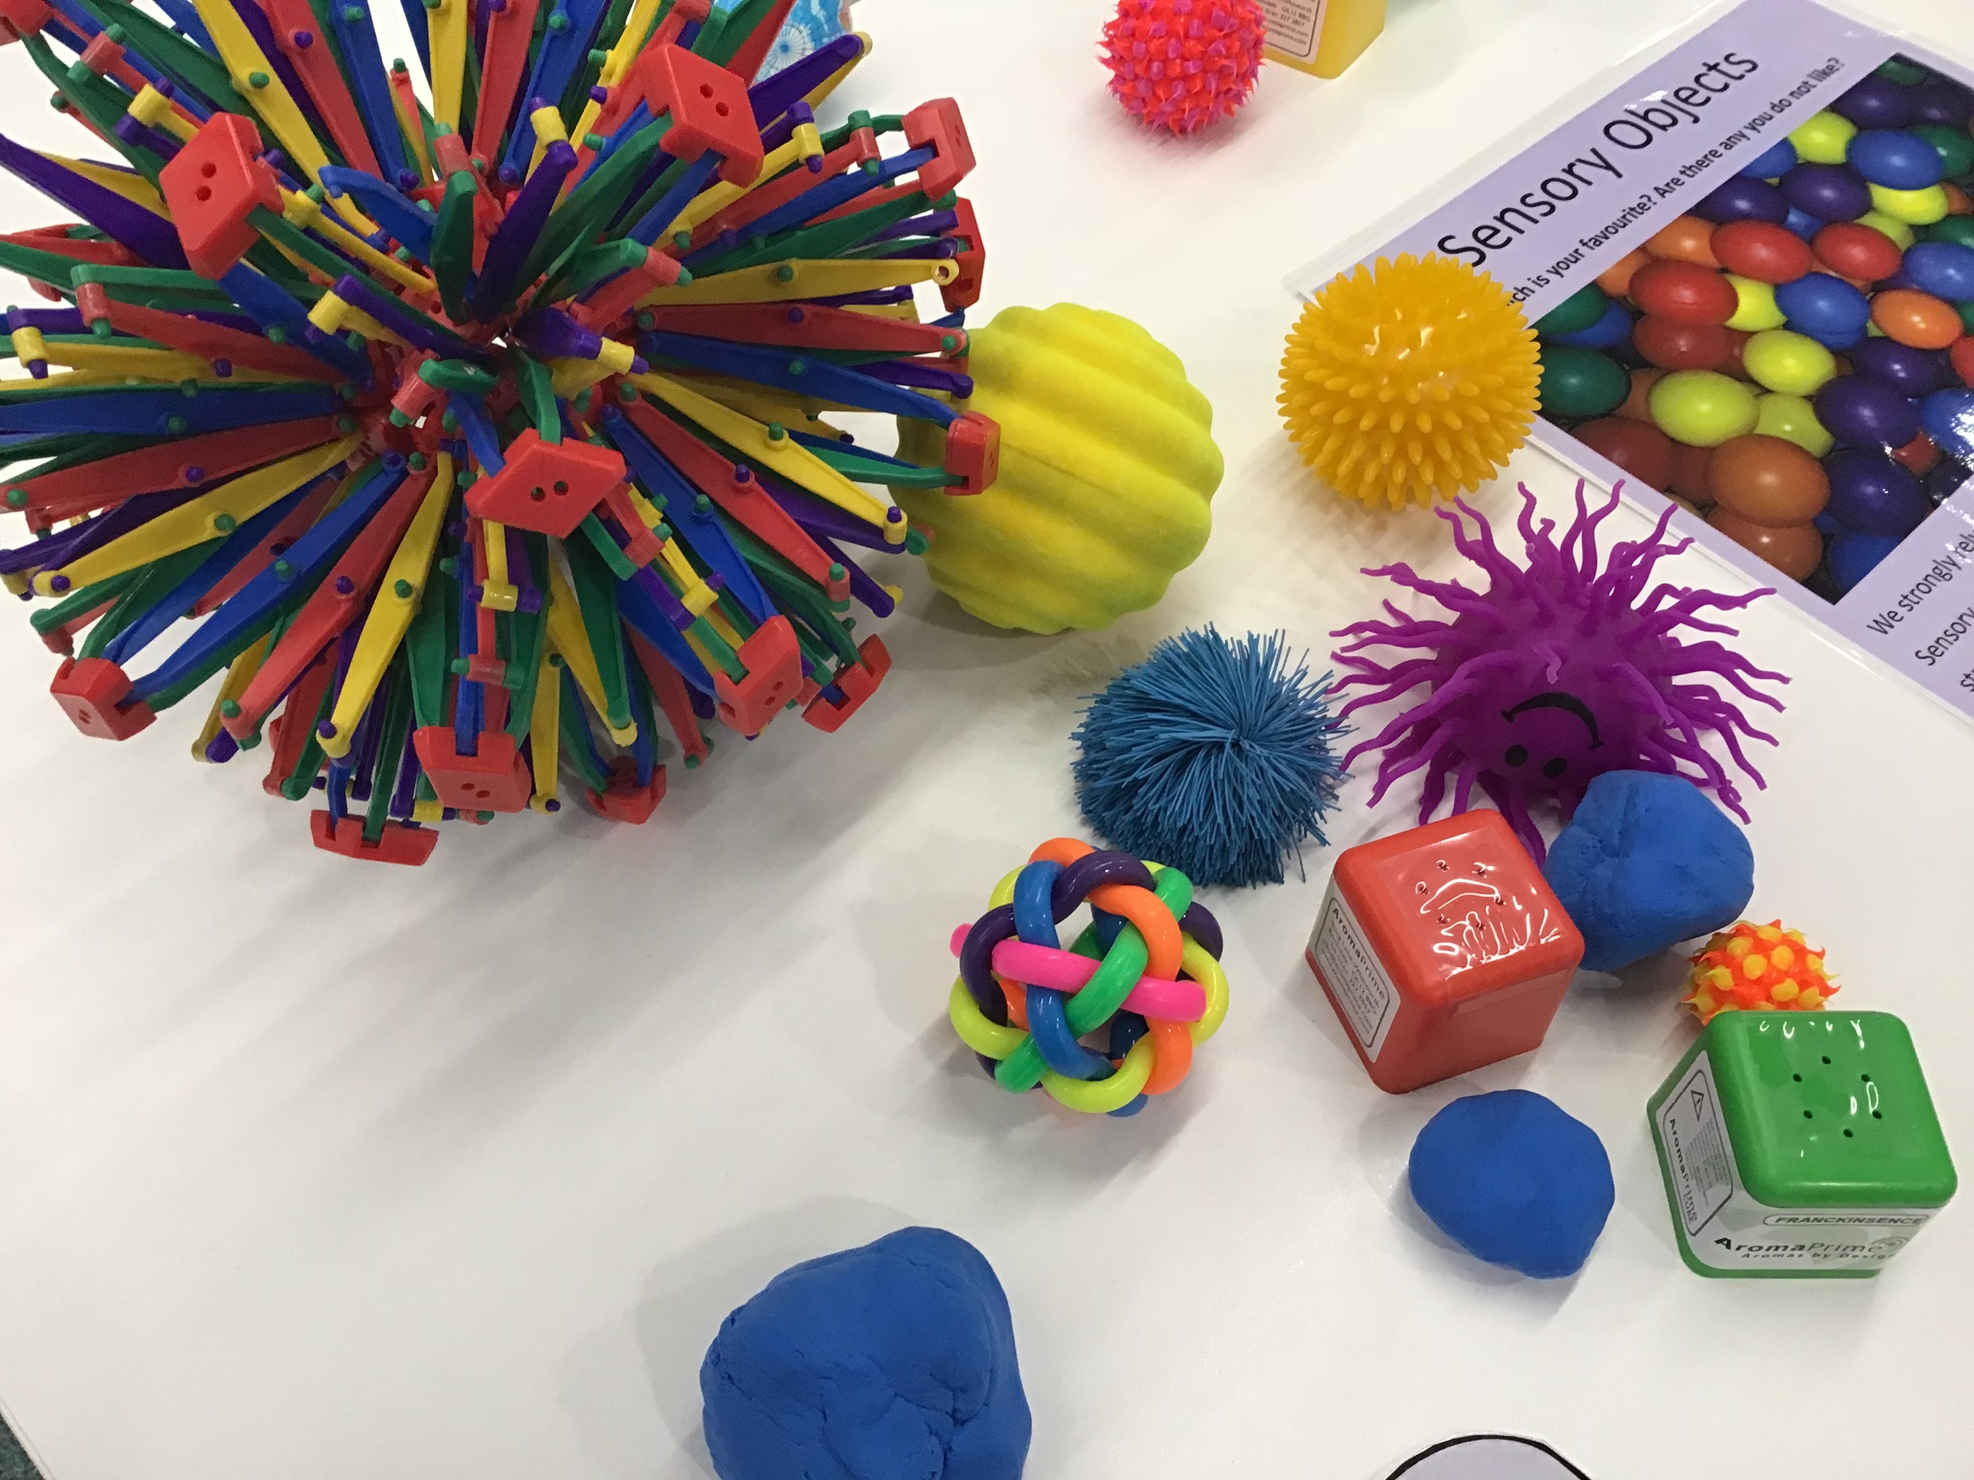
Sensory Refresh- Interactive stations

Slide 15
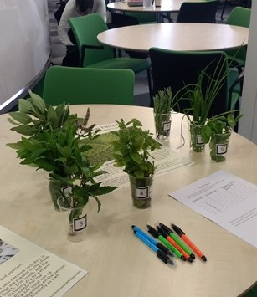
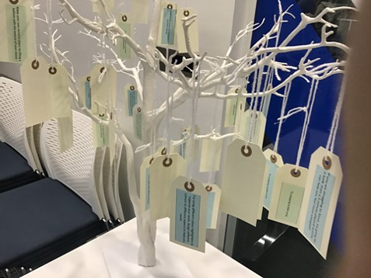
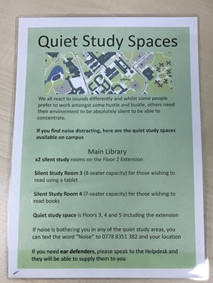
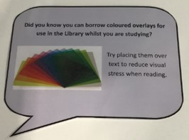

Slide 16
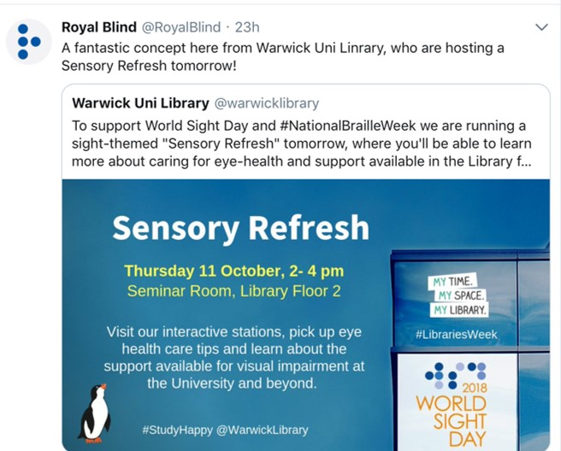
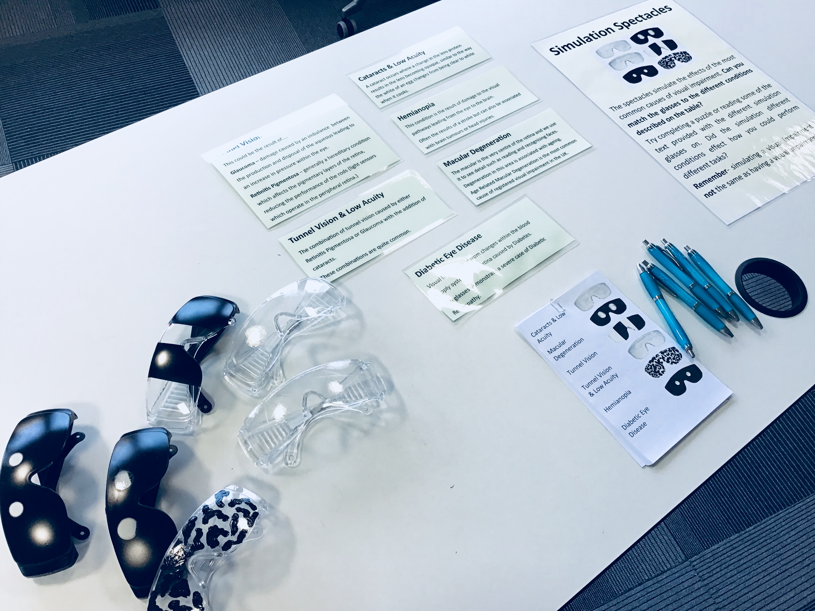
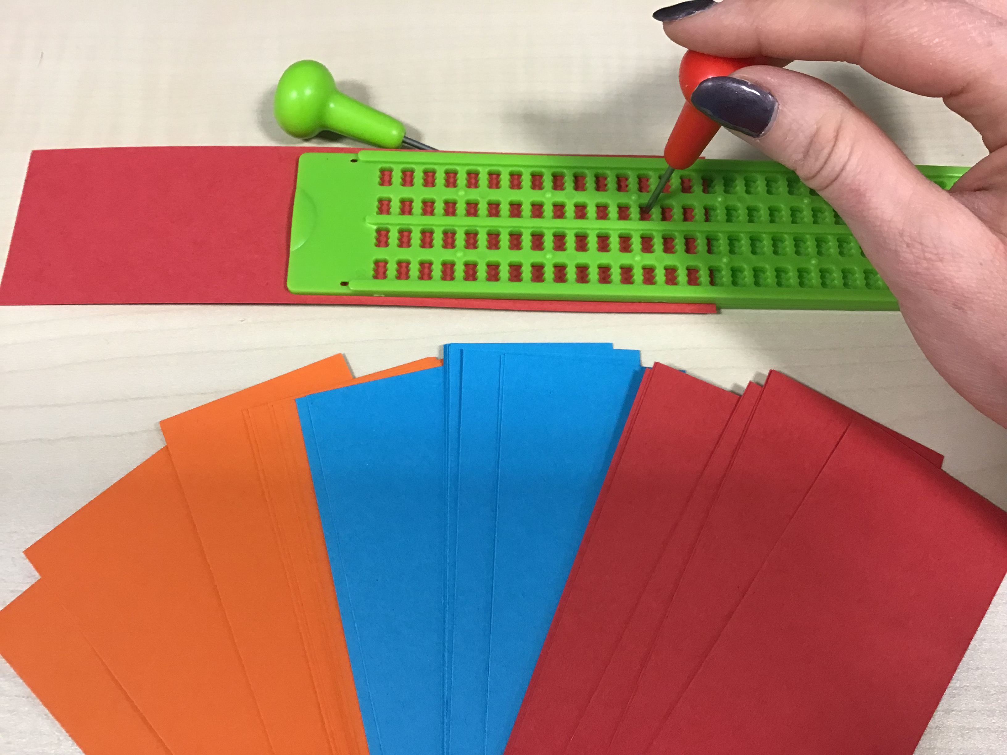

Slide 17
Feedback
'Really nice well done, helped me focus, got nice snacks'
'Was really informative and fun!'
'Lovely service'
‘Great staff! Interactive!'
'Great atmosphere!'
'Especially loved the sensory room today - would love it again!'
'This was a great experience - I wish it would be there everyday'

Slide 18
Future plans
?????

Slide 19
Any questions?

