Slide 1
Outreach and Engagement at University of Leicester
Read at Leicester Blogging Social Media Events Army Outreach #OurLibraryTips

Slide 4
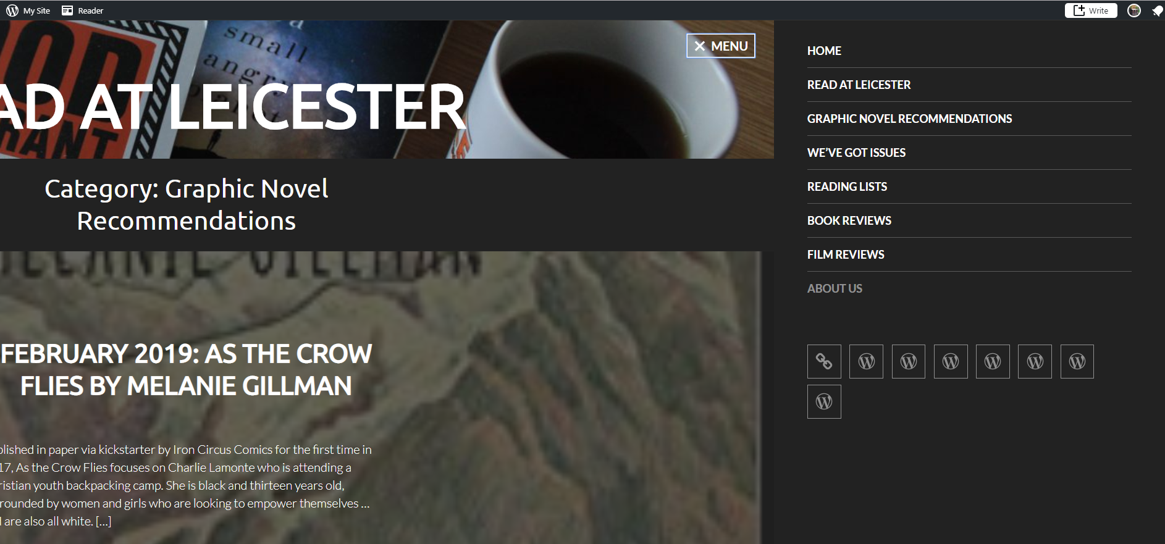

Slide 6
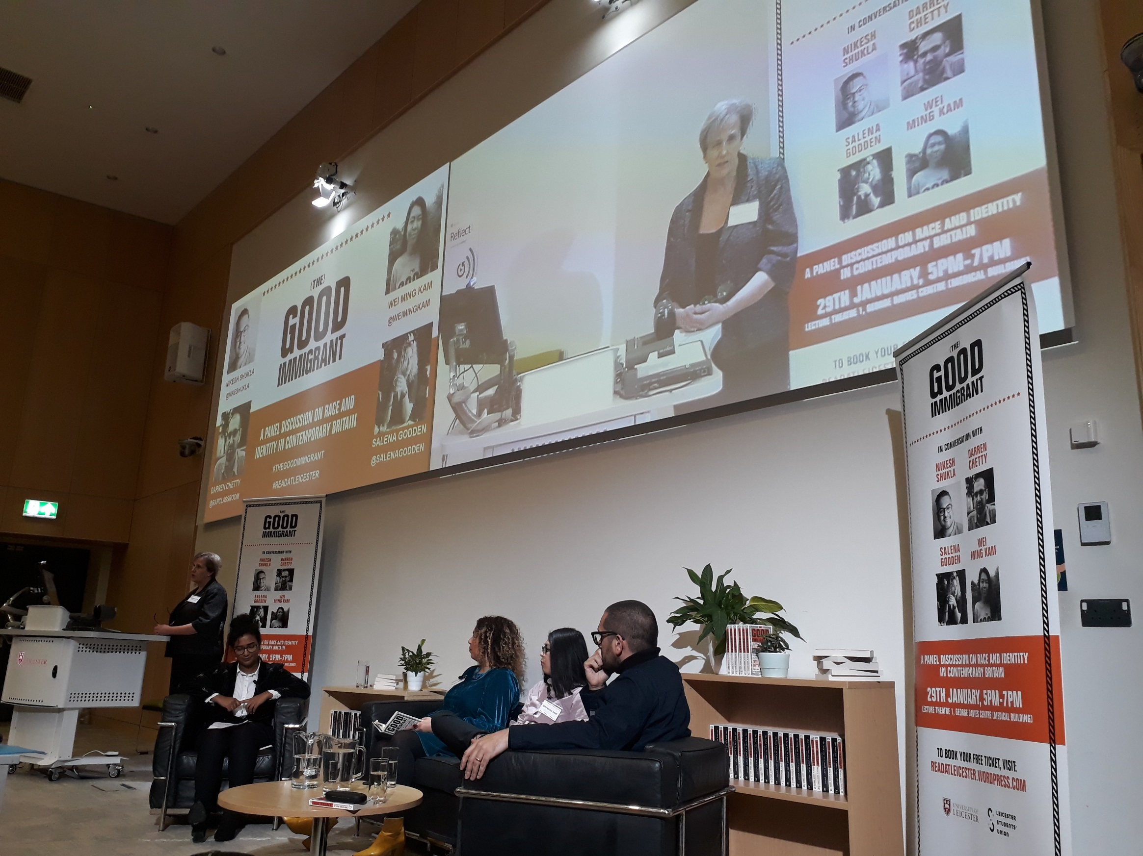
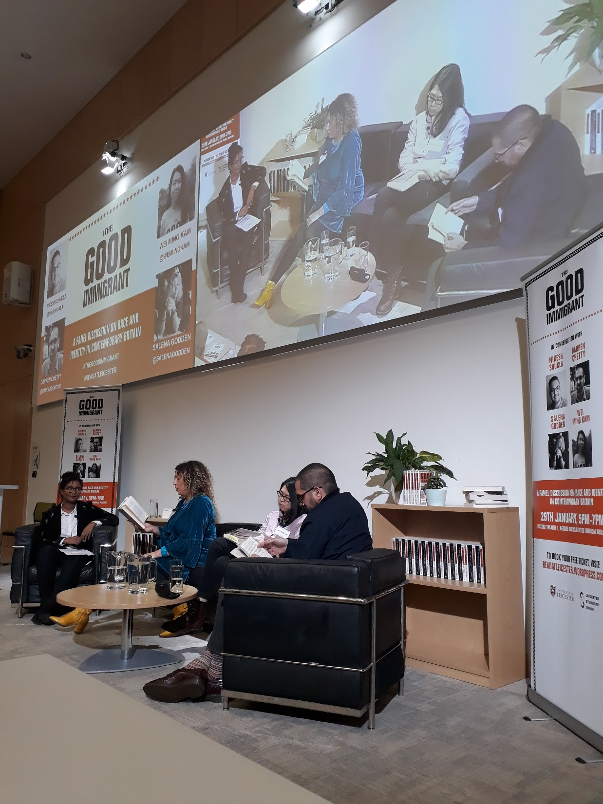

Slide 9
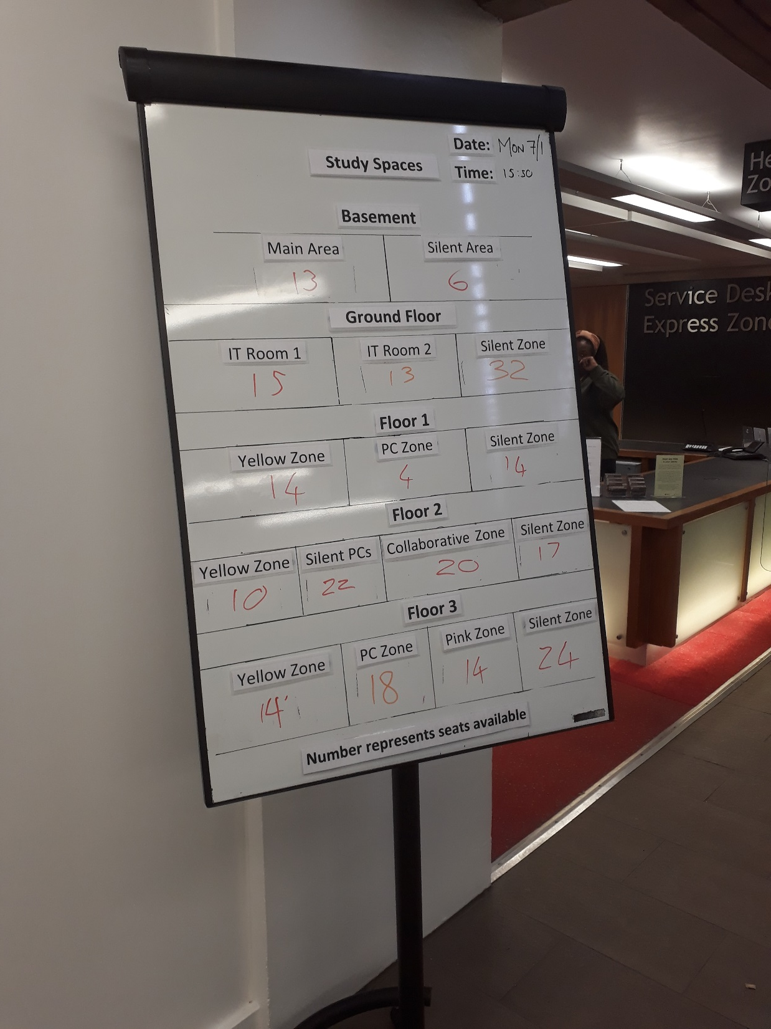
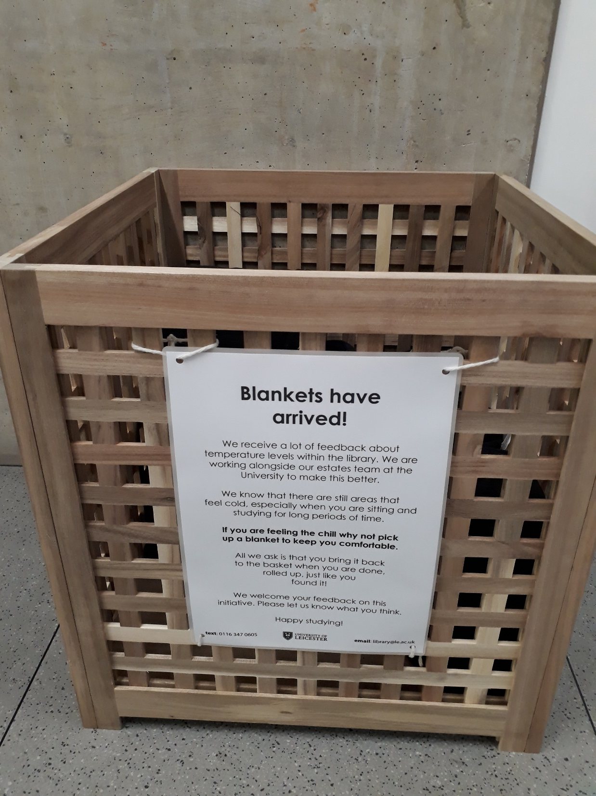

Slide 10
