Slide 1
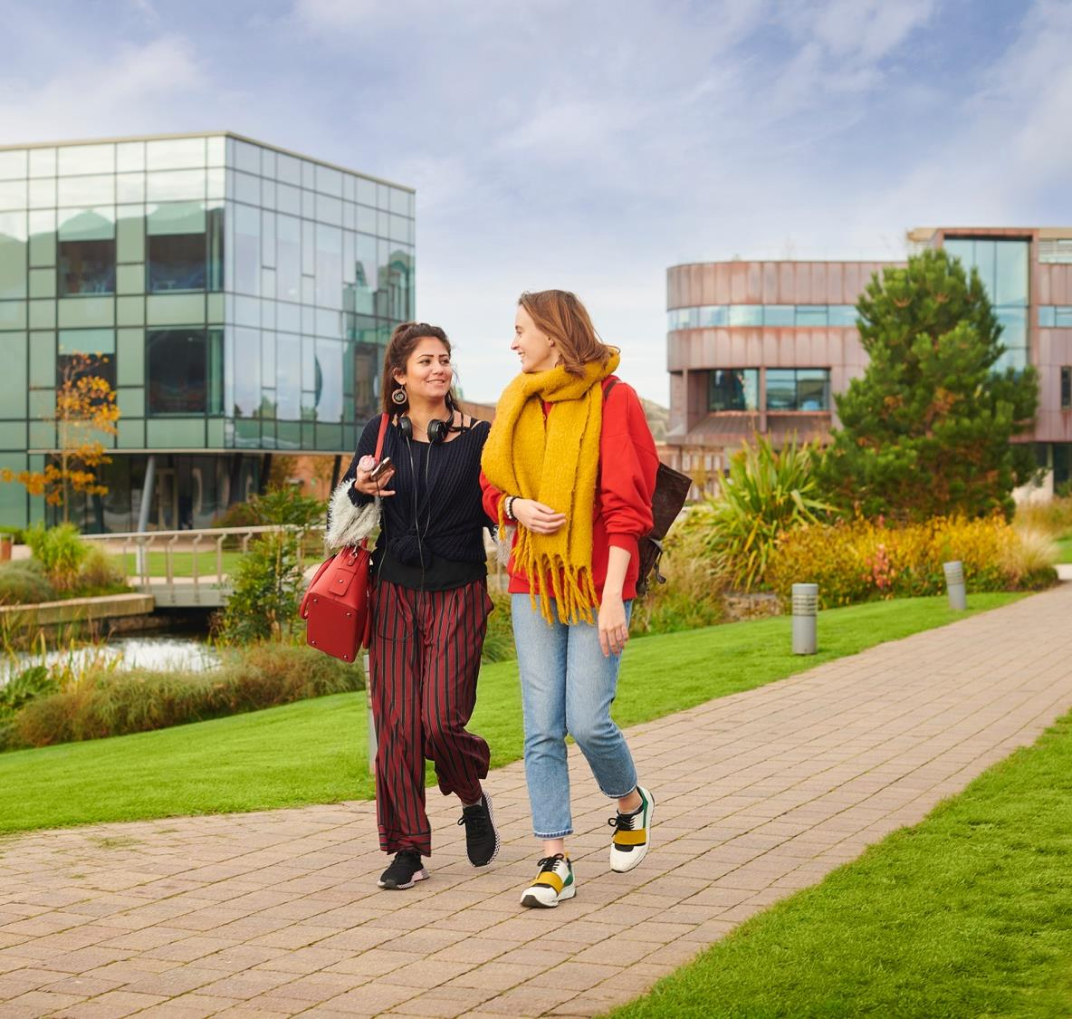
Delivering wellbeing support on the frontline
Jenny Foster (She/her)

Slide 2
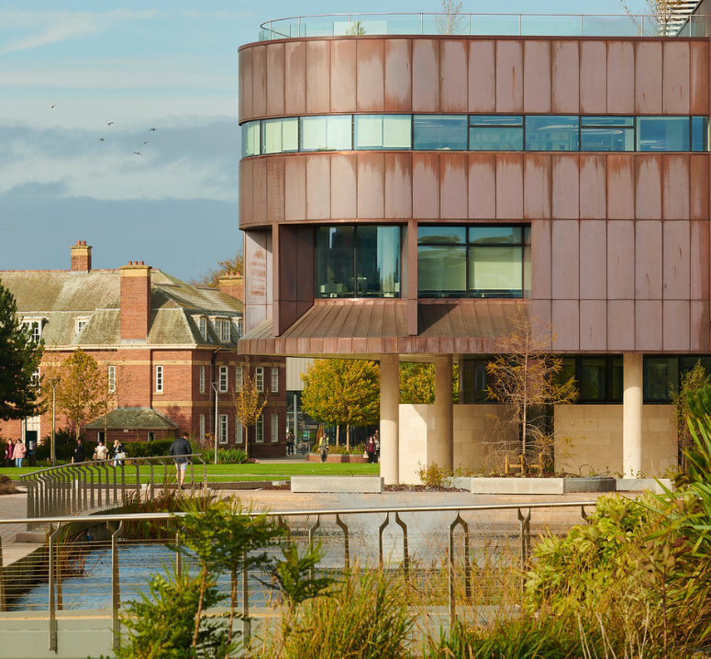
A Vision for Catalyst
To provide the Edge Hill community with a 24/7 destination for students, academics and researchers, where welcoming, knowledgeable, professional staff are on hand to support student life, research, learning and career development.
‘Bringing Together Learning Services, Careers and Student Services under one roof’

Slide 3
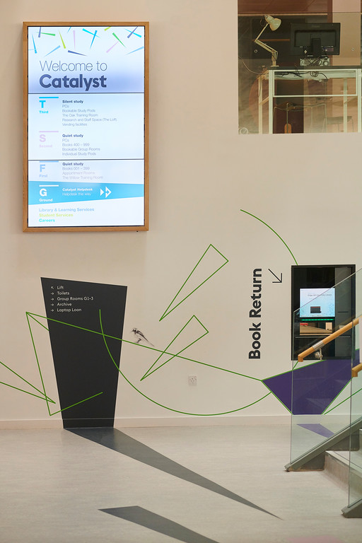
Catalyst Helpdesk:
What’s in the service?
STUDENT SERVICES:
Inclusion, accommodation, halls fees team, campus life, wellbeing, counselling, chaplaincy, money advice, transitions team
LEARNING SERVICES:
Library, student IT support, Uniskills and academic skills, SpLD, classroom and VLE support and Techskills
CAREERS:
Careers advisors, part time work and volunteering support
Additional signposting to estates, academic registry, student union and faculty teams

Slide 4
Catalyst Helpdesk:
At the heart of the building
Single helpdesk supported by:
Virtual support
Email and online form submissions
Online chat
Telephone support
Rovers
A single job description with no specialisms
Helpdesk open:
Weekdays 8am-8pm
Weekends 10am-6pm
Building open 24/7 40 weeks a year
Single helpdesk to act as first point of contact for all services

Slide 5
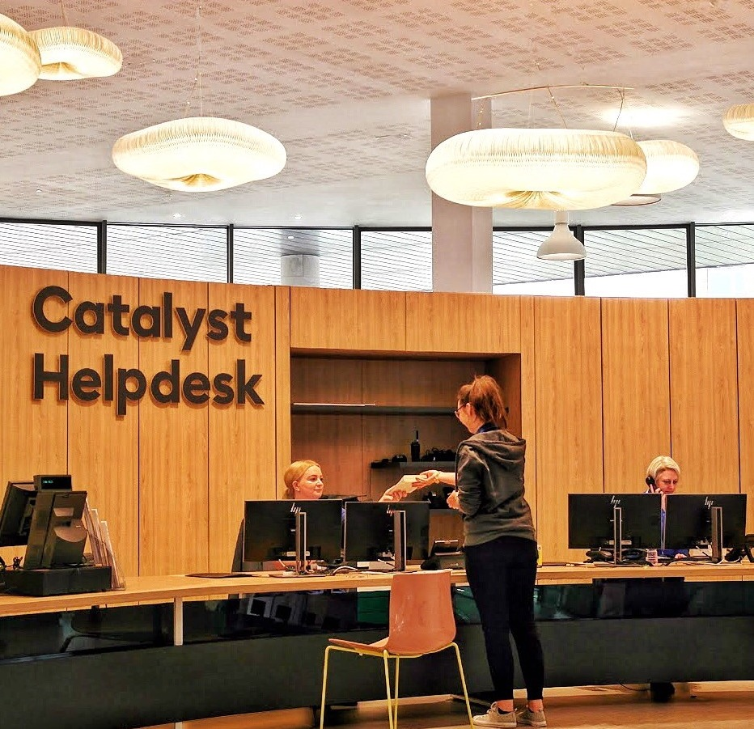
Catalyst Helpdesk: a snapshot
Physical first point of contact for everything in building
Approximately 8,500 enquiries during 1st two weeks of Autumn term 2019
Highest volume of enquiries:
IT (WIFI and password issues)
Library and learning spaces
Wellbeing, while accounting for only a small proportion of face to face enquiries, makes up the highest % of complex queries

Slide 6
Wellbeing and Counselling
Referral to:
Other services within Student Services
External services. E.g GP
Wellbeing workshops
Counselling
Active Wellbeing
Development of action plan
Further appointments
Psycho–education
Separate teams with different processes due to higher levels of confidentiality around counselling
All students seeking support offered an initial appointment:
20 minutes long
By phone or in person
Assessment of risk may result in an immediate referral. E.g. A&E
Risk to self and others
Safeguarding

Slide 7
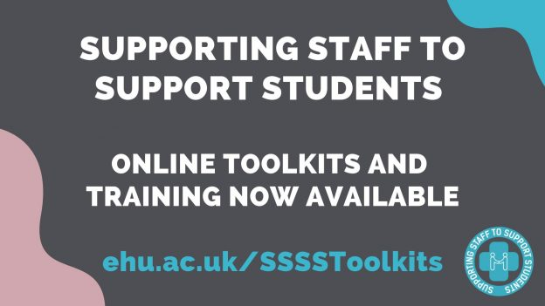
A university wide approach:
Do you know who your students go to for support?
Referrals from:
Personal tutors
Course leader / tutors
Domestic services
Friends and other students
Family
Support staff
Faculty / college helpdesks
Self referral
The helpdesk is one part of a university wide system designed to get students the support they need
University wide training:
Mental health awareness for support staff
Mental health awareness for academics
Suicide awareness
Understanding self harm
Resilience
Notes:
Talk about triage and where we expect this to happen

Slide 8
Catalyst Helpdesk:
Triage Process
Initial triage to establish if student has seen wellbeing previously or if they have an appointment
Establish if wellbeing is the most appropriate team:
Campus Life
Transitions
Money Advice
Chaplaincy
Accommodation
Establish if student is at risk and if necessary complete wellbeing duty form
Helpdesk contacts person on duty. If not available case is escalated to SMT in Student Services
Out of hours creates referral to Campus Support
If not at risk book on to next available appointment
A student approaches the desk asking to see Wellbeing
Notes:
Don’t attempt to fix problems in isolation

Slide 9
A service under pinned with training:
Prior to September 2018
6 months of cross service shadowing
Classroom training
Development of Service Level Agreements
Academic year 2018/19
Team catch ups
Refinement of risk assessment
Ambassador roles
Communication
Summer 2019
Development of collaborative approach to training and development of processes

Slide 10
Changing expectations from the Helpdesk
Historic:
Learning Services team accustomed to finding solutions for enquiries
First line resolution embedded as service standard
Inherited ethos about ownership of problems
Training emphasis on making good decisions for individual circumstances
New model:
More enquiries passed to specialist services
Not all enquiries can be resolved
Outcomes aren’t always known due to confidentiality of circumstances
Shift in perceptions around closure and ownership of enquiries

Slide 11
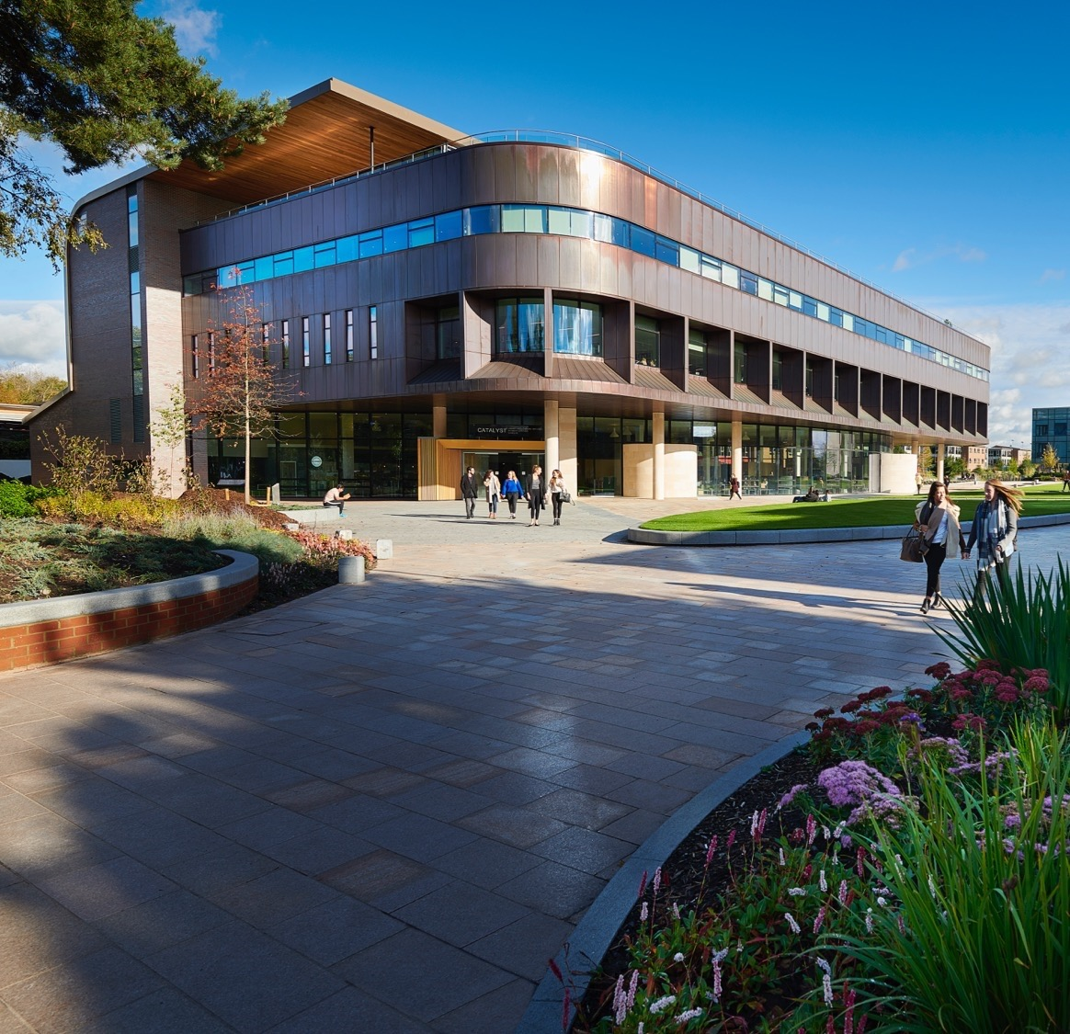
Risk and professional boundaries
Triage/duty model intended to create clear lines of responsibility
Risk lies with senior managers, not the helpdesk team
Training emphasises need for professional boundaries
Ongoing need for conversations, reassurance and discussion

Slide 12
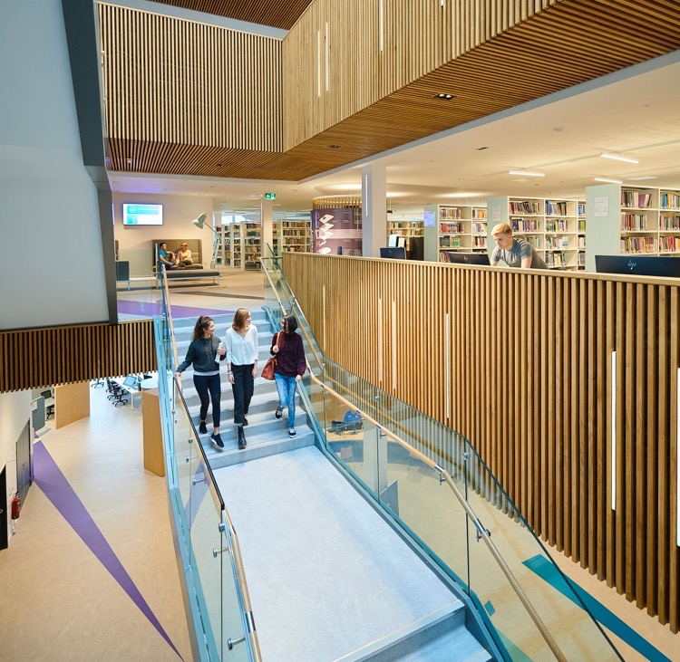
What have we learned?
Operationally:
Be clear on responsibilities:
Team structures and priorities
Hours of service
Definitions of emergencies
Out of hours referrals
Wider knowledge is key:
Duty of care within the University
Alternative forms of support externally and internally
Be aware that some staff may step beyond appropriate boundaries

Slide 13
What have we learned?
As managers:
Embed the idea of constructive failure
Ensure you have the framework for ongoing conversations and have time for support
Ensure engagement from the top level
Understand the implications of delivering a service with a broad spectrum of skill sets

Slide 14
QUESTIONS?
Jenny Foster
Customer Support Manager
Learning Services
Jenny.foster@edgehill.ac.uk

