Slide 1
Integrated Training Model
March 2023
Sue Stokoe and Bruce Mitchell – Kingston University

Slide 2
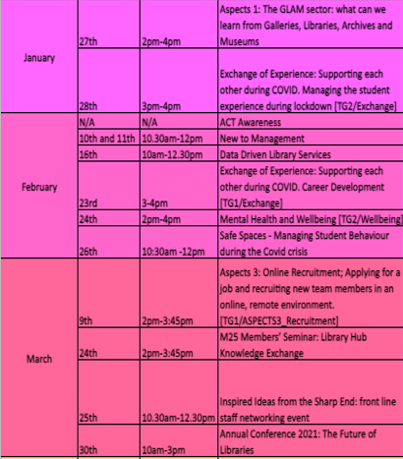
Integrated Training Model
Where did we start?
During the pandemic, we were commissioned to put together documentation on training records
Following a recent restructure – we used these records as the basis for a new training group
This group was responsible for storing records on when training had been attended, a log of certification and a calendar of upcoming training events – a lot were external at this point

Slide 3
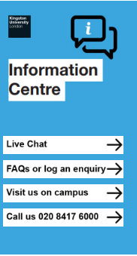
Integrated Training Model
The Information Centre
As we came back to campus, our new Information Centre service began to develop
The Information Centre is a one-stop-shop for all student support enquiries, including the library
The Information Centre is also responsible for day to day management of the library space and buildings
We had many new members of the team join – and developing a new, comprehensive induction programme was more vital than ever

Slide 4
Integrated Training Model
Team Objectives
Future skills - Introduce a standard approach for Library Assistants to have time to reflect on transferable skills and experiences they have learnt whilst working with us that can be used for future job applications / interviews.
Helping IC team career progression- Introduce a standard approach for staff to get opportunities (if they so wish) to gain experience in doing tasks that may help with future career progression via set responsibility overlaps, shadowing opportunities, mentoring and IC (BP) Business Partner model.

Slide 5
Integrated Training Model
What is training?
Training is an active process on the part of the trainee and the trainer
Training should be conducted conversationally, allowing for interaction and discussion
While training should be supported by documentation – the documentation is not the training
While developed by a specific person – it should be possible for the training to be delivered by anyone

Slide 6
Integrated Training Model
What is integrated training?
The further we discussed training, the more we realised it could permeate all aspects of the Information Centre Service
With the team objectives in mind, we sought to design an “Integrated Training Model” that was:
Accessible and Transparent
Centralised
Consistent
Adaptable
Level-Based
Skills-Based

Slide 7
Integrated Training Model
Level Based Training
Level 1
e.g. Queue-Busting Training
Level 2
e.g. Help Desk Training
Level 3
e.g. Supervisor Training
Library Assistant
Information Assistant
Information Advisor

Slide 8
Integrated Training Model
How to build and Integrated Training Model?
First we identified all our training needs – We did this by listing all the areas of work that are carried out in the Information Centre
We then grouped these areas of work into categories, such as “Core Enquiry Services”, “Enquiry Management” and “The Environment”
Next we split up each individual training module into appropriate levels. Not all training exists on all levels.
This document would then be used to track training that was being developed, link to training and identify who was writing the training
Shared the document with the supervisor team – and got them involved

Slide 9
Integrated Training Model
How to build and Integrated Training Model?
Traffic light coding for training in development
Links to training – held on SharePoint
Named “Owner” of training – responsible for development
An adaptable approach that allows for training to be added in the future

Slide 10
Integrated Training Model
Design and Templates
We looked to the team to help produce a simple, replicable but professional design
The design of the training would have subtle colour accent changes based on level
A blank template is available to easily put a piece of training together quickly.
The same document would contain all levels of the training – keeping progression transparent

Slide 11
Integrated Training Model
Folders
Physical Folders – a part of a starter pack for new staff, including headphones – adds personal touch
Includes: Induction Programme, Working Pattern, supplementary material for inductions and induction checklist
Early guidance and quick reference for new starters
Used as a quick reference and touchpoint for 1-2-1s with line manager

Slide 12
Integrated Training Model
Checklists
Induction checklists are included in the Induction Folder
The line manager plays and active role in this checklist beyond the induction work – ensures development is a topic at 1-2-1s from day one
Checklists can be sent back to the training team for recording purposes
The checklist will be developed to reflect level based training – to maintain transparency of development opportunity
Level | Core Enquiry Skills | Date Completed
Level 1 | Queue-Busting
Level 1 | Sign-Posting
Level 1 | Wi-Fi Enquiries
Level 1 | How to borrow books
Level 2 | Help Desk – Etiquette
Level 2 | Telephony
Level 2 | Dashboard
Level 2 | SID/Live Chat
Level 3 | Supervising the Help Desk
Level 3 | Students in Distress
Level 3 | Opening and Closing Procedures
Level 3 | Setting up PDQ Machine
*example

Slide 13
Integrated Training Model
The Role of Line Managers
Builds development-centred relationship between line manager and reportee
The checklist can form the basis for 1-2-1s early on
Helps staff identify development opportunities
Skills for progression are transparent and accessible
Training to enhance particular skills is identifiable

Slide 14
Integrated Training Model
Skills
Highlights the professionalism of the Customer Services skillset
Identifies the skills needed to internal and external progression
Clearly shows the skills that can be learned through particular training – aiding personal development
Can be given to Library Assistants on departure as a part of the Future Skills framework

Slide 15
Integrated Training Model
In Conclusion…
The Integrated Training Programme offers a dynamic, inclusive and transparent method charter an individuals development journey
Underpins all areas of work and personal development – making routes of progress less mysterious
Involve the whole team in the development process – creating better cohesion within ethos and delivery
It is still a work in progress, with more work to be done – but we feel this is a step in the right direction – in line with out Team Objectives

Slide 16
Integrated Training Model
Thank you for listening
Sue Stokoe - S.Stokoe@kingston.ac.uk
Bruce Mitchell - B.Mitchell@kingston.ac.uk

